Slide 1
Multiple Regression
The equation that describes how the dependent variable y is related to the independent variables:
x₁, x₂, . . . x_{p}
and error term ε is called the multiple regression model.
y = β₀ + β₁x₁ + β₂x₂ + . . . + β_{p}x_{p} + ε
where: β₀, β₁, β₂, . . . , β_{p} are parameters
ε is a random variable called the error term
The equation that describes how the mean value of y is related to the p independent variables is called the multiple regression equation:
E(y) = β₀ + β₁x₁ + β₂x₂ + . . . + β_{p}x_{p}

Slide 2
Multiple Regression
A simple random sample is used to compute sample statistics
b₀, b₁, b₂, . . . , b_{p}
that are used as the point estimators of the parameters
β₀, β₁, β₂, . . . , β_{p}
The equation that describes how the predicted value of y is related to the p independent variables is called the estimated multiple regression equation:
^
y = b₀ + b₁x₁ + b₂x₂ + . . . + b_{p}x_{p}

Slide 3
Specification
Formulate a research question:
How has welfare reform affected employment of low-income mothers?
  Issue 1: How should welfare reform be defined?
  Since we are talking about aspects of welfare reform that influence the decision to work, we include the following variables:
  Welfare payments allow the head of household to work less.
tanfben3 = real value (in 1983 $) of the welfare
payment to a family of 3 (x₁)
  The Republican lead Congress passed welfare reform twice, both of which were vetoed by President Clinton. Clinton signed it into law after the Congress passed it a third time in 1996. All states put their TANF programs in place by 2000.
2000 = 1 if the year is 2000, 0 if it is 1994 (x₂)

Slide 4
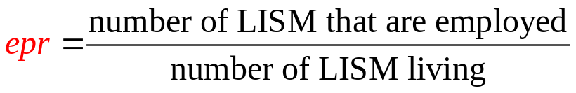
Specification
Formulate a research question:
How has welfare reform affected employment of low-income mothers?
  Issue 1: How should welfare reform be defined? (continued)
  Families receive full sanctions if the head of household fails to adhere to a state’s work requirement.
fullsanction = 1 if state adopted policy, 0 otherwise (x₃)
  Issue 2: How should employment be defined?
  One might use the employment-population ratio of Low-Income Single Mothers (LISM):

Slide 5
Specification
2. Use economic theory or intuition to determine what the true regression model might look like.
Use economics to derive testable hypotheses:
Consumption
Economic theory suggests the following is not true:
H_{o}: β₁ = 0
550
400
U₁
300
U₀
Receiving the welfare check
40
55
Leisure
increases LISM’s leisure which decreases hours worked

Slide 6

Specification
3. Compute means, standard deviations, minimums and maximums for the variables.
state | year | epr | tanfben3 | fullsanction | black | dropo | unemp
Alabama | 1994 | 52.35 | 110.66 | 0 | 25.69 | 26.99 | 5.38
Alaska | 1994 | 38.47 | 622.81 | 0 | 4.17 | 8.44 | 7.50
Arizona | 1994 | 49.69 | 234.14 | 0 | 3.38 | 13.61 | 5.33
Arkansas | 1994 | 48.17 | 137.65 | 0 | 16.02 | 25.36 | 7.50
West Virginia | 2000 | 51.10 | 190.48 | 1 | 3.10 | 23.33 | 5.48
Wisconsin | 2000 | 57.99 | 390.82 | 1 | 5.60 | 11.84 | 3.38
Wyoming | 2000 | 58.34 | 197.44 | 1 | 0.63 | 11.14 | 3.81

Slide 7
Specification
3. Compute means, standard deviations, minimums and maximums for the variables.
 | 1994 Mean | Std Dev | Min | Max |  | 2000 Mean | Std Dev | Min | Max | Diff
epr | 46.73 | 8.58 | 28.98 | 65.64 |  | 53.74 | 7.73 | 40.79 | 74.72 | 7.01
tanfben3 | 265.79 | 105.02 | 80.97 | 622.81 |  | 234.29 | 90.99 | 95.24 | 536.00 | -31.50
fullsanction | 0.02 | 0.14 | 0.00 | 1.00 |  | 0.70 | 0.46 | 0.00 | 1.00 | 0.68
black | 9.95 | 9.45 | 0.34 | 36.14 |  | 9.82 | 9.57 | 0.26 | 36.33 | -0.13
dropo | 17.95 | 5.20 | 8.44 | 28.49 |  | 14.17 | 4.09 | 6.88 | 23.33 | -3.78
unemp | 5.57 | 1.28 | 2.63 | 8.72 |  | 3.88 | 0.96 | 2.26 | 6.17 | -1.69

Slide 8
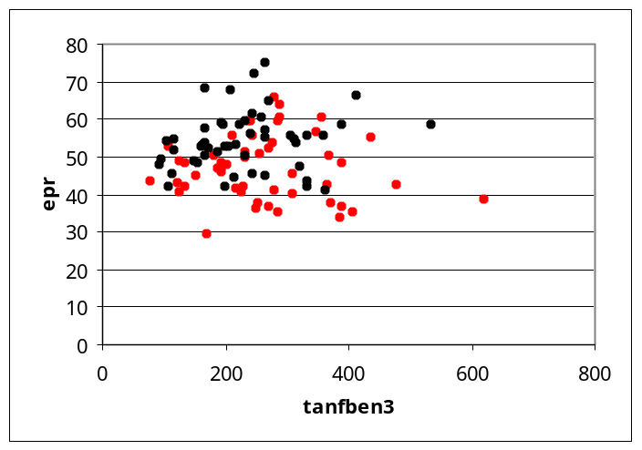
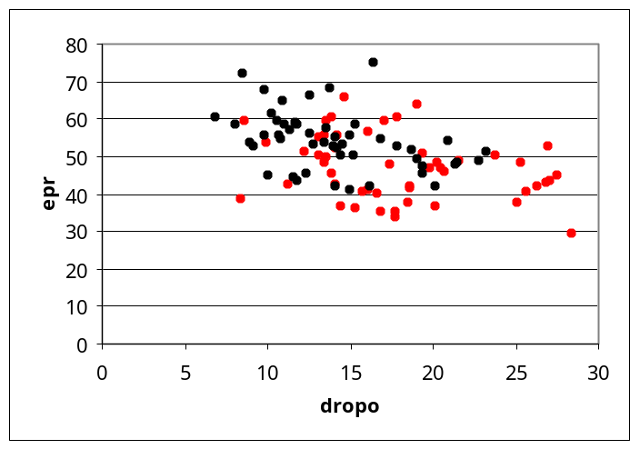
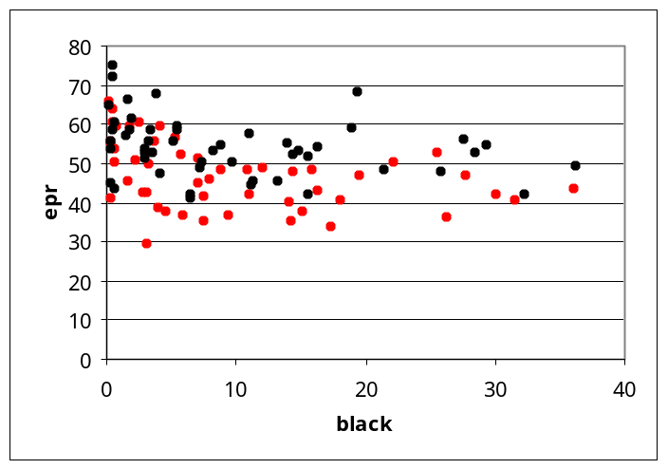
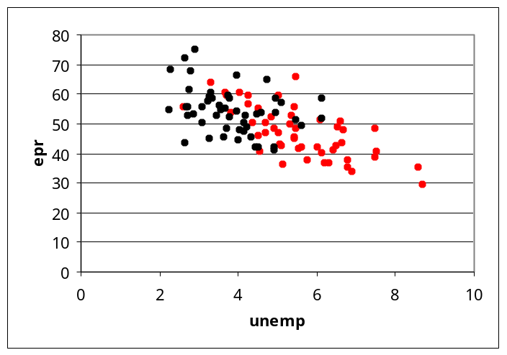
Specification
4. Construct scatterplots of the variables. (1994, 2000)

Slide 9
Specification
5. Compute correlations for all pairs of variables. If | r | > .7 for a pair of independent variables,
  multicollinearity may be a problem
  Some say avoid including independent variables that are highly correlated, but it is better to have multicollinearity than omitted variable bias.
 | epr | fullsanction | black | dropo | unemp
tanfben3 | -0.03 | -0.24 | -0.53 | -0.50 | 0.10
unemp | -0.64 | -0.51 | 0.16 | 0.47
dropo | -0.44 | -0.25 | 0.51
black | -0.32 | 0.07
fullsanction | 0.43

Slide 10


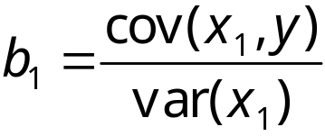
Estimation
Least Squares Criterion:
Computation of Coefficient Values:
In simple regression:

Slide 11
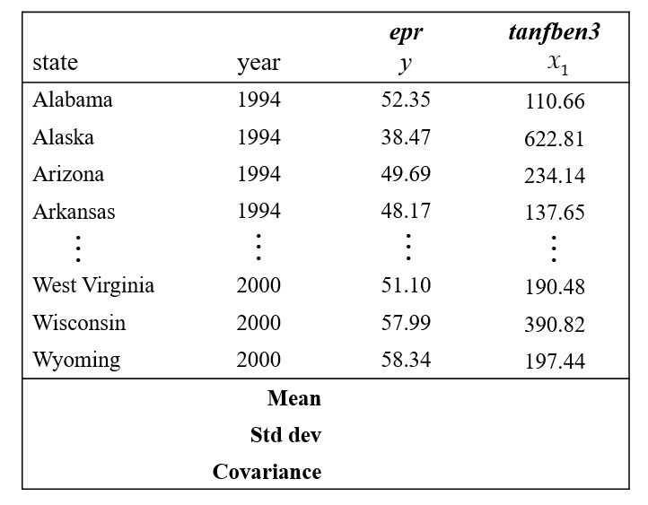

Simple Regression

Slide 12
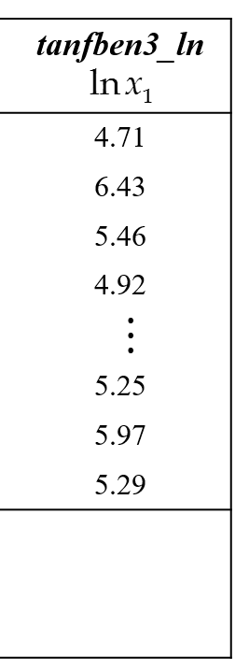
Simple Regression

Slide 13
Simple Regression
Regression Statistics
Multiple R | 0.0279
R Square | 0.0008
Adjusted R Square | -0.0094
Standard Error | 8.8978
Observations | 100
ANOVA
 | df | SS | MS | F
Regression | 1 | 6.031 | 6.031 | 0.076
Residual | 98 | 7758.733 | 79.171
Total | 99 | 7764.764
 | Coefficients | Standard Error | t Stat | P-value
Intercept | 46.9192 | 12.038 | 3.897 | 0.000
tanfben3_ln | 0.6087 | 2.206 | 0.276 | 0.783
r ²·100% of the variability in
y
can be explained by the model.
.08%
epr of LISM
Error

Slide 14

Simple Regression
We cannot reject
Regression Statistics
Multiple R | 0.0279
R Square | 0.0008
Adjusted R Square | -0.0094
Standard Error | 8.8978
Observations | 100
ANOVA
 | df | SS | MS | F
Regression | 1 | 6.031 | 6.031 | 0.076
Residual | 98 | 7758.733 | 79.171
Total | 99 | 7764.764
 | Coefficients | Standard Error | t Stat | P-value
Intercept | 46.9192 | 12.038 | 3.897 | 0.000
tanfben3_ln | 0.6087 | 2.206 | 0.276 | 0.783
α = .05
α/2 = .025
-t_{.025} = -1.984
t_{.025} = 1.984
Error

Slide 15


Simple Regression
If estimated coefficient b₁ was statistically significant, we would interpret its value as follows:

Slide 16

Simple Regression
If estimated coefficient b₁ was statistically significant, we would interpret its value as follows:

Slide 17

Simple Regression
If estimated coefficient b₁ was statistically significant, we would interpret its value as follows:
Increasing monthly benefit levels for a family of three by 10% would result in a .058 percentage point increase in the average epr of LISM
However, since estimated coefficient b₁ is statistically insignificant, we interpret its value as follows:
Increasing monthly benefit levels for a family of three
has no effect on the epr of LISM.
Our theory suggests that this estimate has the wrong sign and is biased towards zero. This bias is called omitted variable bias.

Slide 18


Multiple Regression
Least Squares Criterion:
In multiple regression the solution is:
You can use matrix algebra or computer software packages to compute the coefficients

Slide 19
Multiple Regression
R Square | 0.166
Adjusted R Square | 0.149
Standard Error | 8.171
Observations | 100
ANOVA
 | df | SS | MS | F
Regression | 2 | 1288.797 | 644.398 | 9.652
Residual | 97 | 6475.967 | 66.763
Total | 99 | 7764.764
 | Coefficients | Standard Error | t Stat | P-value
Intercept | 35.901 | 11.337 | 3.167 | 0.002
tanfben3_ln | 1.967 | 2.049 | 0.960 | 0.339
2000 | 7.247 | 1.653 | 4.383 | 0.000
r ²·100% of the variability in
y
can be explained by the model.
15%
epr of LISM
Error

Slide 20
Multiple Regression
R Square | 0.214
Adjusted R Square | 0.190
Standard Error | 7.971
Observations | 100
ANOVA
 | df | SS | MS | F
Regression | 3 | 1664.635 | 554.878 | 8.732
Residual | 96 | 6100.129 | 63.543
Total | 99 | 7764.764
 | Coefficients | Standard Error | t Stat | P-value
Intercept | 31.544 | 11.204 | 2.815 | 0.006
tanfben3_ln | 2.738 | 2.024 | 1.353 | 0.179
2000 | 3.401 | 2.259 | 1.506 | 0.135
fullsanction | 5.793 | 2.382 | 2.432 | 0.017
r ²·100% of the variability in
y
can be explained by the model.
19%
epr of LISM
Error

Slide 21

Multiple Regression
R Square | 0.517
Adjusted R Square | 0.486
Standard Error | 6.347
Observations | 100
ANOVA
 | df | SS | MS | F
Regression | 6 | 4018.075 | 669.679 | 16.623
Residual | 93 | 3746.689 | 40.287
Total | 99 | 7764.764
 | Coefficients | Standard Error | t Stat | P-value
Intercept | 104.529 | 15.743 | 6.640 | 0.000
tanfben3_ln | −5.709 | 2.461 | −2.320 | 0.023
2000 | −2.821 | 2.029 | −1.390 | 0.168
fullsanction | 3.768 | 1.927 | 1.955 | 0.054
black | −0.291 | 0.089 | −3.256 | 0.002
dropo | −0.374 | 0.202 | −1.848 | 0.068
unemp | −3.023 | 0.618 | −4.888 | 0.000
Error

Slide 22
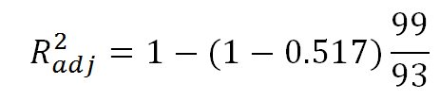
Multiple Regression
R Square | 0.517
Adjusted R Square | 0.486
Standard Error | 6.347
Observations | 100
ANOVA
 | df | SS | MS | F
Regression | 6 | 4018.075 | 669.679 | 16.623
Residual | 93 | 3746.689 | 40.287
Total | 99 | 7764.764
 | Coefficients | Standard Error | t Stat | P-value
Intercept | 104.529 | 15.743 | 6.640 | 0.000
tanfben3_ln | −5.709 | 2.461 | −2.320 | 0.023
2000 | −2.821 | 2.029 | −1.390 | 0.168
fullsanction | 3.768 | 1.927 | 1.955 | 0.054
black | −0.291 | 0.089 | −3.256 | 0.002
dropo | −0.374 | 0.202 | −1.848 | 0.068
unemp | −3.023 | 0.618 | −4.888 | 0.000
Error

Slide 23
Multiple Regression
R Square | 0.517
Adjusted R Square | 0.486
Standard Error | 6.347
Observations | 100
ANOVA
 | df | SS | MS | F
Regression | 6 | 4018.075 | 669.679 | 16.623
Residual | 93 | 3746.689 | 40.287
Total | 99 | 7764.764
 | Coefficients | Standard Error | t Stat | P-value
Intercept | 104.529 | 15.743 | 6.640 | 0.000
tanfben3_ln | −5.709 | 2.461 | −2.320 | 0.023
2000 | −2.821 | 2.029 | −1.390 | 0.168
fullsanction | 3.768 | 1.927 | 1.955 | 0.054
black | −0.291 | 0.089 | −3.256 | 0.002
dropo | −0.374 | 0.202 | −1.848 | 0.068
unemp | −3.023 | 0.618 | −4.888 | 0.000
Error

Slide 24
Multiple Regression
R Square | 0.517
Adjusted R Square | 0.486
Standard Error | 6.347
Observations | 100
ANOVA
 | df | SS | MS | F
Regression | 6 | 4018.075 | 669.679 | 16.623
Residual | 93 | 3746.689 | 40.287
Total | 99 | 7764.764
 | Coefficients | Standard Error | t Stat | P-value
Intercept | 104.529 | 15.743 | 6.640 | 0.000
tanfben3_ln | −5.709 | 2.461 | −2.320 | 0.023
2000 | −2.821 | 2.029 | −1.390 | 0.168
fullsanction | 3.768 | 1.927 | 1.955 | 0.054
black | −0.291 | 0.089 | −3.256 | 0.002
dropo | −0.374 | 0.202 | −1.848 | 0.068
unemp | −3.023 | 0.618 | −4.888 | 0.000
r ²·100% of the variability in
y
can be explained by the model.
49%
epr of LISM
Error

Slide 25
Multiple Regression
 | Coefficients | Standard Error | t Stat | P-value
Intercept | 104.529 | 15.743 | 6.640 | 0.000
tanfben3_ln | −5.709 | 2.461 | −2.320 | 0.023
2000 | −2.821 | 2.029 | −1.390 | 0.168
fullsanction | 3.768 | 1.927 | 1.955 | 0.054
black | −0.291 | 0.089 | −3.256 | 0.002
dropo | −0.374 | 0.202 | −1.848 | 0.068
unemp | −3.023 | 0.618 | −4.888 | 0.000
lnx₁
x₂
+
x₃
x₄
x₅
x₆

Slide 26
Validity
The residuals provide the best information about the errors.
E(ε) is probably equal to zero if E(e) = 0
Var(ε) = σ ² is probably constant for all values of x₁…x_{p} if “spreads” in scatterplots of e versus y, time, x₁…x_{p} appear to be constant
The values of ε are probably independent if the DW-stat is about 2
The true model is probably linear if the scatterplot of e versus y is a horizontal, random band of points
Error ε is probably normally distributed if the chapter 12 normality test indicates e is normally distributed
^
^

Slide 27
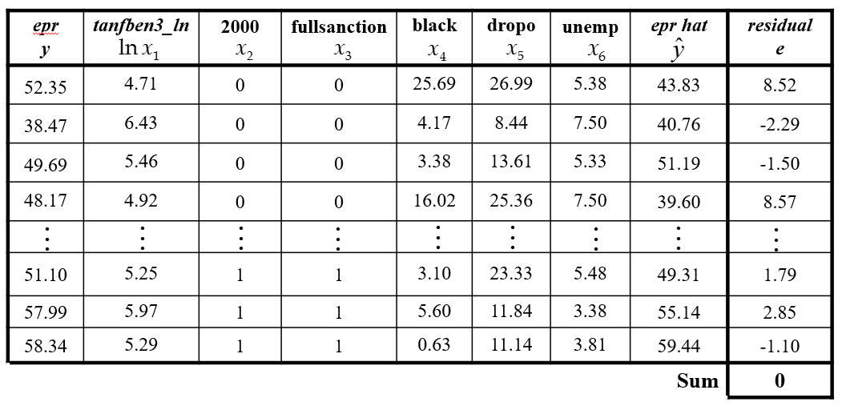
Zero Mean
E(ε) is probably equal to zero since E(e) = 0

Slide 28
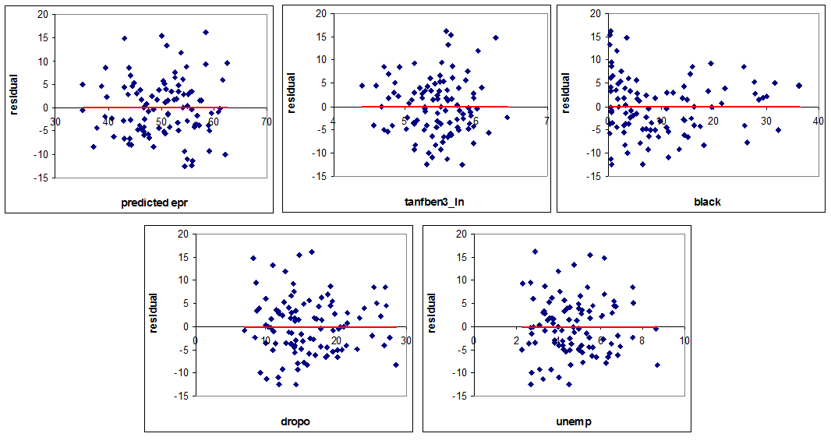
Homoscedasticity
Var(ε) = σ ² is probably constant for all values of x₁…x_{p} if “spreads” in
scatterplots of e versus y, t, x₁…x_{p} appear to be constant
^
okay
okay
Non-constant variance in black?
okay
okay

Slide 29

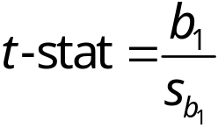
Homoscedasticity
If the errors are not homoscedasticity,
Although the coefficients are okay, the standard errors are not, which may make the t-stats wrong.

Slide 30
Independence
The values of ε are probably independent if the DW-stat is about 2
The DW-stat varies when the data’s order is altered
If you have cross-sectional data, you need DW-stat
If you have time series data, compute DW-stat after sorting by time
If you have panel data, compute the DW-stat after sorting by state and then time.
perfect "−" autocorrelation if DW-stat = 4
perfect "+" autocorrelation if DW-stat = 0

Slide 31
Independence
If the errors are not independent,
Although the coefficients are okay, the standard errors are not, which may make the t-stats wrong.

Slide 32
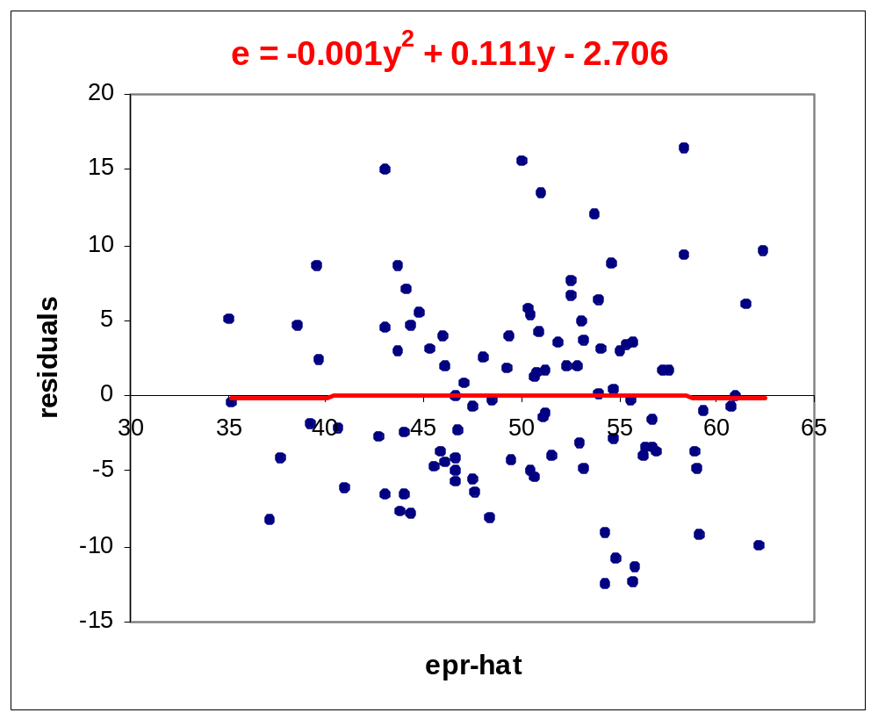
Linearity
^
The true model is probably linear if the scatterplot of e versus y is a horizontal, random band of points
okay

Slide 33
Linearity
If model is not linear,
Although the standard errors are okay, the coefficients are not, which may make the t-stats wrong.

Slide 34
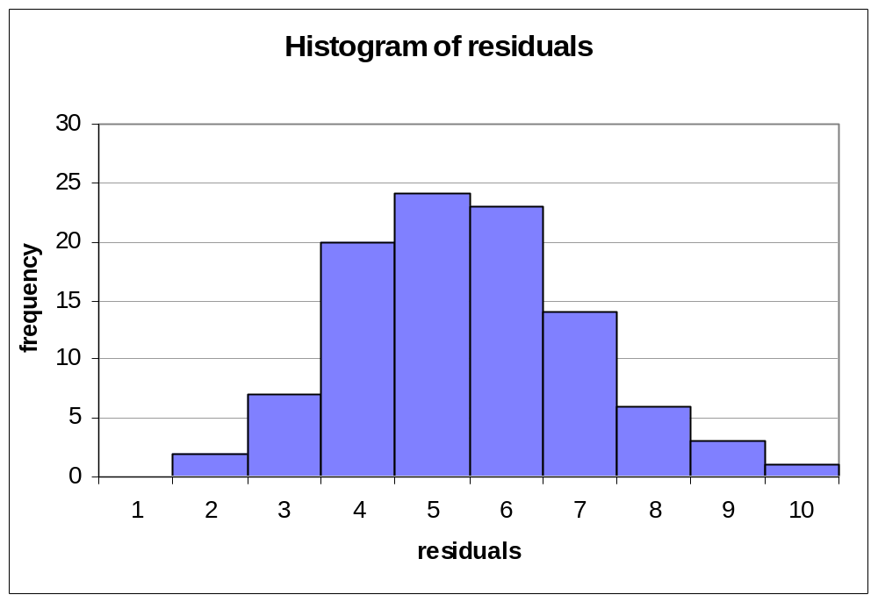
Normality
Error ε is probably normally distributed if the chapter 12 normality test indicates e is normally distributed
-20 -16 -12 -8 -4 0 4 8 12 16 20

Slide 35
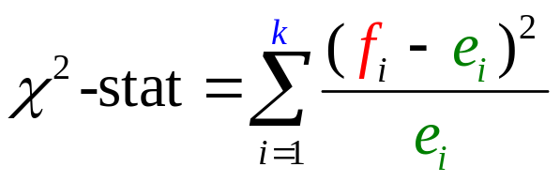
Normality
Error ε is probably normally distributed if the chapter 12 normality test indicates e is normally distributed
H₀: errors are normally distributed
H_{a}: errors are not normally distribution
The test statistic:
has a chi-square distribution, if e_{i} > 5.
To ensure this, we divide the normal distribution into k intervals all having the same expected frequency.
k = 100/5 = 20
20 equal intervals.
The expected frequency:
e_{i} = 5

Slide 36
Normality
Standardized residuals:
mean = 0
std dev = 1
The probability of being in this interval is
1/20 = .0500
-1.645
1.645
z.

Slide 37
Normality
Standardized residuals:
mean = 0
std dev = 1
The probability of being in this interval is
2/20 = .1000
-1.282
1.282
z.

Slide 38
Normality
Standardized residuals:
mean = 0
std dev = 1
The probability of being in this interval is
3/20 = .1500
-1.036
1.036
z.

Slide 39
Normality
Standardized residuals:
mean = 0
std dev = 1
The probability of being in this interval is
4/20 = .2000
-0.842
0.842
z.

Slide 40
Normality
Standardized residuals:
mean = 0
std dev = 1
The probability of being in this interval is
5/20 = .2500
-0.674
0.674
z.

Slide 41
Normality
Standardized residuals:
mean = 0
std dev = 1
The probability of being in this interval is
6/20 = .3000
-0.524
0.524
z.

Slide 42
Normality
Standardized residuals:
mean = 0
std dev = 1
The probability of being in this interval is
7/20 = .3500
0.385
-0.385
z.

Slide 43
Normality
Standardized residuals:
mean = 0
std dev = 1
The probability of being in this interval is
8/20 = .4000
-0.253
0.253
z.

Slide 44
Normality
Standardized residuals:
mean = 0
std dev = 1
The probability of being in this interval is
9/20 = .4500
-0.126
z.
0.126

Slide 45
Normality
Standardized residuals:
mean = 0
std dev = 1
The probability of being in this interval is
10/20 = .5000
0
z.

Slide 46
Normality
Observation | Pred epr | Residuals | Std Res
1 | 54.372 | -12.572 | -2.044
2 | 55.768 | -12.430 | -2.021
3 | 55.926 | -11.412 | -1.855
4 | 54.930 | -10.938 | -1.778
5 | 62.215 | -10.036 | -1.631
6 | 59.195 | -9.302 | -1.512
7 | 54.432 | -9.239 | -1.502
8 | 37.269 | -8.291 | -1.348
9 | 48.513 | -8.259 | -1.343
10 | 44.446 | -7.963 | -1.294
11 | 43.918 | -7.799 | -1.268
99 | 50.148 | 15.492 | 2.518
100 | 58.459 | 16.259 | 2.643
Count the number of residuals that are in the FIRST interval:
-infinity to -1.645
f₁ = 4

Slide 47
Normality
Observation | Pred epr | Residuals | Std Res
1 | 54.372 | -12.572 | -2.044
2 | 55.768 | -12.430 | -2.021
3 | 55.926 | -11.412 | -1.855
4 | 54.930 | -10.938 | -1.778
5 | 62.215 | -10.036 | -1.631
6 | 59.195 | -9.302 | -1.512
7 | 54.432 | -9.239 | -1.502
8 | 37.269 | -8.291 | -1.348
9 | 48.513 | -8.259 | -1.343
10 | 44.446 | -7.963 | -1.294
11 | 43.918 | -7.799 | -1.268
99 | 50.148 | 15.492 | 2.518
100 | 58.459 | 16.259 | 2.643
Count the number of residuals that are in the SECOND interval:
-1.645 to -1.282
f₂ = 6

Slide 48
Normality
LL | UL | f | e | f – e | (f – e)²/e
−∞ | -1.645 | 4 | 5 | -1 | 0.2
-1.645 | -1.282 | 6 | 5 | 1 | 0.2
-1.282 | -1.036 | 4 | 5 | -1 | 0.2
-1.036 | -0.842 | 4 | 5 | -1 | 0.2
-0.842 | -0.674 | 9 | 5 | 4 | 3.2
-0.674 | -0.524 | 7 | 5 | 2 | 0.8
-0.524 | -0.385 | 5 | 5 | 0 | 0
-0.385 | -0.253 | 3 | 5 | -2 | 0.8
-0.253 | -0.126 | 4 | 5 | -1 | 0.2
-0.126 | 0.000 | 7 | 5 | 2 | 0.8
0.000 | 0.126 | 2 | 5 | -3 | 1.8

Slide 49
Normality
LL | UL | f | e | f – e | (f – e)²/e
0.126 | 0.253 | 3 | 5 | -2 | 0.8
0.253 | 0.385 | 7 | 5 | 2 | 0.8
0.385 | 0.524 | 5 | 5 | 0 | 0
0.524 | 0.674 | 7 | 5 | 2 | 0.8
0.674 | 0.842 | 5 | 5 | 0 | 0
0.842 | 1.036 | 5 | 5 | 0 | 0
1.036 | 1.282 | 3 | 5 | -2 | 0.8
1.282 | 1.645 | 5 | 5 | 0 | 0
1.645 | ∞ | 5 | 5 | 0 | 0
 |  |  |  | χ ²-stat = | 11.6

Slide 50
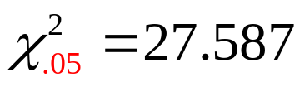


Normality
df = 20 – 3 = 17 (row)
α = .05 (column)
Do Not Reject H₀ Reject H₀
.05
27.587
χ ²
17
There is no reason to doubt the assumption that the errors are normally distributed.

Slide 51
Normality
If the errors are normally distributed,
parameter estimates are normally distributed
F-stat is F-distributed and t-stats are t-distributed
If the errors are not normally distributed but the sample size is large,
parameter estimates are approximately normally distributed (CLT)
F-stat is approximately F-distributed & t-stats are approximately t-distributed
If the errors are not normally distributed and the sample size is small,
parameter estimates are not normally distributed
F-stat may not be F-distributed and t-stats may not be t-distributed

Slide 52
Test of Model Significance
R Square | 0.517
Adjusted R Square | 0.486
Standard Error | 6.347
Observations | 100
ANOVA
 | df | SS | MS | F
Regression | 6 | 4018.075 | 669.679 | 16.623
Residual | 93 | 3746.689 | 40.287
Total | 99 | 7764.764
 | Coefficients | Standard Error | t Stat | P-value
Intercept | 104.529 | 15.743 | 6.640 | 0.000
tanfben3_ln | −5.709 | 2.461 | −2.320 | 0.023
2000 | −2.821 | 2.029 | −1.390 | 0.168
fullsanction | 3.768 | 1.927 | 1.955 | 0.054
black | −0.291 | 0.089 | −3.256 | 0.002
dropo | −0.374 | 0.202 | −1.848 | 0.068
unemp | −3.023 | 0.618 | −4.888 | 0.000
H₀: β₁ = β₂ = . . . = β_{p} = 0
Reject if F-stat > F_{α}
Error

Slide 53
Test of Model Significance
R Square | 0.517
Adjusted R Square | 0.486
Standard Error | 6.347
Observations | 100
ANOVA
 | df | SS | MS | F
Regression | 6 | 4018.075 | 669.679 | 16.623
Residual | 93 | 3746.689 | 40.287
Total | 99 | 7764.764
 | Coefficients | Standard Error | t Stat | P-value
Intercept | 104.529 | 15.743 | 6.640 | 0.000
tanfben3_ln | −5.709 | 2.461 | −2.320 | 0.023
2000 | −2.821 | 2.029 | −1.390 | 0.168
fullsanction | 3.768 | 1.927 | 1.955 | 0.054
black | −0.291 | 0.089 | −3.256 | 0.002
dropo | −0.374 | 0.202 | −1.848 | 0.068
unemp | −3.023 | 0.618 | −4.888 | 0.000
H₀: β₁ = β₂ = . . . = β_{p} = 0
Reject if F-stat > F_{α}
Error

Slide 54
Test of Model Significance
R Square | 0.517
Adjusted R Square | 0.486
Standard Error | 6.347
Observations | 100
ANOVA
 | df | SS | MS | F
Regression | 6 | 4018.075 | 669.679 | 16.623
Residual | 93 | 3746.689 | 40.287
Total | 99 | 7764.764
 | Coefficients | Standard Error | t Stat | P-value
Intercept | 104.529 | 15.743 | 6.640 | 0.000
tanfben3_ln | −5.709 | 2.461 | −2.320 | 0.023
2000 | −2.821 | 2.029 | −1.390 | 0.168
fullsanction | 3.768 | 1.927 | 1.955 | 0.054
black | −0.291 | 0.089 | −3.256 | 0.002
dropo | −0.374 | 0.202 | −1.848 | 0.068
unemp | −3.023 | 0.618 | −4.888 | 0.000
H₀: β₁ = β₂ = . . . = β_{p} = 0
Reject if 16.623 > F_{α}
Error

Slide 55
Test of Model Significance
R Square | 0.517
Adjusted R Square | 0.486
Standard Error | 6.347
Observations | 100
ANOVA
 | df | SS | MS | F
Regression | 6 | 4018.075 | 669.679 | 16.623
Residual | 93 | 3746.689 | 40.287
Total | 99 | 7764.764
 | Coefficients | Standard Error | t Stat | P-value
Intercept | 104.529 | 15.743 | 6.640 | 0.000
tanfben3_ln | −5.709 | 2.461 | −2.320 | 0.023
2000 | −2.821 | 2.029 | −1.390 | 0.168
fullsanction | 3.768 | 1.927 | 1.955 | 0.054
black | −0.291 | 0.089 | −3.256 | 0.002
dropo | −0.374 | 0.202 | −1.848 | 0.068
unemp | −3.023 | 0.618 | −4.888 | 0.000
H₀: β₁ = β₂ = . . . = β_{p} = 0
Reject if 16.623 > F_{α}
Error

Slide 56
Test of Model Significance
R Square | 0.517
Adjusted R Square | 0.486
Standard Error | 6.347
Observations | 100
ANOVA
 | df | SS | MS | F
Regression | 6 | 4018.075 | 669.679 | 16.623
Residual | 93 | 3746.689 | 40.287
Total | 99 | 7764.764
 | Coefficients | Standard Error | t Stat | P-value
Intercept | 104.529 | 15.743 | 6.640 | 0.000
tanfben3_ln | −5.709 | 2.461 | −2.320 | 0.023
2000 | −2.821 | 2.029 | −1.390 | 0.168
fullsanction | 3.768 | 1.927 | 1.955 | 0.054
black | −0.291 | 0.089 | −3.256 | 0.002
dropo | −0.374 | 0.202 | −1.848 | 0.068
unemp | −3.023 | 0.618 | −4.888 | 0.000
H₀: β₁ = β₂ = . . . = β_{p} = 0
Reject if 16.623 > 2.20
Error

Slide 57
Test of Model Significance
R Square | 0.517
Adjusted R Square | 0.486
Standard Error | 6.347
Observations | 100
ANOVA
 | df | SS | MS | F
Regression | 6 | 4018.075 | 669.679 | 16.623
Residual | 93 | 3746.689 | 40.287
Total | 99 | 7764.764
 | Coefficients | Standard Error | t Stat | P-value
Intercept | 104.529 | 15.743 | 6.640 | 0.000
tanfben3_ln | −5.709 | 2.461 | −2.320 | 0.023
2000 | −2.821 | 2.029 | −1.390 | 0.168
fullsanction | 3.768 | 1.927 | 1.955 | 0.054
black | −0.291 | 0.089 | −3.256 | 0.002
dropo | −0.374 | 0.202 | −1.848 | 0.068
unemp | −3.023 | 0.618 | −4.888 | 0.000
H₀: β₁ = β₂ = . . . = β_{p} = 0
Reject
Error

Slide 58
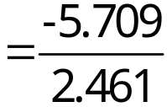

Test of Coefficient Significance
H₀: β₁ = 0
α = .05
α /2 = .025 (column)
df = 100 – 6 – 1 = 93 (row)
Reject
Do Not Reject
Reject
.025
.025
t
-2.3
0
-1.986 1.986
I.e., epr of LISM falls as the TANF welfare payments rises.
Reject H₀ at a 5% level of significance.

Slide 59
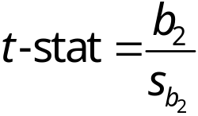
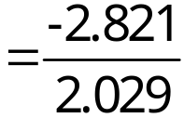

Test of Coefficient Significance
H₀: β₂ = 0
α = .05
α /2 = .025 (column)
df = 100 – 6 – 1 = 93 (row)
Reject
Do Not Reject
Reject
.025
.025
t
-1.39
0
-1.986 1.986
I.e., welfare reform in general does not influence the decision to work.
We cannot reject H₀ at a 5% level of significance.

Slide 60
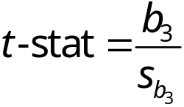
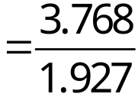

Test of Coefficient Significance
H₀: β₃ = 0
α = .05
α /2 = .025 (column)
df = 100 – 6 – 1 = 93 (row)
Reject
Do Not Reject
Reject
.025
.025
t
0
1.96
-1.986 1.986
Although we cannot reject H₀ at a 5% level of significance,
we can at the 10% level (p-value = .054).
I.e., epr of LISM is higher in states that enacted full sanctions.

Slide 61

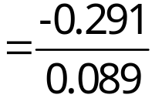

Test of Coefficient Significance
H₀: β₄ = 0
α = .05
α /2 = .025 (column)
df = 100 – 6 – 1 = 93 (row)
Reject
Do Not Reject
Reject
.025
.025
t
-3.26
0
-1.986 1.986
Reject H₀ at a 5% level of significance.
I.e., epr of LISM falls as the black share of the population rises.

Slide 62

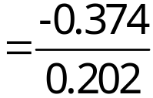

Test of Coefficient Significance
H₀: β₅ = 0
α = .05
α /2 = .025 (column)
df = 100 – 6 – 1 = 93 (row)
Reject
Do Not Reject
Reject
.025
.025
t
-1.85
0
-1.986 1.986
I.e., epr of LISM falls as the high school dropout rate rises.
Although we cannot reject H₀ at a 5% level of significance,
we can at the 10% level (p-value = .068).

Slide 63

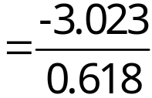

Test of Coefficient Significance
H₀: β₆ = 0
α = .05
α /2 = .025 (column)
df = 100 – 6 – 1 = 93 (row)
Reject
Do Not Reject
Reject
.025
.025
t
-4.89
0
-1.986 1.986
I.e., epr of LISM falls as the unemployment rate rises.
Reject H₀ at a 5% level of significance.

Slide 64



Interpretation of Results
Since the estimated coefficient b₁ is statistically significant, we interpret its value as follows:
Increasing monthly benefit levels for a family of three by 10% would result in a .54 percentage point reduction in the average epr of LISM
Since estimated coefficient b₂ is statistically insignificant (at levels greater than 15%), we interpret its value as follows:
Welfare reform in general
had no effect on the epr of LISM.

Slide 65
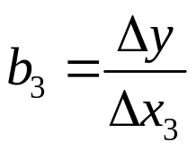
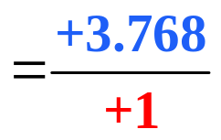

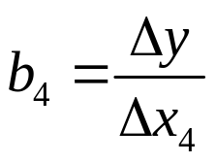
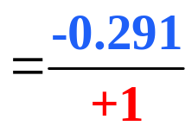

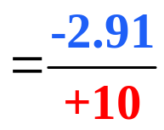

Interpretation of Results
Since estimated coefficient b₃ is statistically significant at the 10% level, we interpret its value as follows:
The epr of LISM is 3.768 percentage points higher in states that adopted full sanctions for families that fail to comply with work rules.
Since estimated coefficient b₄ is statistically significant at the 5% level, we interpret its value as follows:
Each 10 percentage point increase in the share of the black population in states is associated with a 2.91 percentage point decline in the epr of LISM.

Slide 66

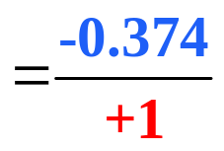
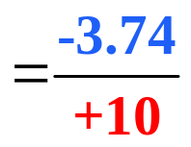

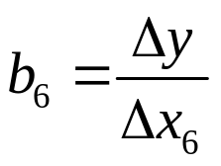
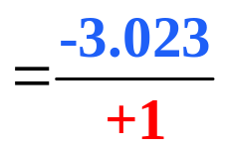

Interpretation of Results
Since estimated coefficient b₅ is statistically significant at the 10% level, we interpret its value as follows:
Each 10 percentage point increase in the high school dropout rate is associated with a 3.74 percentage point decline in the epr of LISM.
Since estimated coefficient b₆ is statistically significant at the 5% level, we interpret its value as follows:
Each 1 percentage point increase in the unemployment rate is associated with a 3.023 percentage point decline in the epr of LISM.

