Slide 1
ANOVA
ANalysis Of VAriance can be used to test for the equality of three or more population means.
H₀: μ₁ = μ₂ = μ₃ = . . . = μ_{k}
H_{a}: Not all population means are equal
normally
For each population, the response variable is
The variances of the response variables are all equal to
The observations must be
distributed.
σ ²
independent.

Slide 2
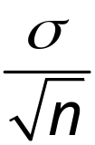



ANOVA
Sampling Distribution of x
given H₀ is true
μ
Sample means are “close” together because there is only one sampling distribution when H₀ is true.

Slide 3








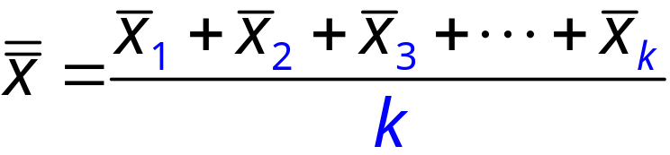
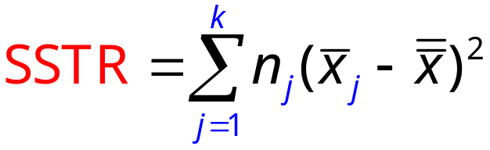
ANOVA
There are k treatments:
For j =
k
1
3
2
yada, yada, yada
is computed from a random sample of size
The overall sample mean:
Dividing the following by k – 1 givens the MSTR
Notes:
MSTR ≈ σιγμα σθυαρεδ
only if H₀ true

Slide 4

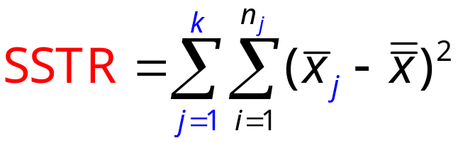
ANOVA
There are k treatments:
For j =
k
is computed from a random sample of size
The overall sample mean:
Dividing the following by k – 1 givens the MSTR
Notes:
MSTR ≈ σιγμα σθυαρεδ
only if H₀ true

Slide 5
ANOVA
Sampling Distribution of x
when H₀ is false
μ ₃
μ
μ ₂
μ ₁
Sample means come from different sampling distributions,
and so are not as “close” together when H₀ is false.

Slide 6




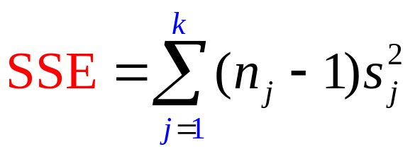
ANOVA
There are k treatments:
For j =
k
1
3
2
yada, yada, yada
is computed from a random sample of size
The overall total number of observations in all samples:
n_{T} = n₁ + n₂ + n₃ + … + n_{k}
Dividing the following by n_{T} – k givens the MSE
Notes:
MSTR ≈ σιγμα σθυαρεδ
whether H₀ true or not
provided ANOVA assumptions hold

Slide 7
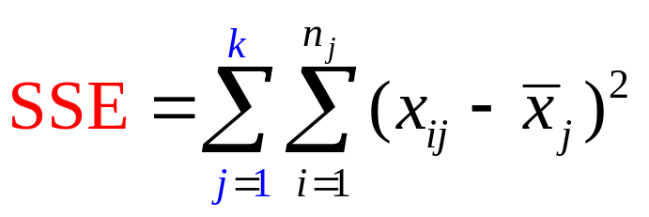
ANOVA
There are k treatments:
For j =
k
is computed from a random sample of size
The overall total number of observations in all samples:
n_{T} = n₁ + n₂ + n₃ + … + n_{k}
Dividing the following by n_{T} – k givens the MSE
Notes:
The MSTR assumes the means are the same (approximated by the grand mean), but the MSE allows the means of the k distributions to be different.

Slide 8
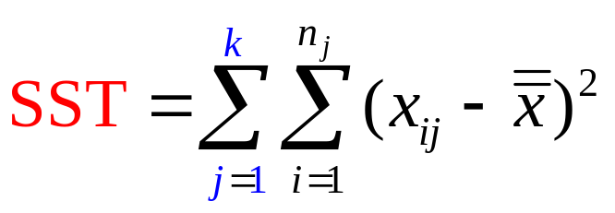
ANOVA
The following is the SST which has n_{T} – 1 degrees of freedom
Notes:
The SST divided by its degrees of freedom n_{T} – 1 is the overall sample variance that would be obtained if we treated the entire set of observations as one data set.

Slide 9
ANOVA
Source of
Variation
Sum of
Squares
Degrees of
Freedom
Mean
Squares
F
Treatment
Error
Total
SSTR
SSE
k – 1
n_{T} – k
MSE
MSTR
F-stat
SST
n_{T} – 1
If F-stat is “small”…
If F-stat is “BIG” …
… you cannot reject H₀
…we reject H₀
The above ANOVA procedure is an example of a completely randomized design, and is applicable when
treatments are randomly assigned to the experimental units
useful when the experimental units are homogenous
Notes:
Completely Randomized Design
If the variance amongst the k sample means is large, the F-stat
is inflated because MSTR overestimates sigma squared.

Slide 10
Completely Randomized Design
Example 1
Janet Reed would like to know if there is any significant difference in the mean number of hours worked per week for the department managers at her three manufacturing plants (in Buffalo, Pittsburgh, and Detroit).
A simple random sample of five managers from each of the three plants was taken and the number of hours worked by each manager for the previous week is shown on the next slide.
Conduct an F test at the 5% level of significance.
NOTE: k = 3 and n₁ = n₂ = n₃ = 5

Slide 11
Completely Randomized Design
Average weekly hours worked by department managers
Plant 1
Buffalo
Plant 2
Pittsburgh
Plant 3
Detroit
Observation
1
2
3
4
5
48
54
57
54
62
73
63
66
64
74
51
63
61
54
56
n_{i}
5 5 5
x_{i}
55 68 57
s_{i}²
26.0 26.5 24.5

Slide 12

Completely Randomized Design
1. Develop the hypotheses.
H₀: μ ₁ = μ ₂ = μ ₃
H_{a}: Not all the means are equal
2. Determine the critical value
Column
k – 1 = 2
2
α = .05
F_{.05} = 3.89
Row: n_{T} – k = 12
3. Compute MSTR
= (55 + 68 + 57)/3 = 60
SSTR = 5(55 – 60)² + 5(68 – 60)² + 5(57 – 60)²
490
= 490
MSTR =
/
= 245

Slide 13
245
Completely Randomized Design
4. Compute the MSE
SSE = 4(26.0) + 4(26.5) + 4(24.5)
308
= 308
MSE =
/(15 – 3) =
25.667
n_{T}
k
5. Compute the F-stat
/
= 9.55
F = MSTR/MSE
=

Slide 14
Completely Randomized Design
Source of
Variation
Sum of
Squares
Degrees of
Freedom
Mean
Squares
F
Treatment
Error
Total
490
308
2
12
245
9.55
25.667
798
14
At 5% significance, the mean hours worked by department managers is not the same.
Do Not Reject H₀ Reject H₀
.05
≈ 1
3.89
9.55

