Slide 1

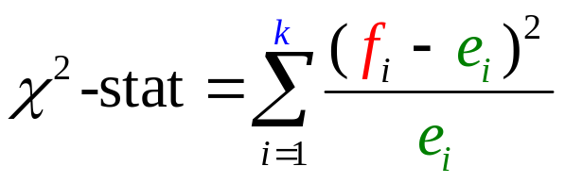
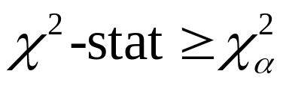
Goodness of Fit Test
1. State the null and alternative hypotheses.
2. Select a random sample and record observed
frequency f_{i} for the i^{th} category (k categories).
Compute expected frequency e_{i} for the i^{th} category:
4. Compute the value of the test statistic.
if e_{i} > 5, this has a chi-square distribution
5. Reject H₀ if
df = k – 1

Slide 2
Goodness of Fit Test
Example: Finger Lakes Homes (A)
k = 4
Finger Lakes Homes manufactures four models of prefabricated homes, a two-story colonial, a log cabin, a split-level, and an A-frame. To help in production planning, management would like to determine if previous customer purchases indicate that there is a preference in the style selected.
The number of homes sold of each model for 100 sales over the past two years is shown below.
Split- A-
Model Colonial Log Level Frame
# Sold 30 20 35 15

Slide 3
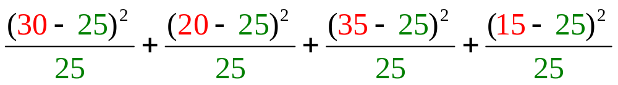
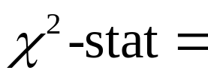

Goodness of Fit Test
e_{i} = (n)(p_{i})
Hypotheses
1/4
H₀: p_{C} = p_{L} = p_{S} = p_{A} =
.25
H_{a}: customers prefer a particular style
i.e., there is at least one proportion much
greater than .25
Expected frequencies
e₁ = (0.25)(100) = 25
e₂ = (0.25)(100) = 25
e₃ = (0.25)(100) = 25
e₄ = (0.25)(100) = 25

Slide 4
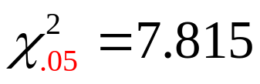

Goodness of Fit Test
df = 4 – 1 = 3 (row)
α = .05 (column)
Do Not Reject H₀ Reject H₀
.05
χ ²
μ = 3
7.815
At 5% significance, the assumption that there is no home style preference is rejected.

Slide 5
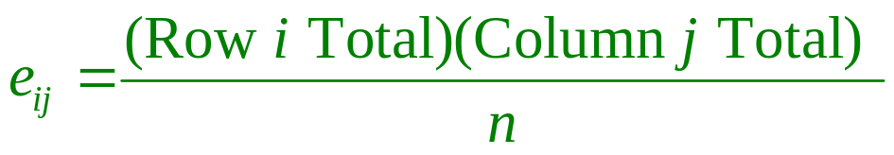
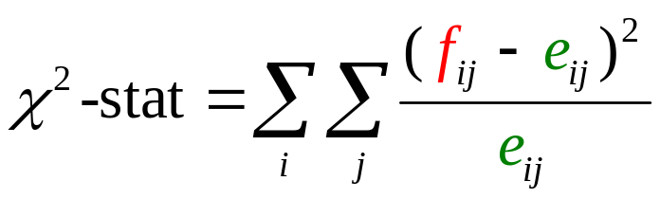
Independence Test
1. State the null and alternative hypotheses.
2. Select a random sample and record observed
frequency f_{i} for each cell of the contingency table.
Compute expected frequency e_{ij} for each cell
4. Compute the test statistic.
if e_{i} > 5, this has a chi-square distribution
5. Reject H₀ if
df = (m - 1)(k - 1)

Slide 6
Independence Test
Example: Finger Lakes Homes (B)
Each home sold by Finger Lakes Homes can be classified according to price and to style. Finger Lakes’ manager would like to determine if the price of the home and the style of the home are independent variables.
The number of homes sold for each model and price for the past two years is shown below. For convenience, the price of the home is listed as either $99,000 or less or more than $99,000.
k = 4
m = 2
Price Colonial Log Split-Level A-Frame
< $99,000
18 6 19 12
> $99,000
12 14 16 3

Slide 7
Independence Test
Observed Frequencies (f_{i})
Price Colonial Log Split-Level A-Frame Total
< $99K
> $99K
Total
18 6 19 12
45
55
12 14 16 3
30
20
35
15
100
Expected Frequencies (e_{i})
Price Colonial Log Split-Level A-Frame Total
< $99K
> $99K
Total
16.5
11
19.25
8.25
55
13.5
9
15.75
6.75
45
30
20
35
15
100

Slide 8
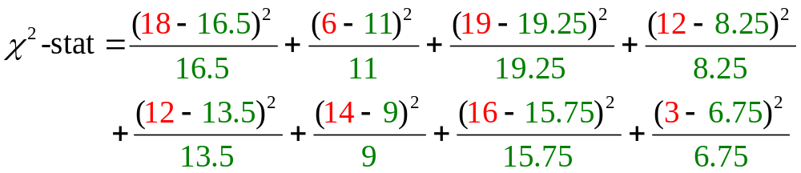

Independence Test
Hypotheses
H₀: Price of the home is independent of the
style of the home that is purchased
H_{a}: Price of the home is not independent of the
style of the home that is purchased
Compute test statistic

Slide 9


Independence Test
df = (4 – 1)(2 – 1) = 3 (row)
α = .05 (column)
Do Not Reject H₀ Reject H₀
.05
χ ²
μ = 3
7.815
At 5% significance, we reject the assumption that the price of the home is independent of the style of home that is purchased.

Slide 10


Goodness of Fit Test: Normal Distribution
1. State the null and alternative hypotheses.
2. Select a random sample and
a. Compute the mean and standard deviation (p = 2).
b. Define intervals so that e_{i} > 5 is in the i^{th} interval
c. For each interval, record observed frequencies f_{i}
3. Compute e_{i} for each interval.
4. Compute the value of the test statistic.
if e_{i} > 5, this has a chi-square distribution
5. Reject H₀ if
df = k – p – 1

Slide 11
Goodness of Fit Test: Normal Distribution
Example: IQ Computers
IQ Computers (one better than HP?) manufactures and sells a general purpose microcomputer. As part of a study to evaluate sales personnel, management wants to determine, at a 5% significance level, if the annual sales volume (number of units sold by a salesperson) follows a normal probability distribution.
A simple random sample of 33 of the salespeople was taken and their numbers of units sold are below.
33 43 44 45 52 52 56 58 63 63 64
64 65 66 68 70 72 73 73 74 74 75
83 84 85 86 91 92 94 98 101 102 105
n = 33, x = 71.76, s = 18.47

Slide 12
Goodness of Fit Test: Normal Distribution
To ensure the test statistic has a chi-square distribution, the normal distribution is divided into k intervals.
k = 33/5 = 6.6
6 equal intervals.
e_{i} = 33/6 = 5.5
Expected frequency:
The probability of being in each interval is equal to
1/6 = .1667
z.

Slide 13
Goodness of Fit Test: Normal Distribution
Find the z that corresponds to the red tail probability
= (1)(.1667)
= .1667
.1667
– .97
z.

Slide 14
Goodness of Fit Test: Normal Distribution
Find the z that corresponds to the red tail probability
= (2)(.1667)
= .3333
.3333
–.43
z.

Slide 15
Goodness of Fit Test: Normal Distribution
Find the z that corresponds to the red tail probability
= (3)(.1667)
= .5000
.5000
0
z.

Slide 16
Goodness of Fit Test: Normal Distribution
Find the remaining z values using symmetry
–.97 –.43
z.
0
.43
.97

Slide 17
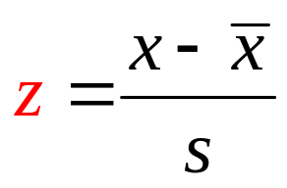












Goodness of Fit Test: Normal Distribution
Find the z that corresponds to the red tail probability
Convert the z’s to x’s
–.97 –.43
z.
0
.43
.97
x

Slide 18

Goodness of Fit Test: Normal Distribution
Observed and Expected Frequencies
LL UL
f_{i} e_{i} f_{i} – e_{i} (f_{i} – e_{i})²/e_{i}
− ∞
53.84
63.81
71.76
79.70
89.68
53.84
63.81
71.76
79.70
89.68
∞
6
5.5
5.5
5.5
5.5
5.5
5.5
33
0.5
-1.5
0.5
0.5
-1.5
1.5
0.05
0.41
0.05
0.05
0.41
0.41
1.36
4
6
6
4
7
Total
33
Data Table
33 43 44 45 52 52 56 58 63 63 64
64 65 66 68 70 72 73 73 74 74 75
83 84 85 86 91 92 94 98 101 102 105

Slide 19
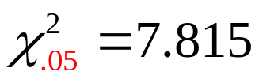


Goodness of Fit Test: Normal Distribution
df = 3 (row)
α = .05 (column)
Do Not Reject H₀ Reject H₀
.05
7.815
χ ²
μ = 3
At 5% significance, there is no reason to doubt the assumption that the population is normally distributed.

