Slide 1
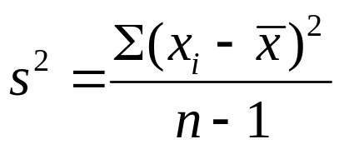
s²
Sampling distribution of
The chi-square distribution results when independent variables with normal distributions are squared and summed.

Slide 2
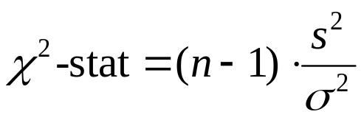

χ²
Sampling distribution of
The chi-square distribution results when independent variables with normal distributions are squared and summed.
0
n – 1

Slide 3
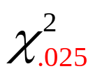
χ²
Sampling distribution of
The chi-square distribution results when independent variables with normal distributions are squared and summed.
.025

Slide 4
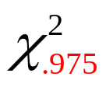
χ²
Sampling distribution of
The chi-square distribution results when independent variables with normal distributions are squared and summed.
.975

Slide 5
Hypothesis Testing – One Variance
Example 1
Buyer’s Digest rates thermostats manufactured for home temperature control. It gives an “acceptable” rating to a thermostat with a temperature variance of 0.5 or less. In a recent test, ten thermostats manufactured by ThermoRite were selected at random and placed in a test room that was maintained at a temperature of 68ºF. Use the ten readings in the table below to test the claim at 10% significance
Thermostat 1 2 3 4 5 6 7 8 9 10
Temperature 67.4 67.8 68.2 69.3 69.5 67.0 68.1 68.6 67.9 67.2

Slide 6

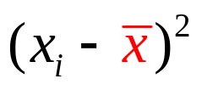
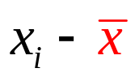
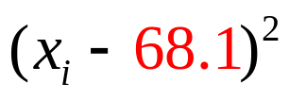
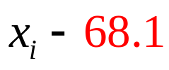
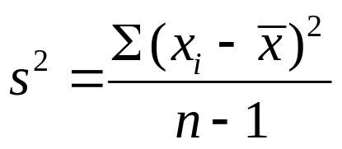

Hypothesis Testing – One Variance
Example 1
67.4
67.8
68.2
69.3
69.5
67.0
68.1
68.6
67.9
67.2
-0.7
-0.3
0.1
1.2
1.4
-1.1
0.0
0.5
-0.2
-0.9
0.49
0.09
0.01
1.44
1.96
1.21
0.00
0.25
0.04
0.81
sum = 6.3
s ² = 0.7

Slide 7



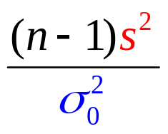
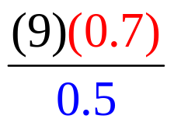


Hypothesis Testing – One Variance
Example 1
Buyer’s Digest rates thermostats manufactured for home temperature control. It gives an “acceptable” rating to a thermostat with a temperature variance of 0.5 or less. In a recent test, ten thermostats manufactured by ThermoRite were selected at random and placed in a test room that was maintained at a temperature of 68ºF. Use the ten readings in the table below to test the claim at 10% significance
Hypotheses:
With s² = 0.7, df = 9, and = 0.5,

Slide 8
Hypothesis Testing – One Variance
Example 1
α = .10 (column)
and df = 10 – 1 = 9 (row)
Selected Values from the Chi-Square Distribution Table
Degrees | Area in Upper Tail
of Freedom | .99 | .975 | .95 | .90 | .10 | .05 | .025 | .01
5 | 0.554 | 0.831 | 1.145 | 1.610 | 9.236 | 11.070 | 12.832 | 15.086
6 | 0.872 | 1.237 | 1.635 | 2.204 | 10.645 | 12.592 | 14.449 | 16.812
7 | 1.239 | 1.690 | 2.167 | 2.833 | 12.017 | 14.067 | 16.013 | 18.475
8 | 1.647 | 2.180 | 2.733 | 3.490 | 13.362 | 15.507 | 17.535 | 20.090
9 | 2.088 | 2.700 | 3.325 | 4.168 | 14.684 | 16.919 | 19.023 | 21.666
10 | 2.558 | 3.247 | 3.940 | 4.865 | 15.987 | 18.307 | 20.483 | 23.209

Slide 9






Hypothesis Testing – One Variance
Example 1
α = .10
Do not reject H₀ Reject H₀
.10
9
There is insufficient evidence to conclude that the temperature variance for ThermoRite thermostats is unacceptable.

Slide 10
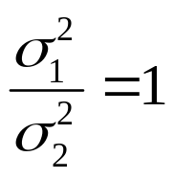
Sampling distribution of F
The F-distribution results from taking the ratio of variances of normally distributed variables.
if σ₁² = σ₂²

Slide 11
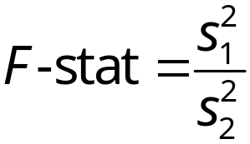
Sampling distribution of F
The F-distribution results from taking the ratio of variances of normally distributed variables.
Bigger
≈1

Slide 12
Sampling distribution of F
The F-distribution results from taking the ratio of variances of normally distributed variables.
≈1
if σ₁² = σ₂²
0
1

Slide 13
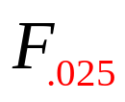
Sampling distribution of F
The F-distribution results from taking the ratio of variances of normally distributed variables.
≈1
.025

Slide 14
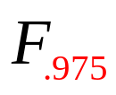
Sampling distribution of F
The F-distribution results from taking the ratio of variances of normally distributed variables.
≈1
.975

Slide 15
Hypothesis Testing – Two Variances
Example 3
Buyer’s Digest has conducted the same test, but on 10 other thermostats. This time it test thermostats manufactured by TempKing. The temperature readings of the 10 thermostats are listed below.
We will conduct a hypothesis at a 10% level of significance to see if the variances are equal for both thermostats.
ThermoRite Sample
Temperature 67.4 67.8 68.2 69.3 69.5 67.0 68.1 68.6 67.9 67.2
s² = 0.7 and df = 9
TempKing Sample
Temperature 67.7 66.4 69.2 70.1 69.5 69.7 68.1 66.6 67.3 67.5
s² = ? and df = 9

Slide 16
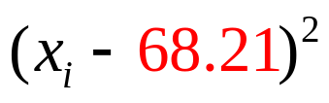
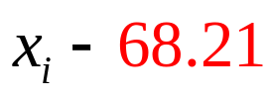



Hypothesis Testing – Two Variances
TempKing
67.7
66.4
69.2
70.1
69.5
69.7
68.1
66.6
67.3
67.5
-0.51
-1.81
0.99
1.89
1.29
1.49
-0.11
-1.61
-0.91
-0.71
0.2601
3.2761
0.9801
3.5721
1.6641
2.2201
0.0121
2.5921
0.8281
0.5041
sum = 15.909
Since this is larger
Than ThermoRite’s
s ² = 1.768

Slide 17
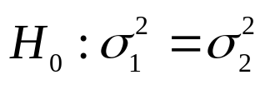
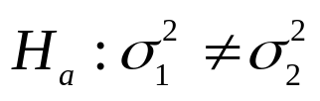
Hypothesis Testing – Two Variances
Hypotheses:
α/2 = .05 (row)
& n ₂ − 1 = 9
n₁ = 10 – 1 = 9 (column)
Selected Values from the F Distribution Table
Denominator | Area in |  | Numerator Degrees of Freedom
Degrees | Upper
of Freedom | Tail |  | 7 | 8 | 9 | 10 | 15
 | .01 |  | 6.18 | 6.03 | 5.91 | 5.81 | 5.52
9 | .10 |  | 2.51 | 2.47 | 2.44 | 2.42 | 2.34
 | .05 |  | 3.29 | 3.23 | 3.18 | 3.14 | 3.01
 | .025 |  | 4.20 | 4.10 | 4.03 | 3.96 | 3.77
 | .01 |  | 5.61 | 5.47 | 5.35 | 5.26 | 4.96

Slide 18

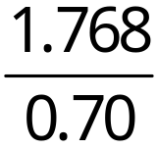





Hypothesis Testing – Two Variances
There is insufficient evidence to conclude that the population variances differ for the two thermostat brands.
Reject H₀ Do not Reject H₀ Reject H₀
.05
.05
≈ 1

