Slide 1
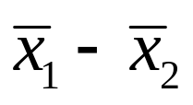


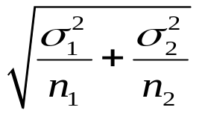
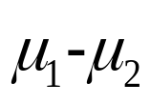
Sampling Distribution of
If and are normally distributed and samples 1 and 2 are
independent, their difference is
Notes:
If population i’s distribution is either normal and n_{i} > 2, roughly symmetric and n_{i} > 30, or heavily skewed and n_{i} > 50, x-bar is normally distributed.

Slide 2

Sampling Distribution of
If and are normally distributed and samples 1 and 2 are
independent, their difference is
is normally distributed off population i’s distribution is
normal and n_{i} > 2
Notes:
If population i’s distribution is either normal and n_{i} > 2, roughly symmetric and n_{i} > 30, or heavily skewed and n_{i} > 50, x-bar is normally distributed.

Slide 3
Sampling Distribution of
If and are normally distributed and samples 1 and 2 are
independent, their difference is
is normally distributed off population i’s distribution is
roughly symmetric and n_{i} > 30
Notes:
If population i’s distribution is either normal and n_{i} > 2, roughly symmetric and n_{i} > 30, or heavily skewed and n_{i} > 50, x-bar is normally distributed.

Slide 4
Sampling Distribution of
If and are normally distributed and samples 1 and 2 are
independent, their difference is
is normally distributed off population i’s distribution is
heavily skewed and n_{i} > 50
Notes:
If population i’s distribution is either normal and n_{i} > 2, roughly symmetric and n_{i} > 30, or heavily skewed and n_{i} > 50, x-bar is normally distributed.

Slide 5
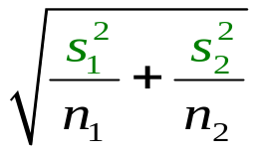
Sampling Distribution of
If and are normally distributed and samples 1 and 2 are
independent, their difference is
Notes:
The t-distribution
is exact if the populations are normally distributed
is the approximate distribution if
populations 1 and 2 are roughly symmetric and n₁+n₂ > 20
populations 1 and 2 are heavily skewed and n₁+n₂ is large.

Slide 6
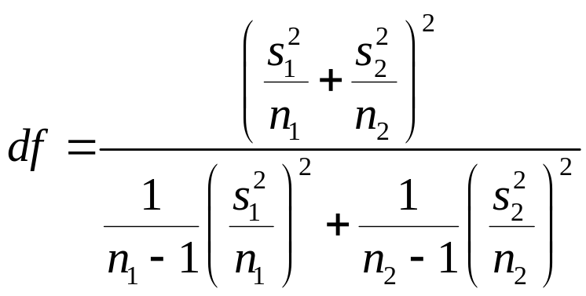
Sampling Distribution of
If and are normally distributed and samples 1 and 2 are
independent, their difference is
The normal distribution is not used if σ₁ and σ₂ are unknown. The t-distribution is used instead with
Notes:
The t-distribution
is exact if the populations are normally distributed
is the approximate distribution if
populations 1 and 2 are roughly symmetric and n₁+n₂ > 20
populations 1 and 2 are heavily skewed and n₁+n₂ is large.

Slide 7
Sampling Distribution of
If and are normally distributed and samples 1 and 2 are
independent, their difference is
The t-distribution is the exact distribution if
  the populations are normally distributed
Notes:
The t-distribution
is exact if the populations are normally distributed
is the approximate distribution if
populations 1 and 2 are roughly symmetric and n₁+n₂ > 20
populations 1 and 2 are heavily skewed and n₁+n₂ is large.

Slide 8
Sampling Distribution of
If and are normally distributed and samples 1 and 2 are
independent, their difference is
The t-distribution is the approximate distribution if
  populations 1 and 2 are roughly symmetric and n₁+ n₂ > 20
Notes:
The t-distribution
is exact if the populations are normally distributed
is the approximate distribution if
populations 1 and 2 are roughly symmetric and n₁+n₂ > 20
populations 1 and 2 are heavily skewed and n₁+n₂ is large.

Slide 9
Sampling Distribution of
If and are normally distributed and samples 1 and 2 are
independent, their difference is
The t-distribution is the approximate distribution if
  populations 1 and 2 are heavily skewed and n₁+ n₂ is large
Notes:
The t-distribution
is exact if the populations are normally distributed
is the approximate distribution if
populations 1 and 2 are roughly symmetric and n₁+n₂ > 20
populations 1 and 2 are heavily skewed and n₁+n₂ is large.

Slide 10
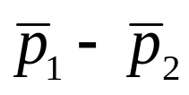


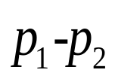
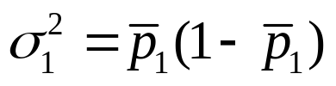
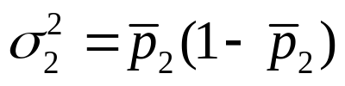
Sampling Distribution of
– is normally distributed if
n₁p₁ > 5
n₁(1 − p₁) > 5
n₂p₂ > 5
n₂(1 − p₂) > 5

Slide 11

Sampling Distribution of
– is normally distributed if
n₁p₁ > 5
n₁(1 − p₁) > 5
n₂p₂ > 5
n₂(1 − p₂) > 5
when testing the equality of proportions

Slide 12
Hypothesis Tests About μ₁ − μ₂
Example 1
Can we conclude, using a 5% level of significance, that the miles-per-gallon (MPG) performance of M cars is greater than the MPG performance of J cars?
Recall
M Cars
J Cars
n
24 cars 28 cars
x
29.8 mpg 27.3 mpg
s
2.56 mpg 1.81 mpg
1. Develop the hypotheses.
H₀: μ₁ - μ₂ < 0
H_{a}: μ₁ - μ₂ > 0

Slide 13
Hypothesis Tests About μ₁ − μ₂
Example 1
2. The degrees of freedom are:

Slide 14

Hypothesis Tests About μ₁ − μ₂
Example 1
2. The degrees of freedom are:
Degrees of freedom calculator for 2 mean tests

Slide 15


Hypothesis Tests About μ₁ − μ₂
Example 1
2. The degrees of freedom are:
40

Slide 16
Hypothesis Tests About μ₁ − μ₂
Example 1
2. The degrees of freedom are:
40
(the row of t-table)
α = .05
α/1 =
.05
(the column of t-table)
t_{.0500} = 1.684

Slide 17
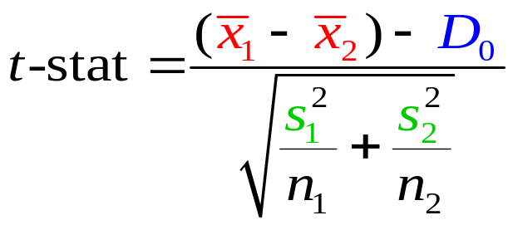
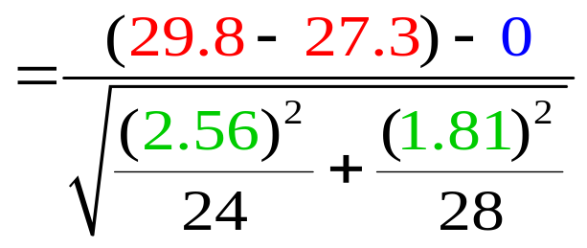

Hypothesis Tests About μ₁ − μ₂
Example 1
3. Compute the value of the test statistic.

Slide 18
Hypothesis Tests About μ₁ − μ₂
Example 1
4. Reject or do not reject the null hypothesis
Do Not Reject H₀ Reject H₀
t
0
1.684
t₀₅₀
4.003
t-stat
At 5% significance, fuel economy of M cars is greater
than the mean fuel economy of J cars.
Notes:
Test the difference in mean sales of promotional and regular customers.

Slide 19
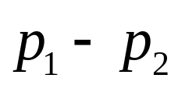
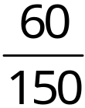
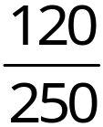






Interval estimate of
Example 2
Market Research Associates is conducting research to evaluate the effectiveness of a client’s new advertising campaign. Before the new campaign began, a telephone survey of 150 households in the test market area showed 60 households “aware” of the client’s product.
The new campaign has been initiated with TV and
newspaper advertisements running for three weeks. A survey
conducted immediately after the new campaign showed 120
of 250 households “aware” of the client’s product. Develop
a 95% confidence interval estimate of the difference between
the proportion of households that are aware of the client’s product.

Slide 20
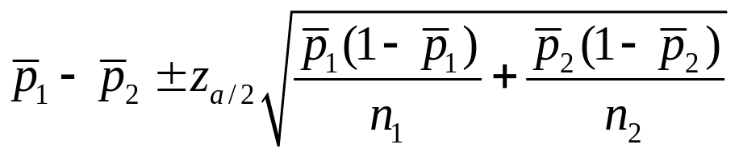
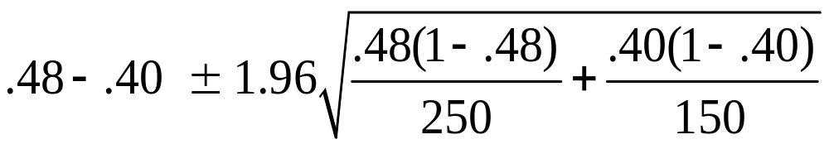
Interval estimate of
Example 2
1−α = .9500
α = .0500
α/2 =
.0250
z_{.0250} = 1.96
.08 + .10
We are 95% confident that the “change in awareness”
due to the campaign is between -0.02 and 0.18…

Slide 21
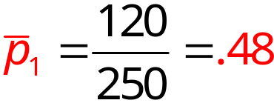
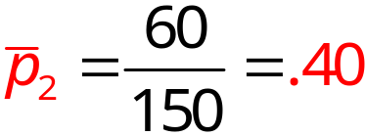
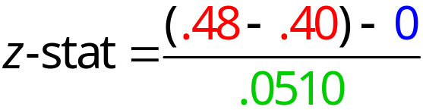
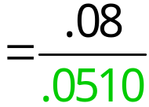

Hypothesis Tests About p₁ − p₂
Example 3
Can we conclude, using a 5% level of significance, that the proportion of households aware of the client’s product increased after the new advertising campaign?
1. Develop the hypotheses.
H₀: p₁ − p₂ < 0
H_{a}: p₁ − p₂ > 0
2. Determine the critical value.
α = .0500
z_{.05} = 1.645
3. Compute the value of the test statistic.

Slide 22
Hypothesis Tests About p₁ − p₂
Example 3
4. Reject or do not reject the null hypothesis
Do Not Reject H₀ Reject H₀
1.57
z-stat
1.645
z
0
z_{.050}
We cannot conclude that the proportion of households aware of the client’s product increased after the new campaign.

Slide 23
Matched Samples
Example 4
A Chicago-based firm has documents that must be quickly distributed to district offices throughout the U.S. The firm must decide between two delivery services, UPX (United Parcel Express) and INTEX (International Express), to transport its documents.
In testing the delivery times of the two services, the firm sent two reports to a random sample of its district offices with one report carried by UPX and the other report carried by INTEX. Do the data on the next slide indicate a difference in mean delivery times for the two services? Use a 5% level of significance.

Slide 24

Matched Samples
Example 4
Delivery Time (Hours)
District Office
UPX
INTEX
Difference (d)
32
30
19
16
15
18
14
10
7
16
25
24
15
15
13
15
15
8
9
11
1
2
3
-1
2
-2
5
7
4
Seattle
Los Angeles
Boston
Cleveland
New York
Houston
Atlanta
St. Louis
Milwaukee
Denver
6
Sum = 27

Slide 25

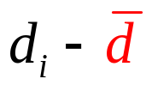
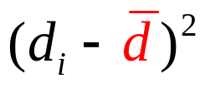
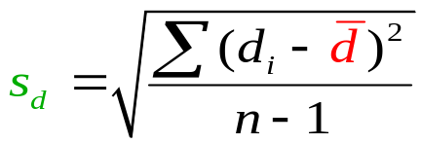
Matched Samples
Example 4
7
6
4
1
2
3
-1
2
-2
5
7– 2.7
6 – 2.7
4 – 2.7
1 – 2.7
2 – 2.7
3 – 2.7
-1 – 2.7
2 – 2.7
-2 – 2.7
5 – 2.7
4.3
3.3
1.3
-1.7
-0.7
0.3
-3.7
-0.7
-4.7
2.3
18.49
10.89
1.69
2.89
0.49
0.09
13.69
0.49
22.09
5.29
Sum =
76.1
s_{d} =
2
8.5
s_{d} =
2.9

Slide 26
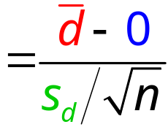
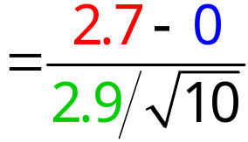


Matched Samples
Example 4
1. Develop the hypotheses
with μ_{d} = μ₁ – μ₂
H₀: μ_{d} = 0
H_{a}: μ_{d} ≠ 0
No difference exists
A difference exists
2. Determine the critical values with
α = .050.
Since this is a
two-tailed test
α /2 = .025
(the column of the t-table)
df = 10 – 1 = 9
(the row of the t-table)
− t_{.025} = −2.262
t_{.025} = 2.262
3. Compute the value of the test statistic.

Slide 27
Matched Samples
Example 4
4. Reject or do not reject the null hypothesis
Reject H₀ Do Not Reject Reject H₀
H₀: μ_{d} = 0
−2.262 2.262
−t_{.025} t_{.025}
0
2.94
t-stat
At the 5% level of significance, the sample evidence indicates there is a difference in mean delivery times for the two services.
Notes:
Test the difference between male and female unemployment.
Test the difference between 1997 and 1998 male unemployment.
Test the difference between 1997 and 1998 female unemployment.

