Slide 1

Hypothesis Testing
Recent coffee research

Slide 2
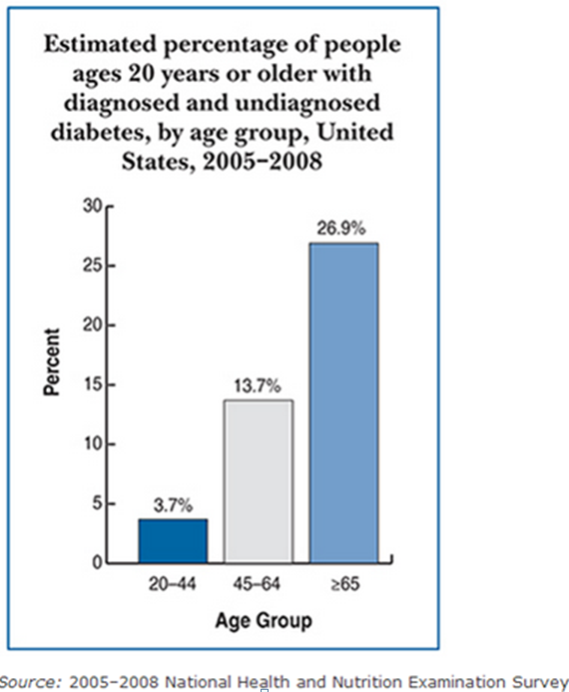
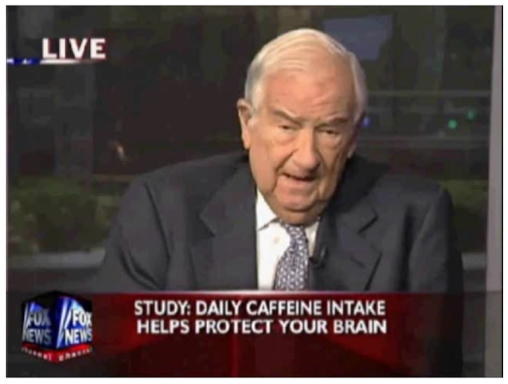
Hypothesis Testing
Recent coffee research
H₀: p > 0.137
Coffee does not reduce the risk of diabetes
H_{a}: p < 0.137
Coffee reduces the risk of diabetes

Slide 3
Hypothesis Testing
H₀: p > 0.137
Coffee does not reduce the risk of diabetes
H_{a}: p < 0.137
Coffee reduces the risk of diabetes
H₀: μ = 12
Subway’s FOOTLONG is a foot long
H_{a}: μ <> 12
Subway’s FOOTLONG is not a foot long

Slide 4
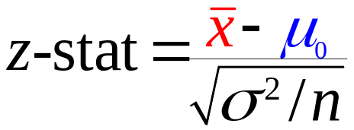
Hypothesis Testing
one mean test—σ known
is normally distributed provided
x is normally distributed
OR x’s distribution is not heavily skewed and n > 30
OR x’s distribution is heavily skewed and n > 50
σ ² is some value that only Deity knows

Slide 5
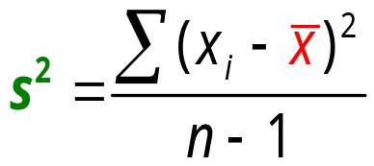
Hypothesis Testing
one mean test—σ known
one mean test—σ unknown
is normally distributed provided
x is normally distributed
OR x’s distribution is not heavily skewed and n > 30
OR x’s distribution is heavily skewed and n > 50
What do you do if Deity won’t reveal to you the value of σ ²?

Slide 6
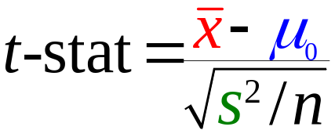
Hypothesis Testing
one mean test—σ unknown
The t distribution is the exact distribution if
x is normally distributed
What do you do if Deity won’t reveal to you the value of σ ²?

Slide 7
Hypothesis Testing
one mean test—σ unknown
The t distribution is the approximate distribution if
x is normally distributed
OR n > 30 and x is NOT heavily skewed
OR n > 50 and x is HEAVILY skewed
What do you do if Deity won’t reveal to you the value of σ ²?

Slide 8
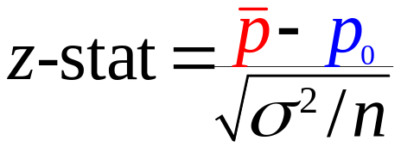

Hypothesis Testing
one proportion test
is approximately normally distributed if
n p₀ > 5 and n (1–p₀) > 5
What do you use for σ ² when you test a proportion?

Slide 9

Hypothesis Testing
1960s Chips Ahoy cookie TV commercial claim

Slide 10
Hypothesis Testing
The null hypothesis is assumed to be true
H₀: μ = 16
the cookies have 16 chips
Rejecting a true H₀ is a Type I error
The sample says the cookies do not have
16 chips when they actually do.
This error is costly because the production line will
be shutdown to fix a problem that does not exist

Slide 11
Hypothesis Testing
The alternative hypothesis is the opposite
H₀: μ = 16
the cookies have 16 chips
H_{a}: μ < > 16
the cookies do not have 16 chips
Rejecting a true H₀ is a Type I error
Rejecting a true H_{a} is a Type II error
The sample says the cookies have 16 chips
when they really do not.
The error will upset Chips Ahoy’s customers if there are too few
OR increase Chips Ahoy’s costs if there are too many

Slide 12
Hypothesis Testing
The alternative hypothesis is the opposite
H₀: μ = 16
the cookies have 16 chips
H_{a}: μ < > 16
the cookies do not have 16 chips
Rejecting a true H₀ is a Type I error
Rejecting a true H_{a} is a Type II error
What conclusion is appropriate when H₀
is rejected?

Slide 13
Hypothesis Testing
The alternative hypothesis is the opposite
H₀: μ = 16
the cookies have 16 chips
We cannot conclude that
H_{a}: μ < > 16
the cookies do not have 16 chips
Rejecting a true H₀ is a Type I error
Rejecting a true H_{a} is a Type II error
What conclusion is appropriate when H₀
cannot be rejected?

Slide 14
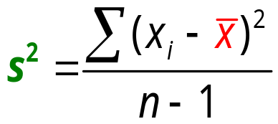
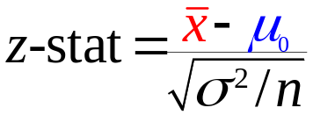

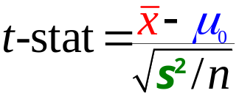
Example: Chips Ahoy Chocolate Chip Cookies
Hypothesis Testing
one mean test—σ unknown
Perform a hypothesis test, at the 5% level of significance, to determine if Chips Ahoy cookies have an average of 16 chips per cookie.
mean test
proportion test
mean test
σ ² known
σ ² = p₀(1 – p₀)

Slide 15
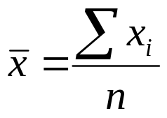
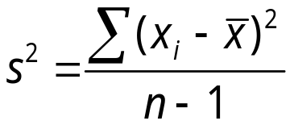
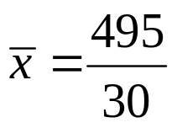
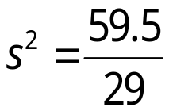


Hypothesis Testing
one mean test—σ unknown
Bottle | Number of Chips | deviation from mean
1 | 14 | -2.5
2 | 15 | -1.5
3 | 15 | -1.5
4 | 17 | 0.5
5 | 18 | 1.5
6 | 16 | -0.5
7 | 15 | -1.5
29 | 19 | 2.5
30 | 17 | 0.5
Total | 495 | 0

Slide 16
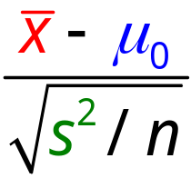
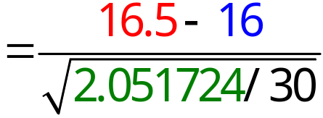


Hypothesis Testing
one mean test—σ unknown
1. Determine the hypotheses.
H₀: μ = 16
H_{a}: μ < > 16
2. Compute the test statistic

Slide 17
Hypothesis Testing
one mean test—σ unknown
3. Determine the critical value(s).
H_{a}: μ < > 16
α = .050
α/2 = .025
df = 30 – 1 = 29
degrees of freedom | .200 | .100 | .050 | .025 | .010 | .005
28 | .855 | 1.313 | 1.701 | 2.048 | 2.467 | 2.763
29 | .854 | 1.311 | 1.699 | 2.045 | 2.462 | 2.756
30 | .854 | 1.310 | 1.697 | 2.042 | 2.457 | 2.750
31 | .853 | 1.309 | 1.696 | 2.040 | 2.453 | 2.744
32 | .853 | 1.309 | 1.694 | 2.037 | 2.449 | 2.738
33 | .853 | 1.308 | 1.692 | 2.035 | 2.445 | 2.733
34 | .852 | 1.307 | 1.691 | 2.032 | 2.441 | 2.728

Slide 18
Hypothesis Testing
one mean test—σ unknown
3. Determine the critical value(s).
H_{a}: μ < > 16
α = .050
degrees of freedom | .200 | .100 | .050 | .025 | .010 | .005
28 | .855 | 1.313 | 1.701 | 2.048 | 2.467 | 2.763
29 | .854 | 1.311 | 1.699 | 2.045 | 2.462 | 2.756
30 | .854 | 1.310 | 1.697 | 2.042 | 2.457 | 2.750
31 | .853 | 1.309 | 1.696 | 2.040 | 2.453 | 2.744
32 | .853 | 1.309 | 1.694 | 2.037 | 2.449 | 2.738
33 | .853 | 1.308 | 1.692 | 2.035 | 2.445 | 2.733
34 | .852 | 1.307 | 1.691 | 2.032 | 2.441 | 2.728
-t_{.0250} = -2.045
t_{.0250} = 2.045

Slide 19
Hypothesis Testing
one mean test—σ unknown
4. Conclude
Do Not Reject
H₀: μ = 16
.025
.025
t
0
1.91
t-stat
-2.045 2.045
We cannot conclude that
the cookies do not have 16 chips

Slide 20
Hypothesis Testing
Example: Complete in-class 09

