Slide 1
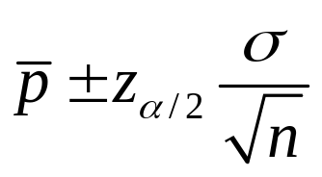
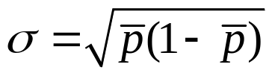
Interval Estimate of a Population
Proportion
The 1 − α confidence interval for unknown p
z_{α/2} is the z value providing an area of α/2 in the
upper tail of the standard normal distribution
and
np > 5
n(1 – p) > 5
and

Slide 2
Interval Estimate of a Population
Proportion
Example: Political Science, Inc.
Political Science, Inc. (PSI) specializes in voter polls and
surveys designed to keep political office seekers informed
of their position in a race. Using telephone surveys, PSI interviewers ask registered voters who they would vote for if the election were held that day.
In a current election campaign, PSI has just found that 220 registered voters, out of 500 contacted, favor McSame. PSI wants to develop a 95% confidence interval estimate for the proportion of the population of registered voters that favor McSame.
n
1 − α

Slide 3
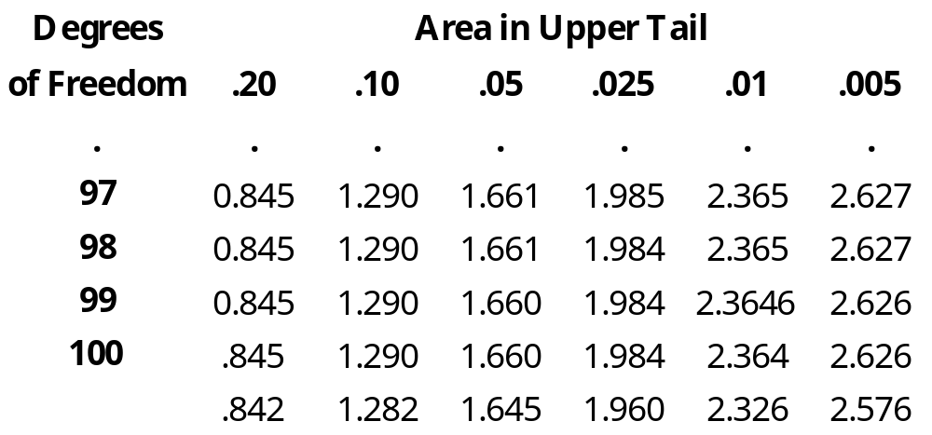

t Distribution
  z values can be found in the infinity row of the t table.
1 − α
= 0.95
α
= 0.05
α / 2
= 0.025
  P(z > 1.960) = .0250

Slide 4
t Distribution
  z values can be found in the infinity row of the t table.
with df = ∞
  .0250
0
1.960

Slide 5
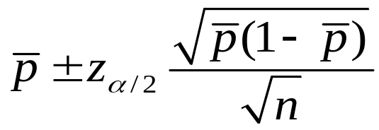

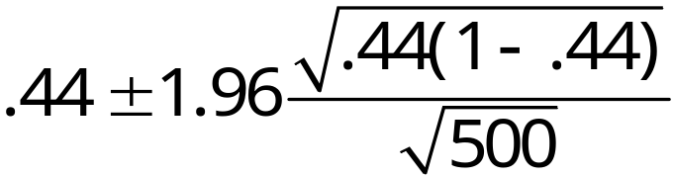
Interval Estimate of a Population
Proportion
Example: Political Science, Inc.
where: n = 500,
= 220/500 = .44,
z_{.025} = 1.960
= .44 + .0435
PSI is 95% confident that the proportion of all voters
that favor McSame is between .3965 and .4835.

Slide 6
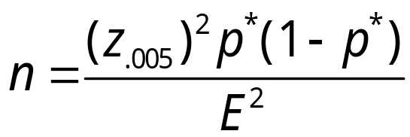
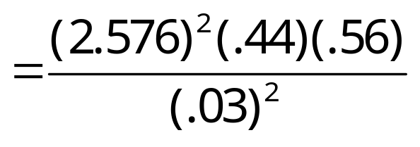

Sufficient Sample Size for the Interval Estimate
of a Population Proportion
Example: Political Science, Inc.
1−α
Suppose that PSI would like a .99 probability that the sample proportion is within .03 of the population proportion. How large should the sample be to meet the required precision? Recall that in the previous example, a sample of 500 similar units yielded a sample proportion of .44.
E
p*
At 99% confidence,
α = .01,
α/2 = .005,
z_{.005} = 2.576
Notes:
Using the sample proportion from a previous sample of the same or similar units
Select a preliminary sample to compute a “preliminary” sample proportion.
If no information is available about p, then .5 is often assumed because it provides the highest possible sample size.

Slide 7
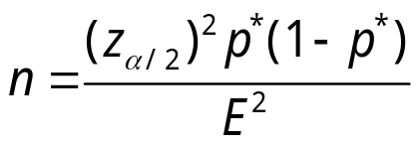
Interval Estimate of a Population Proportion
Example: Review the polls at PollingReport.com and then complete in-class 08

Slide 8
Interval Estimate of a Population
Proportion
The 1 − α confidence interval for unknown p
z_{α/2} is the z value providing an area of α/2 in the
upper tail of the standard normal distribution
and
n > 5/p
n > 5/(1 – p)
and

Slide 9
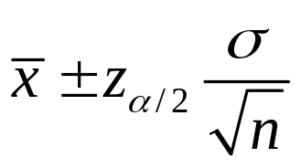
Interval Estimate of a Population
Mean
The 1 − α confidence interval for unknown μ
z_{α/2} is the z value providing an area of α/2 in the
upper tail of the standard normal distribution
σ is the known population standard deviation
and
n > 2 if the data is normally distributed
n > 30 if the data is roughly symmetric
n > 50 if the data is heavily skewed
OR
OR

Slide 10
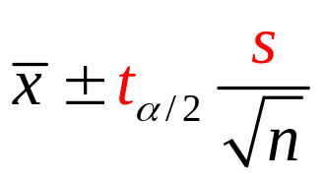
Interval Estimate of a Population
Mean
The 1 − α confidence interval for unknown μ
t_{α/2} is the t value providing an area of α/2 in the
upper tail of the t-distribution
s estimates σ because it is unknown
and
n > 2 if the data is normally distributed
n > 15 if the data is roughly symmetric
n > 30 if the data is slightly skewed
n > 50 if the data is heavily skewed
OR
OR
OR

Slide 11
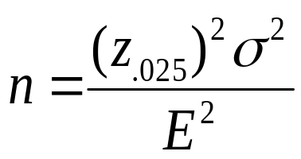
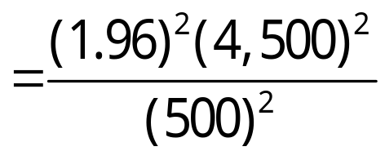


Sufficient Sample Size for the Interval Estimate
of a Population Mean
Recall that Discount Sounds is evaluating a potential location for a new retail outlet, based in part, on the mean annual income of the individuals in the marketing area of the new location.
Suppose that Discount Sounds’ management team
wants an estimate of the population mean such that
there is a .95 probability that the margin of error is $500
or less. How large should the sample be?
1−α
n?
E
At 95% confidence, z_{.025} = 1.96.
Recall that σ = 4,500.

