Slide 1






Sampling
The sampling errors are:
for sample mean
for sample standard deviation
for sample proportion

Slide 2
Example: St. Andrew’s
Sampling
St. Andrew’s College receives 900 applications annually from prospective students. The application form contains a variety of information including the individual’s scholastic aptitude test (SAT) score and whether or not the individual desires on-campus housing.
The director of admissions would like to know the following information:
  Applicants’ average SAT score over the past 10 years
  the proportion of applicants who live on campus.

Slide 3
Example: St. Andrew’s
Sampling
We will now look at two alternatives for obtaining the desired information.
Conducting a census of all applicants over the last ten years (N = 9000) allows us to compute population parameters.
Selecting a sample of 30 from the 9000 current applicants
allows us to compute the sample statistics.
If the relevant data for the entire 9000 applicants were in the college’s database, the population parameters of interest could be calculated using the formulas presented in Chapter 3.

Slide 4
Conducting a Census
Applicant Number | SAT score | Wants on-campus housing | Sqrd. dev. from SAT mean
1 | 1004 | Yes | 112
2 | 942 | Yes | 2643
3 | 890 | Yes | 10694
4 | 1032 | no | 1489
5 | 857 | no | 18608
6 | 1015 | Yes | 466
7 | 1063 | Yes | 4843
8999 | 1090 | Yes | 9329
9000 | 1094 | no | 10118
Total | 8,940,700 | 6,480 | 57,642,979

Slide 5
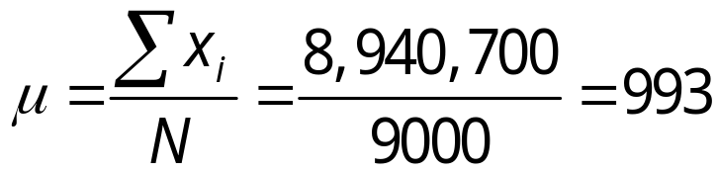
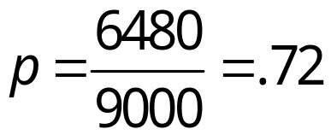
Conducting a Census
Population Mean SAT Score
Population Proportion Wanting On-Campus Housing
Population Standard Deviation for SAT Score

Slide 6
Conducting a Census
μ = 993
Applicant Number | SAT score | Wants on-campus housing | Sqrd. dev. from SAT mean
1 | 1004 | Yes | 121
2 | 942 | Yes | 2601
3 | 890 | Yes | 10609
4 | 1032 | no | 1521
5 | 857 | no | 18496
6 | 1015 | Yes | 484
7 | 1063 | Yes | 4900
8999 | 1090 | Yes | 9409
9000 | 1094 | no | 10201
Total | 8,940,700 | 6,480 | 57,642,979

Slide 7
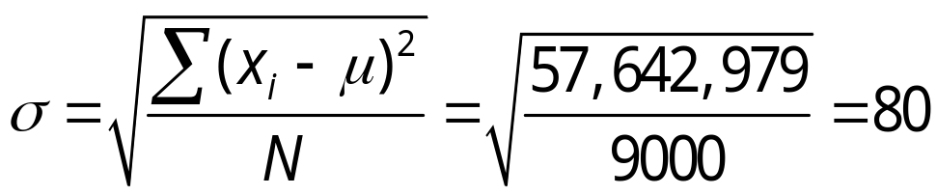
Conducting a Census
Population Mean SAT Score
Population Proportion Wanting On-Campus Housing
Population Standard Deviation for SAT Score
data_sat_pop.xls

Slide 8
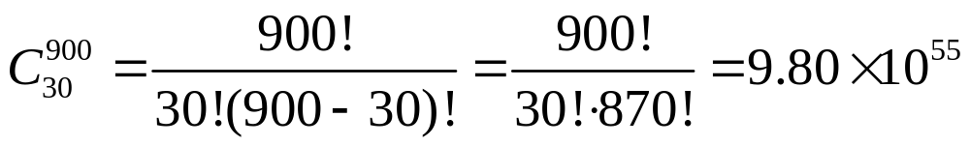
Simple Random Sampling
Suppose the data is stored in boxes off campus.
The Director of Admissions needs estimates of the population parameters for a meeting taking place in an hour.
She decides a sample of 30 applicants will be used.
The number of random samples (without replacement) of size 30 that can be drawn from a population of size 9000 is huge. For just this year, it is

Slide 9
Simple Random Sampling
Taking a Sample of 30 Applicants
Step 1: Assign a random number to each of the 9000
current applicants.
Excel’s RAND function generates
random numbers between 0 and 1
Step 2: Select the 30 applicants corresponding to the
30 smallest random numbers.

Slide 10
Simple Random Sampling
Sort rows by the random numbers
Applicant Number | random
1 | .987
2 | .567
3 | .867
4 | .124
5 | .345
6 | .103
7 | .698
8999 | .432
9000 | .211

Slide 11
Simple Random Sampling
30 applicant
numbers with
smallest random numbers.
Applicant Number | random | SAT score | Wants on-campus housing
675 | .001 | 985 | Yes
34 | .001 | 1002 | Yes
768 | .002 | 913 | Yes
1823 | .003 | 987 | No
8897 | .008 | 1123 | No
7837 | .009 | 989 | Yes
231 | .009 | 912 | Yes
701 | .012 | 987 | Yes
5065 | .015 | 998 | no
Total |  | 30,299 | 20

Slide 12
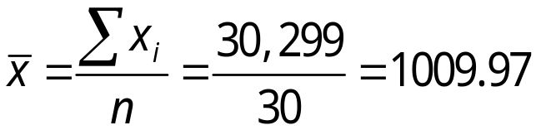

Simple Random Sampling
Sample Mean SAT Score
Sample Proportion Wanting On-Campus Housing
Sample Standard Deviation for SAT Score

Slide 13
Simple Random Sampling
x = 1009.97
Applicant Number | SAT score | Wants on-campus housing | Sqrd. dev. from SAT mean
675 | 985 | Yes | 623.5
34 | 1002 | Yes | 63.52
768 | 913 | Yes | 9403.18
1823 | 987 | no | 527.62
8897 | 1123 | no | 12,775.78
7837 | 989 | Yes | 439.74
231 | 912 | Yes | 9598.12
701 | 987 | Yes | 527.62
5065 | 998 | no | 143.28
Total | 30,299 | 20 | 211,746.97

Slide 14
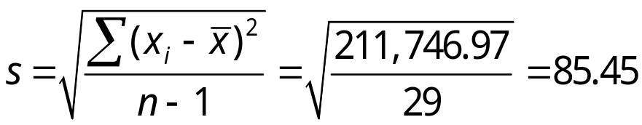
Simple Random Sampling
Sample Mean SAT Score
Sample Proportion Wanting On-Campus Housing
Sample Standard Deviation for SAT Score
data_sampling.xls
Notes:
Note: Different random numbers would have identified a different sample which would have resulted in different point estimates.

Slide 15



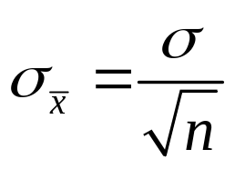
Sampling Distribution of
The sampling distribution of is the probability distribution of all possible values of the sample mean.
Expected Value of
E( ) = μ
where μ = the population mean
Standard Deviation of from an infinite population is
Notes:
Standard Deviation is also known as the standard error of the mean

Slide 16
Sampling Distribution of
Under repeated sampling using random samples of size n, the sample means are normally distributed with mean μ and variance σ ²/n when either
The data is heavily skewed, n > 50, and σ is known.
OR
The data is symmetric, n > 30, and σ is known.
OR
The data is normally distributed and σ is known.

Slide 17
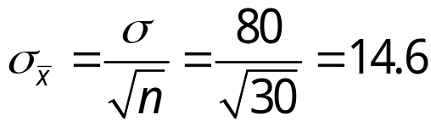


Sampling Distribution of
Sampling
Distribution
of

Slide 18

Sampling Distribution of
What is the probability that a simple random sample
of 30 applicants will provide an estimate of the
population mean SAT score that is within 10 points of
the actual population mean μ ?
In other words, what is the probability that will be
between 983 and 1003?
Step 1: Calculate the z-value at the upper endpoint of
the interval.
z = (1003 - 993)/14.6 = .68

Slide 19
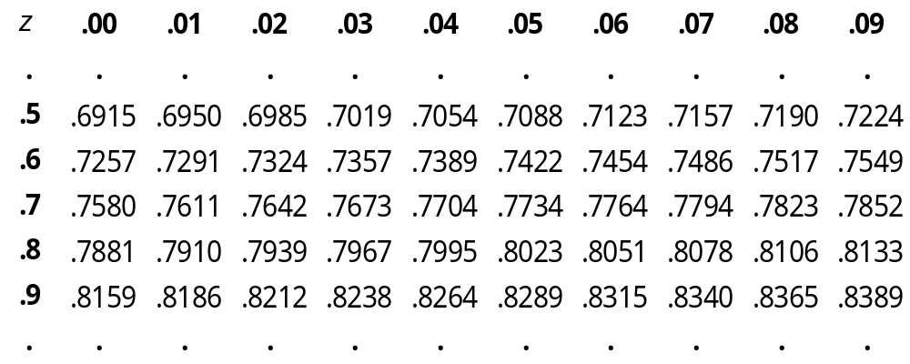
Sampling Distribution of
Step 2: Find the area under the curve to the left of the
upper endpoint.
z = .6 8
P(z < .68) = .7517
P(x < 1003) = .7517

Slide 20


Sampling Distribution of
Sampling
Distribution
of
Area = .2483
Area = .7517
993
1003

Slide 21
Sampling Distribution of
Step 3: Calculate the z-value at the lower endpoint of
the interval.
z = (983 - 993)/14.6 = - .68
Step 4: Find the area under the curve to the left of the
lower endpoint.
P(z < -.68) = .2483
P(x < 983) = .2483

Slide 22


Sampling Distribution of
Step 5: Calculate the area under the curve between
the lower and upper endpoints of the interval.
P(983 < < 1003) = .5034
With n = 30,
.5034
.2483
.2483
983
993
1003
Notes:
The probability that the sample mean SAT score will be between 983 and 1003 is
0.5034

Slide 23
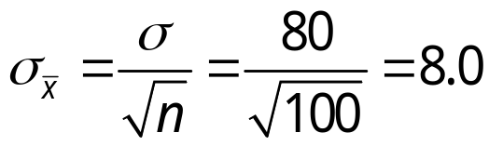
Sampling Distribution of
If the simple had included 100 applicants instead of 30,
, but the standard error falls.
E( ) remains equal to 993
With n = 30,
.5034
.2483
.2483
983
993
1003
Notes:
The standard error was 14.6 when n = 30
The probability that the sample mean SAT score is between 983 and 1003 equals 0.5034 when n = 30, but equals 0.7888 with n = 100.
This is because the sampling distribution with n = 100 has a smaller standard error
So, the values of the sample mean have less variability and tend to hover closer to the population mean when n = 30.

Slide 24

Sampling Distribution of
If the simple had included 100 applicants instead of 30,
, but the standard error falls.
E( ) remains equal to 993
With n = 100,
.7888
With n = 30,
.5034
.2483
.2483
983
993
1003
Notes:
The probability that the sample mean SAT score is between 983 and 1003 equals 0.5034 when n = 30, but equals 0.7888 with n = 100.
This is because the sampling distribution with n = 100 has a smaller standard error
So, the values of the sample mean have less variability and tend to hover closer to the population mean when n = 30.

Slide 25




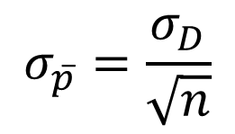
Sampling Distribution of
The Expected value of
Standard deviation of
from an infinite population is
$$σ_{\overline{p}}=\frac{σ_{D}}{\sqrt{n}}$$
σ_{D} = standard deviation of D
The sampling distribution of is approximately normal when
np > 5
and
n(1 – p) > 5
Notes:
Even though the sample proportion wanting on-campus housing is 0.667, we expected it to be equal to the population proportion of p = .72
Most of the time, the sample proportion will be slightly above or slightly below the population proportion. Rarely will the sample proportion be way above or way below the population proportion.

Slide 26
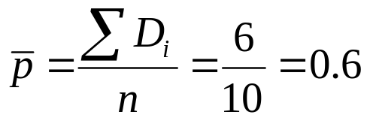
Sampling Distribution of
The sample proportion can be computed in the same way as the sample mean when a dummy variable is coded from a nominal scaled binomial variable.
Vote for Obama | D
Yes | 1
No | 0
No | 0
No | 0
Yes | 1
Yes | 1
Yes | 1
Yes | 1
No | 0
Yes | 1

Slide 27
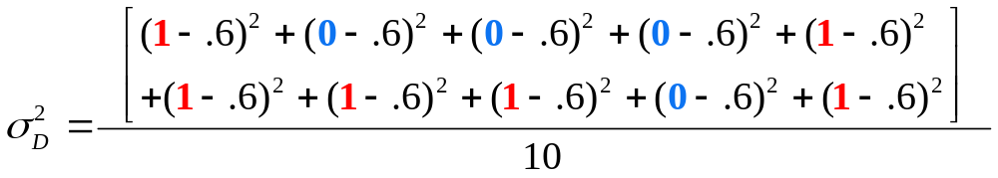
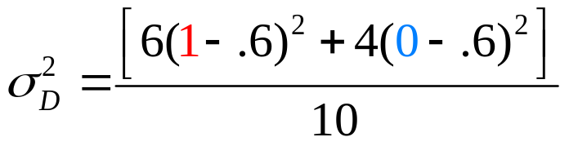



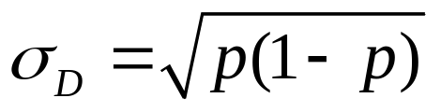
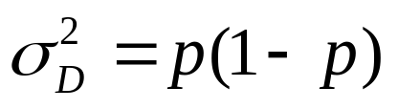
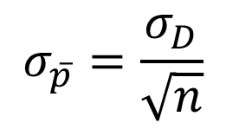
Sampling Distribution of
The sampling distribution of is the probability distribution of all possible values of the sample proportion.
We should have divided by n – 1 because the data came from a sample.
Since there are six 1s and four 0s
In most cases involving sample proportions, n is very large. Hence, dividing by n or
n – 1 yields roughly the same value
$$σ_{\overline{p}}=\frac{σ_{D}}{\sqrt{n}}$$

Slide 28
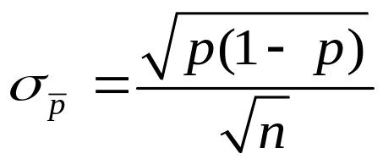
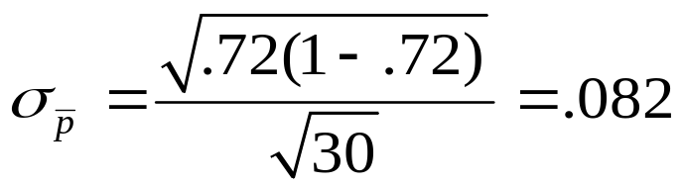
Sampling Distribution of
Example: St. Andrew’s College
Recall that 72% of the prospective students applying to St. Andrew’s College desire on-campus housing. What is the probability that a simple random sample of 30 applicants will provide an estimate of the population proportion of applicants desiring on-campus housing that is within .05 of the actual population proportion?
P(0.67 < < 0.77) = ?
Step 1: Convert the upper endpoint of the interval to z.
z₁ = (.77 - .72)/.082 = .61

Slide 29

Sampling Distribution of
For this example, with n = 30 and p = .72, the normal distribution is an acceptable approximation because:
np = 30(.72) = 21.6 > 5
and
n(1 - p) = 30(.28) = 8.4 > 5
?
.67
.72
.77

Slide 30
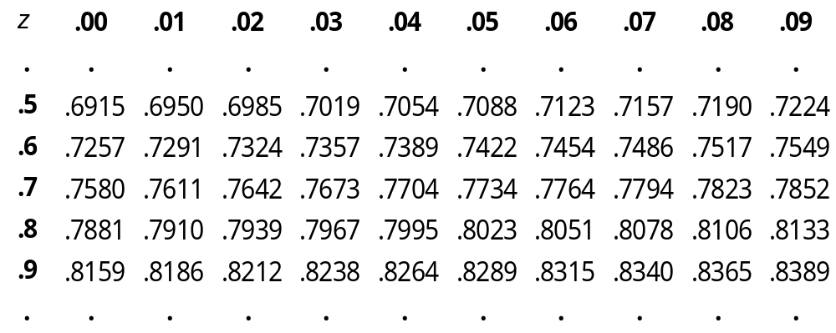
Sampling Distribution of
Step 2: Find the area under the curve to the right of the
upper endpoint.
z₁ = .6 1
P(z₁ < .61) = .7291
P(p < .77) = .7291

Slide 31
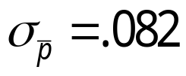

Sampling Distribution of
Area = .2709
Area = .7291
.72
.77

Slide 32
Sampling Distribution of
Step 3: Calculate the z-value of the lower endpoint of
the interval.
z₀ = (.67 - .72)/.082 = -.61
Step 4: Find the area under the curve to the left of the
lower endpoint.
P(z₀ < -.61) = .2709
P(p < .67) = .2709

Slide 33

Sampling Distribution of
Step 5: Calculate the area under the curve between the lower and
upper endpoints of the interval.
Area = .2709
Area = .2709
.4582
.67
.72
.77
Notes:
The probability that the sample proportion of applicants wanting on-campus housing within .05 of the actual population proportion is .4582

Slide 34


Simple Random Sampling
Population
Parameter
Parameter
Value
Point
Estimator
Point
Estimate
μ = Population mean
SAT score
993
= Sample mean
SAT score
1009.97
σ = Population std.
deviation for
SAT score
80
s = Sample std.
deviation for
SAT score
85.45
p = Population pro-
portion wanting
campus housing
.72
= Sample pro-
portion wanting
campus housing
.667
data_sampling_dist.xls
Notes:
The red values vary from sample to sample.
Hence, the sampling distribution of the mean.

