Slide 1

Continuous Probability Distributions
For discrete RVs, f (x)
is the probability distribution function (PDF)
is the probability of x
is the HEIGHT at x
For continuous RVs, f (x)
is the probability density function (PDF)
is not the probability of x but areas under it are probabilities
is the HEIGHT at x

Slide 2
Continuous Probability Distributions
The probability of the random variable assuming a value within some given interval from x₁ to x₂ is defined to be the area under the graph of the probability density function that is between x₁ and x₂.
P(x₁ < x < x₂) = area
Uniform
Normal
Exponential
x
x
x
x₁
x₂
x₁
x₂
x₁
x₂

Slide 3
Uniform Probability Distribution
Example: Slater's Buffet
Slater customers are charged for the amount of
salad they take. Sampling suggests that the amount
of salad taken is uniformly distributed between 5
ounces and 15 ounces.
x
a
b
f (x) = 1/(b – a)
= 1/(15 – 5)
= 1/10
E(x) = (b + a)/2 = (15 + 5)/2 = 10
Var(x) = (b – a)²/12 = (15 – 5)²/12 = 8.33
σ = 8.33 ^{0.5} = 2.886

Slide 4
Uniform Probability Distribution
Uniform Probability Distribution for Salad Plate Filling Weight
f(x)
1/10
x
0
5
10
15
Salad Weight (oz.)

Slide 5
Uniform Probability Distribution
What is the probability that a customer will take between 12 and 15 ounces of salad?
P(12 < x < 15) = (h)(w) = (1/10)(3) = .3
f(x)
1/10
x
0
5
10
12
15
Salad Weight (oz.)

Slide 6
Uniform Probability Distribution
What is the probability that a customer will equal 12 ounces of salad?
P(x = 12) = (h)(w) = (1/10)(0) = 0
f(x)
f(x)
1/10
x
0
5
10
12
15
Salad Weight (oz.)

Slide 7
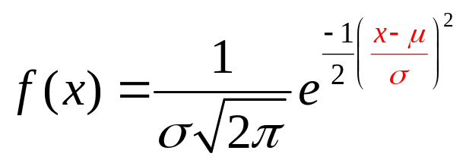
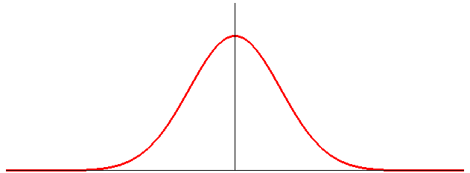
Normal Probability Distribution
The normal probability distribution is widely used in statistical inference, and has many business applications.
x is a normal distributed with mean μ and standard
deviation σ
π ≈ 3.14159…
e ≈ 2.71828…
σ
skew = ?
μ
x
Notes:
Heights of people
Test scores
Rainfall amounts
Scientific measurements
Production line (filling Coke bottles)

Slide 8
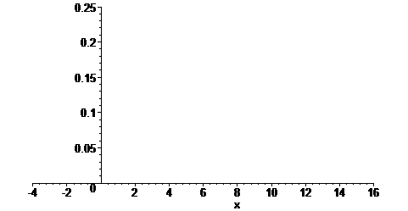
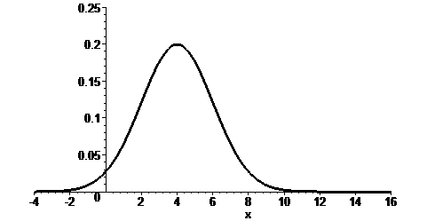
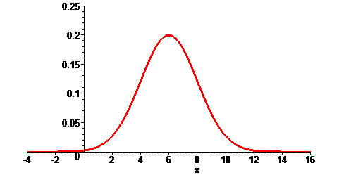
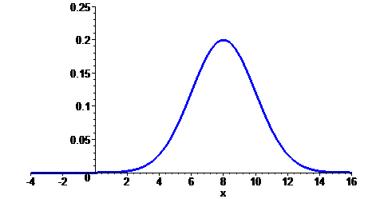
Normal Probability Distribution
The mean can be any numerical value: negative,
zero, or positive.
σ = 2
μ = 4
μ = 6
μ = 8

Slide 9
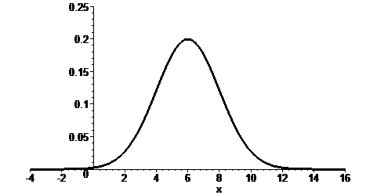
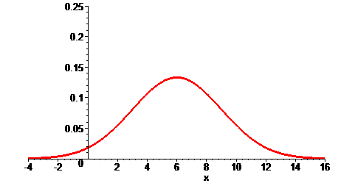
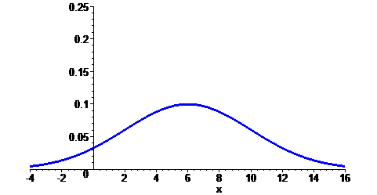
Normal Probability Distribution
The standard deviation determines the width and
height
σ = 2
σ = 3
σ = 4
μ = 6
data_bwt.xls

Slide 10
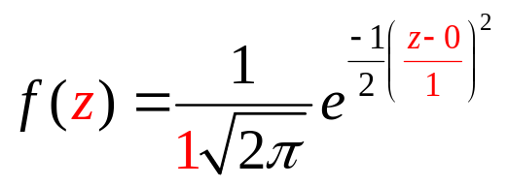
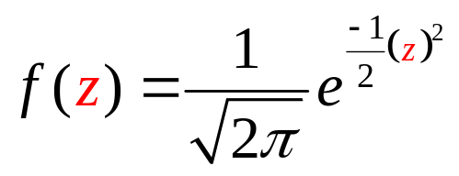
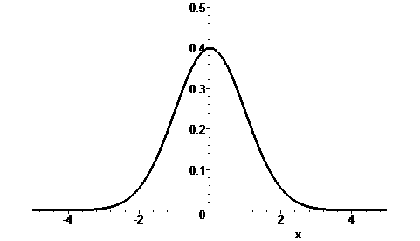
Standard Normal Probability Distribution
z is a random variable having a normal distribution
with a mean of 0 and a standard deviation of 1.
σ = 1
μ = 0
z

Slide 11
Standard Normal Probability Distribution
  Use the standard normal distribution to verify the Empirical Rule:
68.26% of values of a normal random variable
are within 1 standard deviations of its mean.
95.44% of values of a normal random variable
are within 2 standard deviations of its mean.
99.74% of values of a normal random variable
are within 3 standard deviations of its mean.

Slide 12
Standard Normal Probability Distribution
  Compute the probability of being within 3 standard deviations
  from the mean
First compute
P(z < -3) = ?
σ = 1
?
z
-3.00
0

Slide 13
Standard Normal Probability Distribution
P(z < -3.00) = ?
row = -3.0
column = .00
Z | .00 | .01 | .02 | .03 | .04 | .05 | .06 | .07 | .08 | .09
-3.0 | .0013 | .0013 | .0013 | .0012 | .0012 | .0011 | .0011 | .0011 | .0010 | .0010
-2.9 | .0019 | .0018 | .0018 | .0017 | .0016 | .0016 | .0015 | .0015 | .0014 | .0014
-2.8 | .0026 | .0025 | .0024 | .0023 | .0023 | .0022 | .0021 | .0021 | .0020 | .0019
-2.7 | .0035 | .0034 | .0033 | .0032 | .0031 | .0030 | .0029 | .0028 | .0027 | .0026
-2.6 | .0047 | .0045 | .0044 | .0043 | .0041 | .0040 | .0039 | .0038 | .0037 | .0036
-2.5 | .0062 | .0060 | .0059 | .0057 | .0055 | .0054 | .0052 | .0051 | .0049 | .0048
P(z < -3) = .0013

Slide 14
Standard Normal Probability Distribution
  Compute the probability of being within 3 standard deviations
  from the mean
P(z < -3) = .0013
σ = 1
.0013
z
-3.00
0

Slide 15
Standard Normal Probability Distribution
  Compute the probability of being within 3 standard deviations
  from the mean
Next compute
P(z > 3) = ?
σ = 1
?
z
0
3.00

Slide 16
Standard Normal Probability Distribution
P(z < 3.00) = ?
row = 3.0
column = .00
Z | .00 | .01 | .02 | .03 | .04 | .05 | .06 | .07 | .08 | .09
2.5 | .9938 | .9940 | .9941 | .9943 | .9945 | .9946 | .9948 | .9949 | .9951 | .9952
2.6 | .9953 | .9955 | .9956 | .9957 | .9959 | .9960 | .9961 | .9962 | .9963 | .9964
2.7 | .9965 | .9966 | .9967 | .9968 | .9969 | .9970 | .9971 | .9972 | .9973 | .9974
2.8 | .9974 | .9975 | .9976 | .9977 | .9977 | .9978 | .9979 | .9979 | .9980 | .9981
2.9 | .9981 | .9982 | .9982 | .9983 | .9984 | .9984 | .9985 | .9985 | .9986 | .9986
3.0 | .9987 | .9987 | .9987 | .9988 | .9988 | .9989 | .9989 | .9989 | .9990 | .9990
P(z < 3) = .9987

Slide 17
Standard Normal Probability Distribution
  Compute the probability of being within 3 standard deviations
  from the mean
σ = 1
P(z < 3) = .9987
P(z > 3) = 1 – .9987
.9987
.0013
z
0
3.00

Slide 18
Standard Normal Probability Distribution
  Compute the probability of being within 3 standard deviations
  from the mean
σ = 1
.9974
.0013
.0013
z
-3.00
0
3.00
99.74% of values of a normal random variable
are within 3 standard deviations of its mean.

Slide 19
Standard Normal Probability Distribution
  Compute the probability of being within 2 standard deviations
  from the mean
First compute
P(z < -2) = ?
σ = 1
?
z
-2.00
0

Slide 20
Standard Normal Probability Distribution
P(z < -2.00) = ?
row = -2.0
column = .00
Z | .00 | .01 | .02 | .03 | .04 | .05 | .06 | .07 | .08 | .09
-2.2 | .0139 | .0136 | .0132 | .0129 | .0125 | .0122 | .0119 | .0116 | .0113 | .0110
-2.1 | .0179 | .0174 | .0170 | .0166 | .0162 | .0158 | .0154 | .0150 | .0146 | .0143
-2.0 | .0228 | .0222 | .0217 | .0212 | .0207 | .0202 | .0197 | .0192 | .0188 | .0183
-1.9 | .0287 | .0281 | .0274 | .0268 | .0262 | .0256 | .0250 | .0244 | .0239 | .0233
-1.8 | .0359 | .0351 | .0344 | .0336 | .0329 | .0322 | .0314 | .0307 | .0301 | .0294
-1.7 | .0446 | .0436 | .0427 | .0418 | .0409 | .0401 | .0392 | .0384 | .0375 | .0367
P(z < -2) = .0228

Slide 21
Standard Normal Probability Distribution
  Compute the probability of being within 2 standard deviations
  from the mean
P(z < -2) = .0228
σ = 1
.0228
z
-2.00
0

Slide 22
Standard Normal Probability Distribution
  Compute the probability of being within 2 standard deviations
  from the mean
Next compute
P(z > 2) = ?
σ = 1
?
z
0
2.00

Slide 23
Standard Normal Probability Distribution
P(z < 2.00) = ?
row = 2.0
column = .00
Z | .00 | .01 | .02 | .03 | .04 | .05 | .06 | .07 | .08 | .09
1.7 | .9554 | .9564 | .9573 | .9582 | .9591 | .9599 | .9608 | .9616 | .9625 | .9633
1.8 | .9641 | .9649 | .9656 | .9664 | .9671 | .9678 | .9686 | .9693 | .9699 | .9706
1.9 | .9713 | .9719 | .9726 | .9732 | .9738 | .9744 | .9750 | .9756 | .9761 | .9767
2.0 | .9772 | .9778 | .9783 | .9788 | .9793 | .9798 | .9803 | .9808 | .9812 | .9817
2.1 | .9821 | .9826 | .9830 | .9834 | .9838 | .9842 | .9846 | .9850 | .9854 | .9857
2.2 | .9861 | .9864 | .9868 | .9871 | .9875 | .9878 | .9881 | .9884 | .9887 | .9890
P(z < 2) = .9772

Slide 24
Standard Normal Probability Distribution
  Compute the probability of being within 2 standard deviations
  from the mean
σ = 1
P(z < 2) = .9772
P(z > 2) = 1 – .9772
.9772
.0228
z
0
2.00

Slide 25
Standard Normal Probability Distribution
  Compute the probability of being within 2 standard deviations
  from the mean
σ = 1
.9544
.0228
.0228
z
-2.00
0
2.00
95.44% of values of a normal random variable
are within 2 standard deviations of its mean.

Slide 26
Standard Normal Probability Distribution
  Compute the probability of being within 1 standard deviations
  from the mean
First compute
P(z < -1) = ?
σ = 1
?
z
-1.00
0

Slide 27
Standard Normal Probability Distribution
P(z < -1.00) = ?
row = -1.0
column = .00
Z | .00 | .01 | .02 | .03 | .04 | .05 | .06 | .07 | .08 | .09
-1.2 | .1151 | .1131 | .1112 | .1093 | .1075 | .1056 | .1038 | .1020 | .1003 | .0985
-1.1 | .1357 | .1335 | .1314 | .1292 | .1271 | .1251 | .1230 | .1210 | .1190 | .1170
-1.0 | .1587 | .1562 | .1539 | .1515 | .1492 | .1469 | .1446 | .1423 | .1401 | .1379
-.9 | .1841 | .1814 | .1788 | .1762 | .1736 | .1711 | .1685 | .1660 | .1635 | .1611
-.8 | .2119 | .2090 | .2061 | .2033 | .2005 | .1977 | .1949 | .1922 | .1894 | .1867
-.7 | .2420 | .2389 | .2358 | .2327 | .2296 | .2266 | .2236 | .2206 | .2177 | .2148
P(z < -1) = .1587

Slide 28
Standard Normal Probability Distribution
  Compute the probability of being within 1 standard deviations
  from the mean
P(z < -1) = .1587
σ = 1
.1587
z
-1.00
0

Slide 29
Standard Normal Probability Distribution
  Compute the probability of being within 1 standard deviations
  from the mean
Next compute
P(z > 1) = ?
σ = 1
?
z
0
1.00

Slide 30
Standard Normal Probability Distribution
P(z < 1.00) = ?
row = 1.0
column = .00
Z | .00 | .01 | .02 | .03 | .04 | .05 | .06 | .07 | .08 | .09
.7 | .7580 | .7611 | .7642 | .7673 | .7704 | .7734 | .7764 | .7794 | .7823 | .7852
.8 | .7881 | .7910 | .7939 | .7967 | .7995 | .8023 | .8051 | .8078 | .8106 | .8133
.9 | .8159 | .8186 | .8212 | .8238 | .8264 | .8289 | .8315 | .8340 | .8365 | .8389
1.0 | .8413 | .8438 | .8461 | .8485 | .8508 | .8531 | .8554 | .8577 | .8599 | .8621
1.1 | .8643 | .8665 | .8686 | .8708 | .8729 | .8749 | .8770 | .8790 | .8810 | .8830
1.2 | .8849 | .8869 | .8888 | .8907 | .8925 | .8944 | .8962 | .8980 | .8997 | .9015
P(z < 1) = .8413

Slide 31
Standard Normal Probability Distribution
  Compute the probability of being within 1 standard deviations
  from the mean
σ = 1
P(z < 1) = .8413
P(z > 1) = 1 – .8413
.8413
.1587
z
0
1.00

Slide 32
Standard Normal Probability Distribution
  Compute the probability of being within 1 standard deviations
  from the mean
σ = 1
.6826
.1587
.1587
z
-1.00
0
1.00
68.26% of values of a normal random variable
are within 1 standard deviations of its mean.

Slide 33
Standard Normal Probability Distribution
Probabilities for the normal random variable are
given by areas under the curve. Verify the following:
The area to the left of the mean is .5
P(z < 0) = ?
σ = 1
?
z
0

Slide 34
Standard Normal Probability Distribution
P(z < 0.00) = ?
row = 0.0
column = .00
Z | .00 | .01 | .02 | .03 | .04 | .05 | .06 | .07 | .08 | .09
-.5 | .3085 | .3050 | .3015 | .2981 | .2946 | .2912 | .2877 | .2843 | .2810 | .2776
-.4 | .3446 | .3409 | .3372 | .3336 | .3300 | .3264 | .3228 | .3192 | .3156 | .3121
-.3 | .3821 | .3783 | .3745 | .3707 | .3669 | .3632 | .3594 | .3557 | .3520 | .3483
-.2 | .4207 | .4168 | .4129 | .4090 | .4052 | .4013 | .3974 | .3936 | .3897 | .3859
-.1 | .4602 | .4562 | .4522 | .4483 | .4443 | .4404 | .4364 | .4325 | .4286 | .4247
.0 | .5000 | .4960 | .4920 | .4880 | .4840 | .4801 | .4761 | .4721 | .4681 | .4641
P(z < 0) = .5000

Slide 35
Standard Normal Probability Distribution
Probabilities for the normal random variable are
given by areas under the curve. Verify the following:
The area to the left of the mean is .5
P(z < 0) = 0.5000
σ = 1
.5000
z
0

Slide 36
Standard Normal Probability Distribution
Probabilities for the normal random variable are
given by areas under the curve. Verify the following:
The area to the right of the mean is .5
P(z > 0) = 1 – .5000
σ = 1
.5000
z
0

Slide 37
Standard Normal Probability Distribution
Probabilities for the normal random variable are
given by areas under the curve. Verify the following:
The total area under the curve is 1
σ = 1
1.0000
.5000
.5000
z
0

Slide 38
Standard Normal Probability Distribution
  What is the probability that z is less than or equal to -2.76
σ = 1
P(z < -2.76) = ?
?
z
-2.76
0

Slide 39
Standard Normal Probability Distribution
P(z < -2.76) = ?
row = -2.7
column = .06
Z | .00 | .01 | .02 | .03 | .04 | .05 | .06 | .07 | .08 | .09
-3.0 | .0013 | .0013 | .0013 | .0012 | .0012 | .0011 | .0011 | .0011 | .0010 | .0010
-2.9 | .0019 | .0018 | .0018 | .0017 | .0016 | .0016 | .0015 | .0015 | .0014 | .0014
-2.8 | .0026 | .0025 | .0024 | .0023 | .0023 | .0022 | .0021 | .0021 | .0020 | .0019
-2.7 | .0035 | .0034 | .0033 | .0032 | .0031 | .0030 | .0029 | .0028 | .0027 | .0026
-2.6 | .0047 | .0045 | .0044 | .0043 | .0041 | .0040 | .0039 | .0038 | .0037 | .0036
-2.5 | .0062 | .0060 | .0059 | .0057 | .0055 | .0054 | .0052 | .0051 | .0049 | .0048
P(z < -2.76) = .0029

Slide 40
Standard Normal Probability Distribution
  What is the probability that z is less than or equal to -2.76?
P(z < -2.76) = .0029
σ = 1
.0029
z
-2.76
0
  What is the probability that z is less than -2.76?
P(z < -2.76) = .0029

Slide 41
Standard Normal Probability Distribution
  What is the probability that z is greater than or equal to -2.76?
P(z > -2.76) = 1 – .0029
σ = 1
= .9971
.9971
.0029
z
-2.76
0
  What is the that z is greater than -2.76?
P(z > -2.76) = .9971

Slide 42
Standard Normal Probability Distribution
  What is the probability that z is less than or equal to 2.87
P(z < 2.87) = ?
σ = 1
?
z
0
2.87

Slide 43
Standard Normal Probability Distribution
P(z < 2.87) = ?
row = 2.8
column = .07
Z | .00 | .01 | .02 | .03 | .04 | .05 | .06 | .07 | .08 | .09
2.5 | .9938 | .9940 | .9941 | .9943 | .9945 | .9946 | .9948 | .9949 | .9951 | .9952
2.6 | .9953 | .9955 | .9956 | .9957 | .9959 | .9960 | .9961 | .9962 | .9963 | .9964
2.7 | .9965 | .9966 | .9967 | .9968 | .9969 | .9970 | .9971 | .9972 | .9973 | .9974
2.8 | .9974 | .9975 | .9976 | .9977 | .9977 | .9978 | .9979 | .9979 | .9980 | .9981
2.9 | .9981 | .9982 | .9982 | .9983 | .9984 | .9984 | .9985 | .9985 | .9986 | .9986
3.0 | .9987 | .9987 | .9987 | .9988 | .9988 | .9989 | .9989 | .9989 | .9990 | .9990
P(z < 2.87) = .9979

Slide 44
Standard Normal Probability Distribution
  What is the probability that z is less than or equal to 2.87
P(z < 2.87) = .9979
σ = 1
.9979
z
0
2.87
  What is the probability that z is less than 2.87?
P(z < 2.87) = .9971

Slide 45
Standard Normal Probability Distribution
  What is the probability that z is greater than or equal to 2.87?
P(z > 2.87) = 1 – .9979
σ = 1
= .0021
.9979
.0021
z
0
2.87
  What is the that z is greater than 2.87?
P(z > 2.87) = .0021

Slide 46
Standard Normal Probability Distribution
  What is the value of z if the probability of being smaller than it
  is .0250?
P(z < ?) = .0250
σ = 1
.0250
z
?
0

Slide 47
Standard Normal Probability Distribution
  What is the value of z if the probability of being smaller than it
  is .0250?
Z | .00 | .01 | .02 | .03 | .04 | .05 | .06 | .07 | .08 | .09
-2.2 | .0139 | .0136 | .0132 | .0129 | .0125 | .0122 | .0119 | .0116 | .0113 | .0110
-2.1 | .0179 | .0174 | .0170 | .0166 | .0162 | .0158 | .0154 | .0150 | .0146 | .0143
-2.0 | .0228 | .0222 | .0217 | .0212 | .0207 | .0202 | .0197 | .0192 | .0188 | .0183
-1.9 | .0287 | .0281 | .0274 | .0268 | .0262 | .0256 | .0250 | .0244 | .0239 | .0233
-1.8 | .0359 | .0351 | .0344 | .0336 | .0329 | .0322 | .0314 | .0307 | .0301 | .0294
-1.7 | .0446 | .0436 | .0427 | .0418 | .0409 | .0401 | .0392 | .0384 | .0375 | .0367
z = -1.96
row = -1.9
column = .06
P(z < -1.96) = .0250

Slide 48
Standard Normal Probability Distribution
less
  What is the value of z if the probability of being greater than it
  is .0192?
.9808?
P(z > ?) = .0192
σ = 1
.9808
.0192
z
0
?

Slide 49
Standard Normal Probability Distribution
less
  What is the value of z if the probability of being greater than it
  is .0192?
.9808?
Z | .00 | .01 | .02 | .03 | .04 | .05 | .06 | .07 | .08 | .09
1.7 | .9554 | .9564 | .9573 | .9582 | .9591 | .9599 | .9608 | .9616 | .9625 | .9633
1.8 | .9641 | .9649 | .9656 | .9664 | .9671 | .9678 | .9686 | .9693 | .9699 | .9706
1.9 | .9713 | .9719 | .9726 | .9732 | .9738 | .9744 | .9750 | .9756 | .9761 | .9767
2.0 | .9772 | .9778 | .9783 | .9788 | .9793 | .9798 | .9803 | .9808 | .9812 | .9817
2.1 | .9821 | .9826 | .9830 | .9834 | .9838 | .9842 | .9846 | .9850 | .9854 | .9857
2.2 | .9861 | .9864 | .9868 | .9871 | .9875 | .9878 | .9881 | .9884 | .9887 | .9890
z = 2.07
row = 2.0
column = .07
P(z < 2.07) = .9808

Slide 50
Standard Normal Probability Distribution
  What is the value of -z and z if the probability of being
  between them is .9500?
If the area in the middle is .95
σ = 1
then the area NOT in the middle is .05
and so each tail has
an area of .025
.9500
.0250
.0250
z
-z
z
0

Slide 51
Standard Normal Probability Distribution
  What is the value of -z and z if the probability of being
  between them is .9500?
Z | .00 | .01 | .02 | .03 | .04 | .05 | .06 | .07 | .08 | .09
-2.2 | .0139 | .0136 | .0132 | .0129 | .0125 | .0122 | .0119 | .0116 | .0113 | .0110
-2.1 | .0179 | .0174 | .0170 | .0166 | .0162 | .0158 | .0154 | .0150 | .0146 | .0143
-2.0 | .0228 | .0222 | .0217 | .0212 | .0207 | .0202 | .0197 | .0192 | .0188 | .0183
-1.9 | .0287 | .0281 | .0274 | .0268 | .0262 | .0256 | .0250 | .0244 | .0239 | .0233
-1.8 | .0359 | .0351 | .0344 | .0336 | .0329 | .0322 | .0314 | .0307 | .0301 | .0294
-1.7 | .0446 | .0436 | .0427 | .0418 | .0409 | .0401 | .0392 | .0384 | .0375 | .0367
z = -1.96
row = -1.9
column = .06
P(z < -1.96) = .0250

Slide 52
Standard Normal Probability Distribution
  What is the value of -z and z if the probability of being
  between them is .9500?
σ = 1
.9500
.0250
.0250
z
-1.96
1.96
0
By symmetry, the upper z value is 1.96

Slide 53
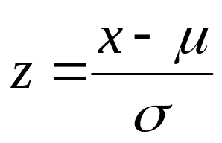
Normal Probability Distribution
z is a random variable that is normally distributed with a mean of 0
and a standard deviation of 1
Let x be a random variable that is normally distribution with a mean of μ
and a standard deviation of σ.
Since there are infinite many choices for μ and σ, it would be impossible
to have more than one normal distribution table in the textbook.
To handle this we simply convert x to z using
We can think of z as a measure of the number of standard deviations
x is from μ.

Slide 54
Normal Probability Distribution
Example: Pep Zone
Pep Zone sells auto parts and supplies including
a popular multi-grade motor oil. When the stock of
this oil drops to 20 gallons, a replenishment order is
placed.
The store manager is concerned that sales are
being lost due to stockouts while waiting for a
replenishment order.

Slide 55
Normal Probability Distribution
Example: Pep Zone
It has been determined that demand during
replenishment lead-time is normally distributed
with a mean of 15 gallons and a standard deviation
of 6 gallons.
The manager would like to know the probability
of a stockout during replenishment lead-time. In
other words, what is the probability that demand
during lead-time will exceed 20 gallons?
P(x > 20) = ?

Slide 56
Normal Probability Distribution
Example: Pep Zone
Step 1: Draw and label the distribution
σ = 6
Note: this probability
must be less than 0.5
p = ?
x
15
20

Slide 57
Normal Probability Distribution
Example: Pep Zone
Step 2: Convert x to the standard normal distribution.
z = (x - μ)/σ = (20 - 15)/6 = .83
z
.83
=
E(z) =
0
Note: this probability
must be less than 0.5
p = ?
x
15
20

Slide 58
Normal Probability Distribution
Example: Pep Zone
Step 3: Find the area under the standard normal
curve to the left of z = .83.
row = .8
column = .03
z
.00
.01
.02
.03
.04
.05
.06
.07
.08
.09
.
.
.
.
.
.
.
.
.
.
.
.5
.6915
.6950
.6985
.7019
.7054
.7088
.7123
.7157
.7190
.7224
.6
.7257
.7291
.7324
.7357
.7389
.7422
.7454
.7486
.7517
.7549
.7
.7580
.7611
.7642
.7673
.7704
.7734
.7764
.7794
.7823
.7852
.8
.7881
.7910
.7939
.7967
.7995
.8023
.8051
.8078
.8106
.8133
.9
.8159
.8186
.8212
.8238
.8264
.8289
.8315
.8340
.8365
.8389
.
.
.
.
.
.
P(z < .83) = .7967
.
.
.
.
.

Slide 59

x
σ = 6
15
Normal Probability Distribution
Example: Pep Zone
Step 4: Compute the area under the standard normal
curve to the right of z = .83.
.7967
.2033
z
0
.83
P(x > 20) = P(z > .83) = 1 – .7967 = .2033
.2033

Slide 60
Normal Probability Distribution
Example: Pep Zone
If the manager of Pep Zone wants the probability
of a stockout during replenishment lead-time to be
no more than .05, what should the reorder point be?
x₁ = ?
P(x > x₁) = .0500

Slide 61
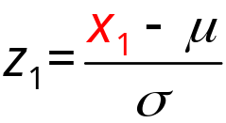
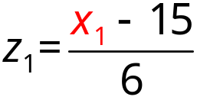




0
σ = 1
z
Normal Probability Distribution
Example: Pep Zone
σ = 6
.9500
.05
x
15
x₁
?

Slide 62
Normal Probability Distribution
Example: Pep Zone
Step 1: Find the z-value that cuts off an area of .05
in the right tail of the standard normal
distribution.
.9500
left
z
.00
.01
.02
.03
.04
.05
.06
.07
.08
.09
.
.
.
.
.
.
.
.
.
.
.
1.5
.9332
.9345
.9357
.9370
.9382
.9394
.9406
.9418
.9429
.9441
1.6
.9452
.9463
.9474
.9484
.9495
.9505
.9515
.9525
.9535
.9545
1.7
.9554
.9564
.9573
.9582
.9591
.9599
.9608
.9616
.9625
.9633
1.8
.9641
.9649
.9656
.9664
.9671
.9678
.9686
.9693
.9699
.9706
1.9
.9713
.9719
.9726
.9732
.9738
.9744
.9750
.9756
.9761
.9767
.
.
.
.
.
.
.
.
.
.
.
z_{.05} = 1.64
z_{.05} = 1.645
z_{.05} = 1.65
or

Slide 63



x
Normal Probability Distribution
σ_{x} = 6
Example: Pep Zone
μ _{x} = 15
15
σ = 1
.9500
.05
z
0
z₁
A reorder point of 24.87 gallons will place the
probability of a stockout at 5%

Slide 64
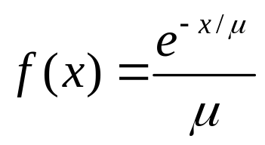
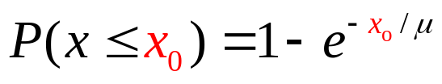
Exponential Probability Distribution
The exponential probability distribution is useful in describing the time it takes to complete a task.
where: μ = mean
(μ > 0)
e ≈ 2.71828
x > 0
Cumulative Probability:
x₀ = some specific value of x
Notes:
Time between vehicle arrivals at a toll booth
Distance between major defects in a highway
Time required to complete a questionnaire

Slide 65
Exponential Probability Distribution
Example: Al’s Full-Service Pump
The time between arrivals of cars at Al’s full-service gas pump follows an exponential probability distribution with a mean time between arrivals of 3 minutes. Al wants to know the probability that the time between two arrivals is 2 minutes or less.
μ
x₀
P(x < 2) = ?
= .4866
1 – e ^{–2/3}
.3
.2
.1
.4866
0 1 2 3 4 5 6 7 8 9 10

