Slide 1
Random Variables
Question
Random Variable x
Type
Family
Size?
x = Number of dependents
reported on tax return
Discrete
Discrete
How much
water did you
buy?
x = Number of bottles of
water you purchase
in a month.
x = ounces of water you
you drink in a day
Continuous
How much
water do you
drink?
Distance from
home to store?
x = Distance in miles from
home to the store site
Continuous

Slide 2
A Discrete Probability Distribution
Example: JSL Appliances
  Using past data on TV sales, a tabular representation of the probability distribution for TV sales was developed.
Number
Units Sold of Days
0 80
1 50
2 40
3 10
4 20
200
x f(x)
0
1
2
3
4
.40
.25
.20
.05
.10
1.00
Notes:
Let x = number of TVs sold at the store in one day, where x can take on 5 values (0, 1, 2, 3, 4)
f(x) > 0
Συμ f(x) = 1

Slide 3
A Discrete Probability Distribution
Example: JSL Appliances
E(x) = Σxf(x)
x f(x) xf(x)
0 .40
1 .25
2 .20
3 .05
4 .10
E(x) =
.00
.25
.40
.15
.40
1.20
expected number of TVs sold in a day: μ = 1.20

Slide 4
A Discrete Probability Distribution
Example: JSL Appliances
Var(x) = Σ(x - μ)²f(x)
x
x – μ
(x – μ)²
f(x)
(x – μ)²f(x)
0
1
2
3
4
-1.2
1.44
.40
.25
.20
.05
.10
.576
μ = 1.20
-0.2
0.04
.010
0.8
0.64
.128
TVs
squared
1.8
3.24
.162
2.8
7.84
.784
Variance of daily sales = σ ² =
1.660
Standard deviation of daily sales:
σ = 1.2884

Slide 5
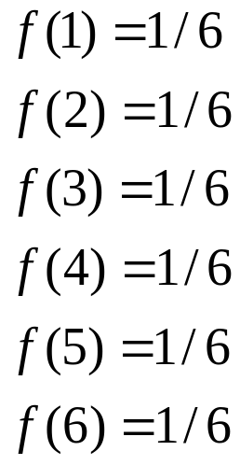
Discrete Uniform Probability Distribution
Example: Rolling a die
Construct the probability distribution table for the rolling a die experiment. The random variable x could take on one of the following six values: 1, 2, 3, 4, 5, 6. What are the probabilities of these events, expected value, and variance?
The probabilities of each of the outcomes are equal:

Slide 6
Discrete Uniform Probability Distribution
Example: Rolling a die
x f(x) xf(x)
1 .1667
2 .1667
3 .1667
4 .1667
5 .1667
6 .1667
E(x) =
.1677
.3333
.5000
.6667
.8333
1.0000
3.5000
expected roll of the die =μ = 3.5

Slide 7
Discrete Uniform Probability Distribution
μ = 3.5
Example: Rolling a die
x
x – μ
(x – μ)²
f(x)
(x – μ)²f(x)
1
2
3
4
5
6
-2.5
6.25
1.0417
.1667
.1667
.1667
.1667
.1667
.1667
-1.5
2.25
0.3750
-0.5
0.25
0.0417
0.5
0.25
0.0417
1.5
2.25
0.3750
2.5
6.25
1.0417
Variance of rolling a die = σ ² =
2.9167
Standard deviation of rolling a die:
σ = 1.7078

Slide 8
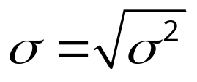
Discrete Uniform Probability Distribution
If x starts at 1 and increases by 1, then
Expected Value
μ = (n + 1)/2
= 3.5
Variance
      σ ² = (n² − 1)/12
= 2.9167
Standard Deviation
= 1.7078

Slide 9
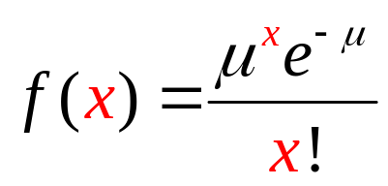
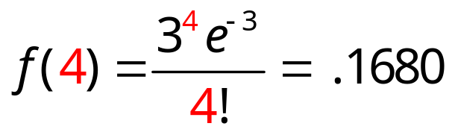
Poisson Probability Distribution
Example: Mercy Hospital
Patients arrive at the emergency room of Mercy
Hospital at the average rate of 3 every 30 minutes on
weekend evenings.
μ
x
What is the probability of 4 arrivals in 30 minutes
on a weekend evening?
Notes:
A Poisson distributed random variable is often useful in estimating the number of occurrences over a specified interval of time or space
The probability of an occurrence is the same for any two intervals of equal length.
It is a discrete random variable that may assume an infinite sequence of values (x = 0, 1, 2, . . . ).
the number of knotholes on an 8-foot two-by-four.
the number of vehicles arriving at a toll booth in one hour
The occurrence or nonoccurrence in any interval is independent of the occurrence or nonoccurrence in any other interval.
f(x) = probability of x occurrences in an interval
μυ = mean number of occurrences in an interval
e = 2.71828…
In Poisson, the shortcuts for computing the expected value are
mean = mu
Variance = mu
3 in either case.

Slide 10
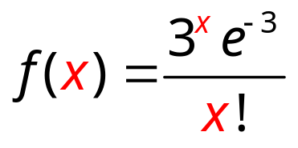

Poisson Probability Distribution
Example: Mercy Hospital
x | f(x) | x f(x)
0 | 0.0498 | 0.0000
1 | 0.1494 | 0.1494
2 | 0.2240 | 0.4481
3 | 0.2240 | 0.6721
4 | 0.1680 | 0.6721
11 | 0.0002 | 0.0024
12 | 0.0001 | 0.0007
 | E(x)
≈ 3.0000
= 1.9147

Slide 11
Poisson Probability Distribution
μ = 3
Example: Mercy Hospital
x | f(x) | x− μ | (x− μ)² | (x− μ)²f(x)
0 | 0.0498 | -3.000 | 9 | 0.4481
1 | 0.1494 | -2.000 | 4 | 0.5974
2 | 0.2240 | -1.000 | 1 | 0.2240
3 | 0.2240 | 0.000 | 0 | 0.0000
4 | 0.1680 | 1.000 | 1 | 0.1680
11 | 0.0002 | 8.000 | 64 | 0.0141
12 | 0.0001 | 9.000 | 81 | 0.0045
 |  |  | var(x)
≈ 3.0000
= 1.4376

Slide 12
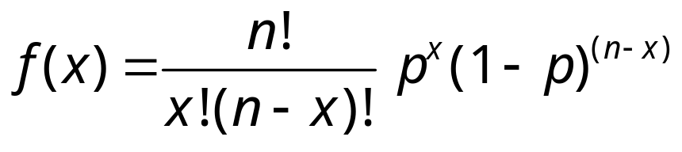
Binomial Probability Distribution
Four Properties of a Binomial Experiment
  1. The experiment consists of a sequence of n
  identical trials.
  2. Two outcomes, success and failure, are possible
  on each trial.
3. The probability of a success, denoted by p, does
not change from trial to trial.
4. The trials are independent.
Notes:
Our interest is in the number of successes occurring in the n trials.
We let x denote the number of successes occurring in the n trials.
x takes on a finite sequence of values (x = 0, 1 . . . n).
f(x) = the probability of x successes in n trials
n = the number of trials
p = the probability of success on any one trial
Number of sequences providing x successes and n – x failures
Probability of a given sequence with x successes and n – x failures
Order of the successes doesn’t matter

Slide 13
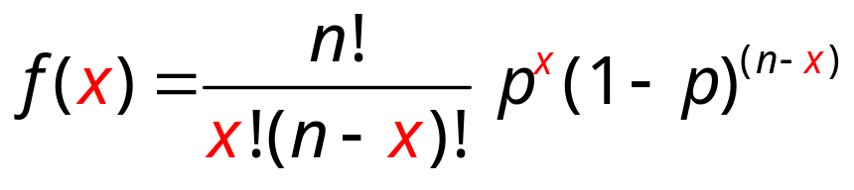
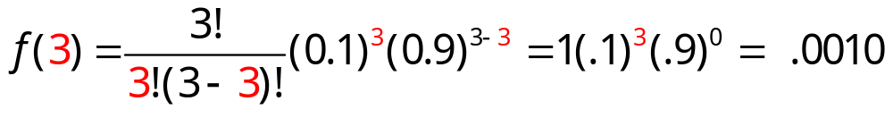
Binomial Probability Distribution
Example: Evans Electronics
Evans is concerned about a low retention rate for employees. In recent years, management has seen a turnover of 10% of the hourly employees annually. Thus, for any hourly employee chosen at random, management estimates a probability of 0.1 that the person will leave the company this year.
p
success
n
Choosing 3 hourly employees at random, what is
the probability that 3 of them will leave the company
this year?
x
success

Slide 14
Binomial Probability Distribution
Example: Evans Electronics
Evans is concerned about a low retention rate for employees. In recent years, management has seen a turnover of 10% of the hourly employees annually. Thus, for any hourly employee chosen at random, management estimates a probability of 0.1 that the person will leave the company this year.
Choosing 3 hourly employees at random, what is
the probability that 3 of them will leave the company
this year?

Slide 15
Binomial Probability Distribution
Example: Evans Electronics
x f(x) xf(x)
0 .729
1 .243
2 .027
3 .001
E(x) =
.000
.243
.054
.003
.300
expected number of employees that leave: μ = 0.3

Slide 16
Binomial Probability Distribution
Example: Evans Electronics
μ = 0.3
x
x – μ
(x – μ)²
f(x)
(x – μ)²f(x)
0
1
2
3
.729
.243
.027
.001
-0.3
0.09
.0656
0.7
0.49
.1191
1.7
2.89
.0780
2.7
7.29
.0073
Variance = σ ² =
.2700
Standard deviation
σ = 0.5196

Slide 17
Binomial Probability Distribution
Expected Value
μ = np
= 3(.1) =
.3
Variance
      σ ² = np(1 − p)
= 3(.1)(1 – .1)
= .27
Standard Deviation
= .5196

Slide 18
Hypergeometric Probability Distribution
For the binomial distribution:
For the Hypergeometric distribution:
  1. The experiment consists of a sequence of n
  identical trials.
  2. Two outcomes, success and failure, are possible
  on each trial.
The probability of a success does not change from
trial to trial.
The probability of a success changes from
trial to trial.
4. The trials are not independent.
4. The trials are independent.
Notes:
If the population size is large, then Hypergeometric becomes binomial with p = r/N

Slide 19
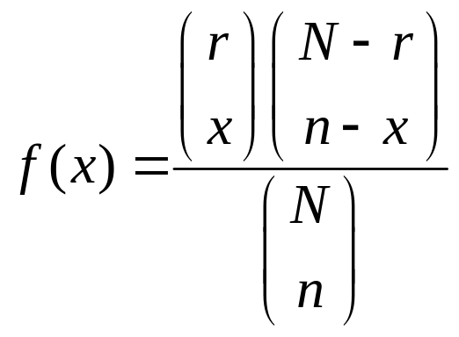
Hypergeometric Probability Distribution
number of ways
n – x failures can be selected
from a total of N – r failures
in the population
  number of ways
  x successes can be selected
  from a total of r successes
  in the population
number of ways
a sample of size n can be selected
from a population of size N
Notes:
n = the number of trials
N = number of elements in the population
r = number of elements in the population labeled success
x = number of elements in the sample labeled success
f(x) = the probability of x successes in n trials

Slide 20
Hypergeometric Probability Distribution
Example: Neveready’s Batteries
N – r
failures
Bob has mistakenly dropped four bad batteries in a kitchen drawer that contains a bunch of miscellaneous tools, other junk, and six good batteries. The ten batteries that are now in the drawer are Neveready brand batteries.
r
successes
N
n
Bob randomly selects three for his cordless beard shaver. What is the probability he selects one good battery?
x
success

Slide 21
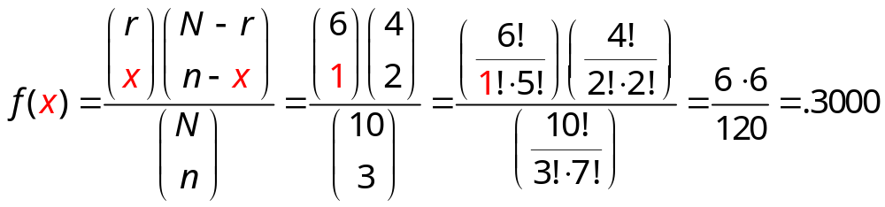
Hypergeometric Probability Distribution
Example: Neveready’s Batteries
where:
x = 1 = number of good batteries in the sample
n – x = 2 = number of bad batteries in the sample
n = 3 = number of batteries in the sample
r = 6 = number of good batteries in the population
N – r = 4 = number of bad batteries in the population
N = 10 = number of batteries in the population

Slide 22
Hypergeometric Probability Distribution
Example: Neveready’s Batteries
x f(x) xf(x)
0 .0333
1 .3000
2 .5000
3 .1667
E(x) =
0.0
0.3
1.0
0.5
1.8
expected number of good batteries in a sample of 3: μ = 1.8

Slide 23
Hypergeometric Probability Distribution
Example: Neveready’s Batteries
μ = 1.8
x
x – μ
(x – μ)²
f(x)
(x – μ)²f(x)
0
1
2
3
.0333
.3000
.5000
.1667
-1.8
3.24
0.108
-0.8
0.64
0.192
0.2
0.04
0.020
1.2
1.44
0.240
Variance = σ ² =
0.560
Standard deviation
σ = 0.748

Slide 24
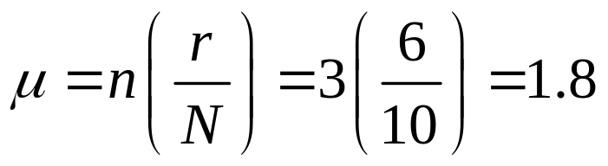
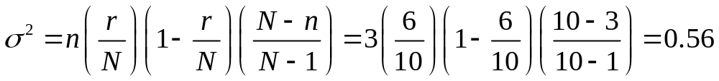
Hypergeometric Probability Distribution
Example: Neveready’s Batteries
Mean
Variance

Slide 25
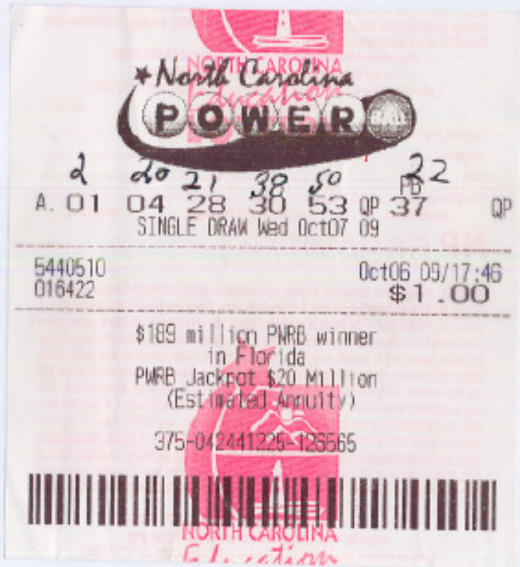
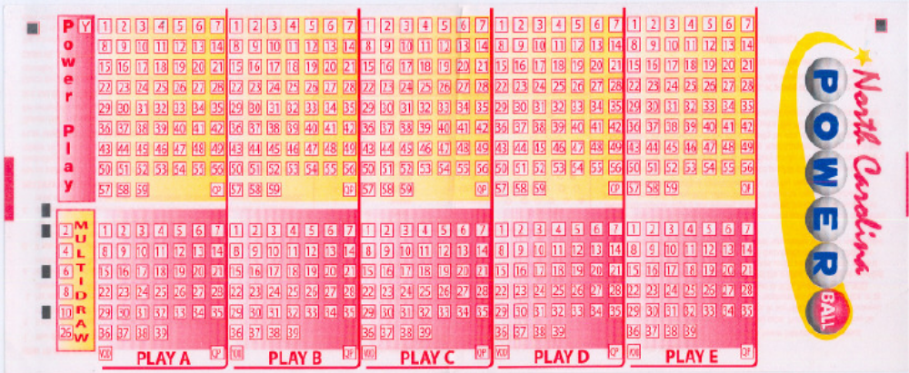
Hypergeometric Probability Distribution
Example: Powerball
www.musl.com/asx/createasx.asp?video=pb091010-high.asf
x
x
N = 59
x
x
x
P(1st 5) = ?
P(PB) =
1/39
x
You will “win” $20,000,000 if the winning numbers are
1
4
28
30
53
and
37

Slide 26
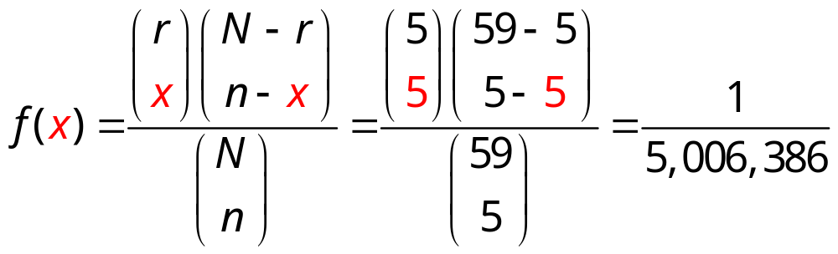
Hypergeometric Probability Distribution
Example: Powerball
1
4
28
30
53
and
37
N = 59 = number of ping pong balls in jar
r = 5 = how many ping pong balls are needed to win
n = 5 = number of ping pong balls selected
x = 5 = number of ping pong balls need to win
P(get 1st 5) = .0000001997

Slide 27
Hypergeometric Probability Distribution
Example: Powerball
P(PB) =1/39
1
4
28
30
53
and
37
P(1st 5 ∩ PB) = P(1st 5) P(PB) = (.0000001997)(1/39) = .00000000512

Slide 28
Hypergeometric Probability Distribution
$30,000,000
Example: Powerball with current Jackpot at $20,000,000
What are your expected winnings if you get the first 5 and
the Powerball correct?
E(x) = Σxf(x)
P(win) = .00000000512
f ($19,999,999) = .00000000512
P(lose) = .99999999488
f(-$1) = .99999999488
Σxf (x) = (-$1)(.99999999488) + ($19,999,999)(.00000000512) = -$0.90
Σxf (x) = (-$1)(.99999999488) + ($29,999,999)(.00000000512) = -$0.85

