Slide 1
The number of experiment outcomes
Example: Bradley Investments
Bradley has invested in two stocks, Markley Oil
and Collins Mining. Bradley has determined that the
possible outcomes of these investments three months
from now are as follows.
Investment Gain or Loss
in 3 Months (in $000)
Markley Oil
Collins Mining
10
5
0
−20
8
−2

Slide 2
The number of experiment outcomes
Example: Bradley Investments
Markley Oil
(Stage 1)
Collins Mining
(Stage 2)
Experimental
Outcomes
+8
(10 + 8)1000 = $18,000
-2
(10 – 2)1000 = $8,000
+10
+8
(5 + 8)1000 = $13,000
+5
(5 – 2)1000 = $3,000
-2
8
+8
(0 + 8)1000 = $8,000
0
-2
(0 – 2)1000 = –$2,000
-20
+8
(-20 + 8)1000 = –$12,000
-2
(-20 – 2)1000 = –$22,000
Notes:
The Product Rule:
(n₁)(n₂) = (4)(2) = 8

Slide 3
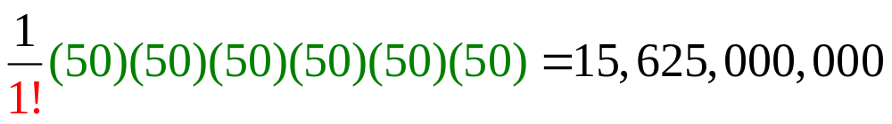
The number of experiment outcomes
Example: State lotteries
Politicians propose a new lottery. In this lottery there are 6 jars each filled with 50 ping pong balls numbered 1 to 50. How many distinct winning tickets could win this lottery if you have to pick the order in which they come out of the jars?
Since order matters and there is replacement the total number of experimental outcomes equals

Slide 4
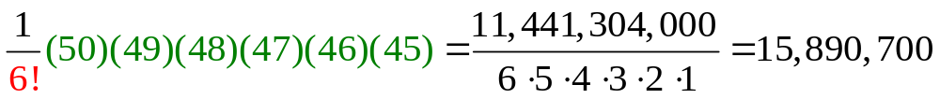
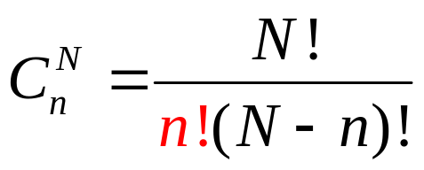
The number of experiment outcomes
Example: State lotteries
Politicians propose a new lottery. In this lottery there is one jar filled with 50 ping pong balls numbered 1 to 50. How many distinct winning tickets could win this lottery if the order of the balls does not have to be picked?
Since order does not matter and there is no replacement the total number of experimental outcomes equals

Slide 5
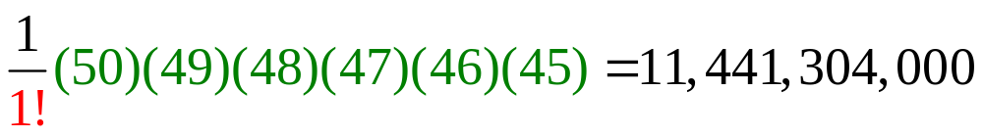
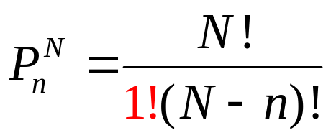
The number of experiment outcomes
Example: State lotteries
Politicians propose a new lottery. In this lottery there is one jar filled with 50 ping pong balls numbered 1 to 50. Six balls are selected one at a time. How many distinct winning tickets could win this lottery if the order of the balls must be chosen too?
Since order matters and there is no replacement the total number of experimental outcomes equals

Slide 6
Probability
Increasing Likelihood of Occurrence
0
.5
1
Probability:
P(A U B) = P(A) + P(B) if A & B are ME
P(A ∩ B) = P(A) P(B) if A & B are Indep.
Notes:
Probability is a measure of the likeliness of an outcome or event.
Snowing in August in Salt Lake City is NOT likely to occur
Snowing in December is very likely
Relative frequencies can be thought of as probabilities
Two concepts that need to placed in your memory now are
The union of events is computed by adding
their probabilities if they are mutually exclusive
The intersection of events is computed by multiplying
their probabilities if they are independent

Slide 7
Probability
Example: Rolling a Die
If an experiment has n possible outcomes, the
classical method would assign a probability of 1/n
to each outcome.
Experiment: Rolling a die
Sample Space: S = {1, 2, 3, 4, 5, 6}
Probabilities: Each sample point has a
1/6 chance of occurring
Notes:
Classical Method -- Assigning probabilities based on the assumption
of equally likely outcomes

Slide 8
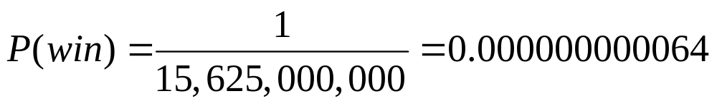
Probability
Example: State lottery 1
Politicians propose a new lottery. In this lottery there are 6 jars each filled with 50 ping pong balls numbered 1 to 50. What is the probability of winning this lottery if you have to pick the order in which they come out of the jars?
Since order matters and there is replacement the total number of experimental outcomes equals

Slide 9
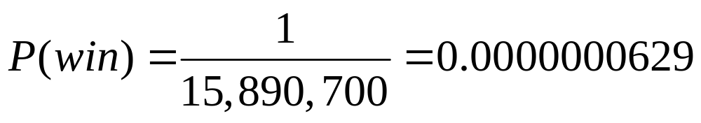
Probability
Example: State lottery 2
Politicians propose a new lottery. In this lottery there is one jar filled with 50 ping pong balls numbered 1 to 50. What is the probability of winning this lottery if the order of the balls does not have to be picked?
Since order does not matter and there is no replacement the total number of experimental outcomes equals

Slide 10
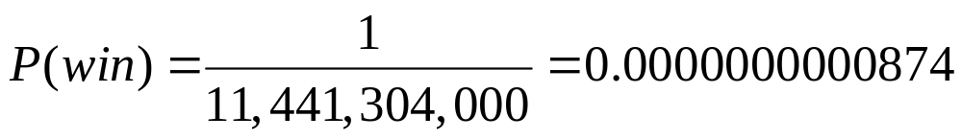
Probability
Example: State lottery 3
Politicians propose a new lottery. In this lottery there is one jar filled with 50 ping pong balls numbered 1 to 50. Six balls are selected one at a time. What is the probability of winning this lottery if the order of the balls must be chosen too?
Since order matters and there is no replacement the total number of experimental outcomes equals

Slide 11
Probability
Example: US population by age (The World Almanac 2004) is given below:
AGE |  | Frequency | Relative
LL | UL | (millions) | Frequency
0 | 19 | 80.5 | 0.29
20 | 24 | 19 | 0.07
25 | 34 | 39.9 | 0.14
35 | 44 | 45.2 | 0.16
45 | 54 | 37.7 | 0.13
55 | 64 | 24.3 | 0.09
65 |  | 35 | 0.12
Totals |  | 281.6 | 1.00
Probability
Notes:
Relative Frequency Method -- Assigning probabilities based on experimentation
or historical data

Slide 12
Probability
Example: Bradley Investments
Bradley has invested in two stocks, Markley Oil
and Collins Mining. Bradley has determined that the
possible outcomes of these investments three months
from now are as follows.
Markley discovers 3 oil reserves under the ocean using its 3 R&D vessels.
Investment Gain or Loss
in 3 Months (in $000)
Markley Oil
Collins Mining
10
5
0
−20
.10
8
−2
Notes:
Subjective Method -- Assigning probabilities based on judgment
When economic conditions and a company’s
circumstances change rapidly it might be
inappropriate to assign probabilities based solely on
historical data.
We can use any available data as well as our
experience and intuition, but ultimately a probability
value should express our degree of belief that the
experimental outcome will occur.
The best probability estimates often are obtained by
combining the estimates from the classical or relative
frequency approach with the subjective estimate.

Slide 13
Probability
Example: Bradley Investments
Bradley has invested in two stocks, Markley Oil
and Collins Mining. Bradley has determined that the
possible outcomes of these investments three months
from now are as follows.
Markley discovers 2 oil reserves under the ocean using its 3 R&D vessels.
Investment Gain or Loss
in 3 Months (in $000)
Markley Oil
Collins Mining
10
5
0
−20
.10
.25
8
−2
Notes:
Subjective probabilities

Slide 14
Probability
Example: Bradley Investments
Bradley has invested in two stocks, Markley Oil
and Collins Mining. Bradley has determined that the
possible outcomes of these investments three months
from now are as follows.
Markley discovers 1 oil reserves under the ocean using its 3 R&D vessels.
Investment Gain or Loss
in 3 Months (in $000)
Markley Oil
Collins Mining
10
5
0
−20
.10
.25
.40
8
−2
Notes:
Subjective probabilities

Slide 15
Probability
Example: Bradley Investments
Bradley has invested in two stocks, Markley Oil
and Collins Mining. Bradley has determined that the
possible outcomes of these investments three months
from now are as follows.
Markley discovers 0 oil reserves under the ocean using its 3 R&D vessels.
Investment Gain or Loss
in 3 Months (in $000)
Markley Oil
Collins Mining
10
5
0
−20
.10
.25
.40
.25
8
−2
Notes:
Subjective probabilities

Slide 16
Probability
Example: Bradley Investments
Bradley has invested in two stocks, Markley Oil
and Collins Mining. Bradley has determined that the
possible outcomes of these investments three months
from now are as follows.
Investment Gain or Loss
in 3 Months (in $000)
The FED keeps interest rates set a 0.25%
Markley Oil
Collins Mining
10
5
0
−20
.10
.25
.40
.25
8
−2
.80
Notes:
Subjective probabilities

Slide 17
Probability
Example: Bradley Investments
Bradley has invested in two stocks, Markley Oil
and Collins Mining. Bradley has determined that the
possible outcomes of these investments three months
from now are as follows.
Investment Gain or Loss
in 3 Months (in $000)
The FED raises interest rates to 2.50%
Markley Oil
Collins Mining
10
5
0
−20
.10
.25
.40
.25
8
−2
.80
.20
Notes:
Subjective probabilities

Slide 18
Probability
Example: Bradley Investments
Markley Oil
(Stage 1)
Collins Mining
(Stage 2)
Experimental
Outcomes
Probability
+8
$18,000
.08
(.10)(.80) =
-2
$8,000
.02
(.10)(.20) =
+10
+8
$13,000
(.25)(.80) =
.20
+5
$3,000
-2
(.25)(.20) =
.05
+8
$8,000
0
(.40)(.80) =
.32
-2
–$2,000
-20
(.40)(.20) =
.08
+8
–$12,000
(.25)(.80) =
.20
-2
–$22,000
.05
(.25)(.20) =
1.00
Notes:
Subjective probabilities

Slide 19


Complement of an Event
Example: US population by age
Let A be the event “55 years of age or older.” Compute the probability of A^{c}.
AGE |  | Relative
LL | UL | Frequency
0 | 19 | 0.29
20 | 24 | 0.07
25 | 34 | 0.14
35 | 44 | 0.16
45 | 54 | 0.13
55 | 64 | 0.09
65 |  | 0.12
Totals |  | 1.00

Slide 20


Intersection of Two Events
Example: US population by age
Let A be the event: “55 years of age or older.” Let B be the event:“64 years of age or younger.” Compute the probability of A and B.
AGE |  | Relative
LL | UL | Frequency
0 | 19 | 0.29
20 | 24 | 0.07
25 | 34 | 0.14
35 | 44 | 0.16
45 | 54 | 0.13
55 | 64 | 0.09
65 |  | 0.12
Totals |  | 1.00

Slide 21



Intersection of Mutually Exclusive Events
Example: US population by age
Let A be the event: “55 years of age or older.” Let C be the event:“24 years of age or younger.” Compute the probability of A and C.
AGE |  | Relative
LL | UL | Frequency
0 | 19 | 0.29
20 | 24 | 0.07
25 | 34 | 0.14
35 | 44 | 0.16
45 | 54 | 0.13
55 | 64 | 0.09
65 |  | 0.12
Totals |  | 1.00
0.36

Slide 22



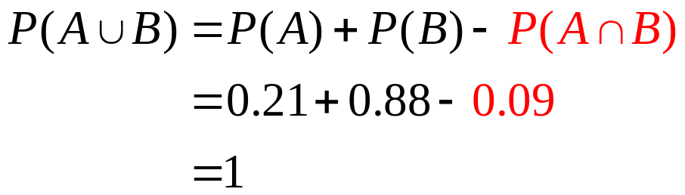
Union of Two Events
Example: US population by age
Let A be the event: “55 years of age or older.” Let B be the event:“64 years of age or younger.” Compute the probability of A or B.
AGE |  | Relative
LL | UL | Frequency
0 | 19 | 0.29
20 | 24 | 0.07
25 | 34 | 0.14
35 | 44 | 0.16
45 | 54 | 0.13
55 | 64 | 0.09
65 |  | 0.12
Totals |  | 1.00
Notes:
A & B are not M.E.

Slide 23
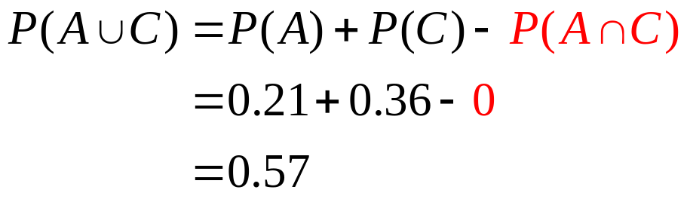
Union of Mutually Exclusive Events
Example: US population by age
Let A be the event “55 years of age or older.” Let C be the event“24 years of age or younger.” Compute the probability of A or C.
AGE |  | Relative
LL | UL | Frequency
0 | 19 | 0.29
20 | 24 | 0.07
25 | 34 | 0.14
35 | 44 | 0.16
45 | 54 | 0.13
55 | 64 | 0.09
65 |  | 0.12
Totals |  | 1.00
Notes:
A & B are not M.E.

Slide 24
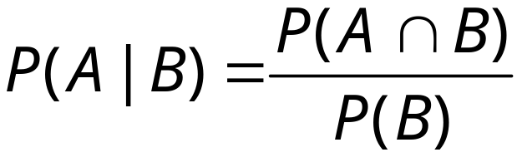
Conditional Probability
The conditional probability of A given B is denoted
by P(A|B).

Slide 25
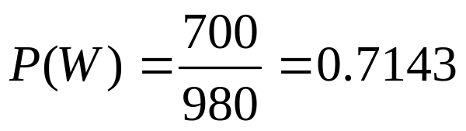
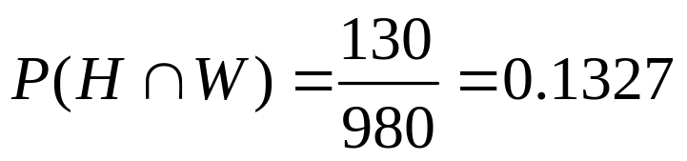
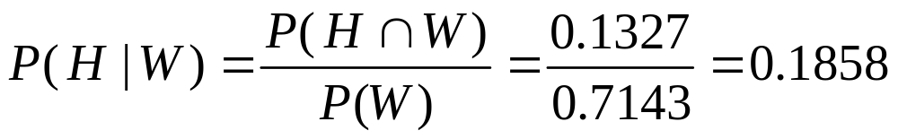
Conditional Probability
Example: Consider the hiring of black and white workers at BigMart
 | White (W) | Black (B) | Total
Hired (H) | 130 | 30 | 160
Not Hired (H^{c}) | 570 | 250 | 820
Total | 700 | 280 | 980

Slide 26
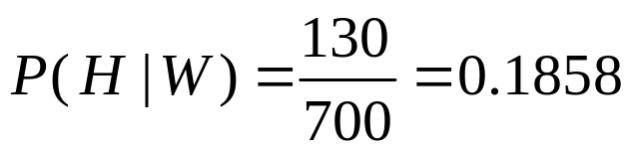
Conditional Probability
Example: Consider the hiring of black and white workers at BigMart
 | White (W) | Black (B) | Total
Hired (H) | 130 | 30 | 160
Not Hired (H^{c}) | 570 | 250 | 820
Total | 700 | 280 | 980

Slide 27
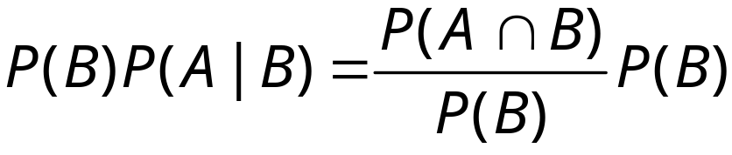


Multiplication Law For Dependent Events
The multiplication law provides a way to compute the
probability of the intersection of two events.
It is derived by manipulating the conditional probability:

Slide 28

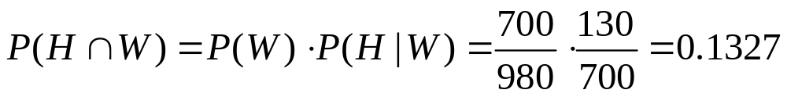
Multiplication Law For Dependent Events
Example: Consider the hiring of black and white workers at BigMart
 | White (W) | Black (B) | Total
Hired (H) | 130 | 30 | 160
Not Hired (H^{c}) | 570 | 250 | 820
Total | 700 | 280 | 980

Slide 29

Independent Events
If the probability of event A is not changed by the
existence of event B, we would say that events A
and B are independent.
Two events A and B are independent if:
P(A|B) = P(A)
P(B|A) = P(B)
or
This changes the multiplication law:

Slide 30
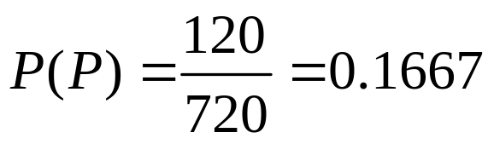
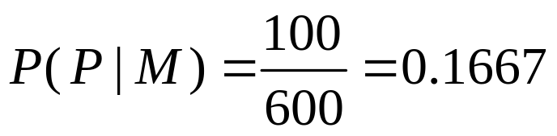
Independent Events
Example: Consider the promotion status of economists at some economic research think tank:
 | Men (M) | Women (W) | Total
Promoted (P) | 100 | 20 | 120
Not Promoted (N) | 500 | 100 | 600
Total | 600 | 120 | 720
“Getting the promotion” and “being male”
are independent events

Slide 31
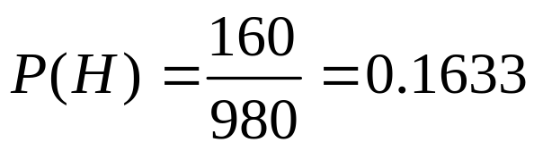
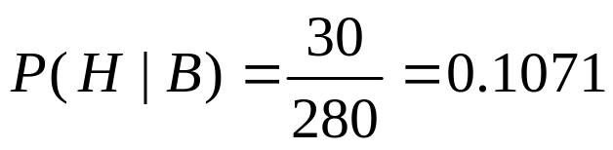
Independent Events
Example: Consider the hiring of black and white workers at BigMart
 | White (W) | Black (B) | Total
Hired (H) | 130 | 30 | 160
Not Hired (H^{c}) | 570 | 250 | 820
Total | 700 | 280 | 980
“Getting hired” and “being black” are not independent events
data_simpson.xls

Slide 32
Bayes’ Theorem
Tells us about how the probability of something changes
when we learn information.
For example, we know from a drug lab’s claim:
P(testing positive | employee is a druggie)
Since we fire druggies, we want to know:
P(employee is a druggie | testing positive)
To compute the latter we need additional information (e.g.,
the false positive rate, prevalence of drug use among our
employees)

Slide 33
Bayes’ Theorem
Example: Cocaine drug testing
We want to ensure that our employees are not taking drugs because this is a safety risk.
We contract with a laboratory that claims their drug test is 94% accurate but there is a 5% chance of a false positive.
Suppose we have 10,000 employees and that 1% of them are druggies. If an employee is found to be a druggie, we fire them for safety reasons.
P = test is Positive
N = test is Negative
D = employee is a Druggie
D^{c} = employee is NOT a Druggie

Slide 34
Bayes’ Theorem
Example: Cocaine drug testing
From the drug lab we know:
P(P | D) = 0.94
(accuracy of the test)
P(N | D) = 0.06
P(P | D^{c}) = 0.05
(false positive rate)
P(N | D^{c}) = 0.95
We believe:
P(D) = 0.01
(prevalence)
P(D^{c}) = 0.99

Slide 35
Bayes’ Theorem
Example: Cocaine drug testing
Prevalence
Drug Lab
Experimental
Outcomes
P(P|D) = .94
P(P ∩ D) = .0094
P(D) = .01
P(N|D) = .06
P(N ∩ D) = .0006
P(P) = .0589
P(N) = .9411
P(P|D^{c}) = .05
P(P ∩ D^{c}) = .0495
P(D^{c}) = .99
P(N|D^{c}) = .95
P(N ∩ D^{c}) = .9405

Slide 36
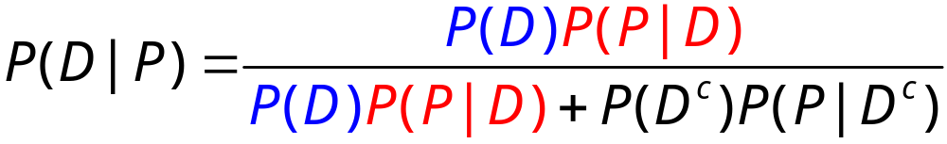
Bayes’ Theorem
Example: Cocaine drug testing
To find the (posterior) probability that an employee is a druggie
given he tested positive, we apply Bayes’ theorem.
Prevalence of drug use in our company.
The proportion of our employees that are not druggies.
The drug lab’s false positive rate.
The drug lab’s accuracy claim

Slide 37
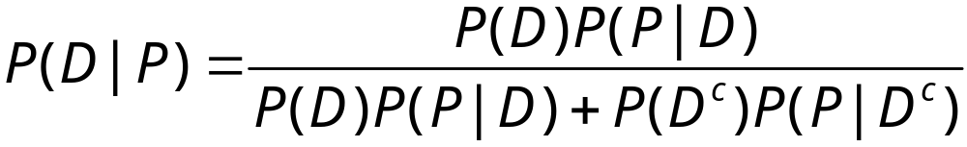
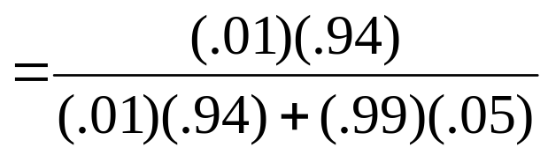
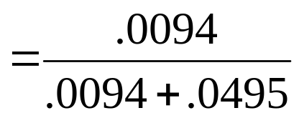
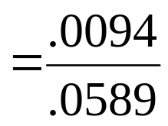
Bayes’ Theorem
Example: Cocaine drug testing
Q1 What is the probability a worker is a druggie given he tested positive for cocaine use?
= .1596

Slide 38
Bayes’ Theorem
Example: Cocaine drug testing
Q2 What is the probability a worker isn’t a druggie given he tested positive for cocaine use?
Q3 What is the probability a worker is a druggie given he did not test positive for cocaine use?
Q4 What is the probability a worker is NOT a druggie given he did not test positive for cocaine use?

