Slide 1
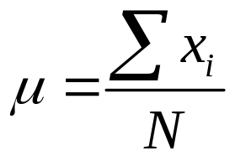
Measures of Location
The population mean of a data set is the average of all the data values.
Sum of the values
of the N observations
Number of
observations in
the population

Slide 2
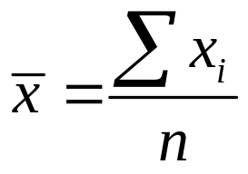
Measures of Location
The population mean of a data set is the average of all the data values.
The sample mean is the point estimator of the population mean μ.
Sum of the values
of the n observations
Number of
observations
in the sample

Slide 3
Measures of Location
Example: Recall the Hudson Auto Repair example
The manager of Hudson Auto would like to have better understanding of the cost of parts used in the engine tune-ups performed in the shop. She examines 50 customer invoices for tune-ups. The costs of parts, rounded to the nearest dollar, are listed below.
91 | 78 | 93 | 57 | 75 | 52 | 99 | 80 | 97 | 62
71 | 69 | 72 | 89 | 66 | 75 | 79 | 75 | 72 | 76
104 | 74 | 62 | 68 | 97 | 105 | 77 | 65 | 80 | 109
85 | 97 | 88 | 68 | 83 | 68 | 71 | 69 | 67 | 74
62 | 82 | 98 | 101 | 79 | 105 | 79 | 69 | 62 | 73
3949
78.98
50
Notes:
NOTE: You won’t know mu, the population mean.

Slide 4
Measures of Location
For an odd number of observations:
26
18
27
12
14
27
19
7 observations
in ascending order
the median is the middle value.
Notes:
Whenever a data set has extreme values, the median
is the preferred measure of central location.
A few extremely large incomes or property values
can inflate the mean.
The median is the measure of location most often
reported for annual income and property value data.

Slide 5
Measures of Location
For an even number of observations:
26
18
27
12
14
27
19
30
8 observations
in ascending order
the median is the average of the middle two values.
Median = (19 + 26)/2 = 22.5

Slide 6
Measures of Location
Example: Hudson Auto Repair
Averaging the 25th and 26th data values:
Median
= (75 + 76)/2 = 75.5
52 | 57 | 62 | 62 | 62 | 62 | 65 | 66 | 67 | 68
68 | 68 | 69 | 69 | 69 | 71 | 71 | 72 | 72 | 73
74 | 74 | 75 | 75 | 75 | 76 | 77 | 78 | 79 | 79
79 | 80 | 80 | 82 | 83 | 85 | 88 | 89 | 91 | 93
97 | 97 | 97 | 98 | 99 | 101 | 104 | 105 | 105 | 109
Note: Data is in ascending order.

Slide 7
Measures of Location
Example: Hudson Auto Repair
Mode
= 62
52 | 57 | 62 | 62 | 62 | 62 | 65 | 66 | 67 | 68
68 | 68 | 69 | 69 | 69 | 71 | 71 | 72 | 72 | 73
74 | 74 | 75 | 75 | 75 | 76 | 77 | 78 | 79 | 79
79 | 80 | 80 | 82 | 83 | 85 | 88 | 89 | 91 | 93
97 | 97 | 97 | 98 | 99 | 101 | 104 | 105 | 105 | 109
Note: Data is in ascending order.

Slide 8
Measures of Location
Example: Hudson Auto Repair
First quartile = 25th percentile
i^{th} = (p/100)n =
(25/100)50
= 12.5
= 13th
First quartile = 69
52 | 57 | 62 | 62 | 62 | 62 | 65 | 66 | 67 | 68
68 | 68 | 69 | 69 | 69 | 71 | 71 | 72 | 72 | 73
74 | 74 | 75 | 75 | 75 | 76 | 77 | 78 | 79 | 79
79 | 80 | 80 | 82 | 83 | 85 | 88 | 89 | 91 | 93
97 | 97 | 97 | 98 | 99 | 101 | 104 | 105 | 105 | 109
Note: Data is in ascending order.
Notes:
Quartiles are specific percentiles.
First Quartile = 25th Percentile
Second Quartile = 50th Percentile = Median
Third Quartile = 75th Percentile
If i is not an integer, round up. The next integer greater than i denotes the position of the pth percentile.
If i is an integer, the pth percentile is the average of the values in positions i and i + 1.

Slide 9
Measures of Location
Example: Hudson Auto Repair
i^{th} = (p/100)n =
(80/100)50
= 40th
Average the 40th and 41st data values
80th Percentile =
= 95
(93 + 97)/2
52 | 57 | 62 | 62 | 62 | 62 | 65 | 66 | 67 | 68
68 | 68 | 69 | 69 | 69 | 71 | 71 | 72 | 72 | 73
74 | 74 | 75 | 75 | 75 | 76 | 77 | 78 | 79 | 79
79 | 80 | 80 | 82 | 83 | 85 | 88 | 89 | 91 | 93
97 | 97 | 97 | 98 | 99 | 101 | 104 | 105 | 105 | 109
Note: Data is in ascending order.

Slide 10
Measures of Location
Example: Hudson Auto Repair:
80th Percentile
52 | 57 | 62 | 62 | 62 | 62 | 65 | 66 | 67 | 68
68 | 68 | 69 | 69 | 69 | 71 | 71 | 72 | 72 | 73
74 | 74 | 75 | 75 | 75 | 76 | 77 | 78 | 79 | 79
79 | 80 | 80 | 82 | 83 | 85 | 88 | 89 | 91 | 93
97 | 97 | 97 | 98 | 99 | 101 | 104 | 105 | 105 | 109
95
Note: Data is in ascending order.
Notes:
At least 80% of the items take on a value of 95 or less.
40/50 = .8 or 80%
At least 20% of the items take on a value of 95 or more
10/50 = .2 or 20%

Slide 11
Pelican Stores -- continued
Pelican Stores is chain of women’s apparel stores. It recently ran a promotion in which discount coupons were set to customers of other National Clothing stores. Data collected for a sample of 100 in-store credit card transactions at Pelican Stores during one day while the promotion was running are shown in Table 2.18. Customers who made a purchase using a discount coupon are referred to as promotional customers and customers who made a purchase but did not use a discount coupon are referred to as regular customers. Because the promotional coupons were not set to regular Pelican Stores customers, management considers the sales made to people presenting the promotional coupons as sales it would not otherwise make.
Pelican’s management would like to use this sample data to learn about its customer base and to evaluate the promotion involving discounts.
Managerial Report
Using graphs and tables, summarize the qualitative variables.
Using graphs and tables, summarize the quantitative variables.
Using pivot tables and scatter plots, summarize the variables.
Compute the mean, mode, median, and the 25th and 75th percentiles.
data_pelican.xls
Notes:
From the crosstabulation it appears that net sales are larger for promotional customers.
Age is not a factor in determining net sales.

Slide 12
Measures of Variability
Example: Hudson Auto Repair
Range = maximum – minimum
Range = 109 – 52 = 57
52 | 57 | 62 | 62 | 62 | 62 | 65 | 66 | 67 | 68
68 | 68 | 69 | 69 | 69 | 71 | 71 | 72 | 72 | 73
74 | 74 | 75 | 75 | 75 | 76 | 77 | 78 | 79 | 79
79 | 80 | 80 | 82 | 83 | 85 | 88 | 89 | 91 | 93
97 | 97 | 97 | 98 | 99 | 101 | 104 | 105 | 105 | 109
Note: Data is in ascending order.
Notes:
Range
Interquartile range
Variance
Standard Deviation
If the measures are computed for data
from a sample, they are called sample statistics.
If the measures are computed for data from a
population, they are called population parameters.
A sample statistic is referred to as the point estimator
of the corresponding population parameter.
100% of the data are within the range.

Slide 13
Measures of Variability
Example: Hudson Auto Repair
3rd Quartile (Q3) = 89
1st Quartile (Q1) = 69
Interquartile Range
= Q3 – Q1
= 20
= 89 – 69
52 | 57 | 62 | 62 | 62 | 62 | 65 | 66 | 67 | 68
68 | 68 | 69 | 69 | 69 | 71 | 71 | 72 | 72 | 73
74 | 74 | 75 | 75 | 75 | 76 | 77 | 78 | 79 | 79
79 | 80 | 80 | 82 | 83 | 85 | 88 | 89 | 91 | 93
97 | 97 | 97 | 98 | 99 | 101 | 104 | 105 | 105 | 109
Note: Data is in ascending order.
Notes:
50% of the data are within the IQR

Slide 14
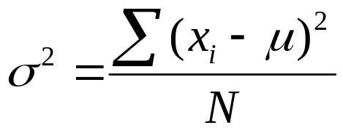
Measures of Variability
The population variance is the average variation
The population
mean

Slide 15
Measures of Variability
The population variance is the average variation
i ^{th} deviation
from the population
mean

Slide 16
Measures of Variability
The population variance is the average variation
i ^{th} squared
deviation from the
population mean

Slide 17
Measures of Variability
The population variance is the average variation
Sum of squared
deviations from
the population mean

Slide 18
Measures of Variability
The population variance is the average variation
Total variation of x

Slide 19
Measures of Variability
The population variance is the average variation
Number of
observations in
the population

Slide 20
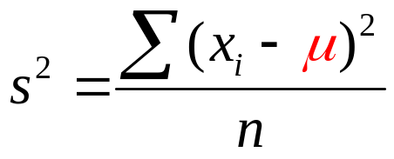
Measures of Variability
The population variance is the average variation
The sample variance is an unbiased estimator of σ ²
Number of
observations in
the sample
Notes:
If the population mean is known but the population
variance is not, the variance from a sample of size
n would be

Slide 21
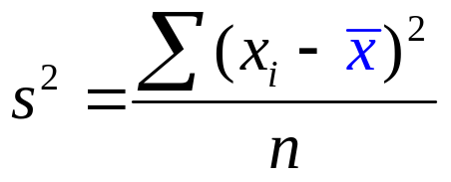
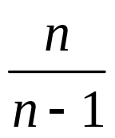
Measures of Variability
The population variance is the average variation
The sample variance is an unbiased estimator of σ ²
Notes:
Since the population mean is unknown in most cases,
the sample mean is used instead.
Dividing by n makes the estimator of the sample standard deviation biased.
Multiplying it by n/(n – 1) eliminates the bias.

Slide 22
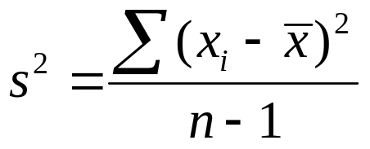
Measures of Variability
The population variance is the average variation
The sample variance is an unbiased estimator of σ ²
Degrees
of freedom
Notes:
Since the population mean is unknown in most cases,
the sample mean is used instead.
Dividing by n makes the estimator of the sample standard deviation biased.
Multiplying it by n/(n – 1) eliminates the bias.

Slide 23


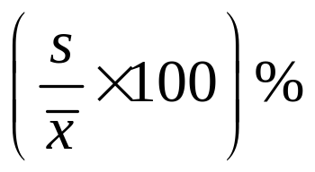
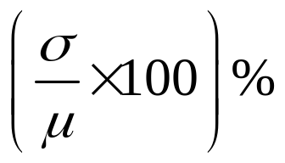
Measures of Variability
Notes:
The standard deviation of a data set is the positive
square root of the variance.
It is measured in the same units as the data, making
it more easily interpreted than the variance.
The coefficient of variation indicates how large the
standard deviation is in relation to the mean.

Slide 24
Measures of Variability
x = 78.98
Sorted invoices | Observed value | Sqrd Dev from the mean
1 | 52 | 727.92
2 | 57 | 483.12
3 | 62 | 288.32
4 | 62 | 288.32
5 | 62 | 288.32
6 | 62 | 288.32
7 | 65 | 195.44
49 | 105 | 677.04
50 | 109 | 901.20
Sum | 3949 | 9592.98

Slide 25
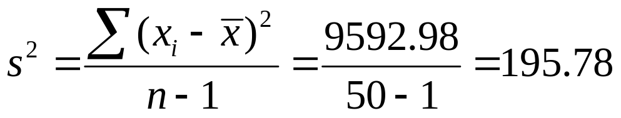
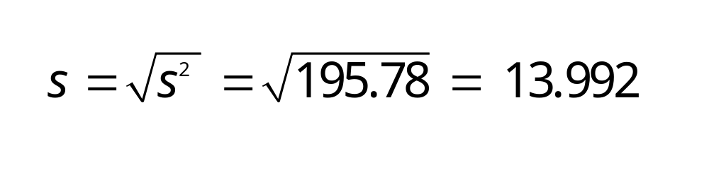
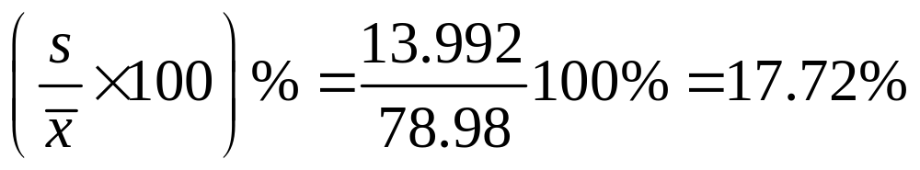
Measures of Variability
Example: Hudson Auto Repair
Variance
Standard Deviation
Coefficient of variation

Slide 26
Pelican Stores -- continued
Pelican Stores is chain of women’s apparel stores. It recently ran a promotion in which discount coupons were set to customers of other National Clothing stores. Data collected for a sample of 100 in-store credit card transactions at Pelican Stores during one day while the promotion was running are shown in Table 2.18. Customers who made a purchase using a discount coupon are referred to as promotional customers and customers who made a purchase but did not use a discount coupon are referred to as regular customers. Because the promotional coupons were not set to regular Pelican Stores customers, management considers the sales made to people presenting the promotional coupons as sales it would not otherwise make.
Pelican’s management would like to use this sample data to learn about its customer base and to evaluate the promotion involving discounts.
Managerial Report
Using graphs and tables, summarize the qualitative variables.
Using graphs and tables, summarize the quantitative variables.
Using pivot tables and scatter plots, summarize the variables.
Compute the mean, mode, median, and the 25th and 75th percentiles.
Compute the range, IQR, variance, and standard deviations.
data_pelican.xls
Notes:
From the crosstabulation it appears that net sales are larger for promotional customers.
Age is not a factor in determining net sales.

Slide 27
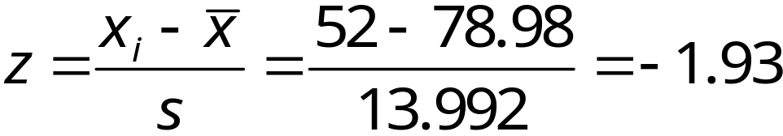
Measures of Shape
Example: Hudson Auto Repair
z-Score of Smallest Value
52 | 57 | 62 | 62 | 62 | 62 | 65 | 66 | 67 | 68
68 | 68 | 69 | 69 | 69 | 71 | 71 | 72 | 72 | 73
74 | 74 | 75 | 75 | 75 | 76 | 77 | 78 | 79 | 79
79 | 80 | 80 | 82 | 83 | 85 | 88 | 89 | 91 | 93
97 | 97 | 97 | 98 | 99 | 101 | 104 | 105 | 105 | 109
Note: Data is in ascending order.
Notes:
An observation’s z-score is a measure of the relative
location of the observation in a data set.
THE MOST IMPORTANT TOPIC IN CHAPTERS 1-8!!!

Slide 28
Measures of Shape
x = 78.98
s = 13.992
Observed value | Dev from the mean | z-score
52 | -26.98 | -1.93
57 | -21.98 | -1.57
62 | -16.98 | -1.21
62 | -16.98 | -1.21
62 | -16.98 | -1.21
62 | -16.98 | -1.21
65 | -13.98 | -1.00
105 | 26.02 | 1.86
109 | 30.02 | 2.15
3949 | 0 | 0

Slide 29
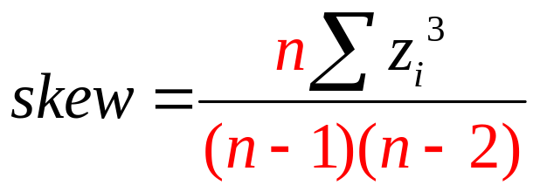
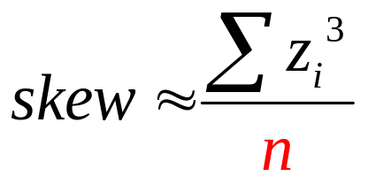
Measures of Shape
An important measure of the shape of a distribution is called skewness.
It is just the average of the n cubed z-scores when n is “large”

Slide 30
Measures of Shape
Observed value | z-score | cubed z-score
52 | -1.93 | -7.17
57 | -1.57 | -3.88
62 | -1.21 | -1.79
62 | -1.21 | -1.79
62 | -1.21 | -1.79
62 | -1.21 | -1.79
65 | -1.00 | -1.00
105 | 1.86 | 6.43
109 | 2.15 | 9.88
3949 | 0 | 22.567

Slide 31
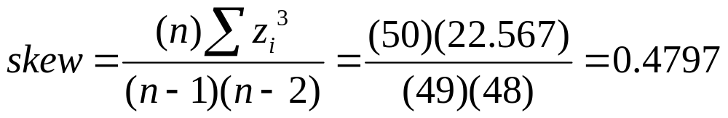
Measures of Shape
Tune-up Parts Cost
18
16
14
12
10
Frequency
8
6
4
2
$75.50
Parts
Cost ($)
$62
$78.98
50 60 70 80 90 100 110

Slide 32
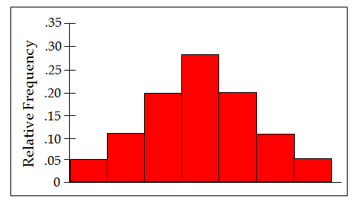
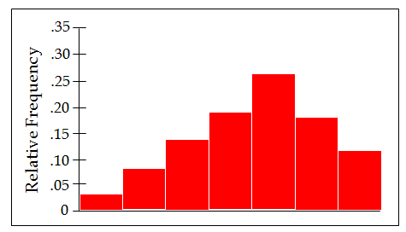
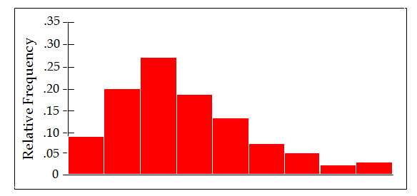
Measures of Shape
Symmetric
Moderately Skewed Left
skew = 0
skew = − .31
Highly Skewed Right
skew = 1.25

Slide 33
Measures of Shape
Chebyshev's Theorem:
At least (1 - 1/z²) of the data values are within z
standard deviations of the mean.
At least 0% of the data values are within 1
standard deviation of the mean
At least 75% of the data values are within 2
standard deviations of the mean
At least 89% of the data values are within 3
standard deviations of the mean
At least 94% of the data values are within 4
standard deviations of the mean

Slide 34
Measures of Shape
Empirical Rule:
68.26% of the data values are within 1
standard deviation of the mean
95.44% of the data values are within 2
standard deviations of the mean
99.74% of the data values are within 3
standard deviations of the mean
99.99% of the data values are within 4
standard deviations of the mean

Slide 35
Measures of Shape
z-score | Is the observation within 2 std dev?
-1.93 | Yes
-1.57 | Yes
-1.21 | Yes
-1.21 | Yes
-1.21 | Yes
-1.21 | Yes
-1.00 | Yes
1.86 | Yes
2.15 | No
49 of the 50 data values are within 2 s of the mean = 98%
50 of the 50 data values are within 3 s of the mean = 100%
None of the values are outliers
Notes:
An outlier is an unusually small or unusually large
value in a data set.
A data value with a z-score less than -3 or greater
than +3 might be considered an outlier.
It might be:
an incorrectly recorded data value
a data value that was incorrectly included in the data set
a correctly recorded data value that belongs in the data set

Slide 36
Pelican Stores -- continued
Pelican Stores is chain of women’s apparel stores. It recently ran a promotion in which discount coupons were set to customers of other National Clothing stores. Data collected for a sample of 100 in-store credit card transactions at Pelican Stores during one day while the promotion was running are shown in Table 2.18. Customers who made a purchase using a discount coupon are referred to as promotional customers and customers who made a purchase but did not use a discount coupon are referred to as regular customers. Because the promotional coupons were not set to regular Pelican Stores customers, management considers the sales made to people presenting the promotional coupons as sales it would not otherwise make.
Pelican’s management would like to use this sample data to learn about its customer base and to evaluate the promotion involving discounts.
Managerial Report
Using graphs and tables, summarize the qualitative variables.
Using graphs and tables, summarize the quantitative variables.
Using pivot tables and scatter plots, summarize the variables.
Compute the mean, mode, median, and the 25th and 75th percentiles.
Compute the range, IQR, variance, and standard deviations.
Compute the z-scores and skew, find the outliers, and count the observations that are within 1, 2, & 3 standard deviations of the mean.
data_pelican.xls
Notes:
From the crosstabulation it appears that net sales are larger for promotional customers.
Age is not a factor in determining net sales.

Slide 37
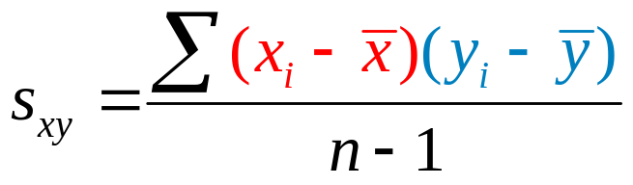
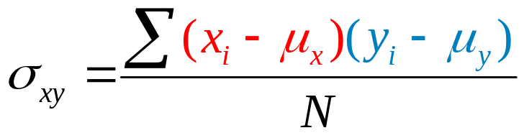
Measures of the relationship between 2 variables
The covariance is computed as follows:
(for samples)
(for populations)
Notes:
Covariance
Correlation Coefficient
If the measures are computed for data
from a sample, they are called sample statistics.
If the measures are computed for data from a
population, they are called population parameters.
A sample statistic is referred to as the point estimator
of the corresponding population parameter.

Slide 38
Measures of the relationship between 2 variables
The covariance is computed as follows:
(for samples)
i ^{th} deviation
from x’s means
(for populations)

Slide 39
Measures of the relationship between 2 variables
The covariance is computed as follows:
(for samples)
i ^{th} deviation
from y’s means
(for populations)

Slide 40
Measures of the relationship between 2 variables
The covariance is computed as follows:
(for samples)
The sizes of the
sample and
population
(for populations)

Slide 41
Measures of the relationship between 2 variables
The covariance is computed as follows:
(for samples)
Degrees of
freedom
(for populations)

Slide 42
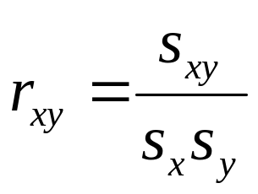
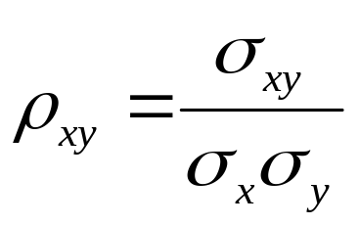
Measures of the relationship between 2 variables
The covariance is computed as follows:
Notes:
Correlation is a measure of linear association not
necessarily causation.
High correlation between two variables does not mean
that one variable is the cause of the other.

Slide 43
Measures of the relationship between 2 variables
Example: Reed Auto Sales
Reed Auto periodically has a special week-long sale. As part of the advertising campaign Reed runs one or more television commercials during the weekend preceding the sale. Data from a sample of 5 previous sales are shown below.
Number of TV Ads
(x)
Number of Cars Sold
(y)
1
3
2
1
3
14
24
18
17
27

Slide 44
Measures of the relationship between 2 variables
Example: Reed Auto Sales
35
30
25
Cars sold
20
15
10
5
0
0
1
2
3
4
TV Ads

Slide 45
Measures of the relationship between 2 variables
Example: Reed Auto Sales
x
y
x – x
(x – x)²
y – y
(y – y)²
(x – x)
(y – y)
1
3
2
1
3
14
24
18
17
27
1
3
2
1
3
−
−
−
−
−
2
2
2
2
2
1
1
0
1
1
14
24
18
17
27
−
−
−
−
−
20
20
20
20
20
36
16
4
9
49
6
4
0
3
7
10 .
100 .
4 .
114 .
20 .
5
5
4
4
4
x
= 2
y
= 20
s_{xx}
= 1
s_{yy}
= 28.5
s_{xy}
= 5
(ads)
(cars)
(ads squared)
(cars squared)
(ads-cars)
s_{x}
= 1
s_{y}
= 5.34
(ads)
(cars)

Slide 46
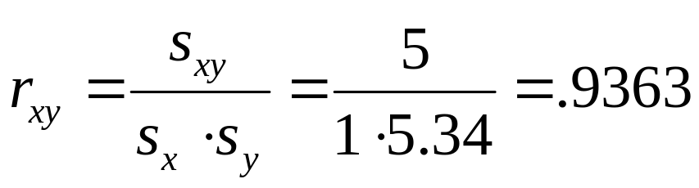
Measures of the relationship between 2 variables
Example: Reed Auto Sales
s_{xy}
= 5
(ads-cars)
s_{x}
= 1
s_{y}
= 5.34
(ads)
(cars)
(ads-cars)
(ads)
(cars)

Slide 47
Pelican Stores -- continued
Pelican Stores is chain of women’s apparel stores. It recently ran a promotion in which discount coupons were set to customers of other National Clothing stores. Data collected for a sample of 100 in-store credit card transactions at Pelican Stores during one day while the promotion was running are shown in Table 2.18. Customers who made a purchase using a discount coupon are referred to as promotional customers and customers who made a purchase but did not use a discount coupon are referred to as regular customers. Because the promotional coupons were not set to regular Pelican Stores customers, management considers the sales made to people presenting the promotional coupons as sales it would not otherwise make.
Pelican’s management would like to use this sample data to learn about its customer base and to evaluate the promotion involving discounts.
Managerial Report
Using graphs and tables, summarize the qualitative variables.
Using graphs and tables, summarize the quantitative variables.
Using pivot tables and scatter plots, summarize the variables.
Compute the mean, mode, median, and the 25th and 75th percentiles.
Compute the range, IQR, variance, and standard deviations.
Compute the z-scores and skew, find the outliers, and count the observations that are within 1, 2, & 3 standard deviations of the mean.
Compute the covariances and correlations.
data_pelican.xls
Notes:
From the crosstabulation it appears that net sales are larger for promotional customers.
Age is not a factor in determining net sales.

