Slide 1
Are the number of bedrooms, square feet, and HVAC significant predictors of monthly rent in the multiple regression model
we estimated in class?
Hal Snarr
Westminster College
Salt Lake City, UT
Professor
Economics
Spring 2016 semester
April 12, 2016

Slide 2

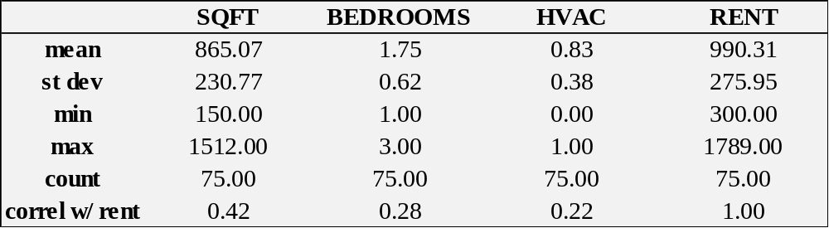
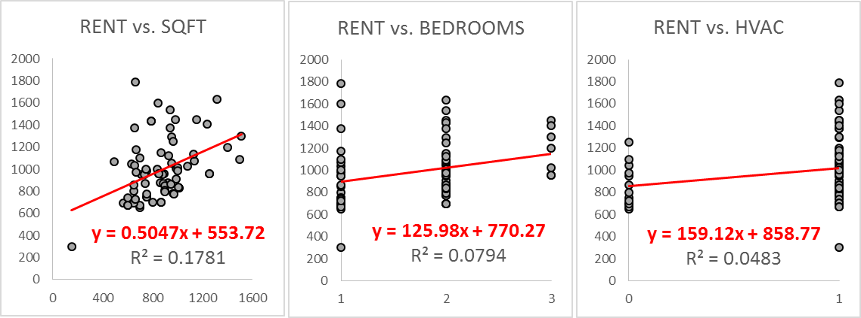
Descriptive Statistics

Slide 3
Simple Regression 1
I estimated the following simple regression model
y = β ₀ + β ₅· x₅ + ε
where
y = monthly rent
x₅ = number of bedrooms
β ₅ = the variable’s coefficient that cannot be known, but can be estimated
ε = the errors that cannot be known, but can be estimated
The coefficient significance test for number of bedrooms:
H₀: β ₅ = 0
H_{a}: β ₅ < > 0

Slide 4
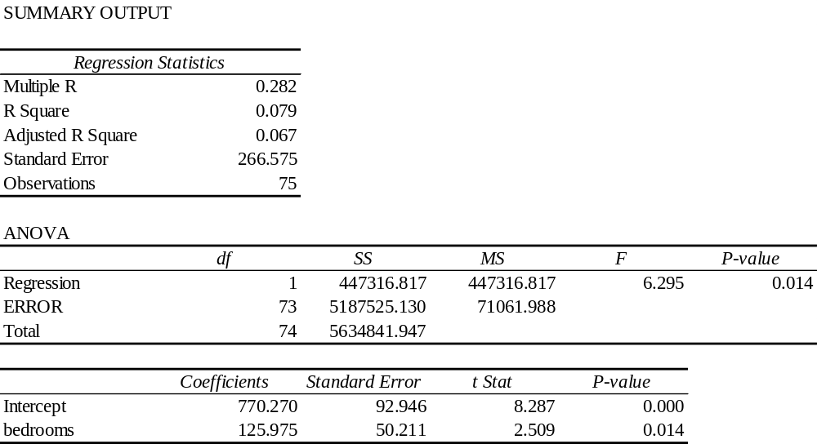
Simple Regression 1
Notes:
The R-square implies that 14% of the variation in monthly rent is explained by the model, number of bedrooms.
For the null hypothesis of the number of bedrooms coefficient test, Ho: B9 = 0, with degrees of freedom equal to 99, the critical values are +/-1.660 at 10% significance. The coefficient’s t-stat (3.96) is NOT IN between the critical values, which implies coefficient 201.91 is significant at the 10% level. Thus, we reject the null hypothesis at 10% significance.
So, holding all else equal, increasing the number of bedrooms by one raises SLC monthly rent by $201.91.

Slide 5
Simple Regression 2
I estimated the following simple regression model
y = β ₀ + β ₅· x₅ + ε
where
y = monthly rent
x₅ = number of bedrooms
β ₅ = the variable’s coefficient that cannot be known, but can be estimated
ε = the errors that cannot be known, but can be estimated
The coefficient significance test for number of bedrooms:
H₀: β ₅ = 0
H_{a}: β ₅ < > 0

Slide 6
Simple Regression 2
Notes:
The R-square implies that 14% of the variation in monthly rent is explained by the model, number of bedrooms.
For the null hypothesis of the number of bedrooms coefficient test, Ho: B9 = 0, with degrees of freedom equal to 99, the critical values are +/-1.660 at 10% significance. The coefficient’s t-stat (3.96) is NOT IN between the critical values, which implies coefficient 201.91 is significant at the 10% level. Thus, we reject the null hypothesis at 10% significance.
So, holding all else equal, increasing the number of bedrooms by one raises SLC monthly rent by $201.91.

Slide 7
Simple Regression 3
I estimated the following simple regression model
y = β ₀ + β ₅· x₅ + ε
where
y = monthly rent
x₅ = number of bedrooms
β ₅ = the variable’s coefficient that cannot be known, but can be estimated
ε = the errors that cannot be known, but can be estimated
The coefficient significance test for number of bedrooms:
H₀: β ₅ = 0
H_{a}: β ₅ < > 0

Slide 8
Simple Regression 3
Notes:
The R-square implies that 14% of the variation in monthly rent is explained by the model, number of bedrooms.
For the null hypothesis of the number of bedrooms coefficient test, Ho: B9 = 0, with degrees of freedom equal to 99, the critical values are +/-1.660 at 10% significance. The coefficient’s t-stat (3.96) is NOT IN between the critical values, which implies coefficient 201.91 is significant at the 10% level. Thus, we reject the null hypothesis at 10% significance.
So, holding all else equal, increasing the number of bedrooms by one raises SLC monthly rent by $201.91.

Slide 9
Multiple Regression 1
coefficient significance t tests
I estimated the following multiple regression model
y = β ₀ + β ₉· x₉ + β ₉· x₉ + β ₉· x₉ + ε
where
y = monthly rent
x₉ = number of bedrooms
β ₉ = number of bedroom’s coefficient that cannot be known, but can be estimated
x₉ = number of bedrooms
β ₉ = number of bedroom’s coefficient that cannot be known, but can be estimated
x₉ = number of bedrooms
β ₉ = number of bedroom’s coefficient that cannot be known, but can be estimated
ε = the errors that cannot be known, but can be estimated
The coefficient significance test for number of bedrooms:
H₀: β ₉ = 0 H_{a}: β ₉ < > 0
The coefficient significance test for number of bedrooms:
H₀: β ₉ = 0 H_{a}: β ₉ < > 0
The coefficient significance test for number of bedrooms:
H₀: β ₉ = 0 H_{a}: β ₉ < > 0

Slide 10
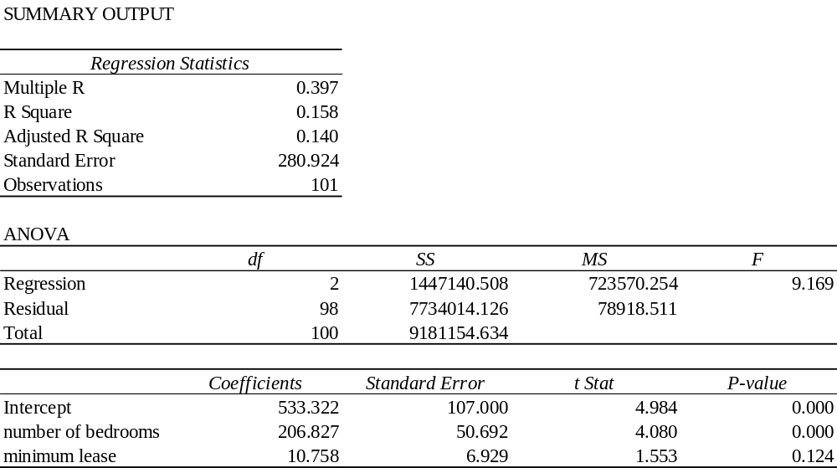
Multiple Regression 1
coefficient significance t tests
Notes:
The adjusted R-square implies that 14% of the variation in monthly rent is explained by the model, number of bedrooms and minimum lease length.
For the null hypothesis of the number of bedrooms coefficient test, Ho: B9 = 0, with degrees of freedom equal to 98, the critical values are +/-1.661 at 10% significance. The coefficient’s t-stat (4.080) is NOT IN between the critical values, which implies coefficient 206.83 is significant at the 10% level. Thus, we reject the null hypothesis at 10% significance.
So, holding all else equal, increasing the number of bedrooms by one raises SLC monthly rent by $206.83
For the null hypothesis of the minimum lease length coefficient test, Ho: B5 = 0, with degrees of freedom equal to 98, the critical values are +/-1.661 at 10% significance. The coefficient’s t-stat (1.553) is IN BETWEEN the critical values, which implies coefficient 10.76 is INSIGNIFICANT at the 10% level. Thus, we CANNOT reject the null hypothesis at 10% significance.
So, holding all else equal, increasing minimum lease length for a SLC rental does NOT affect the monthly.

Slide 11
Multiple Regression 1
model significance F test
I estimated the following multiple regression model
y = β ₀ + β ₉· x₉ + β ₉· x₉ + β ₉· x₉ + ε
where
y = monthly rent
x₉ = number of bedrooms
β ₉ = number of bedroom’s coefficient that cannot be known, but can be estimated
x₉ = number of bedrooms
β ₉ = number of bedroom’s coefficient that cannot be known, but can be estimated
x₉ = number of bedrooms
β ₉ = number of bedroom’s coefficient that cannot be known, but can be estimated
ε = the errors that cannot be known, but can be estimated
There is one model significance test:
H₀: β ₉ = β ₉ = β ₉ = 0
H_{a}: β _{k} < > 0

Slide 12
Multiple Regression 1
model significance F test
Notes:
For the null hypothesis of the model test, Ho: B9 = B5 = 0, with numerator degrees of freedom equal to 2 and denominator degrees of freedom equal to 98, the critical value is 2.36 at 10% significance. The F-stat (9.169) is greater than the critical value. Thus, we reject the null hypothesis at 10% significance. So, the model is significant.

Slide 13
Multiple Regression 2
coefficient significance t tests
In class, we estimated the following regression model
y = β ₀ + β ₁ · x₁ + β ₂ · x₂ + ··· + β ₃₀ · x₃₀ + ε
where
y = monthly rent
x = the independent variables (number of bedrooms, number of bathrooms…)
β = the parameters that cannot be known, but can be estimated
ε = the errors that cannot be known, but can be estimated
Although there are 30 individual significance tests, one for each variable in our multiple regression, I will conduct only the following significance tests for number of bedrooms, number of bedrooms, and number of bedrooms.
H₀: β ₉ = 0 H_{a}: β ₉ < > 0
H₀: β ₉ = 0 H_{a}: β ₉ < > 0
H₀: β ₉ = 0 H_{a}: β ₉ < > 0

Slide 14
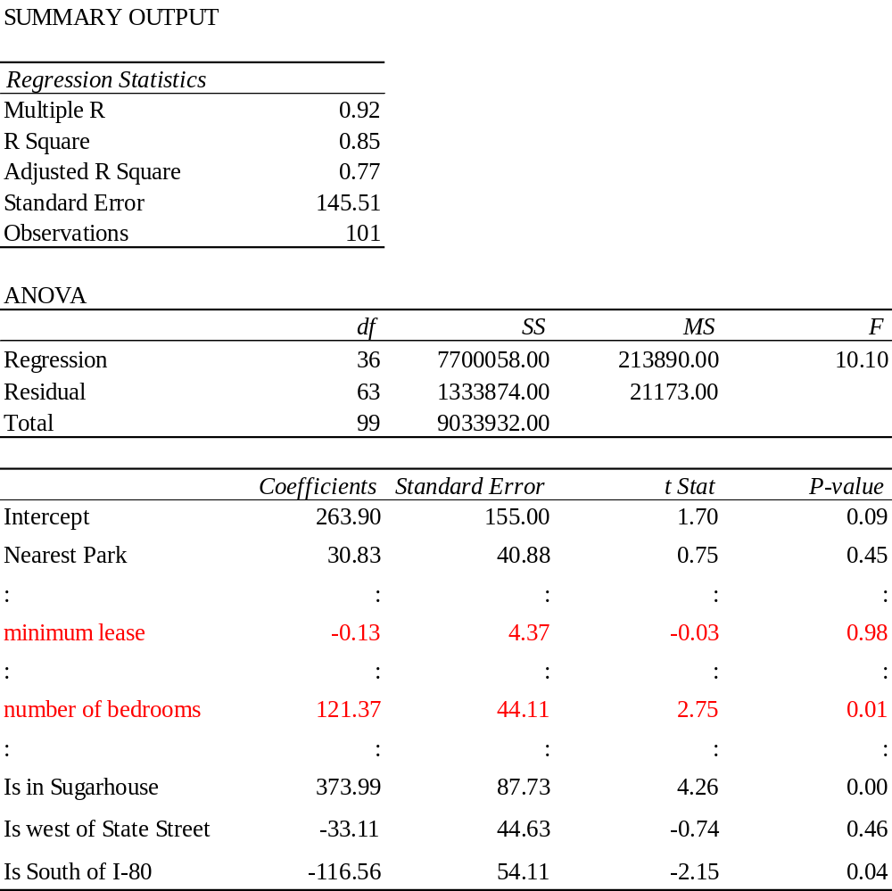
Multiple Regression 2
coefficient significance t tests
Notes:
The adjusted R-square implies that 77% of the variation in monthly rent is explained by the model, the 36 independent variables.
For the null hypothesis of the number of bedrooms coefficient test, Ho: B9 = 0, with degrees of freedom equal to 63, the critical values are +/-1.669 at 10% significance. The coefficient’s t-stat (2.75) is NOT IN between the critical values, which implies coefficient 121.37 is significant at the 10% level. Thus, we reject the null hypothesis at 10% significance.
So, holding all else equal, increasing the number of bedrooms by one raises SLC monthly rent by $121.37
For the null hypothesis of the minimum lease length coefficient test, Ho: B5 = 0, with degrees of freedom equal to 63, the critical values are +/-1.669 at 10% significance. The coefficient’s t-stat (-0.03) is IN BETWEEN the critical values, which implies coefficient -0.13 is INSIGNIFICANT at the 10% level. Thus, we CANNOT reject the null hypothesis at 10% significance.
So, holding all else equal, increasing minimum lease length for a SLC rental does NOT affect the monthly.

Slide 15
Multiple Regression 2
model significance F test
In class, we estimated the following regression model
y = β ₀ + β ₁ · x₁ + β ₂ · x₂ + ··· + β ₃₀ · x₃₀ + ε
where
y = monthly rent
x = the independent variables (number of bedrooms, number of bathrooms…)
β = the parameters that cannot be known, but can be estimated
ε = the errors that cannot be known, but can be estimated
There is one model significance test:
H₀: β ₁ = β ₂ = … = β ₃₀ = 0
H_{a}: β _{k} < > 0

Slide 16
Multiple Regression 2
model significance F test
Notes:
For the null hypothesis of the model test, Ho: B1 = B2 = … = B36 =0, with numerator degrees of freedom equal to 36 and denominator degrees of freedom equal to 63, the critical value is 1.44 at 10% significance.
The F-stat (10.10) is greater than the critical value. Thus, we reject the null hypothesis at 10% significance. So, the model is significant.

Slide 17
Conclusions
The F test in the multiple regression indicated that our final regression model was significant, not all of the 30 coefficients are zero.
The adjusted R² implies that 77% of the variation in monthly rent is explained by the model, the 36 independent variables.
The coefficient of number of bedrooms decreased from a value of around 200 in our early specifications to 121.37 in the final multiple regression specification.
  It was significant predictor of rent
  Its coefficient implies: holding all else equal, increasing the number of
  bedrooms by one raises SLC monthly rent by $121.37
The coefficient of number of bedrooms decreased from a value of around 200 in our early specifications to 121.37 in the final multiple regression specification.
  It was significant predictor of rent
  Its coefficient implies: holding all else equal, increasing the number of
  bedrooms by one raises SLC monthly rent by $121.37
The coefficient of number of bedrooms decreased from a value of around 200 in our early specifications to 121.37 in the final multiple regression specification.
  It was significant predictor of rent
  Its coefficient implies: holding all else equal, increasing the number of
  bedrooms by one raises SLC monthly rent by $121.37

