Slide 1

Money & Banking
Video 05—Monetary Policy in Action
Aggregate Demand and Supply Analysis (Chapter 22)
Monetary Policy Theory (Chapter 23)
Hal W. Snarr
8/20/2015

Slide 2
Chapter 22
Aggregate Demand and Supply Analysis

Slide 3


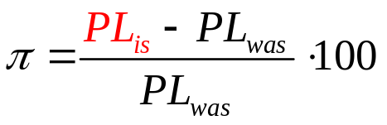
Monetary Economics AD-AS
Aggregate Demand
Aggregate Demand is made up of four component parts:
The PL is missing above, but the Quantity Theory of Money (QTM) implies the AD is downward sloping:

Slide 4

Monetary Economics AD-AS
Aggregate Demand
QTM: The quantity of real GDP demanded decreases in π.
π
AD
Y
Notes:
… income because people with higher incomes have more transactions
… wealth because people with greater wealth have more resources to put into money
… risk of other assets because this makes money less risky, and more desirable
… payment technology because less need for holding money for transactions
… inflation risk because holding money is more risky, and less desirable
… increased liquidity of other assets because money is relatively less liquid, and less desirable

Slide 5
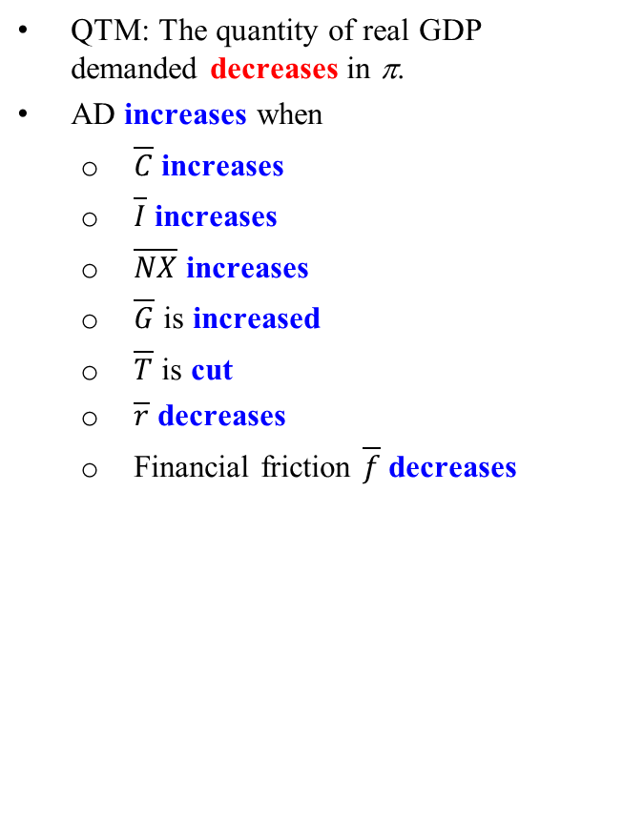
Monetary Economics AD-AS
Aggregate Demand
QTM: The quantity of real GDP demanded decreases in π.
AD increases when
  $\overline{C}$ increases
  $\overline{I}$ increases
  $\overline{NX}$ increases
  $\overline{G}$ is increased
  $\overline{T}$ is cut
  $\overline{r}$ decreases
  Financial friction $\overline{f}$ decreases
π
AD
Y
Notes:
Financial friction are additional costs of borrowing associated with asymmetric information problems in financial markets.
The Congress and President are in charge of fiscal policy.
Expansionary fiscal policy involves a cut in T and/or increase in G
Restrictive fiscal policy involves a raising T and/or cutting G
The Federal Reserve (our central bank) is in charge of monetary policy
Expansionary monetary policy involves lowering the federal funds interest rate
Restrictive monetary policy involves raising the federal funds interest rate

Slide 6
Monetary Economics AD-AS
Aggregate Demand
Example:
  Consumption expenditures are 11 trillion dollars, investment expenditures are 9 trillion dollars, trade deficit equals 0.25 trillion dollars, the fiscal budget deficit is 0.75 trillion dollars, real rate of interest is 2 percent, and financial friction is 2. Assuming AD’s slope is 0.5.
π
Y

Slide 7
Monetary Economics AD-AS
Aggregate Demand
Example:
  Consumption expenditures are 11 trillion dollars, investment expenditures are 9 trillion dollars, trade deficit equals 0.25 trillion dollars, the fiscal budget deficit is 0.75 trillion dollars, real rate of interest is 2 percent, and financial friction is 2. Assuming AD’s slope is 0.5.
π
Y

Slide 8
Monetary Economics AD-AS
Aggregate Demand
Example:
  Consumption expenditures are 11 trillion dollars, investment expenditures are 9 trillion dollars, trade deficit equals 0.25 trillion dollars, the fiscal budget deficit is 0.75 trillion dollars, real rate of interest is 2 percent, and financial friction is 2. Assuming AD’s slope is 0.5.
π
Y

Slide 9
Monetary Economics AD-AS
Aggregate Demand
Example:
  Consumption expenditures are 11 trillion dollars, investment expenditures are 9 trillion dollars, trade deficit equals 0.25 trillion dollars, the fiscal budget deficit is 0.75 trillion dollars, real rate of interest is 2 percent, and financial friction is 2. Assuming AD’s slope is 0.5.
π
Y

Slide 10
Monetary Economics AD-AS
Aggregate Demand
Example:
  Consumption expenditures are 11 trillion dollars, investment expenditures are 9 trillion dollars, trade deficit equals 0.25 trillion dollars, the fiscal budget deficit is 0.75 trillion dollars, real rate of interest is 2 percent, and financial friction is 2. Assuming AD’s slope is 0.5.
π
Y

Slide 11
Monetary Economics AD-AS
Aggregate Demand
Example:
  Consumption expenditures are 11 trillion dollars, investment expenditures are 9 trillion dollars, trade deficit equals 0.25 trillion dollars, the fiscal budget deficit is 0.75 trillion dollars, real rate of interest is 2 percent, and financial friction is 2. Assuming AD’s slope is 0.5.
π
Y

Slide 12

Monetary Economics AD-AS
Aggregate Demand
Example:
  Consumption expenditures are 11 trillion dollars, investment expenditures are 9 trillion dollars, trade deficit equals 0.25 trillion dollars, the fiscal budget deficit is 0.75 trillion dollars, real rate of interest is 2 percent, and financial friction is 2. Assuming AD’s slope is 0.5.
π
Y

Slide 13

Monetary Economics AD-AS
Aggregate Demand
Example:
  Consumption expenditures are 11 trillion dollars, investment expenditures are 9 trillion dollars, trade deficit equals 0.25 trillion dollars, the fiscal budget deficit is 0.75 trillion dollars, real rate of interest is 2 percent, and financial friction is 2. Assuming AD’s slope is 0.5.
π
15
Y

Slide 14



Monetary Economics AD-AS
LRAS
Example:
  Suppose the economy’s production function shows the volume of output that can be produced by its labor force (L) given its physical capital (K), land and natural resources (R), and technology and entrepreneurial talent (Z).
  Suppose R = 0.4 (trillion dollars of land, oil, coal, natural gas…), K = 2.5 (trillion dollars of physical capital like machines, roads, networks…) and z = 1.25 (percent of all knowledge in the universe is known on Earth).
    What is the economy’s short-run production function?

Slide 15

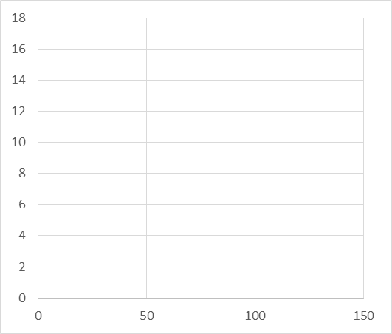
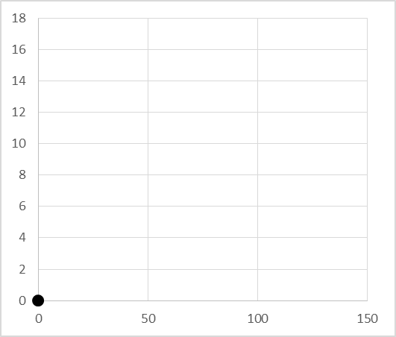
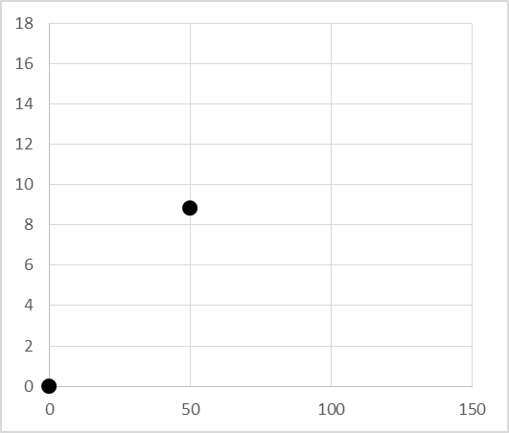
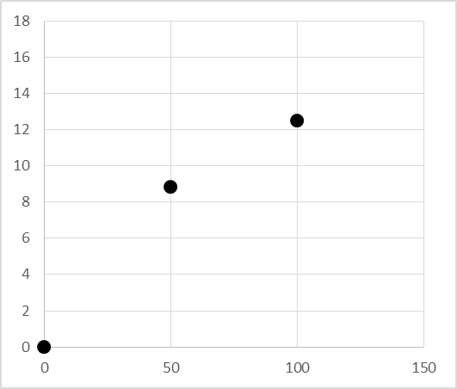
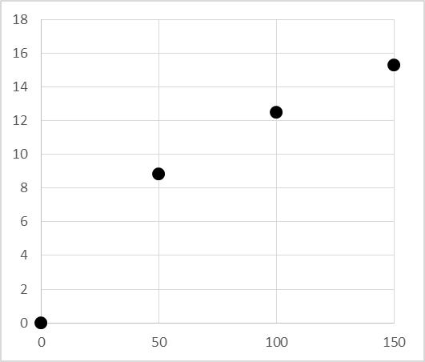
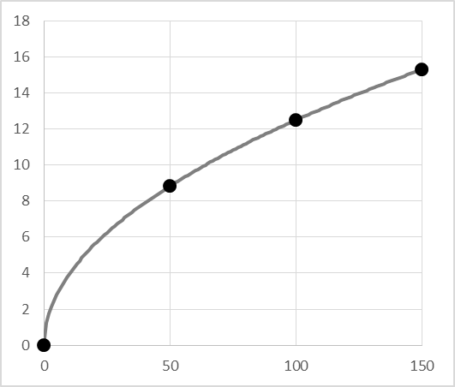
Monetary Economics AD-AS
LRAS
Example:
  2. Graph the economy’s short-run production function.
L | Y
0 | 0
50 | 8.839
100 | 12.500
150 | 15.309
L

Slide 16
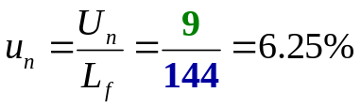

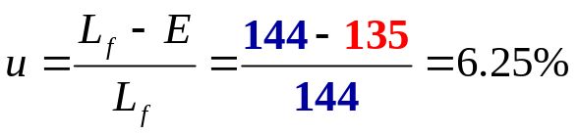


Monetary Economics AD-AS
LRAS
Example:
  3. Suppose there are 9 million workers that are frictionally or structurally unemployed, and 135 million of the 144 million in the labor force are employed. Compute u, u_{n}, u_{c}, real GDP, and Y_{p.}
15
15
L
144
144

Slide 17


Monetary Economics AD-AS
LRAS
Example:
  4. Graph LRAS.
π
LRAS
30
20
10
0
15
Y

Slide 18
Monetary Economics AD-AS
SRAS
SRAS is the relationship between the quantity of real GDP supplied and π when all other influences on production plans remain the same
SRAS shifts upward (decreases) when
  Expected inflation rises
    Workers expecting the PL to rise will demand one-for-one adjustments in w
    Δπ ^{e} = Δw
    In the short-run, w is the most important factor to producing products
    Inflation increases one-for-one in expected inflation
  a price shock (up) occurs due to the nominal price of a resource like energy (ρ).
  Government permanently changes the supply-side tax rate (τ )
  Output gap Y – Y_{p} widens
    workers are being offered higher w and better benefits due to u being too low
    In the short-run, it is believed this pushes inflation higher due to firms raising their prices.
    This makes SRAS upward sloping.
π = π ^{e} + ρ +τ + γ (Y – Y_{p})
π = γ Y + π ^{e} + ρ +τ – γ Y_{p}

Slide 19
Monetary Economics AD-AS
SRAS
Example: In addition to R = 0.4 (trillion dollars of land…), K = 2.5 (trillion dollars of machines…), Z = 1.25 (percent of all knowledge is known to man), U_{n} = 9 (million frictionally or structurally unemployed workers), E = 135 (million), and L = 144 (million), suppose the sensitivity of inflation to the output gap is 0.5, expected inflation is 1.5 (percent), price shock is 0, and the supply-side tax rate is 6 (percent).
  1. Graph the potential GDP you computed in part (3) with AD
Y_{p} = 15
π = γ Y + π ^{e} + ρ +τ – γ Y_{p}
Notes:
R = 0.4
K = 2.5
z = 1.25
L = 144
W =2.25
P = 0.75
T = 5

Slide 20
Monetary Economics AD-AS
Example: In addition to R = 0.4 (trillion dollars of land…), K = 2.5 (trillion dollars of machines…), Z = 1.25 (percent of all knowledge is known to man), U_{n} = 9 (million frictionally or structurally unemployed workers), E = 135 (million), and L = 144 (million), suppose the sensitivity of inflation to the output gap is 0.5, expected inflation is 1.5 (percent), price shock is 0, and the supply-side tax rate is 6 (percent).
  1. Graph the potential GDP you computed in part (3) with AD
Y_{p} = 15
π = γ Y + π ^{e} + ρ +τ – γ 15

Slide 21
Monetary Economics AD-AS
Example: In addition to R = 0.4 (trillion dollars of land…), K = 2.5 (trillion dollars of machines…), Z = 1.25 (percent of all knowledge is known to man), U_{n} = 9 (million frictionally or structurally unemployed workers), E = 135 (million), and L = 144 (million), suppose the sensitivity of inflation to the output gap is 0.5, expected inflation is 1.5 (percent), price shock is 0, and the supply-side tax rate is 6 (percent).
  1. Graph the potential GDP you computed in part (3) with AD
Y_{p} = 15
π = 0.5Y + π ^{e} + ρ +τ – 7.5

Slide 22
Monetary Economics AD-AS
Example: In addition to R = 0.4 (trillion dollars of land…), K = 2.5 (trillion dollars of machines…), Z = 1.25 (percent of all knowledge is known to man), U_{n} = 9 (million frictionally or structurally unemployed workers), E = 135 (million), and L = 144 (million), suppose the sensitivity of inflation to the output gap is 0.5, expected inflation is 1.5 (percent), price shock is 0, and the supply-side tax rate is 6 (percent).
  1. Graph the potential GDP you computed in part (3) with AD
Y_{p} = 15
π = 0.5Y + 1.5 + ρ +τ – 7.5

Slide 23
Monetary Economics AD-AS
Example: In addition to R = 0.4 (trillion dollars of land…), K = 2.5 (trillion dollars of machines…), Z = 1.25 (percent of all knowledge is known to man), U_{n} = 9 (million frictionally or structurally unemployed workers), E = 135 (million), and L = 144 (million), suppose the sensitivity of inflation to the output gap is 0.5, expected inflation is 1.5 (percent), price shock is 0, and the supply-side tax rate is 6 (percent).
  1. Graph the potential GDP you computed in part (3) with AD
Y_{p} = 15
π = 0.5Y + 1.5 + 0 +τ – 7.5

Slide 24
Monetary Economics AD-AS
Example: In addition to R = 0.4 (trillion dollars of land…), K = 2.5 (trillion dollars of machines…), Z = 1.25 (percent of all knowledge is known to man), U_{n} = 9 (million frictionally or structurally unemployed workers), E = 135 (million), and L = 144 (million), suppose the sensitivity of inflation to the output gap is 0.5, expected inflation is 1.5 (percent), price shock is 0, and the supply-side tax rate is 6 (percent).
  1. Graph the potential GDP you computed in part (3) with AD
Y_{p} = 15
π = 0.5Y + 1.5 + 0 + 6 – 7.5

Slide 25
Monetary Economics AD-AS
Example: In addition to R = 0.4 (trillion dollars of land…), K = 2.5 (trillion dollars of machines…), Z = 1.25 (percent of all knowledge is known to man), U_{n} = 9 (million frictionally or structurally unemployed workers), E = 135 (million), and L = 144 (million), suppose the sensitivity of inflation to the output gap is 0.5, expected inflation is 1.5 (percent), price shock is 0, and the supply-side tax rate is 5 (percent).
  1. Graph the potential GDP you computed in part (3) with AD
Y_{p} = 15
π = 0.5Y

Slide 26
Monetary Economics AD-AS
Example (continued):
  2. Graph SRAS: π = 0.5Y
π
SRAS
7.5
15
Y

Slide 27

Aggregate Market Model
  Example (continued):
    3. Graph LRAS, AD & SRAS: Y_{p} = 15 π = 0.5Y π = 15 – 0.5 Y
π
LRAS
SRAS
7.5
AD
15
Y

Slide 28
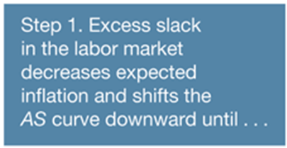
Recessionary Gap
π = γ Y + π ^{e} + ρ +τ – γ Y_{p}
π
LRAS
SRAS
7
AD
14
15
Y

Slide 29
Recessionary Gap
π = γ Y + π ^{e} + ρ +τ – γ Y_{p}
π
LRAS
SRAS
7
6.5
AD
14
15
Y

Slide 30
Recessionary Gap
  But wages are inflexible…
  …need active government policy
π
LRAS
SRAS
7
6.5
AD
14
15
Y

Slide 31

Inflationary Gap
π = γ Y + π ^{e} + ρ +τ – γ Y_{p}
π
LRAS
SRAS
8
AD
15
16
Y

Slide 32
Inflationary Gap
π = γ Y + π ^{e} + ρ +τ – γ Y_{p}
π
LRAS
SRAS
8.5
8
AD
15
16
Y

Slide 33
Inflationary Gap
  Wages and prices are flexible
π = γ Y + π ^{e} + ρ +τ – γ Y_{p}
π
LRAS
SRAS
8.5
AD
15
Y

Slide 34
Positive Demand Shock
AD can shift from temporary demand shocks in which the LRAS and SRAS do not shift

Slide 35


Positive Demand Shock
AD can shift from temporary demand shocks in which the LRAS and SRAS do not shift
π
LRAS
SRAS
3
2
AD
12
13
Y

Slide 36
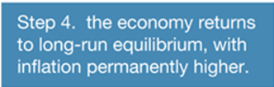

Positive Demand Shock
AD can shift from temporary demand shocks in which the LRAS and SRAS do not shift
π
LRAS
SRAS
3.5
3
2
AD
12
13
Y

Slide 37
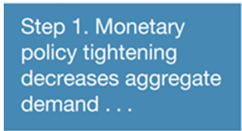
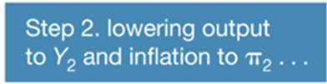

Negative Demand Shock
AD can shift from temporary demand shocks in which the LRAS and SRAS do not shift
π
LRAS
SRAS
2
1.5
AD
11
12
Y

Slide 38
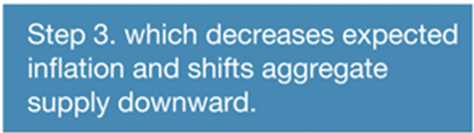
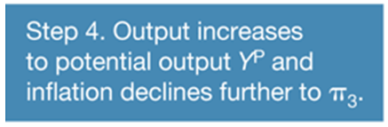
Negative Demand Shock
AD can shift from temporary demand shocks in which the LRAS and SRAS do not shift
π
LRAS
SRAS
2
1.5
1.25
AD
11
12
Y

Slide 39
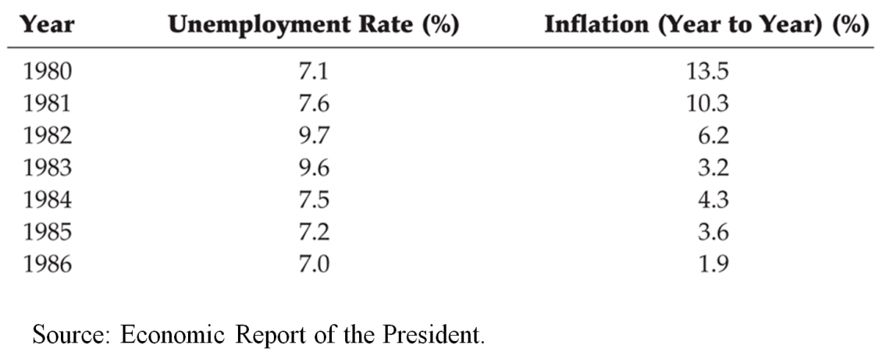
The Volcker Disinflation
Negative Demand Shock
π
LRAS
SRAS
13.5
10.3
AD
Y_{p}
Y

Slide 40
The Volcker Disinflation
Negative Demand Shock
π
LRAS
SRAS
13.5
10.3
AD
Y_{p}
Y

Slide 41
The Volcker Disinflation
Negative Demand Shock
π
LRAS
SRAS
13.5
10.3
6.2
AD
Y_{p}
Y

Slide 42
The Volcker Disinflation
Negative Demand Shock
π
LRAS
SRAS
13.5
10.3
6.2
AD
Y_{p}
Y

Slide 43
The Volcker Disinflation
Negative Demand Shock
π
LRAS
SRAS
13.5
10.3
6.2
3.2
AD
Y_{p}
Y

Slide 44
The Volcker Disinflation
Negative Demand Shock
π
LRAS
SRAS
13.5
10.3
6.2
4.3
AD
Y_{p}
Y

Slide 45
The Volcker Disinflation
Negative Demand Shock
π
LRAS
SRAS
13.5
10.3
6.2
3.6
AD
Y_{p}
Y

Slide 46
The Volcker Disinflation
Negative Demand Shock
π
LRAS
SRAS
13.5
10.3
6.2
3.6
AD
1.9
Y_{p}
Y

Slide 47
The Volcker Disinflation
Negative Demand Shock
π
LRAS
SRAS
13.5
10.3
6.2
3.6
AD
1.9
Y_{p}
Y

Slide 48
The Volcker Disinflation
Negative Demand Shock
π
LRAS
SRAS
1.9
AD
Y_{p}
Y

Slide 49
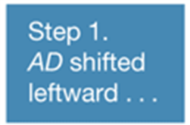

Negative Demand Shock
2001-2004
π
LRAS
SRAS
4.5
3.1
AD
11
12
Y

Slide 50

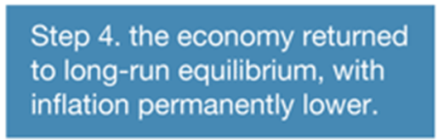

Negative Demand Shock
2001-2004
π
LRAS
SRAS
4.5
3.1
1.6
AD
11
12
Y
Source: Economic Report of the President.

Slide 51
Supply Shock
Temporary supply shock
  SRAS shifts
  LRAS does not shift
Permanent supply shock
  SRAS shifts
  LRAS shifts
  E.g., permanent negative supply shock occurs when ill-advised regulations that cause the economy to be less efficient are adopted
  Real business cycle theory (Edward Prescott of ASU) says that business cycle fluctuations result from permanent supply shocks

Slide 52
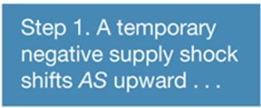
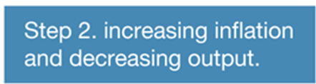
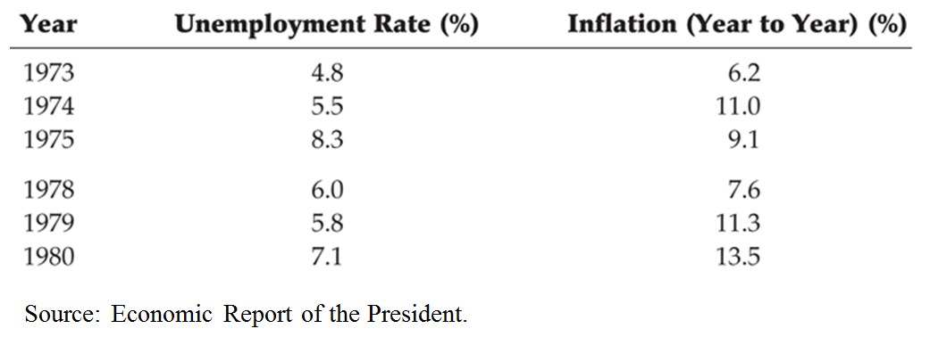
Temporary Negative Supply Shock
1973-1980
π
LRAS
SRAS
6
5
AD
11
12
Y

Slide 53
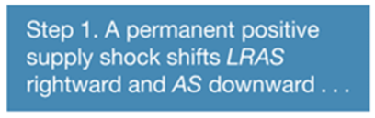
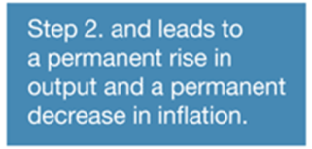
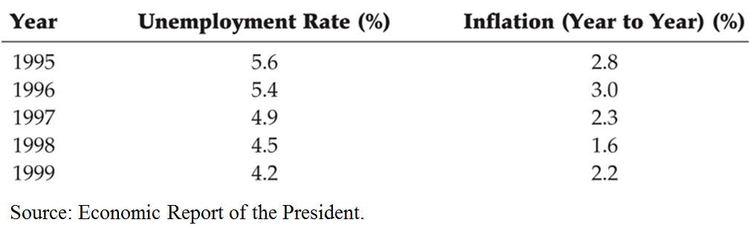
Permanent Positive Supply Shock
1995–1999
π
LRAS
SRAS
5
4
AD
12
13
Y

Slide 54
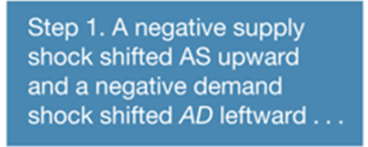
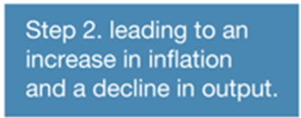
Negative Demand and Supply Shocks
2007–2009
π
LRAS
SRAS
4
3
0
AD
11
12
Y

Slide 55
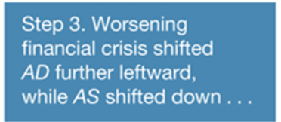
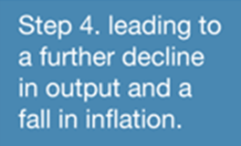
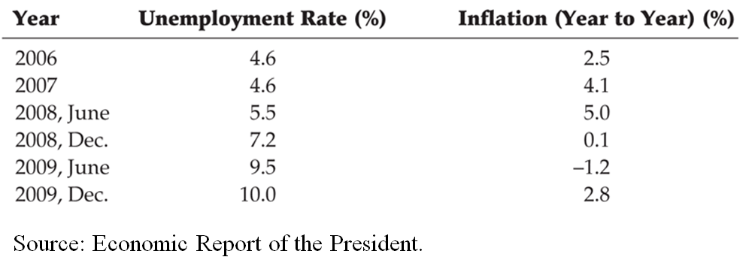
Negative Demand and Supply Shocks
2007–2009
π
LRAS
SRAS
4
3
0
-1
AD
11
11
12
Y

Slide 56
Conclusions
Aggregate demand and supply analysis yields the following conclusions:
1. A shift in the aggregate demand curve affects output only in the short run and has no effect in the long run
A temporary supply shock affects output and inflation only in the short run and has no effect in the long run (holding the aggregate demand curve constant)
3. A permanent supply shock affects output and inflation both in the short and the long run
The economy has a self-correcting mechanism that returns it to potential output and the natural rate of unemployment over time
Monetary policy has a short-run affect on AD only

Slide 57
Chapter 23
Monetary Policy Theory

Slide 58
Response of Monetary Policy to Shocks
Monetary policy should try to minimize the difference between inflation and the inflation target
In the case of both demand shocks and permanent supply shocks, policy makers can simultaneously pursue price stability and stability in economic activity
Following a temporary supply shock, however, policy makers can achieve either price stability or economic activity stability, but not both. This tradeoff poses a dilemma for central banks with dual mandates

Slide 59
Response to an Aggregate Demand Shock
Policy makers can respond to this shock in two possible ways:
  No policy response
  Policy stabilizes economic activity and inflation in the short run
In the case of aggregate demand shocks, there is no tradeoff between the pursuit of price stability and economic activity stability

Slide 60
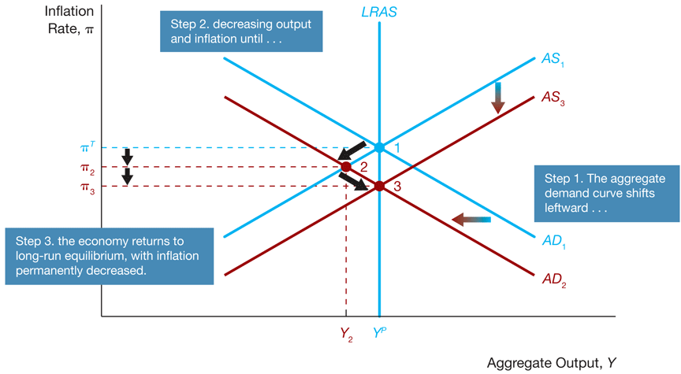
Figure 1 AD Shock: No Policy Response
Response to an Aggregate Demand Shock

Slide 61
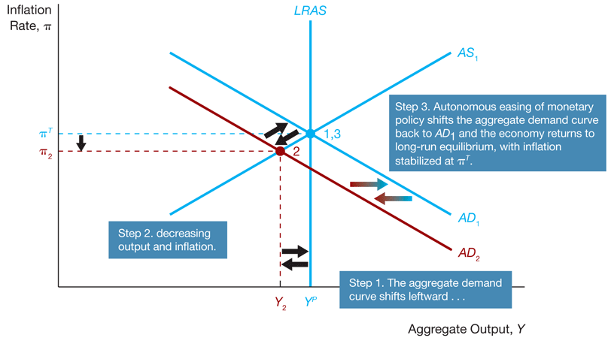
Figure 2 AD shock: Policy Stabilizes Output and Inflation in the Short Run
Response to an Aggregate Demand Shock

Slide 62
APPLICATION
QE and then Global Financial Crisis
Sometimes the negative aggregate demand shock is so large that at some point the central bank cannot lower the real interest rate further because the nominal interest rate hits a floor of zero, as occurred after the Lehman Brothers bankruptcy in late 2008
In this situation when the zero-lower-bound problem arises, the central bank must turn to nonconventional monetary policy
Though the Fed took action, the negative aggregate demand shock to the economy from the global financial crisis was so great that the Fed’s quantitative (credit) easing was insufficient to overcome it, and the Fed was unable to shift the aggregate demand curve all the way back and the economy still suffered a severe recession

Slide 63
Response to a Permanent Supply Shock
There are two possible policy responses to a permanent supply shock:
-No policy response
-Policy stabilizes inflation

Slide 64
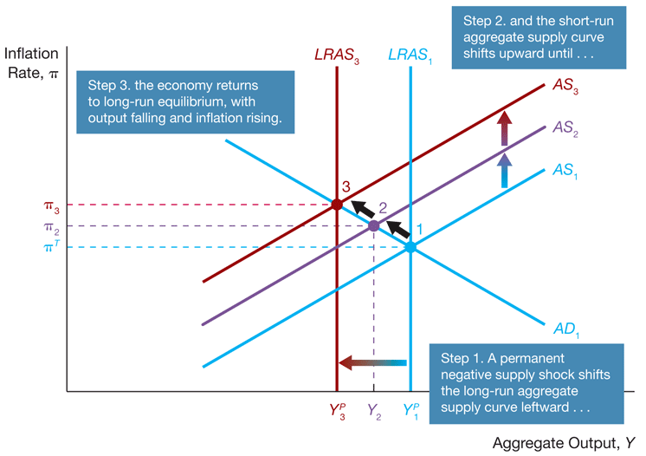
Figure 3 Permanent Supply Shock: No Policy Response
Response to a Permanent Supply Shock

Slide 65
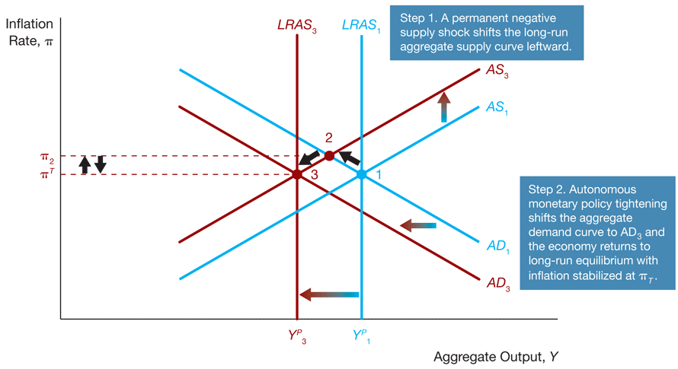
Figure 4 Permanent Supply Shock: Policy Stabilizes Inflation
Response to a Permanent Supply Shock

Slide 66
Response to a Temporary Supply Shock
When a supply shock is temporary, policymakers face a short-run tradeoff between stabilizing inflation and economic activity
Policymakers can respond to the temporary supply shock in three possible ways:
  No policy response
  Policy stabilizes inflation in the short run
  Policy stabilizes economic activity in the short run

Slide 67
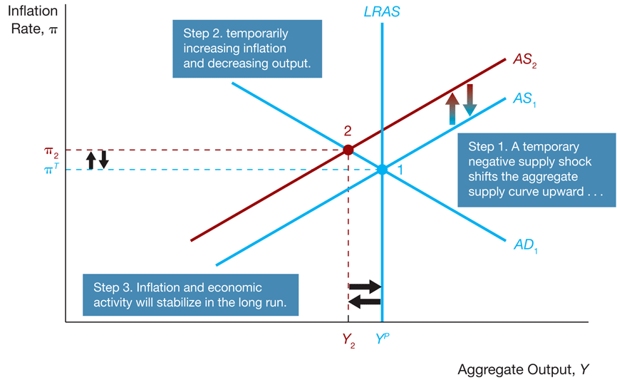
Figure 5 Response to a Temporary AS Shock: No Policy Response
Response to a Temporary Supply Shock

Slide 68
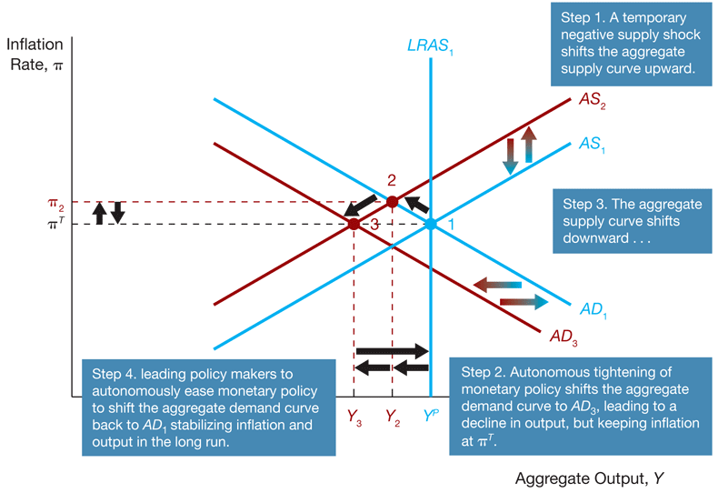
Figure 6 Response to a Temporary AS Shock: Short-Run Inflation Stabilization
Response to a Temporary Supply Shock

Slide 69
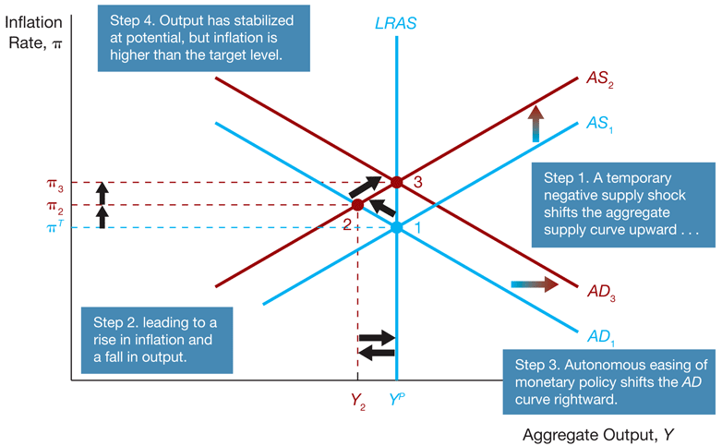
Figure 7 Response to a Temporary AS Shock: Short-Run Output Stabilization
Response to a Temporary Supply Shock

Slide 70
The Bottom Line
Stabilizing Inflation vs. Stabilizing Economic Activity
We can draw the following conclusions from this analysis:
If most shocks to the economy are aggregate demand shocks or permanent aggregate supply shocks, then policy that stabilizes inflation will also stabilize economic activity, even in the short run.
If temporary supply shocks are more common, then a central bank must choose between the two stabilization objectives in the short run.
In the long run there is no conflict between stabilizing inflation and economic activity in response to shocks.

Slide 71
How Actively Should Policy Makers Try to Stabilize Economic Activity?
All economists have similar policy goals (to promote high employment and price stability), yet they often disagree on the best approach to achieve those goals
Nonactivists believe government action is unnecessary to eliminate unemployment
Activists see the need for the government to pursue active policy to eliminate high unemployment when it develops

Slide 72
Lags and Policy Implementation
Several types of lags prevent policymakers from shifting the aggregate demand curve instantaneously
  Data lag: the time it takes for policy makers to obtain data indicating what is happening in the economy
  Recognition lag: the time it takes for policy makers to be sure of what the data are signaling about the future course of the economy

Slide 73
Lags and Policy Implementation
  Legislative lag: the time it takes to pass legislation to implement a particular policy
  Implementation lag: the time it takes for policy makers to change policy instruments once they have decided on the new policy
  Effectiveness lag: the time it takes for the policy actually to have an impact on the economy

Slide 74
FYI The Activist/Nonactivist Debate Over the Obama Fiscal Stimulus Package
Many activists argued that the government needed to do more by implementing a massive fiscal stimulus package
On the other hand, nonactivists opposed the fiscal stimulus package, arguing that fiscal stimulus would take too long to work because of long implementation lags
The Obama administration came down squarely on the side of the activists and proposed the American Recovery and Reinvestment Act of 2009, a $787 billion fiscal stimulus package that Congress passed on February 13, 2009

Slide 75
Inflation: Always and Everywhere a Monetary Phenomenon
This adage is supported by our aggregate demand and supply analysis because it shows that monetary policy makers can target any inflation rate in the long run by shifting the aggregate demand curve with autonomous monetary policy

Slide 76
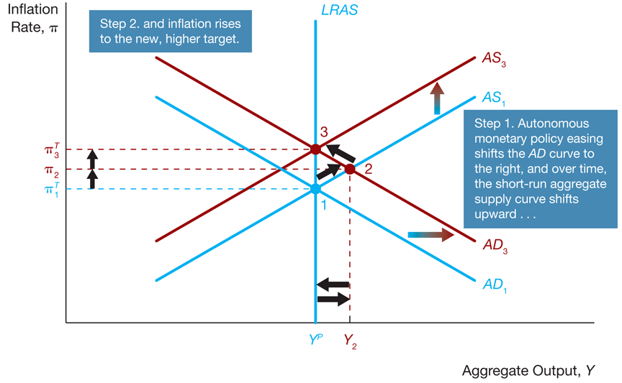
Figure 8 A Rise in the Inflation Target

Slide 77
Causes of Inflationary Monetary Policy
High Employment Targets and Inflation
  Cost-push inflation results either from a temporary negative supply shock or a push by workers for wage hikes beyond what productivity gains can justify
  Demand-pull inflation results from policy makers pursuing policies that increase aggregate demand

Slide 78
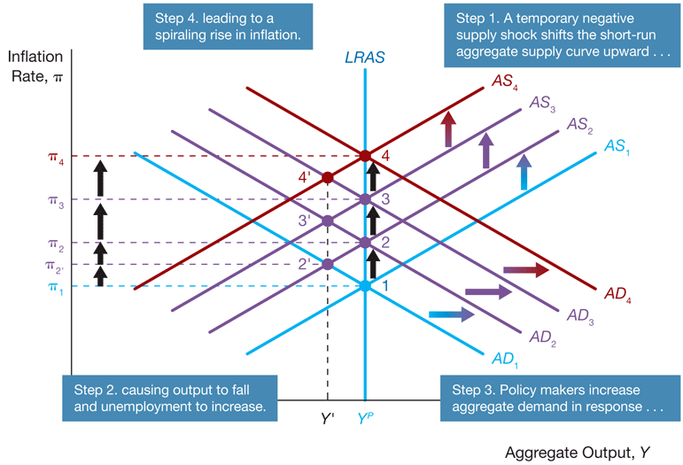
Figure 9 Cost-Push Inflation

Slide 79
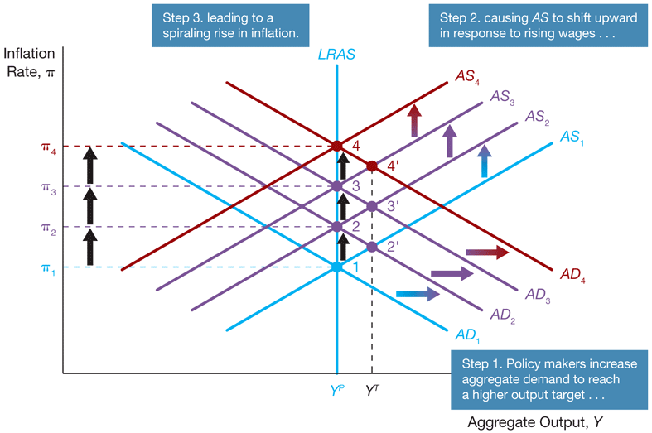
Figure 10 Demand-Pull Inflation

Slide 80
APPLICATION The Great Inflation
Now that we have examined the roots of inflationary monetary policy, we can investigate the causes of the rise in U.S. inflation from 1965 to 1982, a period dubbed the “Great Inflation”
Panel (a) of Figure 11 documents the rise in inflation during those years. Just before the Great Inflation started, the inflation rate was below 2% at an annual rate; by the late 1970s, it averaged around 8% and peaked at nearly 14% in 1980 after the oil price shock in 1979
Panel (b) of Figure 11 compares the actual unemployment rate to estimates of the natural rate of unemployment

Slide 81
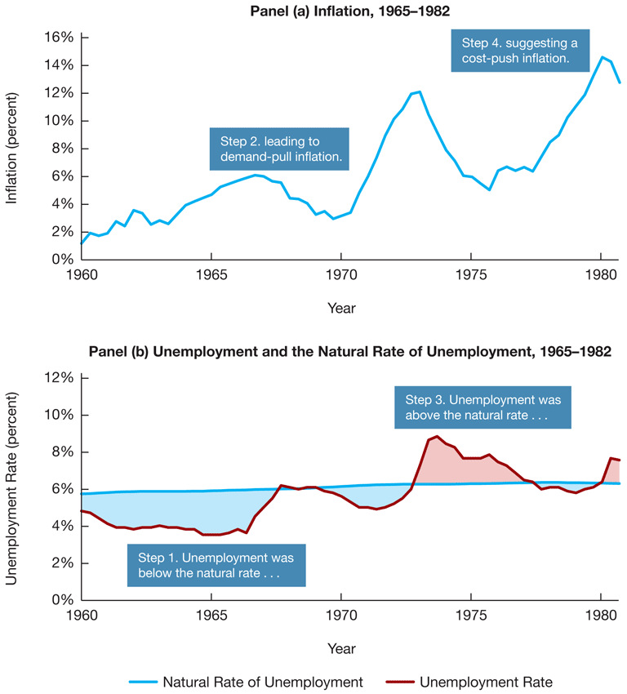
Figure 11 Inflation and Unemployment, 1965-1982

