Slide 1

Money & Banking
Video 04—Money Supply
The Money Supply Process (Chapter 14)
Tools of Monetary Policy (Chapter 15)
The Conduct of Monetary Policy (Chapter 16)
Hal W. Snarr
8/20/2015

Slide 2
Chapter 14
The Money
Supply Process
Notes:
Nonbank Public, Banks, and the Fed

Slide 3
George Jetson’s Balance Sheet
Three Players in the Money Supply Process
Assets |  | Liabilities
Securities |  |  | C&I loans
Currency
Checkable Deposits |  |  | Net worth

Slide 4
Bank A’s Balance Sheet
Three Players in the Money Supply Process
  Reserves: assets not lent out by banks
  Banks are Required to hold a fraction of Reserves (R_{R} )
  Reserves in Excess of R_{R} are called excess reserves (R_{E} )
  If ρ = 10%, R_{E} = 50, and D = 3000, then
  R_{R} = D X ρ = 3000 X 0.1 = 300
R = R_{R} + R_{E} = $350
Assets |  | Liabilities
Required Reserves |  |  | Checkable deposits (D)
Excess Reserves |  |  | Discount loans
Securities |  |  | Loans owed to other banks
C&I Loans
Loans made to other banks |  |  | Net worth

Slide 5
The Fed’s Balance Sheet
Three Players in the Money Supply Process
Assets | Liabilities
Securities | Currency in circulation
Discount loans to Banks | Reserves

Slide 6
Three Players in the Money Supply Process
The Fed’s Balance Sheet
Assets | Liabilities
Securities | Currency in circulation
Discount loans to Banks | Reserves
High-powered money
MB = C + R

Slide 7
Controlling the Monetary Base
Open Market Purchase from Bank A
Net result is that reserves have increased by $100m
No change in currency
Monetary base has risen by $100m
Bank A |  |  |  |  | Federal Reserve System
Assets |  | Liabilities |  |  | Assets |  | Liabilities
Securities | -$100m |  |  |  | Securities | +$100m | Reserves | +$100m
Reserves | +$100m

Slide 8
Controlling the Monetary Base
Open Market Purchase from the Nonbank Public
George Jetson cashed the Fed’s check
Reserves are unchanged
Currency in circulation rises by the amount of the open market purchase
Monetary base increases by the amount of the open market purchase
George Jetson |  |  |  |  | Federal Reserve System
Assets |  | Liabilities |  |  | Assets |  | Liabilities
Securities | -$100m |  |  |  | Securities | +$100m | Currency | +$100m
Currency | +$100m
Notes:
The effect of an open market purchase on reserves depends on whether the seller of the bonds keeps the proceeds from the sale in currency or in deposits
The effect of an open market purchase on the monetary base always increases the monetary base by the amount of the purchase

Slide 9
Controlling the Monetary Base
Open Market Purchase from the Nonbank Public
After selling his bonds to the Fed, George Jetson deposits his check in Bank A
Identical result as the purchase from Bank A
Monetary base has risen by $100m
No change in currency
Bank A |  |  |  |  | Federal Reserve System
Assets |  | Liabilities |  |  | Assets |  | Liabilities
Reserves | +$100m | Checkable deposits | +$100m |  | Securities | +$100m | Reserves | +$100m

Slide 10
Controlling the Monetary Base
Open Market Sale to Bank A
Net result is that reserves have decreased by $100m
No change in currency
Monetary base has fallen by $100m
Bank A |  |  |  |  | Federal Reserve System
Assets |  | Liabilities |  |  | Assets |  | Liabilities
Securities | +$100m |  |  |  | Securities | -$100m | Reserves | -$100m
Reserves | -$100m

Slide 11
Controlling the Monetary Base
Open Market Sale to the Nonbank Public
Reduces the monetary base by the amount of the sale
Reserves remain unchanged
The effect of open market operations on the monetary base is much more certain than the effect on reserves
George Jetson |  |  |  |  | Federal Reserve System
Assets |  | Liabilities |  |  | Assets |  | Liabilities
Securities | +$100m |  |  |  | Securities | -$100m | Currency | -$100m
Currency | -$100m

Slide 12
Controlling the Monetary Base
Open Market Sale to the Nonbank Public
George Jetson writes the Fed a check when he buys bonds from the Fed.
Identical result as the sale to Bank A
Bank A |  |  |  |  | Federal Reserve System
Assets |  | Liabilities |  |  | Assets |  | Liabilities
Reserves | -$100m | Checkable deposits | -$100m |  | Securities | -$100m | Reserves | -$100m

Slide 13
Controlling the Monetary Base
Shifts from Deposits into Currency
No change in monetary base
Thus, reserves are changed by random fluctuations
Thus, monetary base is a more stable variable
Nonbank Public |  |  |  |  | Bank A
Assets |  | Liabilities |  |  | Assets |  | Liabilities
Checkable deposits | -$100m |  |  |  | Reserves | -$100m | Checkable deposits | -$100m
Currency | +$100m
Federal Reserve System
Assets |  | Liabilities
 |  | Currency in circulation | +$100m
 |  | Reserves | -$100m

Slide 14
Controlling the Monetary Base
Loans to Financial Institutions
Monetary base also increases by the amount of the D loan
Banking System |  |  |  |  | Federal Reserve System
Assets |  | Liabilities |  |  | Assets |  | Liabilities
Reserves | +$100m | D loans | +$100m |  | D loans | +$100m | Reserves | +$100m

Slide 15
Controlling the Monetary Base
Other Factors that Affect the Monetary Base
Float, which is the bump in the MB due to the check clearing process
Treasury moving deposits from banks to the Fed drops the MB
Interventions in the foreign exchange market
Overview of The Fed’s Ability to Control the Monetary Base
Open market operations are controlled by the Fed
The Fed cannot determine the amount of borrowing by banks from the Fed
  It hinders it by keeping the discount rate above the federal funds rate
Split the monetary base into two components
  MB_{n} = MB – R_{B}
  MB_{n} = (R + C) – R_{B}
  MB_{n} = (R_{B} + R_{N} + C) – R_{B}
  MB_{n} = R_{N} + C
The money supply is positively related to both the non-borrowed monetary base MB_{n} and to the level of borrowed reserves, R_{B}

Slide 16
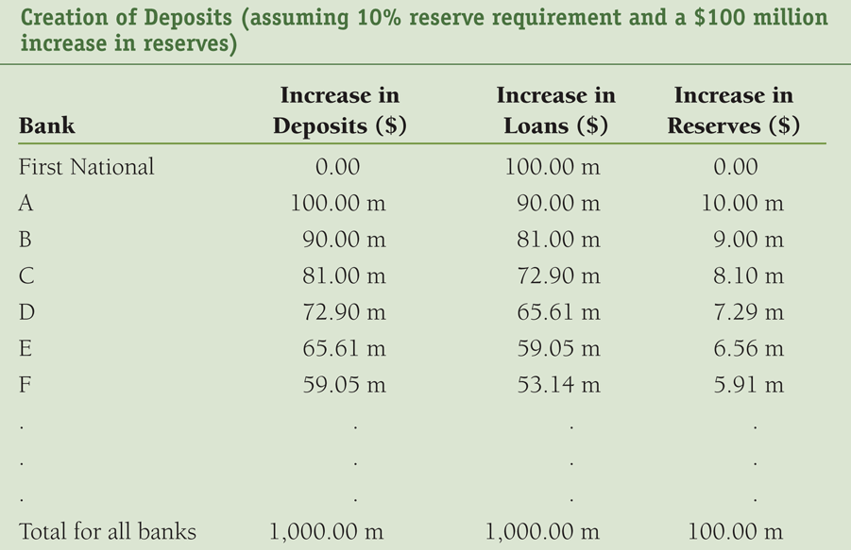




Table 1
Simple Multiple Deposit Creation
simple money multiplier

Slide 17

Table 1
Simple Multiple Deposit Creation
simple money multiplier

Slide 18
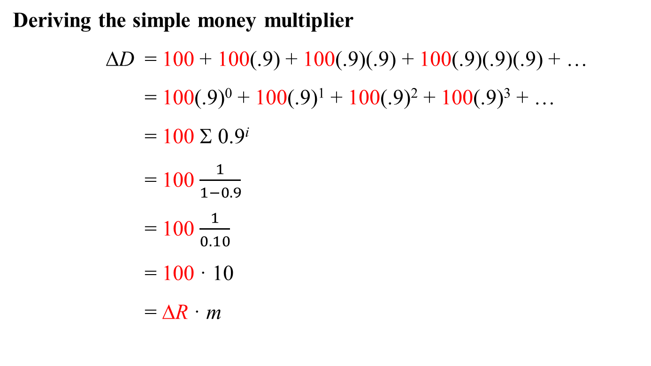
Simple Multiple Deposit Creation
Deriving the simple money multiplier
ΔD = 100 + 100(.9) + 100(.9)(.9) + 100(.9)(.9)(.9) + …
= 100(.9)⁰ + 100(.9)¹ + 100(.9)² + 100(.9)³ + …
= 100 Σ 0.9^{i}
= 100 $\frac{1}{1−0.9}$
= 100 $\frac{1}{0.10}$
= 100 · 10
= ΔR · m
rrr

Slide 19
Multiple Deposit Creation
Deriving the money multiplier
If the propensity of holding cash increases for firms and consumers
  holding cash stops the process of lending money into existence
  currency has no multiple deposit expansion
  MS is negatively related to currency holdings
If the propensity of holding cash (reserves) for banks increases
  excess reserves increases
  Buying securities falls
  Making C&I loans falls
  Excess reserves have no multiple deposit expansion
  MS is negatively related to the amount of excess reserves
If the Fed increases rrr
  The money supply is negatively related to the required reserve ratio.

Slide 20
Multiple Deposit Creation
Deriving the money multiplier
If the propensity to hold currency (C) and the propensity to hold excess reserves (R_{E}) grow proportionally with checkable deposits (D), then
cr = C/D
err = R_{E} / D
currency ratio
excess reserves ratio

Slide 21
Multiple Deposit Creation
Deriving the money multiplier
With cr = C / D and err = R_{E} / D
C = cr · D and R_{E} = err · D
Recall total reserves is given by the following
R = R_{R} + R_{E}
R = rrr · D + err · D
The monetary base MB equals currency (C) plus reserves (R):
MB = C + R
MB = cr · D + rrr · D + err · D
MB = (cr + rrr + err) · D
Notes:
Equation reveals the amount of the monetary base needed to support the existing amounts of checkable deposits, currency and excess reserves

Slide 22
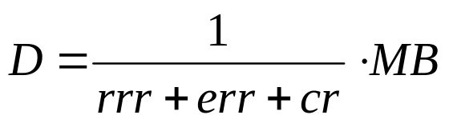
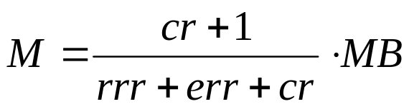
Multiple Deposit Creation
Deriving the money multiplier
Dividing both sides by D’s coefficient yields
Define money as currency plus checkable deposits (M1):
M = C + D
M = cr · D + D
M = (cr + 1) · D
Replace D above with what it equals:
Notes:
Equation reveals the amount of the monetary base needed to support the existing amounts of checkable deposits, currency and excess reserves

Slide 23
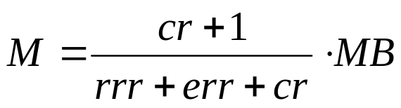
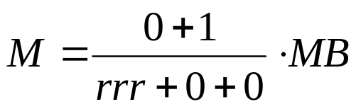
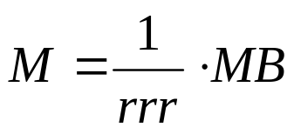
Multiple Deposit Creation
Properties of the money multiplier
If the propensities to hold currency and excess reserves are zero,
The money multiplier becomes the simple money multiplier

Slide 24
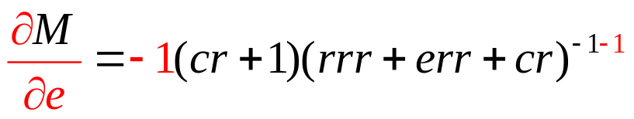
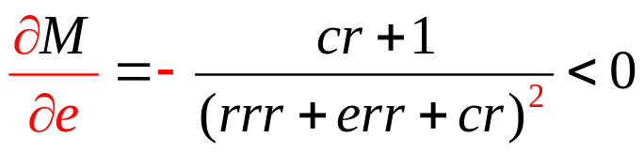
Multiple Deposit Creation
Properties of the money multiplier
Suppose the propensity to hold excess reserves increases.
Thus, an increase in the propensity to hold excess reserves
decreases the money supply
This also implies that an increase in the required reserves ratio
decreases the money supply

Slide 25
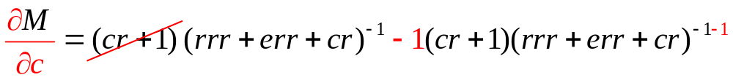
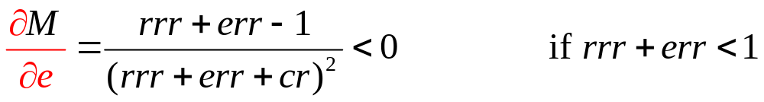
Multiple Deposit Creation
Properties of the money multiplier
Suppose the propensity to hold currency increases.
Thus, an increase in the propensity to hold currency will
generally decrease the money supply

Slide 26
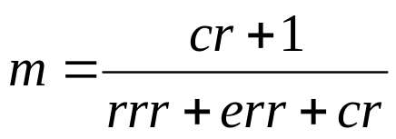
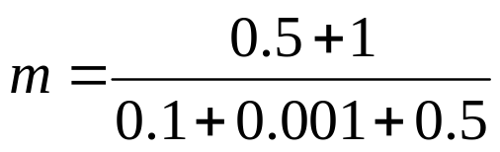

Multiple Deposit Creation
Example: money multiplier
Suppose rrr = 0.1, C = $400b, D = $800b, and R_{E} = $0.8b
cr = C / D = 400/800 = 0.5
err = R_{E} / D = 0.8/800 = 0.001
This is much smaller than the simple money multiplier = 10
Notes:
Equation reveals the amount of the monetary base needed to support the existing amounts of checkable deposits, currency and excess reserves

Slide 27
Chapter 15
Tools of
Monetary Policy
Notes:
The Fed was (est. 1913) is charged with
regulating banks
supervising the payments system
setting reserve requirements
being a lender of last resort in times of financial emergencies
Conducting monetary policy
The FOMC
Includes all 7 BOG members, the NY Fed president, 4 other Bank presidents
The BOG’s chair heads the FOMC
meets once every six weeks (on Tuesdays)
monetary policy is set in its meetings: low inflation and full-employment
During normal times, conventional monetary policy tools include
Discount rate (i_{d})
Required reserves ratio (ρ)
Open market operations (OMP, OMS)
Interest on reserves (i_{or})

Slide 28



Demand for Reserves
Quantity Demanded for Excess Reserves ( ) provide banks with insurance against big withdrawals (caused by bank runs)
  The federal funds interest rate (i_{ff} ) is the cost of “big withdrawal” insurance.
  The cost of excess reserves is the opportunity cost of not making loans.
  If i_{ff} falls, the cost of excess reserves falls (the cost of big withdrawal insurance).
  Thus banks are more willing to purchase more “big-withdrawal” insurance
  Demand for Excess Reserves:
    s = shock parameter, which increases if
      in government intervention (e.g., w & p controls) because interfering with price signals can stifle innovation & entrepreneurialism.
      in economic growth (default risk is lower & C&I lending rises)
      ρ is adjusted up or down
      During bank panics

Slide 29






Demand for Reserves
Quantity of Required Reserves (R_{R} )
  The Federal Reserve (the Fed) requires banks to hold (not lend out) a percentage of the total amount of checkable deposits in their vaults (D)
  The percentage required is called the required reserves ratio ( rrr )
  Thus the quantity of required reserves is
Quantity Demanded for Reserves ( ) is
Demand for Reserves:
Slope = a = 1

Slide 30




Demand for Reserves
Example: Suppose rrr = 0.1, D = 50 (billion $), s = 25, and a = 1. Graph the demand for reserves in the graph below.
Federal Funds Market
i_{ff}
5
i_{ff} (percent) | (Billions $)
2 | 28
5 | 25
2
D^{R}
25
28
Q

Slide 31

Supply for Reserves
A bank that can’t meet its reserve requirement (R_{R} ) borrows from a bank that has excess reserves in the federal funds market and Q^{S} remains unchanged.
The vertical part of reserves supply curve is the amount of reserves the Fed supplies to the federal funds market.
  When banks borrow from the Fed, discount loans rise, borrowed reserves (R_{B}) increase, the quantity of reserves supplied increases.
  When banks sell US Treasury securities to the Fed, non-borrowed reserves (R_{N}) increase, which increases the quantity of reserves.
  Hence, the supply of reserves is the sum
The horizontal part of the reserves supply curve is the discount rate (i_{d} )
  If the federal funds rate is less than the discount rate (i_{ff} < i_{d}), banks will not borrow from the Fed because
    “Insurance” purchased from the Fed is more expensive than from other banks
  If the federal funds rate is more than the discount rate (i_{ff} > i_{d}), banks will want to borrow from the Fed instead of other banks
    “Insurance” purchased from other banks is more expensive than from the Fed.

Slide 32
Supply for Reserves
Example: Suppose R_{B} = 0 (billion $), R_{N} = 28 (billion $) and i_{d} = 3 (percent). Graph the supply of reserves in the figure below.
Vertical part:
R_{B} + R_{N} = 0 + 28 = 28
Horizontal part:
i_{d} = 3
Federal Funds Market
i_{ff}
3
S^{R}
28
Q

Slide 33
Federal funds market equilibrium
If demand for reserves intersects the vertical section of the supply of reserves, then
  The federal funds interest rate is less than the discount interest rate (i_{ff} < i_{d} )
  A bank would rather borrow from other banks
  The quantity of reserves equals R_{N} + R_{B}
If demand for reserves intersects the horizontal section of the supply of reserves, the federal funds interest rate equals the discount interest rate (i_{ff} = i_{d} )
  A bank is indifferent between borrowing from other banks or the Fed
  However, the bank borrows from the Fed because something (a crisis) has dried up all of the excess reserves held by banks.
  The equilibrium quantity of reserves exceeds R_{N} + R_{B}
  The difference between equilibrium quantity of reserves and R_{N} + R_{B} is the quantity of discount loans made by the Fed

Slide 34
Federal funds market equilibrium
Example: Assume the following values for the demand for reserves: rrr = 0.1, D = 50,
s = 25, and a = 1. Assume the following values for the supply of reserves: R_{B} = 0,
R_{N} = 28, and i_{d} = 3. Graph the reserves supply and demand in the figure below.
Vertical part: R_{N} + R_{B} = 28
Horizontal part: i_{d} = 3
Federal Funds Market
i_{ff}
i_{ff} (percent) | (Billions $)
2 | 28
5 | 25
5
3
S^{R}
Equilibrium
2
D^{R}
25
28
Q

Slide 35
Discount Rate
Example (continued ): Suppose the Fed increases the discount rate to 4 (percent). Show the affect of this policy change in the figure below.
The horizontal section
i_{d} = 4
Federal Funds Market
i_{ff}
The vertical section
no change
4
S^{R}
3
S^{R}
Starting on 1/1/03 the Fed
began setting the discount
rate 100 basis points (1 pct.
point) above its federal funds
rate target
2
D^{R}
28
Q

Slide 36
Discount Rate
Discount Policy and the Lender of Last Resort
Discount window
Primary credit: standing lending facility
  Lombard facility
Secondary credit
Seasonal credit
Lender of last resort to prevent financial panics
  Creates moral hazard problem
Advantages and Disadvantages of Discount Policy
Used to perform role of lender of last resort
  Important during the subprime financial crisis of 2007-2008.
Cannot be controlled by the Fed; the decision maker is the bank
Discount facility is used as a backup facility to prevent the federal funds rate from rising too far above the target

Slide 37





Required Reserves Ratio
Example (continued ): Instead, suppose the Fed increases the required reserve ratio to 14%. Show the affect of this policy change in the figure below.
      When rrr is adjusted up or down s increases
.14
26
Federal Funds Market
i_{ff}
5
3
S^{R}
The new equilibrium:
i_{ff} = 3
2
D^{R}
D^{R}
28
30
Q

Slide 38
Required Reserves Ratio
Example (continued ): Instead, suppose the Fed increases the required reserve ratio to 14%. Show the affect of this policy change in the figure below.
In the past, the Fed has tried slowing the economy by increasing rrr.
Doing this creates a big collapse in bank lending to businesses and consumers.
In addition, the Fed has to make discount loans to banks.
So even though total reserves have increased via discount lending ($2 billion in the diagram above), this cash is sitting idle.
The effect is a reduction in money supply.
Federal Funds Market
i_{ff}
3
S^{R}
2
D^{R}
D^{R}
28
30
Q

Slide 39
Required Reserves Ratio
Example (continued ): Instead, suppose the Fed increases the required reserve ratio to 14%. Show the affect of this policy change in the figure below.
Money
MS’
MS
This increases r provided inflation remains unchanged.
i₁
i₀
MD
M₁
M₀

Slide 40
Required Reserves Ratio
Example (continued ): Instead, suppose the Fed increases the required reserve ratio to 14 (percent). Show the affect of this policy change in the figure below.
Higher r decreases I, and both of these collapse AD.
This results in lower prices and real GDP.
In the past, small increases in rrr have put a “hot” economy (one that is growing too fast) into a recessionary gap.
The Fed has not changed the ρ since 1992
AD-AS
SRAS
PL₀
PL₁
AD
AD’
Y₁
Y_{F}
Y₀

Slide 41
Required Reserves Ratio
Depository Institutions Deregulation and Monetary Control Act of 1980 sets the reserve requirement the same for all depository institutions
3% of the first $48.3 million of checkable deposits; 10% of checkable deposits over $48.3 million
The Fed can vary the 10% requirement between 8% to 14%
Disadvantages of Reserve Requirements
  No longer binding for most banks
  Can cause liquidity problems
  Increases uncertainty for banks

Slide 42
Open Market Operations
The Fed conducts an Open Market Purchase (OMP) by buying Treasuries from banks
  Cash flows from the Fed to Banks
  The quantity of reserves in the federal funds market rises
  The federal funds interest rate declines
  This is an exPansionary monetary policy
The Fed conducts an Open Market Sale (OMS) by selling Treasury bonds to banks
  The Fed has bonds to sell because it purchased them directly from
    Treasury in the primary market (this is called monetizing the debt)
    Banks in the secondary market in a previous OMP
  Banks give cash (reserves) to the Fed in exchange for Treasury bonds
  The quantity of reserves in the federal funds market declines
  The federal funds interest rate increases
  This is a reStrictive monetary policy

Slide 43


Open Market Purchase
Example (continued ): Instead, suppose of changing i_{d} or rrr the Fed performs an OMP by buying a half of a billion dollars worth of bonds from banks (R_{N} = 28 + .5 = 28.5). Show the affect of this policy change in the figure below.
The horizontal section
no change
Federal Funds Market
i_{ff}
The vertical section
R_{N} + R_{B} = (28 + .5) + 0 = 28.5
3
S^{R}
S^{R}
2
New equilibrium
1.5
D^{R}
28
28.5
Q

Slide 44
Open Market Purchase
Example (continued ): Instead, suppose of changing i_{d} or rrr the Fed performs an OMP by buying a half (billion $) worth of bonds from banks. Show the affect of this policy change in the figure below.
Federal Funds Market
Starting on 1/1/03 the Fed
began setting the discount
rate 100 basis points (1 pct. point) above its federal funds rate target.
i_{ff}
3
S^{R}
S^{R}
2
1.5
D^{R}
28
28.5
Q

Slide 45
Open Market Purchase
Example (continued ): Instead, suppose of changing i_{d} or rrr the Fed performs an OMP by buying a half (billion $) worth of bonds from banks. Show the affect of this policy change in the figure below.
Federal Funds Market
Starting on 1/1/03 the Fed
began setting the discount
rate 100 basis points (1 pct. point) above its federal funds rate target.
So the Fed lowers the discount rate to 2.5
i_{ff}
3
S^{R}
S^{R}
2.5
S^{R}
1.5
D^{R}
28
28.5
Q

Slide 46
Open Market Purchase
Example (continued ): Instead, suppose of changing i_{d} or rrr the Fed performs an OMP by buying a half (billion $) worth of bonds from banks. Show the affect of this policy change in the figure below.
Increased R_{N} means banks have more cash to lend to consumers and business.
The money supply increases via increased lending
If m = 4, then
ΔMS = 4(0.5)
ΔMS = 2
If inflation remains unchanged, r will fall too, increasing I (and X).
Money
MS
MS’
3.85
2.75
MD
500
502

Slide 47
Open Market Purchase
Example (continued ): Instead, suppose of changing i_{d} or rrr the Fed performs an OMP by buying a half (billion $) worth of bonds from banks. Show the affect of this policy change in the figure below.
AD-AS
Increases in I and X, and lower r increase AD.
This results in higher GDP, lower unemployment, and higher prices
SRAS
225
215
AD’
AD
14
15

Slide 48


Open Market Sale
Example (continued ): Suppose the Fed performs an OMS by selling a half of a billion dollars worth of bonds to banks (R_{N} = 28 – .5 = 27.5). Show the affect of this policy change in the figure below.
The horizontal section
no change
Federal Funds Market
i_{ff}
The vertical section
R_{N} + R_{B} = (28 – .5) + 0 = 27.5
3
S^{R}
S^{R}
2.5
2
New equilibrium
D^{R}
27.5
28
Q

Slide 49
Open Market Sale
Example (continued ): Suppose the Fed performs an OMS by selling a half of a billion dollars worth of bonds to banks (R_{N} = 28 – .5 = 27.5). Show the affect of this policy change in the figure below.
Federal Funds Market
Starting on 1/1/03 the Fed
began setting the discount
rate 100 basis points (1 pct. points) above its federal funds rate target.
So the Fed raises the discount rate to 3.5
i_{ff}
3.5
S^{R}
3
S^{R}
S^{R}
2.5
D^{R}
27.5
28
Q

Slide 50
Open Market Sale
Example (continued ): Suppose the Fed performs an OMS by selling a half of a billion dollars worth of bonds to banks (R_{N} = 28 – .5 = 27.5). Show the affect of this policy change in the figure below.
Money
Lower R_{N} means banks have less cash to lend to consumers and business.
The money supply decreases via decreased lending
If m = 4, then
ΔMS = 4(-0.5)
ΔMS = -2
If inflation remains unchanged, r rises with i, and I (and X) will fall.
MS’
MS
3.75
2.75
MD
500
498

Slide 51
Open Market Sale
Example (continued ): Suppose the Fed performs an OMS by selling a half of a billion dollars worth of bonds to banks (R_{N} = 28 – .5 = 27.5). Show the affect of this policy change in the figure below.
AD-AS
Falling I and X, and rising r decrease AD.
This results in lower GDP, higher unemployment, and lower prices
SRAS
225
AD
215
AD’
15
16

Slide 52
Open Market Operations
Dynamic open market operations
Defensive open market operations
Primary dealers
TRAPS (Trading Room Automated Processing System)
Repurchase agreements
Matched sale-purchase agreements
Advantages of open market operations
  The Fed has complete control over the volume
  Flexible and precise
  Easily reversed
  Quickly implemented

Slide 53
Open Market Operations
Suppose the Fed targets interest rates
A decline in D
  decreases reserves demand
  lowers i_{ff} below its target
  The NY Fed Bank conducts an OMP to push i_{ff} back up to its target
  If the OMP = $10b and m = 4, ΔMS = 40
A rise in D
  increases reserves demand
  reduces i_{ff} below its target
  The NY Fed Bank conducts an OMS to push i_{ff} back down to its target
  If the OMS = $10b and m = 4, ΔMS = -40
Because GDP is constantly fluctuating, NY Fed Bank constantly conducts OMS and OMP to keep i_{ff} ≈ its target
Targeting interest rates causes MS to oscillate
Suppose the Fed targets money growth
To keep money growing at a small, constant rate causes fluctuations in i
The Fed has to target interest rates or money supply growth – not both.

Slide 54
Nonconventional Monetary Policy Tools
To combat the Global Financial Crisis
Liquidity provision: The Federal Reserve implemented unprecedented increases in its lending facilities to provide liquidity to the financial markets
  Discount Window Expansion
  Term Auction Facility
  New Lending Programs
Asset Purchases: During the crisis the Fed started two new asset purchase programs to lower interest rates for particular types of credit: Government Sponsored Entities Purchase Program; QE2
Congress moved the implementation date of allowing the Fed to pay interest on reserves (i_{or}) from 2011 to October 2008.

Slide 55
Interest on Reserves
The Fed’s rescue of the financial system in 2008-2009 included purchasing enough securities to increase the supply of reserves so much that it would drive the federal funds rate negative.
Federal Funds Market
i_{ff}
D^{R}
To prevent this in October of 2008, the Fed began paying interest on reserves (i_{or}), which is currently about 0.25%
Crisis mode
i_{d}
S^{R}
i_{or}
i_{ff}
0
Q
-i_{ff}

Slide 56
Interest on Reserves
The Fed’s rescue of the financial system in 2008-2009 included purchasing enough securities to increase the supply of reserves so much that it would drive the federal funds rate negative.
Federal Funds Market
i_{ff}
D^{R}
This allows the Fed to buy
i_{d}
S^{R}
i_{or}
0
Q

Slide 57
Interest on Reserves
The Fed’s rescue of the financial system in 2008-2009 included purchasing enough securities to increase the supply of reserves so much that it would drive the federal funds rate negative.
Federal Funds Market
i_{ff}
D^{R}
This allows the Fed to buy or sell as many securities as it wants without changing the federal funds rate.
i_{d}
S^{R}
i_{or}
0
Q

Slide 58
Interest on Reserves
The Fed’s rescue of the financial system in 2008-2009 included purchasing enough securities to increase the supply of reserves so much that it would drive the federal funds rate negative.
Federal Funds Market
i_{ff}
D^{R}
This allows the Fed to buy or sell as many securities as it wants without changing the federal funds rate.
i_{d}
S^{R}
i_{or}
0
Q

Slide 59
Interest on Reserves
The Fed’s rescue of the financial system in 2008-2009 included purchasing enough securities to increase the supply of reserves so much that it would drive the federal funds rate negative.
Federal Funds Market
i_{ff}
D^{R}
This allows the Fed to buy or sell as many securities as it wants without changing the federal funds rate.
i_{d}
S^{R}
i_{or}
0
Q

Slide 60
Interest on Reserves
The Fed’s rescue of the financial system in 2008-2009 included purchasing enough securities to increase the supply of reserves so much that it would drive the federal funds rate negative.
Federal Funds Market
i_{ff}
D^{R}
This allows the Fed to buy or sell as many securities as it wants without changing the federal funds rate.
i_{d}
S^{R}
i_{or}
0
Q

Slide 61
Interest on Reserves
The Fed’s rescue of the financial system in 2008-2009 included purchasing enough securities to increase the supply of reserves so much that it would drive the federal funds rate negative.
Federal Funds Market
i_{ff}
D^{R}
The federal reserve can also raise and lower the federal funds rate by simply raising IOR and i_{d} simultaneously.
i_{d}
S^{R}
i_{or}
0
Q

Slide 62
Interest on Reserves
The Fed’s rescue of the financial system in 2008-2009 included purchasing enough securities to increase the supply of reserves so much that it would drive the federal funds rate negative.
Federal Funds Market
i_{ff}
D^{R}
The Fed will need to conduct several controlled OMS while carefully raising IOR to reduce its $2-3 trillion balance sheet while keeping a eye on inflation.
i_{d}
S^{R}
i_{ff}
This (should) return the federal funds market to normal mode.
0
Q

Slide 63
Chapter 16
The Conduct of Monetary Policy:
Strategy and Tactics

Slide 64
Goals of Monetary Policy
  Price stability using nation’s PL (or MS)
  Economic growth
  Price stability and full employment
  stability of financial markets
  interest-rate stability
  stability in foreign exchange markets

Slide 65
Inflation Targeting
Public announcement of medium-term numerical target for inflation
Institutional commitment to price stability as the primary, long-run goal of monetary policy and a commitment to achieve the inflation goal
Information-inclusive approach in which many variables are used in making decisions
Increased transparency of the strategy
Increased accountability of the central bank
Notes:
Advantages
Does not rely on one variable to achieve target
Easily understood
Reduces potential of falling in time-inconsistency trap
Stresses transparency and accountability
Disadvantages
Delayed signaling
Too much rigidity
Potential for increased output fluctuations
Low economic growth during disinflation

Slide 66
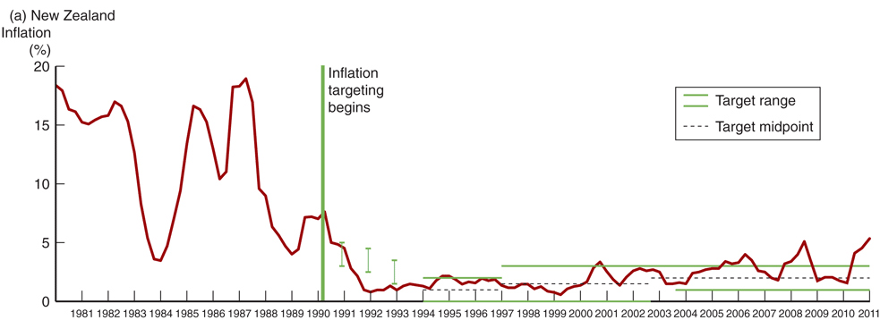


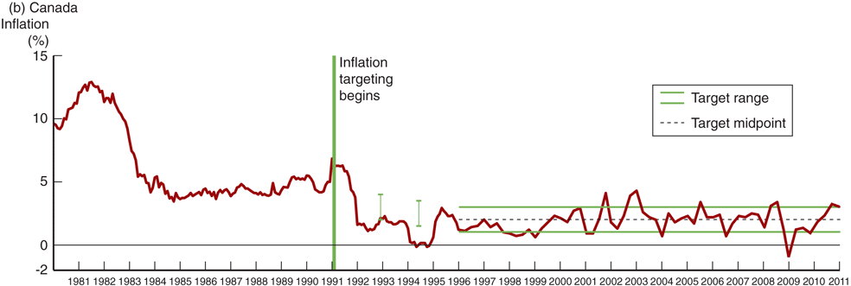
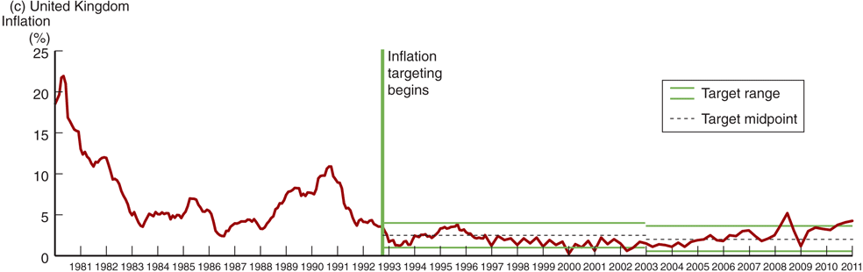
Inflation Targeting
Figure 1
Notes:
New Zealand (effective in 1990)
Inflation was brought down and remained within the target most of the time.
Growth has generally been high and unemployment has come down significantly
Canada (1991)
Inflation decreased since then, some costs in term of unemployment
United Kingdom (1992)
Inflation has been close to its target.
Growth has been strong and unemployment has been decreasing.

Slide 67
The Fed’s Monetary Policy Strategy
U.S. has achieved excellent macroeconomic performance (including low and stable inflation) until the onset of the global financial crisis without using an explicit nominal anchor such as an inflation target
History:
  Fed began to announce publicly targets for money supply growth in 1975
  Paul Volker (1979) focused more in nonborrowed reserves
  Greenspan (July 1993): monetary aggregates no longer used
Now:
  No nominal anchor in the form of an overriding concern for the Fed
  Forward looking behavior and periodic “preemptive strikes”
  The goal is to prevent inflation from getting started
Notes:
Advantages of the Fed’s “Just Do It” Approach
Uses many sources of information
Demonstrated success
Forward-looking behavior and stress on price stability also help to discourage overly expansionary monetary policy, thereby ameliorating the time-inconsistency problem
Disadvantages of the Fed’s “Just Do It” Approach
Lack of accountability/transparency
Inconsistent with democratic principles
Depends too much on preferences, skills and trustworthiness of people who work at the Fed

Slide 68
Discount Rate in Normal Mode
Raising and lowering the discount rate has no effect on reserves
Federal Funds Market
i_{ff}
4
S^{R}
3
S^{R}
2
D^{R}
28
Q

Slide 69
Discount Rate in Normal Mode
Raising and lowering the discount rate has no effect on reserves
Federal Funds Market
i_{ff}
4
S^{R}
3
S^{R}
2
D^{R}
28
Q

Slide 70
Required Reserves Ratio in Normal Mode
Raising the required reserve ratio raises, the federal funds rate, increases discount lending, can increase excess reserves, and shrink MS.
Federal Funds Market
i_{ff}
3
S^{R}
2
D^{R}
28
31
Q

Slide 71
Federal Funds Rate in Normal Mode
Normal fluctuations in economic activity cause reserves demand to fluctuate
Federal Funds Market
i_{ff}
3
S^{R}
Target 2
D^{R}
28
Q

Slide 72
Federal Funds Rate in Normal Mode
Inflation targeting: OMOs are used to keep i_{ff} at its target
Federal Funds Market
i_{ff}
If each oscillation
in R equals $100b
and m = 4, then
each oscillation in
MS equals $400b
3
S^{R}
S^{R}
Target 2
D^{R}
D^{R}
OMS
OMP
28
Q

Slide 73
Federal Funds Rate in Normal Mode
Money targeting: OMOs are used to keep MS growing at 3%
Federal Funds Market
i_{ff}
3
S^{R}
OMS > OMP
2
D^{R}
28
Q

Slide 74
Federal Funds Rate in Normal Mode
Money targeting: OMOs are used to keep MS growing at 3%
Federal Funds Market
i_{ff}
3
S^{R}
OMP > OMS
2
D^{R}
28
Q

Slide 75
Federal Funds Rate in Normal Mode
Money targeting: OMOs are used to keep MS growing at 3%
Federal Funds Market
i_{ff}
S^{R}
3
OMS > OMP
2
D^{R}
28
Q

Slide 76
Federal Funds Rate in Normal Mode
Money targeting: OMOs are used to keep MS growing at 3%
Federal Funds Market
i_{ff}
3
S^{R}
OMP > OMS
2
D^{R}
28
Q

Slide 77
Federal Funds Rate in Normal Mode
Money targeting: OMOs are used to keep MS growing at 3%
Federal Funds Market
i_{ff}
S^{R}
3
OMP > OMS
2
D^{R}
28
Q

Slide 78
Federal Funds Rate in Normal Mode
Money targeting: OMOs are used to keep MS growing at 3%
Federal Funds Market
i_{ff}
3
S^{R}
OMP > OMS
2
When R are grown at a rate that grows MS
at its desired rate,
i_{ff} fluctuates.
D^{R}
28
Q

Slide 79
Discount Rate in CRISIS Mode
Raising and lowering the discount rate has no effect on reserves
Federal Funds Market
i_{ff}
4
S^{R}
3
S^{R}
i_{ff} = i_{or} =
2
D^{R}
28
Q

Slide 80
Discount Rate in CRISIS Mode
Raising and lowering the discount rate has no effect on reserves
Federal Funds Market
i_{ff}
4
S^{R}
3
S^{R}
i_{ff} = i_{or} =
2
D^{R}
28
Q

Slide 81
Required Reserves Ratio in CRISIS Mode
Raising the required reserve ratio raises, the federal funds rate, increases discount lending, can increase excess reserves, and shrink MS.
Federal Funds Market
i_{ff}
3
S^{R}
i_{ff} = i_{or} =
D^{R}
2
D^{R}
28
29
Q

Slide 82
Federal Funds Rate in CRISIS Mode
Normal fluctuations in economic activity cause reserves demand to fluctuate
Federal Funds Market
i_{ff}
With i_{or} set
i_{ff} & R
do not change
3
S^{R}
i_{ff} = i_{or} =
D^{R}
2
28
Q

Slide 83
Federal Funds Rate in CRISIS Mode
Inflation targeting: OMOs are used to keep i_{ff} at its target?
Federal Funds Market
i_{ff}
OMOs have no
effect on MS or i_{ff}
with i_{or} set.
3
S^{R}
i_{ff} = i_{or} =
D^{R}
2
28
Q

Slide 84
Federal Funds Rate in CRISIS Mode
Inflation targeting: OMOs are used to keep i_{ff} at its target?
Federal Funds Market
i_{ff}
i_{d} and i_{or} can be
raised together
without affecting
R or MS
3
S^{R}
i_{ff} = i_{or} =
D^{R}
2
28
Q

Slide 85
Required Reserves Ratio in CRISIS Mode
Money targeting: Can OMOs be used to keep MS growing steady?
Federal Funds Market
i_{ff}
OMPs increase the
amount of excess Reserves
3
S^{R}
OMP
i_{ff} = i_{or} =
2
D^{R}
28
Q

Slide 86
Required Reserves Ratio in CRISIS Mode
Money targeting: Can OMOs be used to keep MS growing steady?
Federal Funds Market
i_{ff}
OMPs increase the
amount of excess Reserves
3
S^{R}
OMP
i_{ff} = i_{or} =
2
D^{R}
28
Q

Slide 87
Required Reserves Ratio in CRISIS Mode
Money targeting: Can OMOs be used to keep MS growing steady?
Federal Funds Market
i_{ff}
OMPs increase the
amount of excess Reserves
3
S^{R}
OMP
i_{ff} = i_{or} =
2
D^{R}
28
Q

Slide 88
Required Reserves Ratio in CRISIS Mode
Money targeting: Can OMOs be used to keep MS growing steady?
Federal Funds Market
i_{ff}
OMPs increase the
amount of excess Reserves
3
S^{R}
OMP
i_{ff} = i_{or} =
2
Federal Funds
market is in
a liquidity trap
D^{R}
28
Q
The Fed can’t
target money

Slide 89
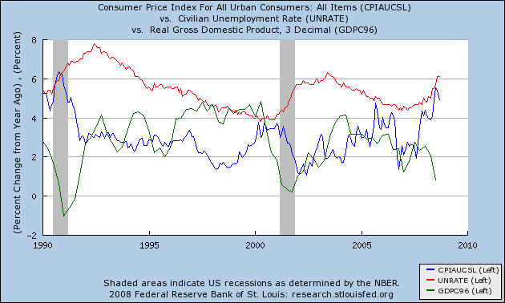
The Taylor Rule, NAIRU, and the Phillips Curve
6.1%
The red line suggests unemployment is on the rise.
It was 6.1% in September, 2008.
Sept
2008

Slide 90
The Taylor Rule, NAIRU, and the Phillips Curve
6.1%
4.9%
The blue line suggests inflation is beginning to decline.
It was about 4.9% in September, 2008.
Sept
2008

Slide 91
The Taylor Rule, NAIRU, and the Phillips Curve
6.1%
4.9%
0.8%
The green line suggests that the economic growth rate is falling rapidly. It was only about 0.8% in September, 2008.
Sept
2008

Slide 92
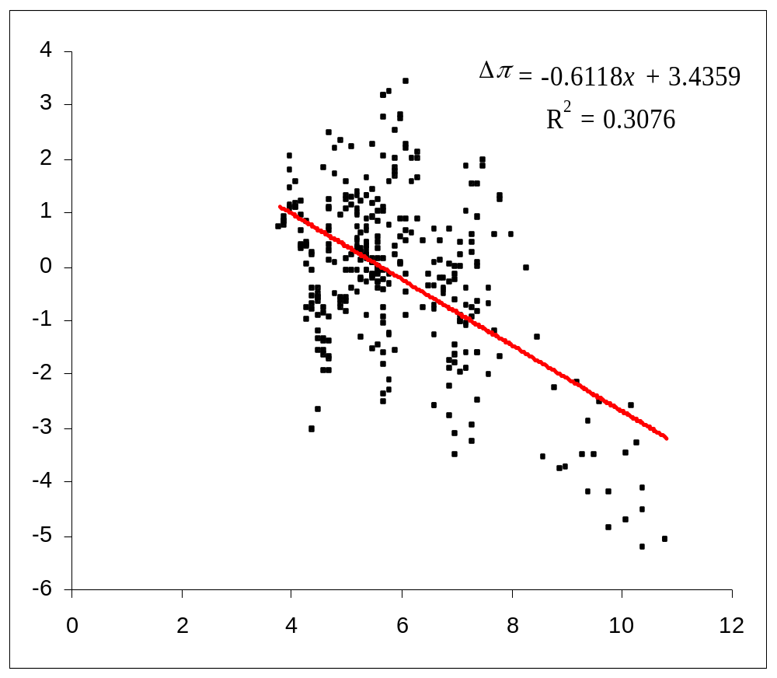
Augmented Phillips Curve
(monthly CPI, 1982-2008)
The Taylor Rule, NAIRU, and the Phillips Curve
This curve demonstrates how inflation reacts to unemployment in the economy
Change in the inflation rate
Thus,
inflation should fall by about
1.6% per year
Suppose the Fed expects future unemployment to
rise to 8%
Unemployment rate

Slide 93
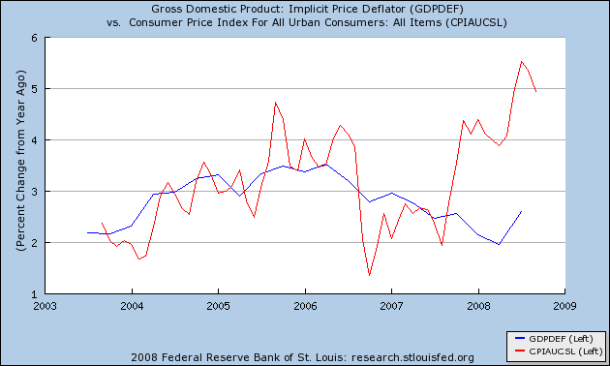
The Taylor Rule, NAIRU, and the Phillips Curve
With the inflation rate expected to fall by 1.6%,
the Implicit Price Deflator inflation rate
should fall from 2.6%
to 1%
2.6%
-1.6%
1%

Slide 94
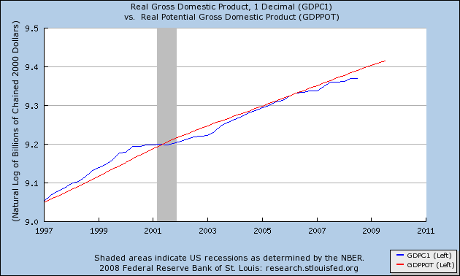
The Taylor Rule, NAIRU, and the Phillips Curve
The red line represents full-employment output, while the
blue line represents actual economic output.

Slide 95
The Taylor Rule, NAIRU, and the Phillips Curve
When the red line lies above the blue one the economy
is underperforming.

Slide 96
The Taylor Rule, NAIRU, and the Phillips Curve
When the red line lies below the blue one the economy
is overheating.

Slide 97
ln(GDP) – ln(GDP potential)
The Taylor Rule, NAIRU, and the Phillips Curve
Suppose the Federal Reserve expects the gap to continue to widen
9.404
9.369
-3.5%
Thus, the Projected GDP gap = (9.369 – 9.404)100%
= -3.5%
Jan

Slide 98
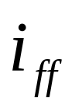
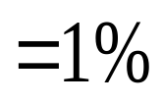
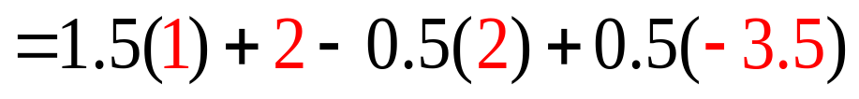
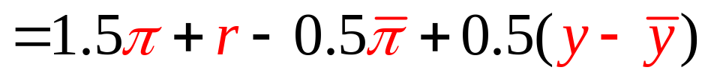
The Taylor Rule, NAIRU, and the Phillips Curve
Substituting in these values yields a Federal Funds rate target of
Expected future inflation (GDP Deflator)
1%
Expected GDP gap
–3.5%
Equilibrium interest rate
2%
Fed Inflation target
2%

Slide 99
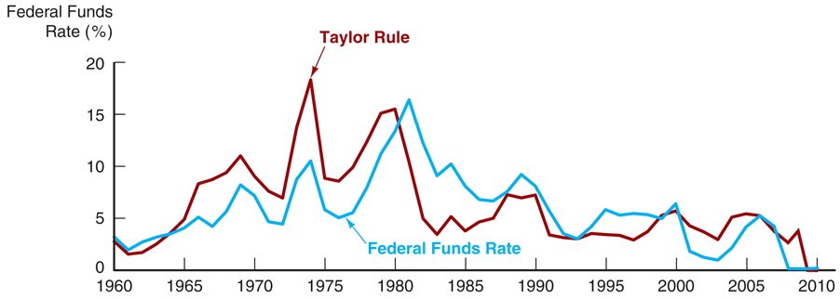
The Taylor Rule, NAIRU, and the Phillips Curve
Source: Federal Reserve; www.federalreserve.gov/releases and author’s calculations.

Slide 100
Lessons from the Global Financial Crisis
Developments in the financial sector have a far greater impact on economic activity than was earlier realized
The zero-lower-bound on interest rates can be a serious problem
The cost of cleaning up after a financial crisis is very high
Price and output stability do not ensure financial stability
How should Central banks respond to asset price bubbles?
  Asset-price bubble: pronounced increase in asset prices that depart from fundamental values, which eventually burst.
  Types of asset-price bubbles
    Credit-driven bubbles (subprime financial crisis)
    Bubbles driven irrational exuberance OR bad housing & monetary policies
  Strong argument for not responding to bubbles driven by irrational exuberance
  Bubbles are easier to identify when asset prices and credit are increasing rapidly at the same time (Isn’t this going on now?)
  Monetary policy should not be used to prick bubbles (or create them)

Slide 101
Lessons from the Global Financial Crisis
Macropudential policy: regulatory policy to affect what is happening in credit markets in the aggregate.
Monetary policy: Central banks and other regulators should not have a laissez-faire attitude and let credit-driven bubbles proceed without any reaction.
  What laissez-faire attitude?
  let credit-driven bubbles proceed without any reaction OR inflate them with bad easy credit and bad housing policy?

