Slide 1

Money & Banking
Video 02--Money Demand
What is Money? (Chapter 3)
Quantity Theory of Money (Chapter 20)
Hal W. Snarr
8/20/2015

Slide 2
Chapter 3
What is money?
Notes:
In the absence of money, goods and services are exchanged in a barter system where individuals directly exchange the surplus from the fruits of their labor.
Farmer Ted has 50-pound sacks of potatoes & wants coffee or a horse.
Ted lugs around 50-pound sacks of potatoes while seeking those with surplus coffee or a horse and wants potatoes.
If Ted cannot find anyone to make either exchange, he has to find someone who wants potatoes and has something horse owners need.
Horse owners have a commodity that cannot be converted into smaller units that can be exchanged for an ice cream soda or haircut.

Slide 3
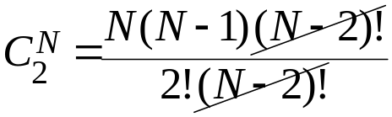
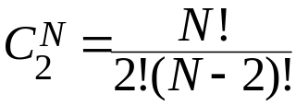
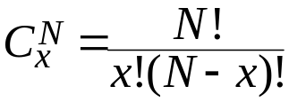
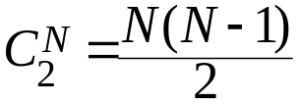
Money
In the absence of money, goods and services are exchanged in a barter system where individuals directly exchange the surplus from the fruits of their labor.
  The following gives the number of barter prices there would be in an economy with N goods, with x = 2 because exchanges are done in pairs:
  Among competing forms of money, the least marketable tend
  to be one by one rejected until at last only a single commodity
  remained, which was universally employed as a medium of exchange – Mises, 1953, pp. 32-33
  The winner of this contest is durable, divisible, transportable, and difficult to counterfeit.
Notes:
double coincidence: Sellers demand money for their goods, but not everyone has demand for all goods
A seller accepts it because she believes when she needs it in the future to buy goods it will be accepted by sellers of those goods
A buyer holds and uses it because she believes the seller of a good or service will accept it.
It is a unit of account (i.e., prices are quoted in terms of money)
It serves as a store of value even though it may not be a perfect store of value because it loses value during inflation
It is easily standardized
It is widely accepted
It is divisible
It is easy to carry
It does not deteriorate quickly
Anything that is regularly used in exchange.
Gold
Silver
Pots
Iron
Copper
Rum
Big Stones
Wine
Corn
Sheep
Whale Teeth
Polished Beads (Wampum)
Cigarettes
Coat check tickets?
The Shawshank Redemption, inmates exchanged cigarettes for posters, whiskey, and playing cards.
In Time depicts a future where time is literally money that is used to purchase immortality.
When the inhabitants of one country became more dependent on those of another, and they imported what they needed, and exported what they had too much of, money necessarily came into use – Aristotle (in Politics)

Slide 4
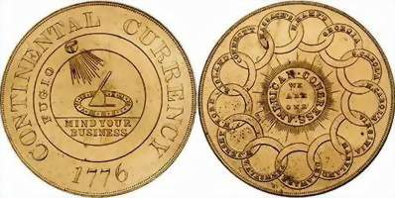
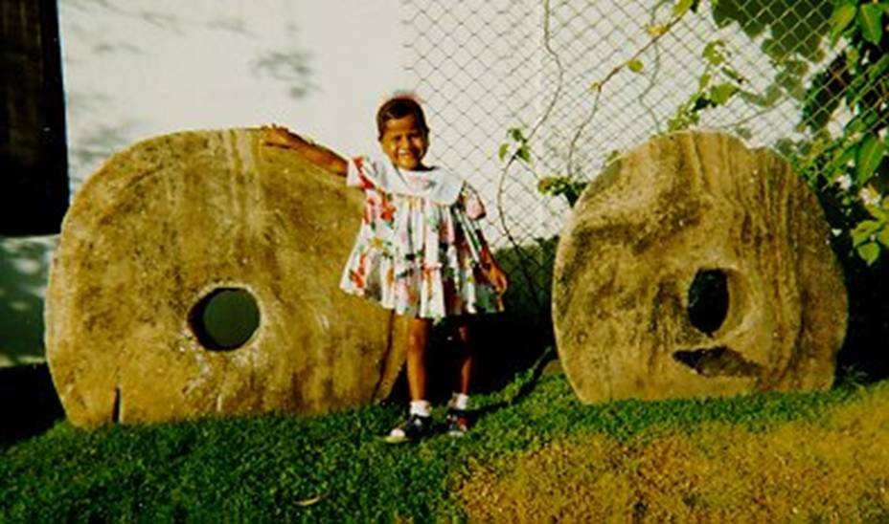

Money
Commodity Money:
Gold coins in 1776-Colonial America
Stone Money, Island of Yap
“Tiger Tongue” from Siam, Bronze Coin
Notes:
Coins were first minted between 700 and 500 BC (Weatherford, 1997)

Slide 5
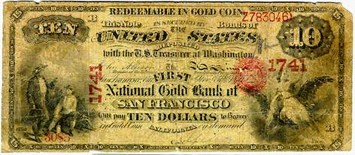
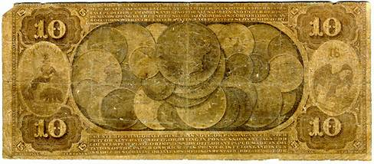
Money
Gold
Paper Money is backed by something like
Notes:
chiao-tzu was the first paper money
issued in 10th century Szechwan, China (Lui, 1983).
It was a bank receipt for iron Chinese coins deposited in Szechwan banks.

Slide 6
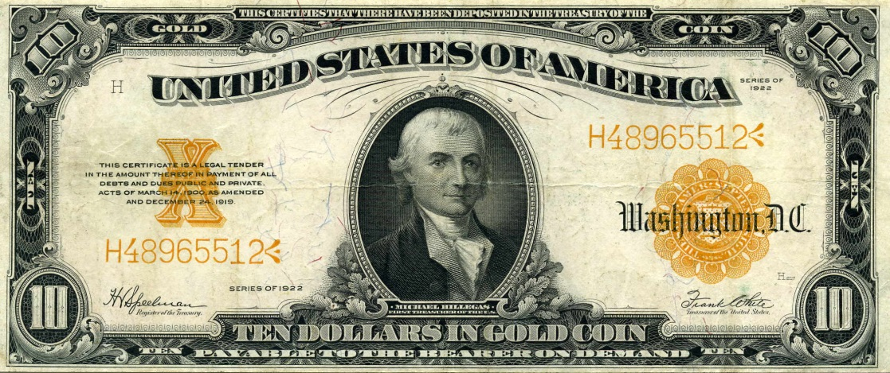
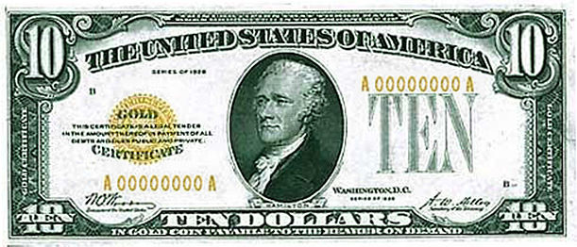
Money
Gold
Paper Money is backed by something like
Notes:
In 16th century London, goldsmiths began charging fees for safely storing gold coins.
The receipts were redeemable to only the depositor unless ‘or bearer’ was printed next to his or her name.
In 1694, the Bank of England began issuing receipts called banknotes called the British Pound.
The notes circulated as money because they were redeemable in gold.

Slide 7
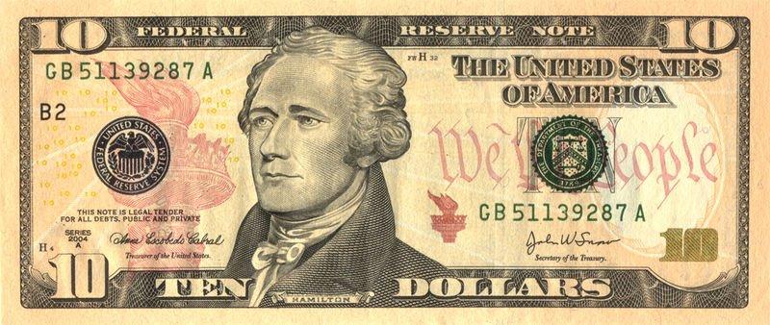
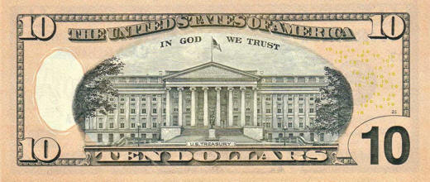
Money
Gold
Fiat Money: gov’t decreed money backed by
Notes:
When the Szechwan government took control of this money in 1023, chiao-tzu became the world’s first fiat money, money backed not by commodities but by government decree.
… in the U.S.’s case, backed by God
In 1931, the British Pound became fiat money when the United Kingdom abandoned the gold standard.
In the U.S., converting the dollar into fiat money took nearly forty years perhaps a result of the classical-liberal founding principles
FDR ended the gold standard in domestic exchanges and restricted private ownership of gold with the Emergency Banking Act of 1933, EO 6102, and the Gold Reserve Act of 1934.
President Nixon completed the process, ending he gold standard in foreign exchanges, when he issued EO 11615 in 1971.
Meanwhile, In God We Trust began appearing on U.S. paper money in 1957.
Hence, presidents from FDR to Nixon removed the ‘l’ in ‘gold’ on the dollar, which slowly transitioned it from the gold standard to the God standard.

Slide 8
Money
Checks:
Electronic Payment
E-Money (electronic money):
  Debit card
  Stored-value card (smart card)
  E-cash
Are We Headed for a Cashless Society?
Louisiana House Bill 195 bans cash on all second-hand transactions, which passed near unanimously with one nay vote in the senate. (www.forbes.com)
http://www.youtube.com/watch?v=7ujgi4rXsiQ
www.youtube.com/watch?v=yrGMgsJQGUE
Notes:
Predictions of a cashless society have been around for decades, but they have not come to fruition
Although e-money might be more convenient and efficient than a payments system based on paper, several factors work against the disappearance of the paper system
Still, the use of e-money will likely still increase in the future
So, when a good Louisianian holds a garage sale after a bout of spring cleaning, if they accept cash for their old vinyl collection, they’ve broken the law.

Slide 9
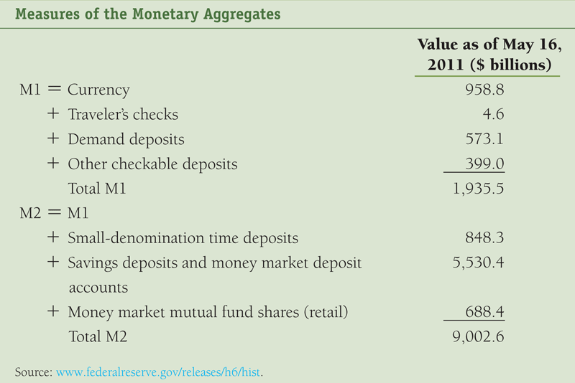


Money
Table 1
Notes:
Construct monetary aggregates using the concept of liquidity
M1 (most liquid assets)
M2 (adds to M1 other assets that are not so liquid)
M1 + small denomination CDs + savings deposits and money market deposit accounts + money market mutual fund shares.
money market deposit accounts = a cross between a checking and a savings account, which earn slightly higher interest than interest-earing checking accounts because the number of deposits or withdrawals are more limited
money market mutual fund shares = investment pools that buy safe, short-term securities like T-bills, CDs, commercial paper (an short term IOU issued by a firm needing money to finance accounts receivable or inventories).

Slide 10
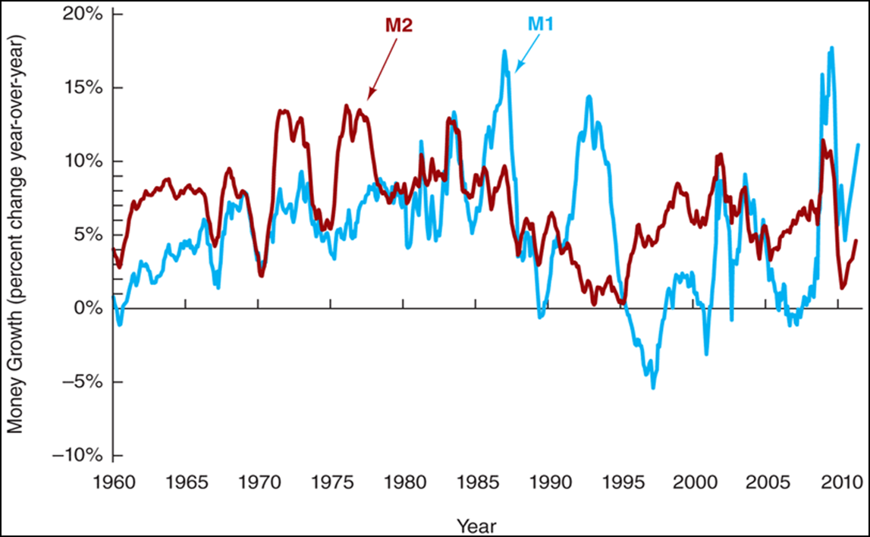
Figure 1 Growth Rates of M1 & M2
Money
www.federalreserve.gov/releases/h6/Current
Notes:
M1 and M2 can move in different directions in the short run
Conclusion: the choice of monetary aggregate is important for policymakers
In the U.S., each person holds about $2,000 of currency
Most of it is held by Criminals and Foreigners

Slide 11
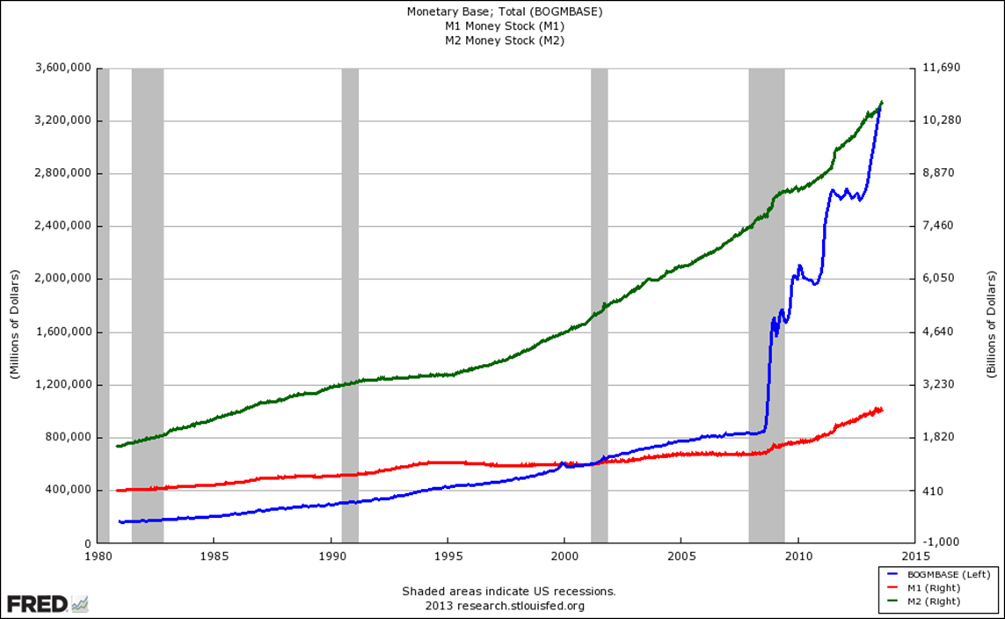
Money
http://research.stlouisfed.org/fred2/graph/?id=BOGMBASE#
M1, M2 and the Monetary Base
Notes:
MB = high-powered money = C + R

Slide 12
Chapter 20
Quantity Theory of Money?
Notes:
From the QTM, came the fisher’s Money demand model, which Keynes, and then Friedman extended. Money demand is simply the amount of money consumers and firms are willing to HOLD at given interest rate.

Slide 13

Fisher’s Equation of Exchange
Irving Fisher’s equation of exchange
Mainstream economics defines inflation as a general increase in the prices of products
π = P_{is}/P_{was} – 1 > 0
Demand-pull inflation
Cost-push inflation
Excessive growth in the quantity of money
> 0
Notes:
Irving Fisher (1911) The Purchasing Power of Money
P = Price level
Y = real GDP
M = quantity of money
V = velocity of money, the number of times a 1$ bill is used to buy products in a specific period of time
The QTM assumes V is determined and stable.
If people use ATM machines, debit cards, interest bearing checking accounts, and e-payments more, the velocity of money increases.
If people begin using credit cards and charge accounts, V falls.
Samuelson: velocity is not constant because “You can lead a horse to water, but you can’t make him drink. You can force money on the system in exchange for government bonds, its close money substitute; but you can’t make the money circulate against new goods and new jobs.”
Austrian Economist Henry Hazlitt noted that when money is newly introduced, the price level increases by a smaller proportion than the increase in the supply of money, but that when the money has been in circulation for a while, that the price level has increased by a greater proportion than the supply of money. This is due to "fears . . . that the inflation will continue into the future, and that the value of the monetary unit will fall further." It’s not the velocity of money that determines the value of a currency, but rather the sum of individuals' value of the currency that determines the velocity of money.
Ludwig von Mises: "The main deficiency of the velocity of circulation concept is that it does not start from the actions of individuals but looks at the problem from the angle of the whole economic system. This concept in itself is a vicious mode of approaching the problem of prices and purchasing power. It is assumed that, other things being equal, prices must change in proportion to the changes occurring in the total supply of money available. This is not true."

Slide 14
Fisher’s Equation of Exchange
Demand-pull inflation
LRAS
15.5
π
= 15.5/14.5 – 1
= 6.9%
14.5
SRAS
AD
15
16
Notes:
In Keynesian theory, increased employment pushes aggregate demand out, which leads to further hiring by firms to increase output. Due to capacity constraints, this increase in output will eventually become so small that the price of the good will rise.

Slide 15
Fisher’s Equation of Exchange
Demand-pull inflation
LRAS
16.5
15.5
π
= 14.8%
= 16.5/14.5 – 1
14.5
SRAS
AD
15
16

Slide 16
Fisher’s Equation of Exchange
Demand-pull inflation?
LRAS
15.5
π
= 14.5/14.5 – 1
= 0%
14.5
SRAS
AD
15
16
17

Slide 17
Fisher’s Equation of Exchange
Cost-push inflation
LRAS
15.5
π
= 15.5/14.5 – 1
= 6.9%
14.5
SRAS
AD
14
15

Slide 18
Fisher’s Equation of Exchange
Cost-push inflation?
LRAS
15.5
π
= 14.5/14.5 – 1
= 0%
14.5
SRAS
AD
14
15

Slide 19
Fisher’s Equation of Exchange
If Velocity of money is fairly constant in short run and u = u_{n},
an increase in the quantity of Money
the Price level increases
LRAS
16.5
15.5
14.5
A
SRAS
AD
15
16
Notes:
an increase in the quantity of Money caused by Fed action that lowers interest rates, will push AD out

Slide 20
Fisher’s Equation of Exchange
Excessive growth in the quantity of money
causes inflation
Who agrees?
Milton Friedman (The Counter-Revolution in Monetary Theory):
Inflation is always and everywhere a monetary phenomenon in the sense that it is and can be produced only by a more rapid increase in the quantity of money than in output.

Slide 21

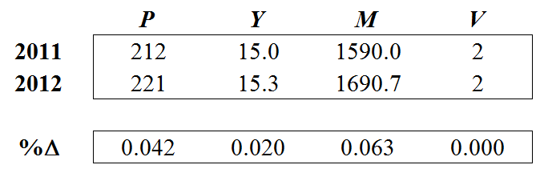
Quantity Theory of Money
Assuming V is constant in the short run gives the quantity theory of money (QTM)
Nominal income is determined by changes in the quantity of money
The above can be written as follows
+
≈
+
Notes:
Fisher and other classicalists believe V is normally constant in the short run.
Recently, central banks massively expanded money supplies, but instead of lifting nominal GDP as predicted by this theory, velocity fell as nominal GDP was relatively unchanged
This may have been caused by many factors.
Millions deleveraged (paying off loans and credit cards) in the wake of the crisis.
Banks were being paid interest on reserves, money that could have been lent out to the private sector.

Slide 22


Quantity Theory of Money
Assuming V is constant in the short run gives the quantity theory of money (QTM)
Nominal income is determined by changes in the quantity of money
The above can be written as follows
π
The quantity theory of money is also a theory of inflation

Slide 23
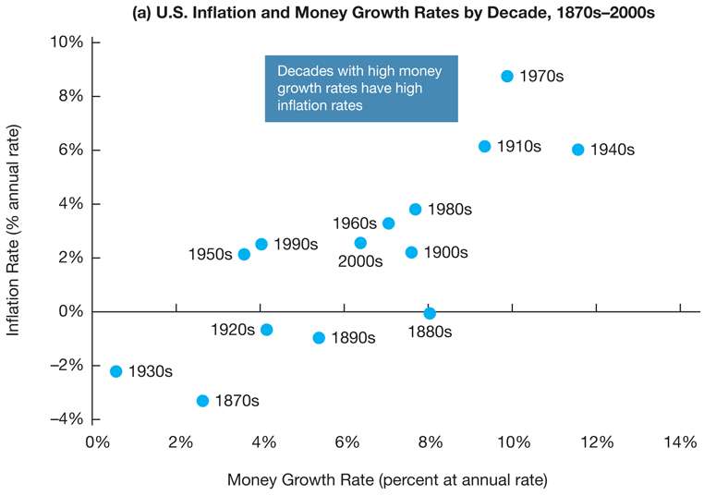
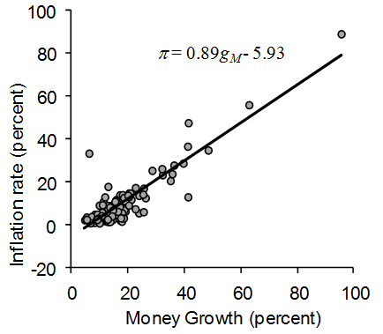
Figure 1
Quantity Theory of Money
Sources: For panel (a), Milton Friedman and Anna Schwartz, Monetary trends in the United States and the United Kingdom: Their Relation to Income, Prices, and Interest Rates, 1867–1975, Federal Reserve Economic Database (FRED), Federal Reserve Bank of St. Louis, http://research.stlouisfed.org/fred2/categories/25 and Bureau of Labor Statistics at http://data.bls.gov/cgi-bin/surveymost?cu.
Source: IFS data for 120 countries, averaged over years 1996-2004
Notes:
Decades with high money growth rate in the US have high inflation.

Slide 24
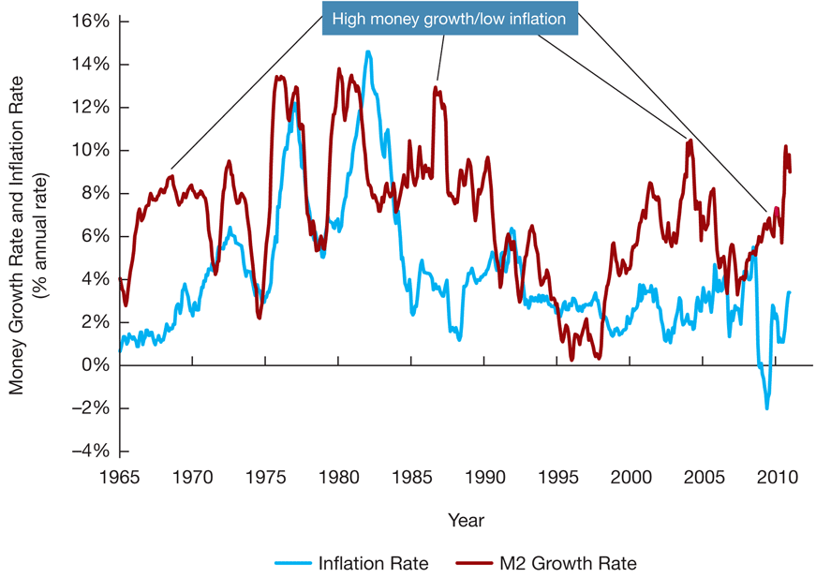
Figure 2
Quantity Theory of Money
High Money Growth & low inflation
Sources: FRED, Federal Reserve Economic Data, Federal Reserve Bank of St. Louis; Bureau of Labor Statistics, http://research.stlouisfed.org/fred2/categories/25; accessed September 30, 2010.

Slide 25
Quantity Theory of Money
Figure 2
… but high money growth is followed by accelerating inflation
Sources: FRED, Federal Reserve Economic Data, Federal Reserve Bank of St. Louis; Bureau of Labor Statistics, http://research.stlouisfed.org/fred2/categories/25; accessed September 30, 2010.

Slide 26
Quantity Theory of Money
Government expenditures is paid for by
Raising tax revenue
Treasuries can print money
    In the U.S., the Fed buys bonds directly from Treasury
Treasuries can sell more bonds
    If the deficit is financed by selling bonds to the public, there is no effect on the MB = R + C, and on the MS
    If the deficit is financed by the Fed buying bonds from banks, the MB and MS increase
    $1 could buy 11% more goods in 1912 than in 1776
    $1 could buy 95% fewer goods in 2008 than in 1913
$1m held from 1913 to 2008 is worth $50k
www.lewrockwell.com/2009/07/erik-voorhees/the-record-of-the-federal-reserve/
Notes:
After the Fed, if in 1913, you sat on your savings pile of $1,000,000 for95 years, it would then be worth only $50,000 in purchasing power (it will have depreciated in value by 95%)

Slide 27
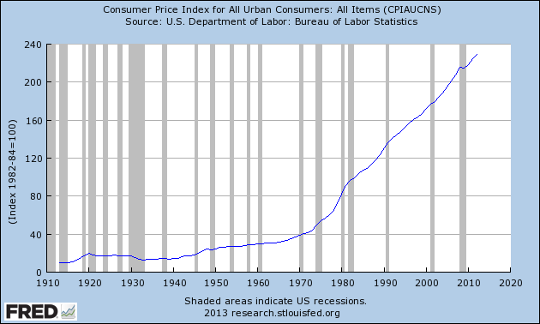
Quantity Theory of Money
Example – CPI data from the FRED
Notes:
After the Fed, if in 1913, you sat on your savings pile of $1,000,000 for95 years, it would then be worth only $50,000 in purchasing power (it will have depreciated in value by 95%)

Slide 28
Quantity Theory of Money
Hyperinflation is a period of high inflation (> 50% per month)
Larry Allen’s The Encyclopedia of Money:
Bolshevik Revolution
    Prior to 1917, prices rose 2 to 3 times faster than wages.
    After 1917, prices rose by
    92,300% from 1913 to 1919
    64,823,000,000% from 1913 to 1923
Post WWI Germany
    In 1914, there were 6,323 million marks in circulation
    By 1923 there were 17,393,000 million.
    A newspaper costing one mark in May 1922 cost 1,000 marks 16 months later, and 70 million marks a year and a half later.
    At its worst,
    Customers rolled wheelbarrows full of money to the grocery store
    Customers and restaurants negotiated the cost of meals in advance
    Printed money was bailed like hay to heat one’s home.
    It took about 4 days for prices to double

Slide 29
Quantity Theory of Money
Hyperinflation is a period of high inflation (> 50% per month)
Erich Maria Remarque’s The Black Obelisk:
  Workmen are given their pay twice a day now--in
  the morning and in the afternoon, with a recess
  of a half-hour each time so that they can rush
  out and buy things--for if they waited a few
  hours the value of their money would drop
Steve Hanke’s R.I.P. Zimbabwe Dollar:
The time it took for prices to double in
  1994 Yugoslavia, 33.6 hours
  2008 Zimbabwe, 24.7 hours
  1946 Hungary, 15.6 hours

Slide 30
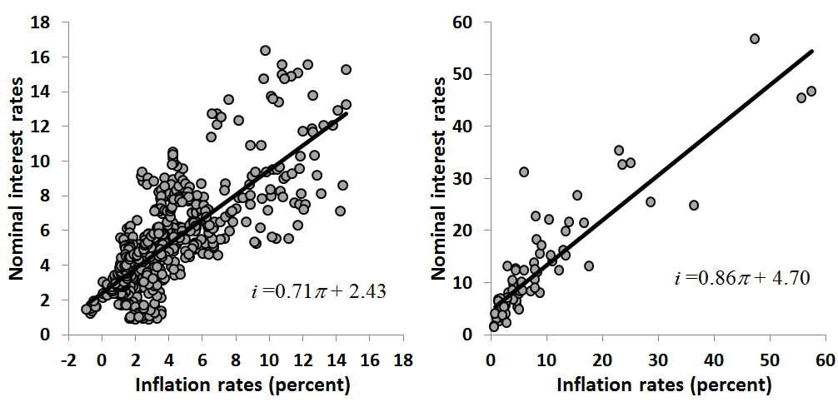
Quantity Theory of Money
The Fisher Effect: Rising inflation (caused by excessive money growth) raises the nominal rate of interest (i)
i = r + π
Source: Federal Reserve Economic Data (FRED)
Source: IFS data for 120 countries, averaged over years 1996-2004

Slide 31
Quantity Theory of Money
The Fisher Effect: Rising inflation (caused by excessive money growth) raises the nominal rate of interest (i)
i = r + π
e
Using current inflation assumes inflation does not change.
Future r will be different from what it was expected to be when loans were signed.
Borrowers do better and lenders do worse when loans are repaid with devalued money.
In an uncertain world, the Fisher Effect must account for uncertainty
π_{e} is commonly estimated using
    the difference between the yields on TIPS and Treasuries (TIPS spread)

Slide 32
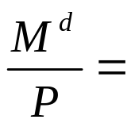

Money Demand
Fisher
i
M
billions $
Notes:
Fisher
Assume the market for money is in equilibrium, M^{s} = M^{d}, and express Fisher’s equation of exchange as
Because V is constant, the level of transactions generated by a fixed level of PY determines the quantity of M^{d}.
Although many argue that i is the price of holding money, Fisher’s demand for money is not affected by it.

Slide 33
Money Demand
Fisher
Example: P = 1, V = 1.5, Y = 15,000, r_{b} = 2, r_{e} = 4, π_{e} = 3
i
M
billions $

Slide 34
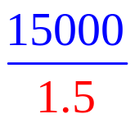
Money Demand
Fisher
Example: P = 1, V = 1.5, Y = 15,000, r_{b} = 2, r_{e} = 4, π_{e} = 3
i
M
billions $

Slide 35

Money Demand
Fisher
Example: P = 1, V = 1.5, Y = 15,000, r_{b} = 2, r_{e} = 4, π_{e} = 3
i
MD_{Fisher}
10000
M
billions $

Slide 36
Money Demand
Fisher
Example: P = 1, V = 1.5, Y = 15,000, r_{b} = 2, r_{e} = 4, π_{e} = 3
i
MD_{Fisher}
15
2.5
10000
M
billions $

Slide 37

Money Demand
Keynes
i
MD_{Fisher}
2.5
10000
M
billions $
Notes:
Keynes (Liquidity Preference Theory)
Transactions motive for holding money is
Keynes agreed with the quantity theory that the transactions component is proportional to income
He later recognized that technological advances will create methods for payment (payment technology), which affects money demand
Precautionary motive for holding money
Keynes also recognized that people hold money as a cushion against unexpected wants, which is proportional to income
i is negatively related to the precautionary demand for money because as it increases the opportunity cost of holding money for precautionary reasons rises
Speculative motive for holding money
Keynes also believed people choose to hold money as a store of wealth
Liquidity Preference Function
When Keynes put the 3 motives together, he recognized that people make decisions based on the real value of the money they hold (M^{d}/P) not its nominal value (M^{d})
He identified i and Y as its determinants:
M/P = L(Y,i)
Rearranging:
P/M = 1/L(Y,i)
PY/M = Y/L(Y,i)
V = Y/L(Y,i)
Because i fluctuates in the short-run, so does V.
Increases in i decrease real money demand, which increases V
This challenges QTM’s view that nominal income is determined by M

Slide 38

Money Demand
Keynes
Example: P = 1, V = 1.5, Y = 15,000, r_{b} = 2, r_{e} = 4, π_{e} = 3
i
MD_{Fisher}
2.5
10000
M
billions $

Slide 39

Money Demand
Keynes
Example: P = 1, V = 1.5, Y = 15,000, r_{b} = 2, r_{e} = 4, π_{e} = 3
i
MD_{Fisher}
2.5
10000
M
billions $

Slide 40

Money Demand
Keynes
Example: P = 1, V = 1.5, Y = 15,000, r_{b} = 2, r_{e} = 4, π_{e} = 3
i
MD_{Fisher}
2.5
10000
M
billions $

Slide 41

Money Demand
Keynes
Example: P = 1, V = 1.5, Y = 15,000, r_{b} = 2, r_{e} = 4, π_{e} = 3
i
MD_{Fisher}
2.5
10000
M
billions $

Slide 42

Money Demand
Keynes
Example: P = 1, V = 1.5, Y = 15,000, r_{b} = 2, r_{e} = 4, π_{e} = 3
i
MD_{Fisher}
2.5
10000
M
billions $

Slide 43

Money Demand
Keynes
Example: P = 1, V = 1.5, Y = 15,000, r_{b} = 2, r_{e} = 4, π_{e} = 3
i
MD_{Fisher}
2.5
10000
M
billions $

Slide 44

Money Demand
Keynes
i
MD_{Fisher}
2.5
MD_{Keynes}
10000
M
billions $

Slide 45

Money Demand
Friedman
i
MD_{Fisher}
2.5
MD_{Keynes}
10000
M
billions $
Notes:
permanent income or the expected long run average of current and future income
It links i to M^{d}
When i is low, people speculate it will rise in the future.
So, people adjust their expectations of future income upward, making money more attractive today
Y_{p} is more stable than Y because it is a long-run average, implying money demand is more stable than Keynes had posited.
r_{b} = the expected return on bonds
r_{e} = the expected return on stocks
r = the expected return on money
Friedman did not assume the r = 0 because it depends on bank services (e.g., check cashing, bill paying, and interest checking).
Money and goods are substitutes
Return spreads tend to be stable because returns tend to move together, implying M^{d} is not as sensitive to changes in i as Keynes posited.

Slide 46
Money Demand
Friedman
Example: P = 1, V = 1.5, Y = 15,000, r_{b} = 2, r_{e} = 4, π_{e} = 3
i
MD_{Fisher}
2.5
MD_{Keynes}
10000
M
billions $

Slide 47
Money Demand
Friedman
Example: P = 1, V = 1.5, Y = 15,000, r_{b} = 2, r_{e} = 4, π_{e} = 3
i
MD_{Fisher}
2.5
MD_{Keynes}
10000
M
billions $

Slide 48
Money Demand
Friedman
Example: P = 1, V = 1.5, Y = 15,000, r_{b} = 2, r_{e} = 4, π_{e} = 3
i
MD_{Fisher}
2.5
MD_{Keynes}
10000
M
billions $

Slide 49
Money Demand
Friedman
Example: P = 1, V = 1.5, Y = 15,000, r_{b} = 2, r_{e} = 4, π_{e} = 3
i
MD_{Fisher}
2.5
MD_{Keynes}
10000
M
billions $

Slide 50
Money Demand
Friedman
Example: P = 1, V = 1.5, Y = 15,000, r_{b} = 2, r_{e} = 4, π_{e} = 3
i
MD_{Fisher}
2.5
MD_{Keynes}
10000
M
billions $

Slide 51
Money Demand
Friedman
Example: P = 1, V = 1.5, Y = 15,000, r_{b} = 2, r_{e} = 4, π_{e} = 3
i
MD_{Fisher}
2.5
MD_{Keynes}
10000
M
billions $

Slide 52
Money Demand
Friedman
Example: P = 1, V = 1.5, Y = 15,000, r_{b} = 2, r_{e} = 4, π_{e} = 3
i
MD_{Fisher}
2.5
MD_{Keynes}
10000
M
billions $

Slide 53

Money Demand
Friedman
Example: P = 1, V = 1.5, Y = 15,000, r_{b} = 2, r_{e} = 4, π_{e} = 3
i
MD_{Fisher}
2.5
MD_{Keynes}
10000
M
billions $

Slide 54
Money Demand
Friedman
Example: P = 1, V = 1.5, Y = 15,000, r_{b} = 2, r_{e} = 4, π_{e} = 3
i
MD_{Fisher}
2.5
MD_{Keynes}
10000
M
billions $

Slide 55

Money Demand
Friedman
Example: P = 1, V = 1.5, Y = 15,000, r_{b} = 2, r_{e} = 4, π_{e} = 3
i
MD_{Fisher}
2.5
MD_{Keynes}
10000
M
billions $

Slide 56
Money Demand
Friedman
Example: P = 1, V = 1.5, Y = 15,000, r_{b} = 2, r_{e} = 4, π_{e} = 3
i
MD_{Fisher}
2.5
MD_{Keynes}
10000
M
billions $

Slide 57
Money Demand
Friedman
i
MD_{Friedman}
MD_{Fisher}
2.5
MD_{Keynes}
10000
M
billions $

Slide 58
Money Demand
  People and firms demand money because there are benefits to doing so because doing so makes it easier to pay for things.
  The marginal benefit of holding an additional dollar diminishes as the amount held increases.
  E.g., the benefit of holding $2 rather than $1 is greater than holding an additional dollar when one has $1000.
Holding the additional dollar is also costly
      interest is forgone
      inflation reduces its buying power.
    i = r + π_{e} is the price of holding money; as it rises, M^{d} falls.

Slide 59
Money Demand
Empirical evidence:
The quantity of money demanded increases as i falls.
i
MD
M
Notes:
… income because people with higher incomes have more transactions
… wealth because people with greater wealth have more resources to put into money
… risk of other assets because this makes money less risky, and more desirable
… payment technology because less need for holding money for transactions
… inflation risk because holding money is more risky, and less desirable
… increased liquidity of other assets because money is relatively less liquid, and less desirable

Slide 60
Money Demand
Empirical evidence:
The quantity of money demanded increases as i falls.
Money demand increases in
    income
    Wealth
    Risk of other assets
i
MD
M
Notes:
… income because people with higher incomes have more transactions
… wealth because people with greater wealth have more resources to put into money
… risk of other assets because this makes money less risky, and more desirable
… payment technology because less need for holding money for transactions
… inflation risk because holding money is more risky, and less desirable
… increased liquidity of other assets because money is relatively less liquid, and less desirable

Slide 61
Money Demand
Empirical evidence (Table 1):
The quantity of money demanded increases as i falls.
Money demand increases in
    income
    Wealth
    Risk of other assets
Money demand decreases in
    Payment technology
    Inflation risk
    Liquidity of other assets
i
MD
M
Notes:
… income because people with higher incomes have more transactions
… wealth because people with greater wealth have more resources to put into money
… risk of other assets because this makes money less risky, and more desirable
… payment technology because less need for holding money for transactions
… inflation risk because holding money is more risky, and less desirable
… increased liquidity of other assets because money is relatively less liquid, and less desirable

Slide 62
Money Demand
If Keynes is correct
money demand fluctuates with i
velocity oscillates and is unpredictable
the link between M and aggregate spending is weak
The Fed should target interest rates
If Friedman is correct
Money demand is relatively insensitive to changes i
velocity is stable and predictable
QTM’s view of aggregate spending being determined by M is more likely to be true
The Fed should target MS

