Slide 1

Money & Banking
Macro Review
Chapter 1
Hal W. Snarr
8/20/2015

Slide 2
GDP
Real GDP is determined by aggregate demand (AD) and short-run aggregate supply (SRAS)
SRAS
AD
GDP

Slide 3
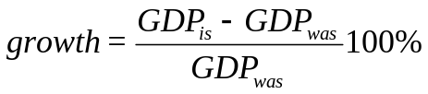
GDP
  The economic growth rate = the percent change in real Gross Domestic Product (GDP)
  Nominal GDP (nGDP) is the market value of all the final goods and services produced within a country exchanged in formal/legal markets during a given time period
    Nominal GDP is the economy’s output valued at the current year’s prices
    Real GDP is the economy’s output valued at the base year’s prices
  In practice, nominal GDP is computed using the income or expenditure approaches:
    nGDP = Wages + Interest + Rents + Profits
    + Indirect taxes – Subsidies + Depreciation
    + Statistical discrepancy
    nGDP = C + I + G + X – M
Notes:
Inclusions/exclusions in nGDP
Only the final goods and services count; e.g.,
Only the Dell computer you buy is counted, the parts inside the computer do not get counted
An Intel chip sold to your computer geek neighbor George is counted in GDP.
The 2008 Toyota you buy is counted, the tires that came with it are not counted.
Only goods that pass through organized/legal markets are counted.
Illegal gambling and drugs are not counted, neither are garage sales.
The “underground” economy is estimated by many to be more than 10% of GDP.
Leisure is not counted
GDP would be 44% higher if unpaid housework was included (Ann Chadeau, “What is Households’ Non-Market Production Worth?” OECD Economic Studies 18, 1992, pp. 85-103)
Only those goods produced within the boundaries of the USA are counted
Sales of used goods and existing homes are not counted
Purchases of stocks and bonds are not counted (these are loans not goods or services)
Wars and natural disasters over state GDP
Pollution (a bad) is not deducted from GDP

Slide 4
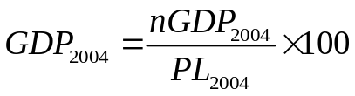
GDP
Nominal GDP and Real GDP
Year | GDP (GDP) | GDP deflator (GDPDEF) | Real GDP (GDPC1)
2003 | 11.511 | 86.7 | 13.277
2004 | 12.275 | 89.1 | 13.777
2005 | 13.094 | 92.0 | 14.233
2006 | 13.856 | 94.8 | 14.616
2007 | 14.478 | 97.3 | 14.880
2008 | 14.719 | 99.3 | 14.823
2009 | 14.419 | 100.0 | 14.419
2010 | 14.964 | 101.2 | 14.787
2011 | 15.518 | 103.3 | 15.022
2012 | 16.155 | 105.2 | 15.356
2013 | 16.663 | 106.9 | 15.587
2014 | 17.348 | 108.7 | 15.960
100 =
100 =
100 =
100 =
100 =
100 =
100 =
100 =
100 =
100 =
100 =
100 =
Notes:
Standard of Living over time
If the economic growth rate exceeds the grow rate of the population the current generation is better than previous generations
In 1967, real GDP in the United States was $3942.5 billion and the population of the United States was 198.712 million.
Real GDP per person in 1967 = $19,840
In 2008, real GDP in the United States was $13,312.2 billion and the population of the United States was 304.06 million.
Real GDP per person in 2008 = $43,781
If the population growth rate exceeds a country’s economic growth rate the current generation is worse off than previous generations.

Slide 5
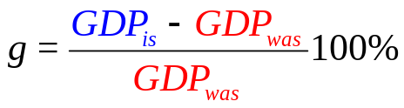
GDP
The economic growth rate
Year | Real GDP | Econ growth rate
2003 | 13.277
2004 | 13.777 | 3.77
2005 | 14.233 | 3.31
2006 | 14.616 | 2.69
2007 | 14.880 | 1.81
2008 | 14.823 | -0.38
2009 | 14.419 | -2.73
2010 | 14.787 | 2.55
2011 | 15.022 | 1.59
2012 | 15.356 | 2.22
2013 | 15.587 | 1.50
2014 | 15.960 | 2.39
An expansion occurs when the economic growth rate is positive.
A recession occurs when g is negative for 2 consecutive quarters.
A depression is a long lasting (persistent) recession

Slide 6
Price Level
PL and real GDP are determined by AD and SRAS
SRAS
PL
AD
GDP

Slide 7
Price Level
Suppose I am the “typical” urban consumer (we had infant triplets during the making of this video) and that the government interviews me to determine what goods should be in the CPI market basket.
Good | Average quantity purchased per month | Price on 11/14 | Total Cost
box of formula | 13 | 30 | 390
TVs | 0.01 | 800 | 8
Computers | 0.01 | 500 | 5
Minivan | 0.001 | 15000 | 15
Snickers | 30 | 0.5 | 15
Can of coffee | 5 | 4 | 20
six packs of Busch Light | 0 | 9 | 0
Box of Diapers | 3 | 32.8 | 98.4
Pounds of chicken | 2 | 3 | 6
Pounds of hamburger | 2 | 10 | 20
Boxes of Raisin Bran | 4 | 3 | 12
Cable TV | 1 | 74.98 | 74.98
Bunch of Bananas | 5 | 2 | 10
Cost of the CPI basket in 11/14 =
$674.38
PL_{11/14} =
Notes:
The Consumer Price Index (CPI) is a common measure of the PL
BLS calculates the CPI every month by computing a weighted average of the prices paid by urban consumers for a fixed market basket of consumer goods and services.
CPI is calculated each month by holding quantities in the basket constant over time.
The CPI basket in 2007 is based on information obtained from the Consumer Expenditure Survey conducted during 2005.
The survey is used to assign weights to each item in the CPI basket to reflect the average urban household’s consumption behavior.
Because the CPI is used to measure price changes, it is important that the prices recorded refer to exactly the same items.
We can use these numbers in the CPI to compare what a fixed basket of goods costs this month with what it cost in some previous month.

Slide 8
Price Level
  PL_{current year}
  CPI_{current year} = 100%
  PL_{base year}
Month | PL | CPI (CPIAUCSL)
4/1983 | 279.93 | 98.70
5/1983 | 281.63 | 99.30
6/1983 | 282.48 | 99.60
7/1983 | 283.62 | 100.00
8/1983 | 284.47 | 100.30
9/1983 | 285.89 | 100.80
10/1983 | 286.74 | 101.10
11/1983 | 287.30 | 101.30
8/2014 | 675.36 | 238.12
9/2014 | 675.97 | 238.34
10/2014 | 676.34 | 238.47
11/2014 | 674.38 | 237.78
12/2014 | 672.16 | 236.99
1/2015 | 667.59 | 235.38
2/2015 | 669.03 | 235.89
Base year = 1983
100 X
/283.62 =
100 X
/283.62 =
100 X
/283.62 =
100 X
/283.62 =
100 X
/283.62 =
100 X
/283.62 =
100 X
/283.62 =
100 X
/283.62 =
Numbers in the CPI are percentages
100 X
/283.62 =
100 X
/283.62 =
100 X
/283.62 =
100 X
/283.62 =
100 X
/283.62 =
100 X
/283.62 =
100 X
/283.62 =
Notes:
Costs of expected inflation
Menu costs – change posted prices
Shoe leather costs – make more trips to the bank and search costs
Psychic dislike – people don’t like paying more for the same stuff
Inflation taxes – fixed interest rates
Inflation decreases the purchasing power of the dollar
The dollar does not go as far as it use to
The nominal value of some thing is in current dollars.
The real value of some thing is measured in the dollars of a given reference base year (e.g., CPI’s base year is 1983, GDP Deflator’s base year is 2005).
Macroeconomics makes a big issue of the distinction between nominal values and real values:
Nominal price and real price
Nominal wage rate and real wage rate
Nominal interest rate and real interest rate
Nominal GDP and real GDP

Slide 9
Price Level
The inflation rate
Month | CPI | Inflation
11/2013 | 234.04
12/2013 | 234.70
1/2014 | 235.13
2/2014 | 235.36
3/2014 | 235.79
4/2014 | 236.24
5/2014 | 236.95
6/2014 | 237.35
7/2014 | 237.60
8/2014 | 237.41
9/2014 | 237.63
10/2014 | 237.75
11/2014 | 237.07 | 1.29
12/2014 | 236.28 | 0.68
1/2015 | 234.68 | -0.19
2/2015 | 235.19 | -0.07
  CPI_{is} – CPI_{was}
  Inflation = 100%
  CPI_{was}
Inflation is a positive percent increase in the price level.
Disinflation occurs when inflation decreases overtime.
Deflation is a negative percent change in the price level.

Slide 10
Price Level
Nominal price and real price
  To compare dollar amounts at different dates, we need to know the CPI at those dates.
  The price of a Hershey bar in 1936 cost 5 cents (1.5 oz) but now costs $1.10 (1.55oz) (see: http://www.foodtimeline.org/foodfaq5.html)
Nominal Price
Nominal Price
Price of a 1936 Hersey in 1936$
= 5₵
CPI₂₀₀₉
CPI₁₉₃₆
Price of a 1936 Hersey in 2009$
= Price₁₉₃₆ ×
Notes:
Spend time helping students appreciate the distinction between real values and nominal values.

Slide 11
Price Level
Nominal price and real price
  To compare dollar amounts at different dates, we need to know the CPI at those dates.
  The price of a Hershey bar in 1936 cost 5 cents (1.5 oz) but now costs $1.10 (1.55oz) (see: http://www.foodtimeline.org/foodfaq5.html)
Price of a 1936 Hersey in 1936$
= 5₵
CPI₂₀₀₉
CPI₁₉₃₆
Price of a 1936 Hersey in 2009$
= Price₁₉₃₆ ×
Notes:
Spend time helping students appreciate the distinction between real values and nominal values.

Slide 12
Price Level
Nominal price and real price
  To compare dollar amounts at different dates, we need to know the CPI at those dates.
  The price of a Hershey bar in 1936 cost 5 cents (1.5 oz) but now costs $1.10 (1.55oz) (see: http://www.foodtimeline.org/foodfaq5.html)
Price of a 1936 Hersey in 1936$
= 5₵
CPI₂₀₀₉
CPI₁₉₃₆
Price of a 1936 Hersey in 2009$
= Price₁₉₃₆ ×
216.18
14
The real
price of a candy bar purchased
= 5₵ ×
= 77₵
Notes:
Spend time helping students appreciate the distinction between real values and nominal values.

Slide 13
Inflation and Economic Growth
An increase in AD
(16-15)/15 × 100
(250-230)/230 × 100
inflation =
growth =
8.7%
6.7%
PL
SRAS
250
230
AD
AD
15
16
GDP

Slide 14
Inflation and Economic Growth
A decrease in AD
(13-15)/15 × 100
(180-230)/230 × 100
inflation =
growth =
-21.7%
-13.3%
PL
SRAS
230
180
AD
AD
13
15
GDP

Slide 15

Real Interest Rate
Nominal and Real Interest Rates
  Nominal interest rate (i) is the rate quoted in loan and deposit agreements. It compensates the lender for the risks that he/she takes on when lending money to borrowers.
  Real interest rate (r) is the nominal interest rate less inflation (π_{e})

Slide 16
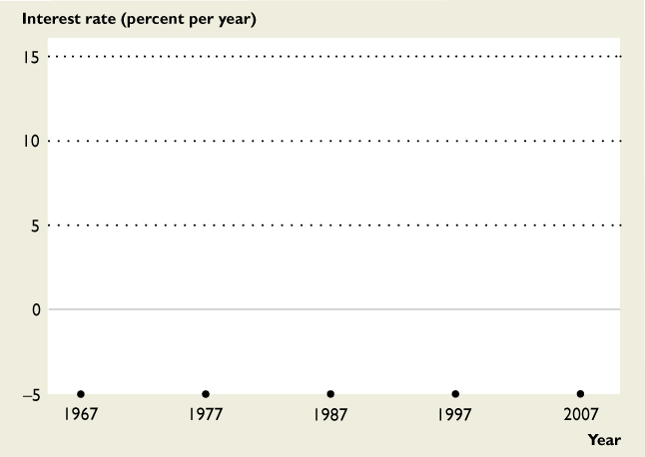
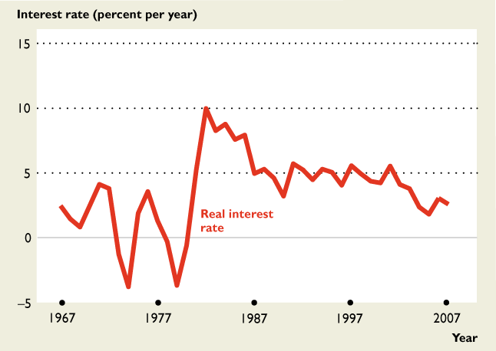
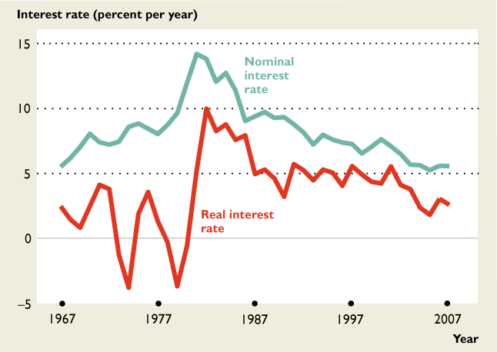
Real Interest Rate
Nominal and Real Interest Rates
  Nominal interest rate (i) is the rate quoted in loan and deposit agreements. It compensates the lender for the risks that he/she takes on when lending money to borrowers.
  Real interest rate (r) is the nominal interest rate less inflation (π_{e})
The figure shows real and nominal interest rates: 1967–2007.
During the 1970s, the real interest rate became negative.
The nominal interest rate increased during the high-inflation 1980s.
Inflation = ?%
Inflation = ? %

Slide 17
Unemployment
U = L – E
U .
L
u = x 100%
Year | Labor Force (CLF16OV) | Employed (CE16OV) | Unemployed (UNEMPLOY) | u (UNRATE)
2007 | 153.123 | 146.050 | 7.073 | 4.62
2008 | 154.322 | 145.373 | 8.948 | 5.80
2009 | 154.189 | 139.894 | 14.295 | 9.27
2010 | 153.885 | 139.077 | 14.808 | 9.62
2011 | 153.618 | 139.882 | 13.737 | 8.94
2012 | 154.966 | 142.467 | 12.498 | 8.06
2013 | 155.387 | 143.932 | 11.455 | 7.37
2014 | 155.899 | 146.303 | 9.596 | 6.16
=
Types of unemployment
Frictional (u_{f} ): workers temporarily between jobs because of a move/career change.
Structural (u_{s} ): workers displaced by automation.
Cyclical (u_{c} ): workers who loose their jobs due to recession.
u = u_{f} + u_{s} + u_{c}
Natural rate of unemployment (u_{n} ≈ 5%): It’s the rate at which inflation remains constant.
u_{f} + u_{s} = 5%
u_{c} = 1.16%
Notes:
The Current Population Survey is a joint project of the BLS and the Bureau of the Census
Every month, 1,600 CPS interviewers survey 60,000 households to establish job market status of each member of the household.
Working-age population (WAP) = all people aged 16 years and over not jailed, hospitalized, institutionalized nor in the U.S. Armed Forces. (WAP = L + those not in L )
Labor force (L) is the number of people employed plus the number unemployed (L = E + U ).
The CPS counts as employed (E ) all those in the WAP who, during the prior week, either
Worked at least 1 hour in a paid job or 15 hours unpaid in family business.
Were not working but who had jobs from which they were temporarily absent.
The CPS counts as unemployed (U ) all those in the WAP who, during the prior week,
Weren’t working but were available for work,
Looked for work during the previous 4 weeks OR were waiting to be recalled to a job from which they had been laid off.

Slide 18
Unemployment
Recessionary Gap
  A recessionary gap occurs when GDP is less than potential GDP.
  Resources, capital, and workers are not being fully utilized, and so u is high.
  As a result, there is downward pressure on wages
PL
LRAS
SRAS
inflation =
-21.7%
(180-230)/230 × 100
growth =
15.4%
(15-13)/13 × 100
230
180
AD
13
15
GDP

Slide 19
Unemployment
Inflationary Gap
  An inflationary gap occurs when GDP exceeds potential GDP.
  Workers are working overtime and firms are competing for their labor, resulting in low u
  As a result, there is upward pressure on wages
230
PL
LRAS
SRAS
(380-230)/230 × 100
inflation =
65.2%
380
growth =
-6.3%
(15-16)/16 × 100
AD
AD
15
16

Slide 20




Unemployment & Inflation
Source: http://www.bls.gov/

Slide 21
Unemployment & Inflation
Source: http://www.bls.gov/

Slide 22
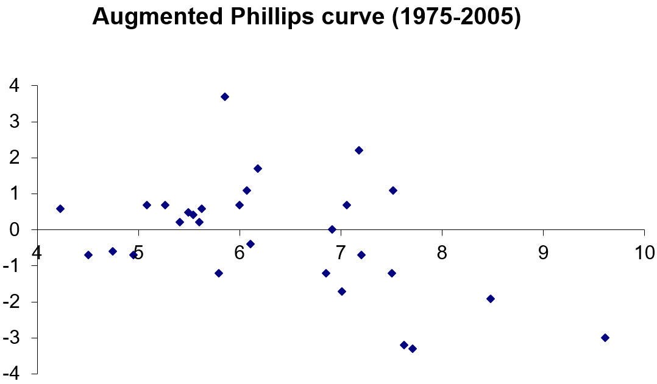
Unemployment & Inflation
NAIRU or Natural Rate of unemployment
Source: http://www.bls.gov/

Slide 23
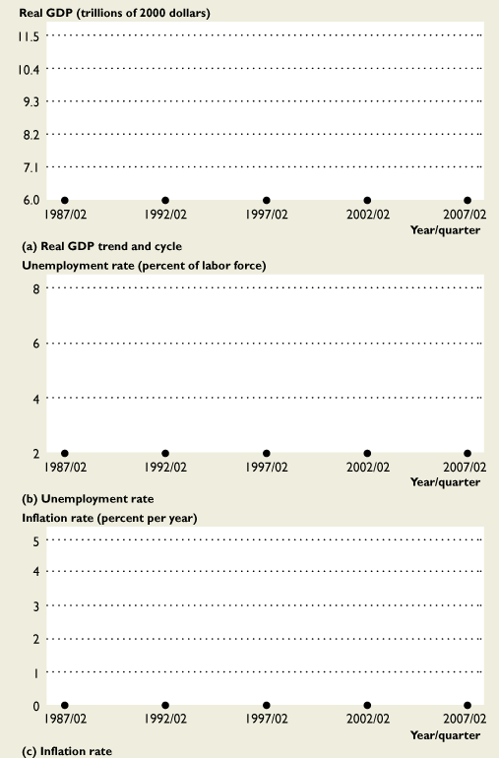
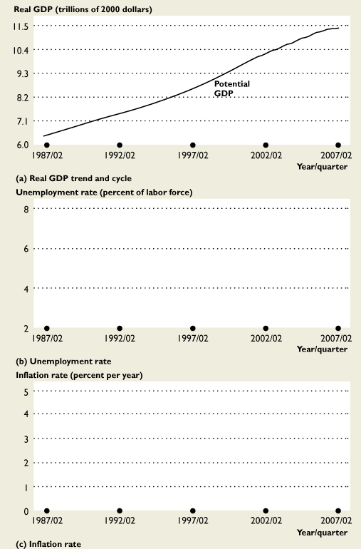
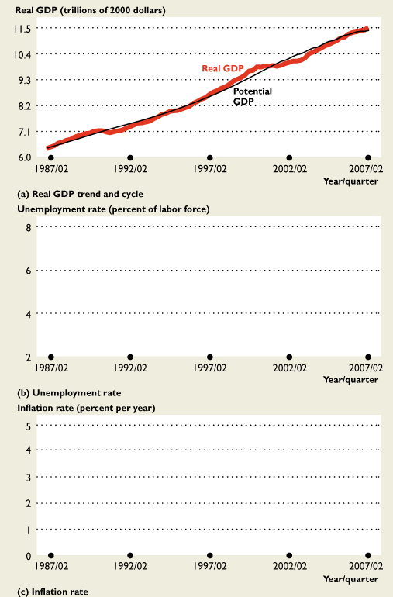
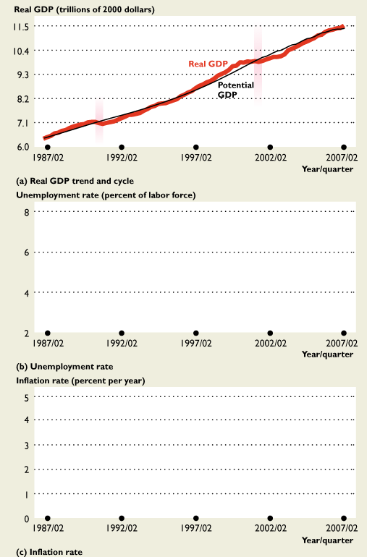
Unemployment, Inflation & Economic Growth
The business cycle
Recessions began in mid-1990 and in first quarter of 2001.
The longest expansion in U.S. history ran from the March 1991 to March 2001.
The figure shows the recent cycles in real GDP.

Slide 24
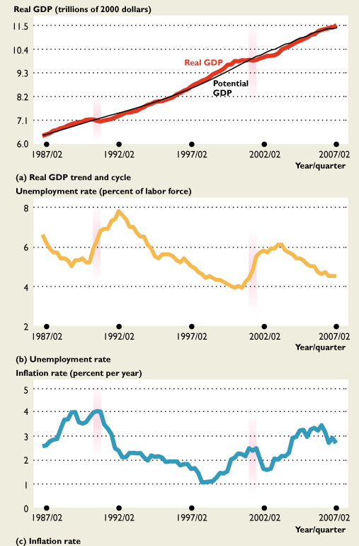
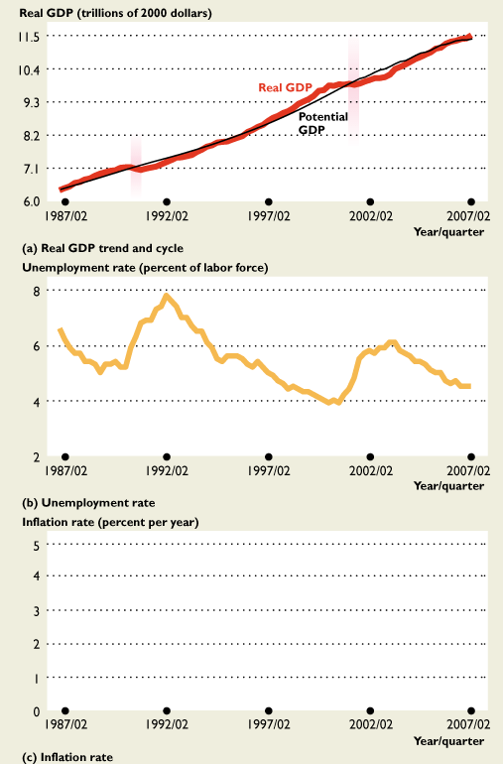
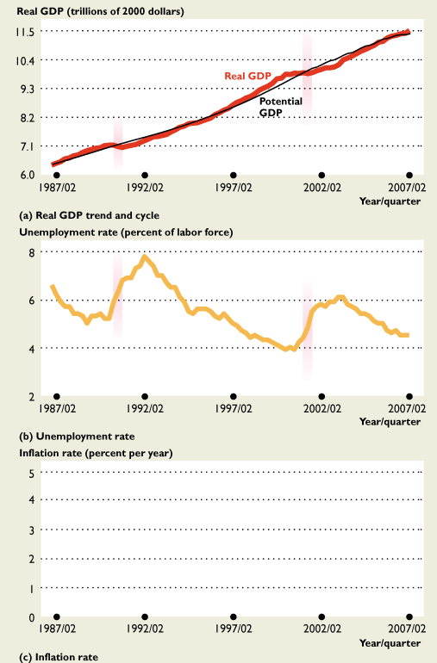
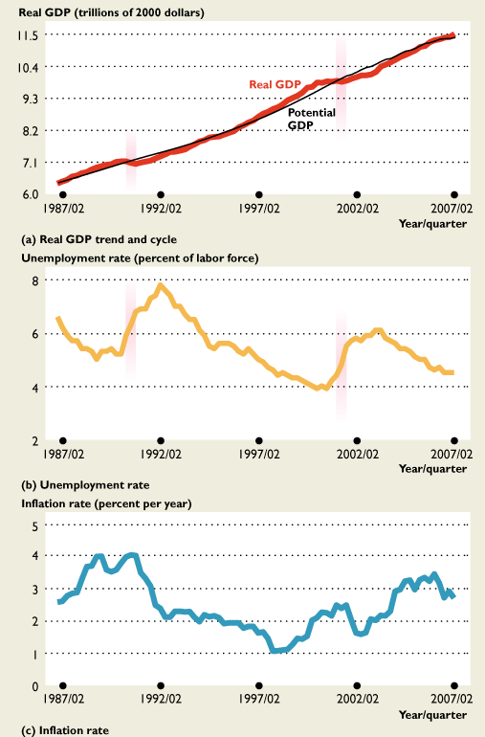
Unemployment, Inflation & Economic Growth
The business cycle
Recessions began in mid-1990 and in first quarter of 2001.
The longest expansion in U.S. history ran from the March 1991 to March 2001.
When GDP decreased in the recession (a),
The unemployment rate increased (b).
And a little later, the inflation rate decreased (c).
As real GDP increased back toward potential GDP, the unemployment rate fell toward the natural unemployment rate and the inflation rate fell.
The figure shows the recent cycles in real GDP.

Slide 25

Fiscal Policy
Assume the classicalists are mostly correct, and politicians want to stimulate the economy out of a recessionary gap
  Democrats raise G
  Republicans cut T
PL
LRAS
inflation =
65.2%
380
(380-230)/230 × 100
growth =
15.4%
(15-13)/13 × 100
230
SRAS
AD
13
15
GDP

Slide 26
Fiscal Policy
Assume the Keynesians are mostly correct, and politicians want to stimulate the economy out of a recessionary gap
  Democrats raise G
  Republicans cut T
PL
LRAS
(240-230)/230 × 100
inflation =
4.3%
growth =
15.4%
(15-13)/13 × 100
240
230
SRAS
AD
13
15
GDP

Slide 27
Monetary Policy
Money Supply
Quantity of money is fixed & independent of i
If bank lending increases or the Fed buys Treasuries from banks, the money supply increases
MS
i
3
1800

Slide 28
Monetary Policy
Money Supply
Quantity of money is fixed & independent of i
If bank lending decreases or the Fed sells Treasuries to banks, the money supply decreases
MS
i
3
1800

Slide 29
Monetary Policy
Money Demand
lower i → lower OC of holding money → more money held
An increase in the use of credit cards
i
2.5
MD
1900 2300 M
2500

Slide 30
Monetary Policy
Money Demand
lower i → lower OC of holding money → more money held
An increase in PL, real GDP, or the use of ATMs, debit cards, interest checking
i
2.5
MD
1900 2300 M
2500

Slide 31
Monetary Policy
Equilibrium in the Market for Money
i is determined by MS and MD
i falls if the Fed buys Treasuries
MS
i
2.5
2.0
MD
1900 2300 M
2400

Slide 32
Monetary Policy
Equilibrium in the Market for Money (if classicalists are mostly correct)
i is determined by MS and MD
i falls if the Fed buys Treasuries
(390-230)/230 × 100
inflation =
69.6%
growth =
15.4%
(15-13)/13 × 100
PL
LRAS
MS
i
390
230
2.5
2.0
AD
MD
1900 15 Y
1900 2300 M
13
2400

Slide 33
Monetary Policy
Equilibrium in the Market for Money (if Keynesians are mostly correct)
i is determined by MS and MD
i falls if the Fed buys Treasuries
(240-230)/230 × 100
inflation =
4.3%
growth =
15.4%
(15-13)/13 × 100
PL
LRAS
MS
i
240
230
2.5
2.0
AD
MD
1900 15 Y
1900 2300 M
13
2400

Slide 34
Monetary Policy
Equilibrium in the Market for Money
i is determined by MS and MD
i rises if the Fed sells Treasuries
MS
i
2.5
2.0
MD
1900
1900 2300 M
2300
2400

Slide 35
Monetary Policy
Equilibrium in the Market for Money (if classicalists are mostly correct)
i is determined by MS and MD
i rises if the Fed sells Treasuries
(190-230)/230 × 100
inflation =
-17.4%
growth =
-6.3%
(15-16)/16 × 100
PL
LRAS
SRAS
MS
i
230
2.5
190
AD
2.0
MD
1 16 Y
1900 2300 M
15
2400

Slide 36
Monetary Policy
Equilibrium in the Market for Money (if Keynesians are mostly correct)
i is determined by MS and MD
i rises if the Fed sells Treasuries
(220-230)/230 × 100
inflation =
-4.3%
growth =
-6.3%
(15-16)/16 × 100
PL
LRAS
MS
i
SRAS
230
220
2.5
AD
2.0
MD
1 16 Y
1900 2300 M
15
2400

Slide 37
Monetary Policy
Keynesians intervene in the short-run to steer the economy back to full-employment. They pursue policies that close short-run recessionary and inflationary gaps.
Hayekians are not concerned with short-run fluctuations, advocating instead for pro-growth, free-market (not pro-business) polices.

Slide 38
Monetary Policy
Keynesians intervene in the short-run to steer the economy back to full-employment. They pursue policies that close short-run recessionary and inflationary gaps.
Hayekians are not concerned with short-run fluctuations, advocating instead for pro-growth, free-market (not pro-business) polices.
Watch the “Fear the boom and bust” YouTube video
PL
AD-AS-Y_{FE}
Hayek
AS
Keynes
AD
Y

