Slide 1
The Market for Money
Jill Student
Jack Deskoccupier
Dan Intheclouds
Joanie Willgraduatesoon
Austrian Economics
May Term 2015
Professor Hal Snarr
Westminster College

Slide 2
The Market for Money
Money Demand
  The lower the nominal interest rate, the lower the opportunity cost of holding money, the greater is the quantity of real money demanded.
i
3.5
2.5
MD
500 550 M
2300

Slide 3
The Market for Money
Money Demand
  The lower the nominal interest rate, the lower the opportunity cost of holding money, the greater is the quantity of real money demanded.
  M rises by 5% if PL rises by 5%
  real GDP
  Financial technology: ATM, debit cards, interest checking
i
2.5
MD
1900 550 M

Slide 4
The Market for Money
Money Demand
  The lower the nominal interest rate, the lower the opportunity cost of holding money, the greater is the quantity of real money demanded.
  M rises by 5% if PL rises by 5%
  real GDP
  Financial technology: ATM, debit cards, interest checking
  credit cards
i
2.5
MD
1900 550 M
Notes:
PIH = permanent income hypothesis
QTM = quantity theory of money
LPT = liquidity preference theory

Slide 5
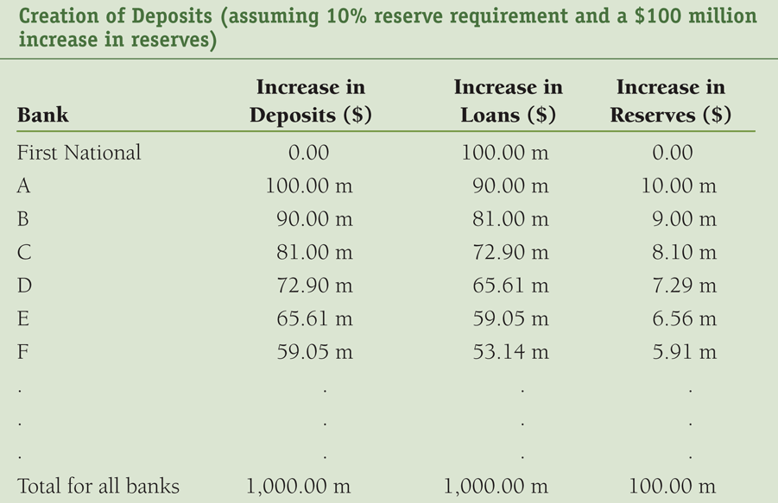

The Market for Money
Money Supply
The Fed buys $100 million worth of First National’s Treasury bonds and the reserve requirement ratio is 10%

Slide 6




The Market for Money
Money Supply
The Fed buys $100 million worth of First National’s Treasury bonds and the reserve requirement ratio is 10%

Slide 7
The Market for Money
Money Supply
The Fed buys $100 million worth of First National’s Treasury bonds and the reserve requirement ratio is 10%
1/rrr
simple
money
multiplier

Slide 8
The Market for Money
Money Supply
  It is the relationship between the quantity of money supplied and i.
  On any given day, the quantity of money is fixed independent of the interest rate.
MS
i
3.5
2.5
500 2300 M

Slide 9
The Market for Money
Money Supply
  It is the relationship between the quantity of money supplied and i.
  On any given day, the quantity of money is fixed independent of the interest rate.
  Increased bank lending raises MS and lowers the interest rate (see previous slide)
MS
i
3.5
3.0
MD
500 2300 M

Slide 10
The Market for Money
Money Supply
  It is the relationship between the quantity of money supplied and i.
  On any given day, the quantity of money is fixed independent of the interest rate.
  Increased bank lending raises MS and lowers the interest rate
  Expansionary monetary policy raise MS and lowers interest rates (see future slide)
MS
i
3.5
3.0
2.5
MD
500 2300 M

