Slide 1
Hyperinflation & Discretionary MP
Jill Student
Jack Deskoccupier
Dan Intheclouds
Joanie Willgraduatesoon
Austrian Economics
May Term 2015
Professor Hal Snarr
Westminster College

Slide 2
Hyperinflation & Discretionary MP
Hyperinflation is a period of high inflation (> 50% per month)
Erich Maria Remarque’s The Black Obelisk:
  Workmen are given their pay twice a day now--in
  the morning and in the afternoon, with a recess
  of a half-hour each time so that they can rush
  out and buy things--for if they waited a few
  hours the value of their money would drop
Steve Hanke’s R.I.P. Zimbabwe Dollar:
The time it took for prices to double in
  1994 Yugoslavia, 33.6 hours
  2008 Zimbabwe, 24.7 hours
  1946 Hungary, 15.6 hours

Slide 3
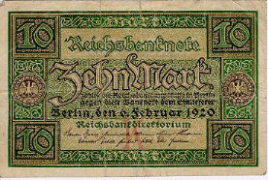
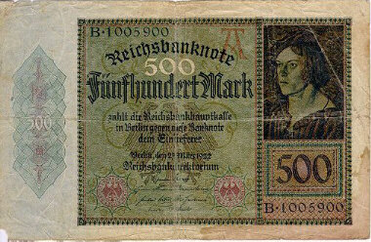
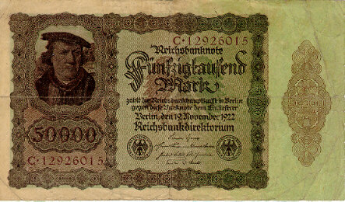
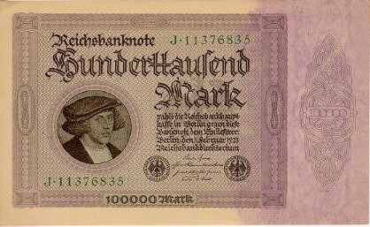
Hyperinflation & Discretionary MP
Hyperinflation in the Weimar Republic (Germany, post WWI)
Feb., 1920
March,1922
Nov.,1922
Feb., 1923

Slide 4
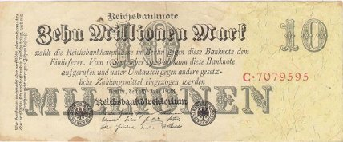
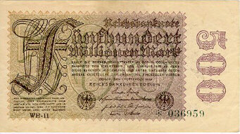
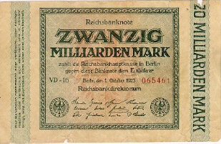
Hyperinflation & Discretionary MP
Hyperinflation in the Weimar Republic (Germany, post WWI)
July, 1923
Sept., 1923
Oct., 1923
Why did this happen?
  In Nov. of 1918, there were 29,200,000,000 paper marks in circulation
  A year later, 497,000,000,000,000,000,000 paper marks in circulation
  That was a massive increase in the money supply, an increase of
1,702,054,794,421%

Slide 5
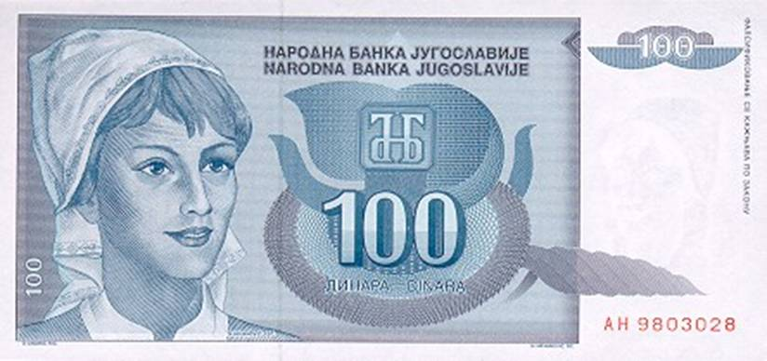
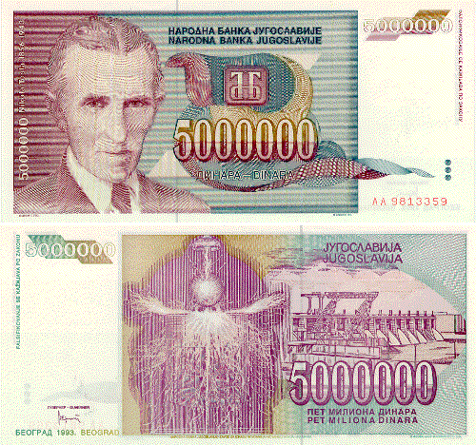
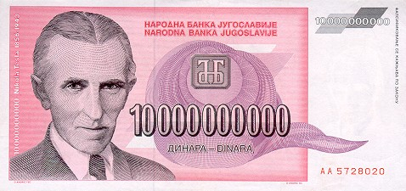
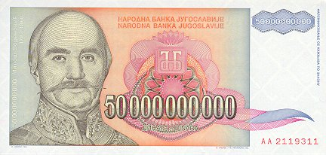
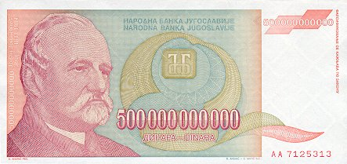
Hyperinflation & Discretionary MP
Yugoslavia had inflation problems in the 1980’s, but in 1993 things really got bad.
$1 = 900 Dinar (1/1/93)
$1 = 2,000,000 Dinar (11/12/93)
$1 = 13,000,000 Dinar (11/23/93)
$1 = 64,000,000 Dinar (11/31/93 )
$1 = 6,400,000,000 Dinar (12/15/93)
PRICES WERE DOUBLING EVERY DAY
$1 = 12,000,000,000,000,000,000,000 Dinar (1/24/94)

