Slide 1
Austrian Macroeconomics
Roger Garrison’s Capital Based Macroeconomics
Hal W. Snarr
2014

Slide 2

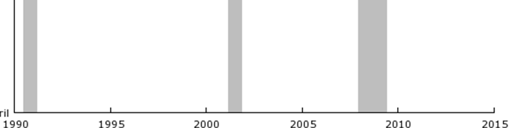
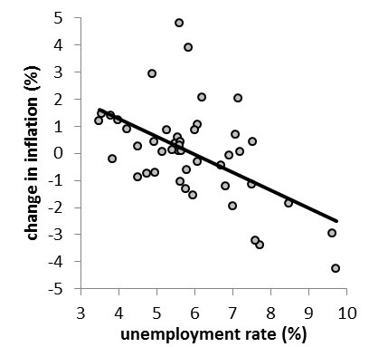
Austrian Macroeconomics
A critique of mainstream economics
u
i_{ff}

Slide 3
Austrian Macroeconomics
A critique of mainstream economics
u
i_{ff}

Slide 4
Austrian Macroeconomics
A critique of mainstream economics
u
i_{ff}

Slide 5
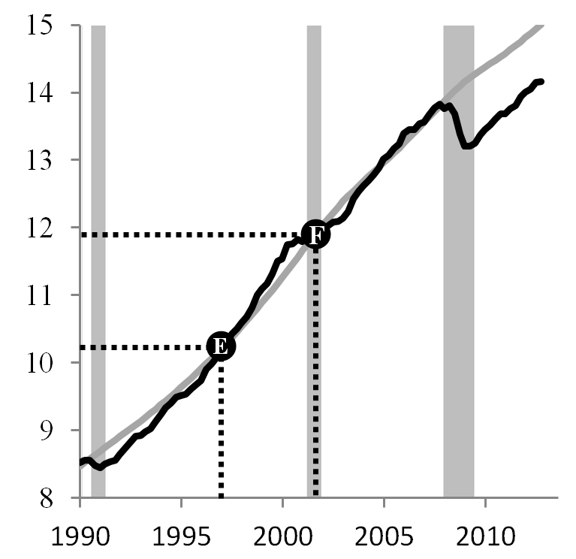
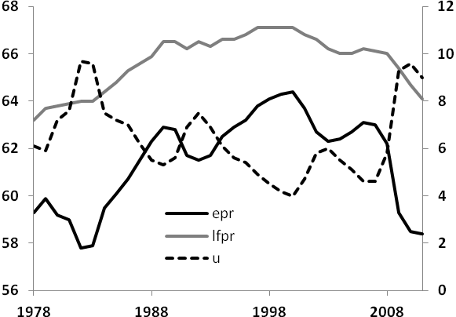
Austrian Macroeconomics
A critique of mainstream economics
R_{e}
D
Y_{p}
Y
lfpr, epr
Trillion dollars
unemployment
E
F
lfpr
epr
u
I do not think it an exaggeration to say that history is largely a history of inflation, and usually of inflations engineered by governments and for the gain of governments. — FA Hayek

Slide 6
Austrian Macroeconomics
A critique of mainstream economics
LR econ number
growth of pages
10
8
6
4
2
80
60
40
20
Thousands of pages
LR economic growth
1940 1950 1960 1970 1980 1990 2000 2010
The curious task of economics is to demonstrate to men how little they really know about what they imagine they can design. — FA Hayek

Slide 7
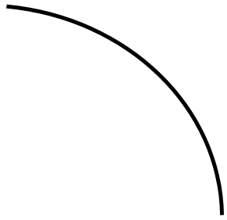
Austrian Macroeconomics
C
6
R
3
I

Slide 8
Austrian Macroeconomics
C
I
4
I

Slide 9
Austrian Macroeconomics
C
7
O
3
I

Slide 10
Austrian Macroeconomics
C
C, I_{j}
C
7
O
I₂
I₁
1
2
3
3
I

Slide 11
Austrian Macroeconomics
C
C, I_{j}
C
7
O
I₂
I₁
1
2
3
3
I
i
4
O
D_{LF}
S_{LF}
3
I

Slide 12
Austrian Macroeconomics
C
C, I_{j}
C
7
O
I₂
I₁
1
2
3
3
I
w₃
i
26
O
4
O
LS₃
LD₃
D_{LF}
S_{LF}
38
E₃
3
I

Slide 13
Austrian Macroeconomics
C
C, I_{j}
C
7
O
I₂
I₁
1
2
3
3
I
w₃
w₃
i
26
O
4
O
13
O
LS₂
LS₃
LD₃
D_{LF}
S_{LF}
LD₂
20
E₂
38
E₃
3
I

Slide 14

Austrian Macroeconomics
C
C, I_{j}
C
7
O
F
I₂
I₁
1
2
3
4
1
2
3
3
4
I
w₃
w₃
i
26
O
4
O
16
20
13
O
3
F
LS₂
LS₃
LD₃
D_{LF}
S_{LF}
LD₂
20
26
E₂
30
38
E₃
3
4
I

Slide 15
Austrian Macroeconomics
C
C, I_{j}
E
C
7
O
F
I₂
I₁
1 2 3 4 5
1
2
3
4
1
2
3
3
4
4.5
I
THE PARADOX OF THRIFT
An increase in saving reduces production because a decrease in spending leads to a decrease in employment, which leads to a further decrease in spending… and so on
If Enterprise is afoot, wealth accumulates whatever may be happening to Thrift; and if Enterprise is asleep, wealth decays whatever Thrift may be doing. Thus, Thrift may be the handmaiden of Enterprise… But equally she may not. And, perhaps, even usually she is not.—Keynes

Slide 16
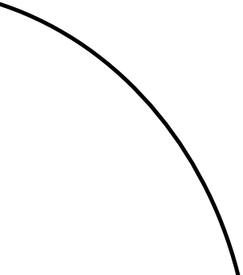
Austrian Macroeconomics
C
8.75
C, I_{j}
O
1 2 3
2 3 4 I
Suppose the Fed sets interest rates low.
i
4
S_{LF}
O
D_{LF}
2 3 4 I

Slide 17
Austrian Macroeconomics
C
10
8.75
C, I_{j}
C
O
1 2 3
1 2 3
2 3 4 I
Suppose the Fed sets interest rates low.
If firms do not respond to lower interest but consumers do, the economy would move to point C.
…. and the Hayekian triangle shifts to the red bars.
i
4
3
S_{LF}
O
C
D_{LF}
2 3 4 I

Slide 18
Austrian Macroeconomics
C
10
8.75
7
C, I_{j}
O
I
1 2 3
2 3 4 I
Suppose the Fed sets interest rates low.
If consumers do not respond to lower interest but firms do, the economy would move to point I.
…. and the Hayekian triangle shifts to the blue bars.
i
4
3
S_{LF}
O
C
I
D_{LF}
2 3 4 I

Slide 19
Austrian Macroeconomics
C
10
8.75
7
C, I_{j}
C
B
I
1 2 3
2 3 4 I
Suppose the Fed sets interest rates low.
If consumers and firms respond to lower interest, the economy moves to point B, the boom.
The shortage of loanable funds is papered over with printed money
i
4
3
S_{LF}
O
C
I
D_{LF}
2 3 4 I

Slide 20
Austrian Macroeconomics
C
10
8.75
7
C, I_{j}
B
Overconsumption
Malinvestment
1 2 3
2 3 4 I
Suppose the Fed sets interest rates low.
…. overconsumption and malinvestment result.
i
4
3
S_{LF}
O
C
I
D_{LF}
2 3 4 I

Slide 21

Austrian Macroeconomics
C
10
8.75
7
C, I_{j}
B
B
1 2 3
2 3 4 I
Suppose the Fed sets interest rates low.
The heavy use of leverage by consumers and firms creates intense competition for the economy’s limited resources.
Prices rise, which causes expected inflation to rise.
When the Fed withdraws stimulus, the boom becomes the bust
i
4
3
S_{LF}
O
C
I
D_{LF}
2 3 4 I

