Slide 1
Mainstream Microeconomics
Hal Snarr
Westminster College
May Term, 2015
Introduction to Austrian Economics

Slide 2
Law of Demand
Press-grilled panini
Individual | P₀ = 10.10 | P₁ = 0.10
1 | 0 | 15
2 | 1 | 10
3 | 0 | 2
4 | 0 | 3
5 | 0 | 10
6 | 0 | 3
7 | 1 | 2
8 | 0 | 10
9 | 0 | 15
10 | 0 | 20
11 | 10 | 22
Total | 12 | 112

Slide 3
Law of Demand
According to our data,
When P₀ = $0.10, Q_{D} = 112
10.10
Price
12
Quantity

Slide 4
Law of Demand
According to our data,
When P₁ = $10.10, Q_{D} = 12
10.10
Price
0.10
D
12
112
Quantity

Slide 5
Law of Demand
The following equation fits these two points.
P = 11.3 − 0.1Q
Panini Demand
Moving from this point …
… to this point is a movement along a demand curve
10.10
Price
0.10
D
12
112
Quantity

Slide 6
Law of Demand
A shift of a demand curve is a change in the location of the demand curve that is caused by a change in a factor, ceteris paribus.
If demand of a good increases when income increases, the good is a normal good
Panini Demand
Price
2.30
D
D’
90
135
Quantity

Slide 7
Law of Demand
A shift of a demand curve is a change in the location of the demand curve that is caused by a change in a factor, ceteris paribus.
If demand of a good decreases when income increases, the good is an inferior good
Panini Demand
Price
2.30
D
D
65
90
Quantity

Slide 8
Law of Demand
A shift of a demand curve is a change in the location of the demand curve that is caused by a change in a factor, ceteris paribus.
If the price of a side salad falls (Q_{D} for salad would increase), demand
for paninis increases. Paninis and salads are complements.
Panini Demand
Price
2.30
D
D’
90
145
Quantity

Slide 9
Law of Demand
A shift of a demand curve is a change in the location of the demand curve that is caused by a change in a factor, ceteris paribus.
If the price of Burger King Whoppers falls (Q_{D} for Whoppers increases), demand for Paninis decreases. Paninis and Whoppers are substitutes.
Panini Demand
Price
2.30
D
D’
75
90
Quantity

Slide 10
Law of Demand
A shift of a demand curve is a change in the location of the demand curve that is caused by a change in a factor, ceteris paribus.
If Lebron James and James Franco are shown devouring Big Macs and fries in really cool TV ads, consumers tastes may switch back to traditional fast food.
Panini Demand
Price
2.30
D
D’
75
90
Quantity

Slide 11
Law of Demand
A shift of a demand curve is a change in the location of the demand curve that is caused by a change in a factor, ceteris paribus.
is ceteris paribus?
If the population increases, demand for Big Macs might increase as well.
Panini Demand
Price
2.30
D
D’
90
105
Quantity

Slide 12
Law of Supply
Press-grilled panini
Individual | P = 0.15 | P = 10.15
1 | 0 | 8,000
2 | 0 | 10,000
3 | 0 | 12,000
4 | 0 | 5,000
5 | 0 | 15,000
6 | 0 | 13,000
7 | 0 | 7,000
8 | 0 | 9,000
9 | 0 | 10,000
10 | 0 | 11,000
Total | 0 | 100,000

Slide 13
Law of Supply
According to our data,
When P = $0.15, Q_{S} = 0
Price
0.15
0
Quantity

Slide 14
Law of Supply
According to our data,
When P = $10.15, Q_{S} = 100,000
Panini Supply
S
10.15
Price
0.15
0
100,000
Quantity

Slide 15
Law of Supply
The following equation fits these two points.
P = 0.15 + 0.001Q
Panini Supply
S
10.15
Moving from this point …
…to this point is a movement along a supply curve
Price
0.15
0
100,000
Quantity

Slide 16
Law of Supply
A shift in supply is a change in the location of the supply curve that is caused by
a change in a factor, ceteris paribus.
If the price of muffins falls (Q_{S} of muffins falls), supply of paninis increases.
Panini Supply
S
S’
Price
5
350,000
700,000
Quantity

Slide 17
Law of Supply
A shift in supply is a change in the location of the supply curve that is caused by
a change in a factor, ceteris paribus.
If the price of an input to production (workers’ wages) falls, supply of paninis increases.
Panini Supply
S
S’
Price
5
350,000
700,000
Quantity

Slide 18
Law of Supply
A shift in supply is a change in the location of the supply curve that is caused by
a change in a factor, ceteris paribus.
If government cuts payroll taxes, supply of paninis increases.
Panini Supply
S
S’
Price
5
350,000
700,000
Quantity

Slide 19
Law of Supply
A shift in supply is a change in the location of the supply curve that is caused by
a change in a factor, ceteris paribus.
If better technology lowers production costs, panini supply increases.
Panini Supply
S
S’
Price
5
10,150,000
11,400,000
Quantity

Slide 20
Law of Supply
A shift in supply is a change in the location of the supply curve that is caused by
a change in a factor, ceteris paribus.
is ceteris paribus?
If government taxes prepared foods, the supply of paninis will decrease.
Panini Supply
S
S’
Price
5
84,000
115,000
Quantity

Slide 21


Law of Supply and Demand
The Law of Supply and Demand states that in a free market the forces of supply and demand generally push the price toward the level at which quantity supplied (Q_{S}) equals quantity demanded (Q_{D}).
Use the following model to explain why the price of gasoline is so high.
Assume the daily demand and supply for gasoline is given by
Q_{D} (millions) | P ($) |  | Q_{S} (millions) | P ($)
100 | 6.10 |  | 300 | 0.30
500 | 1.10 |  | 500 | 5.30

Slide 22
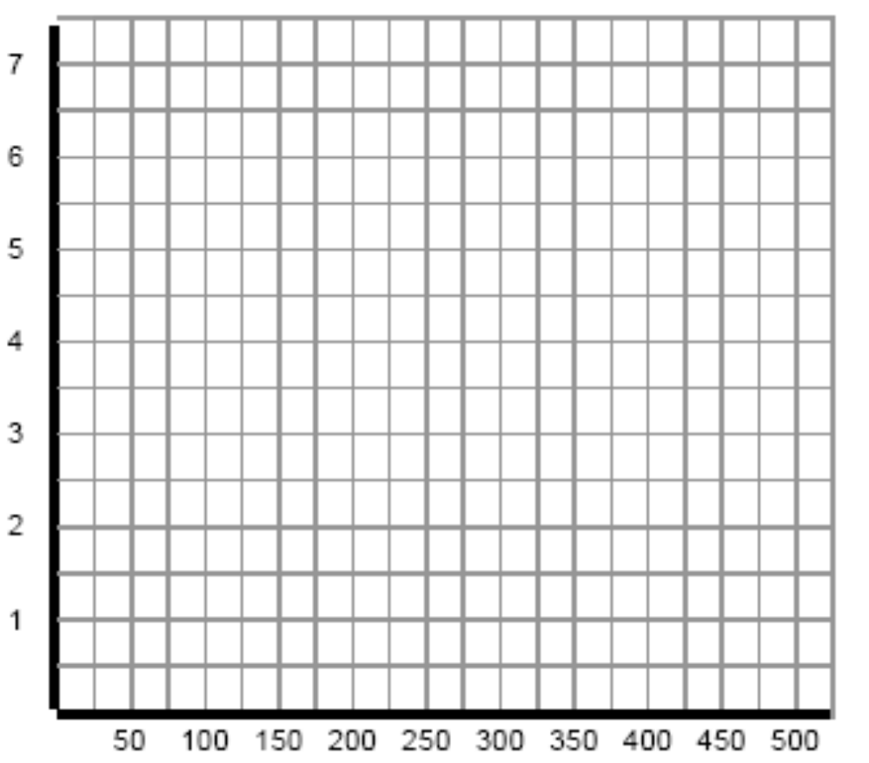
Law of Supply and Demand
Gasoline Market
P
($)
S
D
Q (millions)

Slide 23








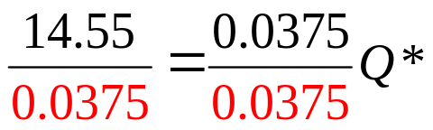



Law of Supply and Demand
Compute the equilibrium price and quantity of gasoline

Slide 24
Law of Supply and Demand
Gasoline Market
P
S
D
Q (millions)

Slide 25
Law of Supply and Demand
Use supply and demand analysis to explain why gas prices jumped after Hurricane Katrina.
How does a spike in gasoline prices encourage Americans to conserve gasoline during
after natural disasters such as Katrina?
Katrina shut down Gulf Coast refineries, pipe lines and Gulf of Mexico deep water oil wells.
Gasoline
S
S
3.92
Demand for gasoline increases because people are trying to get out of harms way or they “hoard”.
Price
2.50
D
D
372
388
Q (millions)

Slide 26

Law of Supply and Demand
Using supply and demand analysis, explain why the government should or should not intervene and impose a price ceiling on gasoline after natural disasters such as Katrina.
Suppose the government decides that the P is too high. It may impose a ceiling on the price gas stations charge.
Gasoline
S
3.92
The government’s “good intentions” result in long lines at the gas pump
(a shortage).
Price
2.50
D
372
Q (millions)

Slide 27
Law of Supply and Demand
Using supply and demand analysis, explain how does the Strategic Petroleum Reserve (SPR) contribute to higher gasoline prices.
The SPC (underground salt caverns in TX, LA and MS) is the D of E’s emergency supply of oil, holding up to 727,000,000 barrels of crude oil (a 60-day supply).
Crude Oil
In a past State of the Union, Bush announced he would double the SPR for national security.
This increases the price of crude oil.
S
Price
D
D
Q

Slide 28
Law of Supply and Demand
Using supply and demand analysis, explain how does the Strategic Petroleum Reserve (SPR) contribute to higher gasoline prices.
The higher crude oil prices raise the cost of refining gasoline, which decreases its supply.
This results in a higher gas price.
Gasoline
S
S
Price
D
Q
Notes:
In 2005, the U.S. imported 3,695,971,000 barrels of crude oil.
Refineries convert crude oil into gasoline, diesel fuel, asphalt base, heating oil, kerosene. The U.S. has not built a new refinery since 1976.
Gasoline tax in NC amounts to 48.6 cents per gallon, while in NY it amounts to 60.1 cents. 20 gallons of gas/week over 52 weeks means you pay $505.44 in gasoline taxes each year in North Carolina versus $625.04 in New York.
The U.S. economy consumes about 388,000,000 gallons per day.
Or 150,544,000,000 gallons per year
US consumers paid $27.1 billion in Federal gasoline taxes last year at the pump.
Exxon Mobile’s 2007 pre-tax profit was about $70 billion, assuming a 35 percent tax rate, Exxon Mobil’s federal income tax bill was
($70)(0.35) billion = $31.85 billion
This is about 10% of all corporate income
taxes collected by the federal government.

Slide 29
Why is there a shortage of math teachers?
Law of Supply and Demand
Mathematics
History
LS (mathematicians)
LS (historians)
$60k
$30k
LD
$20k
LD
_{100k}
100k
shortage
surplus

Slide 30
Law of Supply and Demand
How does increasing the minimum wage affect workers and firms?
Low skilled labor market
LS (workers)
w_{min}
w_{min}
w*
LD (firms)
E
E
E*
LF
LF
unemployment
unemployment

Slide 31
Law of Supply and Demand
Is there a cost to immigration?
Low skilled labor market
LS (workers)
A flood of low skilled workers into an economy…
w*
w*
LD (firms)
E*
E*

Slide 32
Law of Supply and Demand
Is Lebron James over paid?
There are 41 Cleveland home games a season and the stadium the team plays in seats about 20,000 fans.
Before Lebron Cleveland averaged 12,000 fans per game at an average ticket price of about $40 per ticket.
After Lebron the team nearly sold out every game at an average ticket price of $41 per ticket.
Suppose this increase in fan interest is attributable entirely to Lebron (8,000 additional fans do not attend games to see the new white guy sitting at the end of the bench).
Demand for Cavalier home basketball games jumps from D_{BL} to D_{AL} as a result of adding Lebron to their roster.

Slide 33
Law of Supply and Demand
Is Lebron James over paid?
Low skilled labor market
S
Lebron is drafted…
41
40
D_{AL}
D_{BL}
12000
20000
Empty seats

Slide 34
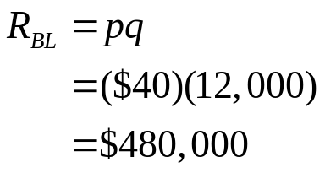
Law of Supply and Demand
Is Lebron James over paid?
Low skilled labor market
S
Revenue per home game:
41
40
D_{BL}
D_{AL}
12000
20000

Slide 35
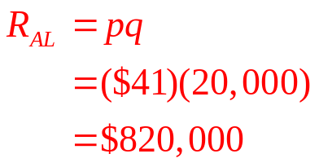
Law of Supply and Demand
Is Lebron James over paid?
Low skilled labor market
S
Revenue per home game:
41
40
D_{BL}
D_{AL}
12000
20000

Slide 36


Law of Supply and Demand
Is Lebron James over paid?
Total revenue for all 41 home games:
Marginal Revenue of adding Lebron (MR):
Adding one Lebron increases total home game revenue by $13.94 million while the marginal cost of hiring one Lebron (MC) is $6 million a year.
Cleveland would love to continue hiring more Lebrons until MR = MC.

Slide 37
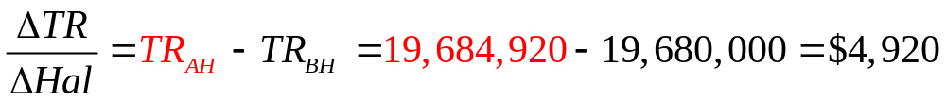
Law of Supply and Demand
Is Lebron James over paid?
How many additional fans would come to Cleveland home games to watch me sit at the end of the bench?
Maybe my mom, wife and grandmother. This increase in the quantity demand is so small that it would have no effect on the price of a ticket.
Marginal Revenue of adding me (MR):
Adding one Hal increases total home game revenue by $4,920 while the marginal cost of hiring one Hal (MC) is $250,000 a year.
Since MR < MC Cleveland would not hire an additional Hal. In fact, the team prefers cutting him from the squad.

Slide 38


Economics of Mandatory Healthcare
The President’s health care proposal
B E
C
A D
98
90
74
0 20 28 36
Is point A efficient? Is point A attainable?
A is not efficient because it lies inside the PPF
A is attainable but is associated with high unemployment

Slide 39
Economics of Mandatory Healthcare
The President’s health care proposal
B E
C
A D
98
90
74
0 20 28 36
Is point B efficient? Is point B attainable?
Point B is attainable, and is efficient, meaning more of one good cannot be produced without producing less of something else.
Points C and D are also efficient production levels.
Unemployment equals its natural rate when the economy is its PPF.

Slide 40
Economics of Mandatory Healthcare
The President’s health care proposal
B E
C
A D
98
90
74
0 20 28 36
What is the opportunity cost (OC) of moving from D to C?
If we want 16 more units of health care
we have to give up 8 units of all other goods (tradeoff)
Health care is not a free lunch because its OC = 0.5 units of all other goods

Slide 41
Economics of Mandatory Healthcare
The President’s health care proposal
B E
C
A D
98
90
74
0 20 28 36
What is the opportunity cost (OC) of moving from C to B?
If we want 8 more units of health care
we have to give up 8 units of all other goods (tradeoff)
Health care is not a free lunch because its OC = 1 units (of all other goods)

Slide 42
Economics of Mandatory Healthcare
The President’s health care proposal
To get one more health care unit we have to give up 1 unit of all other goods
B E
C
A D
98
90
74
To get one more health care unit we have to give up a half unit of all other goods
0 20 28 36
Why does the OC of health care rise as we move up along the PPF to the left?
As an economy increasingly specializes in HC, the OC of producing HC increases because we are using more and more resources that are poorly suited to produce HC.

Slide 43
Economics of Mandatory Healthcare
The President’s health care proposal
B E
C
A D
98
90
74
0 20 28 36
Is point E attainable?
E is not attainable (in the short-run) because this economy does not have the resources to produce at point E.
Point E is attained when new resources and technologies are found.

Slide 44
Economics of Mandatory Healthcare
Technological advancements lead to economic growth
E
D
98
74
F
G
0 36
We are at point D. What happens if new medical techniques are invented?
We can get more health care by moving to point F
or we can get more all other goods if we move to point G.

Slide 45
Economics of Mandatory Healthcare
Natural resource discoveries lead to economic growth
E
98
F
0 36
We are at F. What happens if 1.2 trillion barrels of natural gas are discovered?
Point E is now an attainable efficient production level.

Slide 46
Economics of the Fiscal Budget
  Tax revenue (T ) is $24,000 (per citizen). Government spends money (G) on health care and military services, with prices P_{m} = $120 and P_{h} = $100.
120 Q_{m} + 100 Q_{h} = 24000
Q_{m}
The entire budget is being spent.
The entire budget is being spent.
The entire budget is being spent.
200
240
Q_{h}

Slide 47
Economics of the Fiscal Budget
Plot a point that indicates the government is running a budget deficit.
120 (150) + 100 (180) =
18,000 + 18,000 =
36,000
Budget deficit = 24,000 - 36,000 =
-12,000
Q_{m}
150
180
Q_{h}

Slide 48
Economics of the Fiscal Budget
Plot a point that indicates the government is running a budget surplus.
120 (50) + 100 (60) =
6000 + 6000 =
12,000
Budget surplus = 24,000 - 12,000 =
12,000
Q_{m}
50
60
Q_{h}

Slide 49
Economics of the Fiscal Budget
What is the OC of moving from A to B?
From A to B
we can buy 120 more units of health care (ΔQ_{HC} = 120 )
but we have to give up 100 units of military protection (ΔQ_{m} = -100 ).
The OC of 1.2 units of health care requires giving up 1 unit of military protection
Q_{m}
A
150
50
B
60
180
Q_{h}

Slide 50
Economics of the Fiscal Budget
What is the OC of moving from A to B?
From A to B
we can buy 120 more units of health care (ΔQ_{HC} = 120 )
but we have to give up 100 units of military protection (ΔQ_{m} = -100 ).
The OC of 1.2 units of health care requires giving up 1 unit of military protection
Q_{m}
150
Budget deficit (12,000) is the
political compromise.
180
Q_{h}

Slide 51


Economics of Free Trade
  C denotes baseball caps produced and T denotes t-shirts produced. Indonesia and North Carolina devotes all of their resources according to
T
1400
1200
1000
800
600
400
200
100 200 300 400 500 600 700 C
Indonesia
NC

Slide 52
Economics of Free Trade
Which country has the absolute advantage in t-shirts production?
T
1400
1200
1000
800
600
400
200
100 200 300 400 500 600 700 C
Indonesia
NC
If Indonesia devotes all its resources to producing t-shirts, it mkes1200.
Indonesia has the absolute advantage in t-shirts.
If North Carolina devotes all its resources to producing t-shirts, it makes1000.

Slide 53
Economics of Free Trade
Which country has the absolute advantage in caps?
T
1400
1200
1000
800
600
400
200
100 200 300 400 500 600 700 C
Indonesia
Neither country has an absolute advantage in trade.
NC
If Indonesia devotes all its resources to producing caps, it makes 300.
North Carolina has the absolute advantage in caps.
If North Carolina devotes all its resources to producing caps, it makes 500.

Slide 54
Economics of Free Trade
Which country has the comparative advantage in baseball caps?
T
1400
1200
1000
800
600
400
200
100 200 300 400 500 600 700 C
Indonesia
Indonesia
North Carolina
NC
If Indonesia wants 1 more cap, it gives up 4 t-shirts.
NC has the comparative advantage in caps.
If NC wants 1 more cap, it gives up 2 t-shirts.

Slide 55
Economics of Free Trade
Which country has the comparative advantage in baseball caps?
T
1400
1200
1000
800
600
400
200
100 200 300 400 500 600 700 C
Indonesia
Indonesia
North Carolina
Inverse = ¼ = 0.25
Inverse = ½ = 0.5
NC
If Indonesia wants 1 more t-shirt, it gives up 0.25 caps.
NC has the comparative advantage in caps.
If NC wants 1 more t-shirt, it gives up 0.5 caps.

Slide 56
Economics of Free Trade
Suppose NC and Indonesia are the only producers of caps and t-shirts, trade barriers exist, and both countries devote half their respective resources to producing both goods.
T
1400
1200
1000
800
600
400
200
100 200 300 400 500 600 700 C
Indonesia
NC
Indonesia makes 150 caps and 600 t-shirts.
NC makes 250 caps and 500 t-shirts.
Total world production = 400 caps and 1100 t-shirts = $15000 if price of both is $10.

Slide 57
Economics of Free Trade
Suppose NC and Indonesia pass a Free Trade Agreement, what will NC produce? What will Indonesia produce? Why is free trade good? Why is free trade bad?
T
1400
1200
1000
800
600
400
200
100 200 300 400 500 600 700 C
Indonesia
NC
Indonesia makes 1200 t-shirts.
NC makes 500 caps.
Total world production increases from $15,000 to $17,000 when trade is free.

