Slide 1
Mainstream Macroeconomics
Hal Snarr
Westminster College
May Term, 2015
Introduction to Austrian Economics

Slide 2
Fiscal Policy
The classical school The Keynesian school
PL
LRAS
PL
LRAS
SRAS
115
115
SRAS
AD
AD
15
Y
15
Y

Slide 3
Fiscal Policy
The classical school The Keynesian school
PL
LRAS
PL
LRAS
SRAS
115
115
SRAS
AD
AD
15
Y
14
15
Y

Slide 4
Fiscal Policy
The classical school The Keynesian school
PL
LRAS
PL
LRAS
SRAS
115
115
SRAS
AD
AD
15
Y
15
16
Y

Slide 5
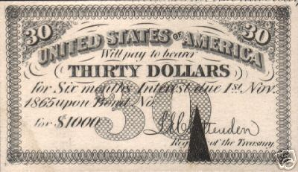
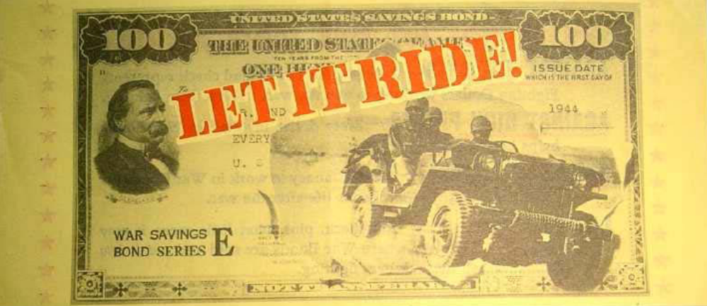
USA Treasury Bonds
Fiscal Policy
Government bonds
Notes:
The federal budget is the primary tool of fiscal policy.
Discretionary changes in fiscal policy are deliberate changes in G designed to affect the size of the budget deficit or surplus.
Budget surplus: Present when total government spending is less than total taxes collected from businesses and consumers (G < T ).
Surpluses reduce the magnitude of the government’s outstanding debt.
Budget deficit: Present when total government spending exceeds total taxes collected from businesses and consumers (G > T ).
Deficits are typically covered with borrowing.
Changes in the size of the federal deficit or surplus are often used to gauge whether fiscal policy is stimulating or restraining AD, which arise from either:
A change in the state of the economy, or,
A change in discretionary fiscal policy.
Treasury borrows to cover deficits by auctioning bonds to banks, large firms, foreign governments, central banks and international organizations.

Slide 6
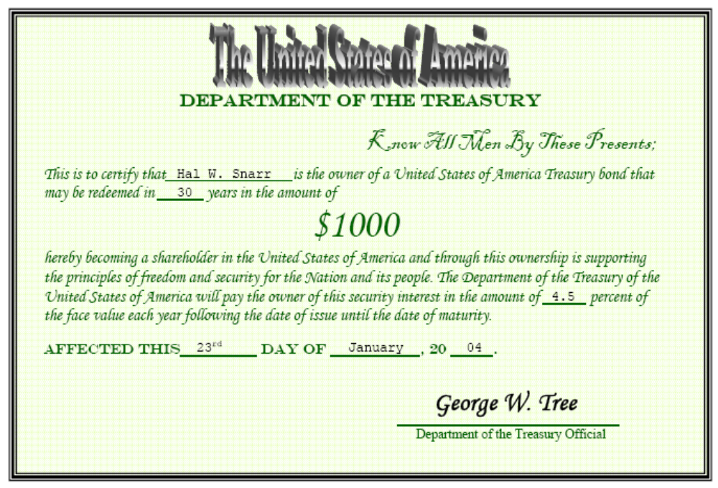
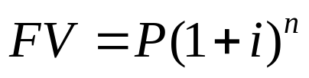
USA Treasury Bonds
Fiscal Policy
Government bonds
0
Mock Auction

Slide 7
Expansionary Fiscal Policy
Cut T or raise G
The classical school The Keynesian school
PL
LRAS
PL
LRAS
SRAS
118
115
115
SRAS
AD
AD
15
16
Y
14
15
Y
Low u …
Notes:
Keynesian theory highlights the potential of fiscal policy as a tool capable of reducing fluctuations in aggregate demand.
Following the Great Depression, Keynesians challenged the view that governments should always balance their budget.
Rather than balancing their budget annually, Keynesians argue that counter-cyclical policy should be used to offset fluctuations in aggregate demand.
Expansionary fiscal policy – used when the economy is weak
Recessionary gap exists if real GDP is less than potential output
Annual budget deficits can close this gap if the government
Increases government purchases of goods & services
Cuts taxes

Slide 8
Expansionary Fiscal Policy
Cut T or raise G
The classical school The Keynesian school
PL
LRAS
PL
LRAS
121
SRAS
118
115
115
SRAS
AD
AD
15
16
Y
14
15
Y
Low u … pushes wages & prices of other production inputs up.

Slide 9
Restrictive Fiscal Policy
Raise T or cut G?
The classical school The Keynesian school
PL
LRAS
PL
LRAS
SRAS
115
115
SRAS
113
AD
AD
14
15
Y
15
16
Y
High u …
Notes:
Restrictive fiscal policy – used when strong demand threatens to cause inflation
Inflationary gap exists if real GDP exceeds potential output
Annual budget surpluses can close this gap if the government
reduces government spending
raises taxes

Slide 10
Restrictive Fiscal Policy
Raise T or cut G?
The classical school The Keynesian school
PL
LRAS
PL
LRAS
SRAS
115
115
SRAS
113
AD
111
AD
14
15
Y
15
16
Y
High u … pushes wages & prices of other production inputs down.
Notes:
The resulting fiscal surplus can then be used to pay off budget deficits that were used to close recessionary gaps

Slide 11
Shortcomings of Fiscal Policy
In the 1970s,
there were inflationary recessions
there was stagflation
wages and prices are not rigid as Keynesians believed
SRAS slopes upward
Even if the Keynesian view that fiscal policy can close output gaps is valid, doing so is futile because
Predicting the size of the stimulus (increase in G or cut in T) is difficult
Forecasting is increasingly unreliable the further into the future predictions are made
Undershooting
Overshooting

Slide 12
Shortcomings of Expansionary Fiscal Policy
Forecasting a cut T or an increase in G
PL
LRAS
SRAS
Undershooting a recessionary gap
109
108
AD
14
15
Y
Notes:
If the initial stimulus was too large with the economy at point A, AD will shift along SRAS to a point that is to the right of point B.
This induces an inflationary gap, and requires a withdrawal of stimulus or tighter money from the Fed to avert SRAS from eventually self-adjusting up due to resources being overemployed.

Slide 13
Shortcomings of Expansionary Fiscal Policy
Forecasting a cut T or an increase in G
PL
LRAS
SRAS
Overshooting a recessionary gap
116
108
AD
14
15
16
Y
Low u …
Notes:
If the initial stimulus was too large with the economy at point A, AD will shift along SRAS to a point that is to the right of point B.
This induces an inflationary gap, and requires a withdrawal of stimulus or tighter money from the Fed to avert SRAS from eventually self-adjusting up due to resources being overemployed.

Slide 14
Shortcomings of Expansionary Fiscal Policy
Forecasting a cut T or an increase in G
PL
LRAS
SRAS
Overshooting a recessionary gap
121
116
108
AD
14
15
16
Y
Low u … pushes wages & prices of other production inputs up.

Slide 15
Shortcomings of Restrictive Fiscal Policy
Forecasting a hike in T or a cut to G
PL
LRAS
SRAS
116
AD
15
16
Y
Will Republicans agree to a tax hike or a cut in defense spending?
Will Democrats agree to a cut in government expenditures on social programs?
Notes:
If the initial stimulus was too large with the economy at point A, AD will shift along SRAS to a point that is to the right of point B.
This induces an inflationary gap, and requires a withdrawal of stimulus or tighter money from the Fed to avert SRAS from eventually self-adjusting up due to resources being overemployed.

Slide 16
Shortcomings of Expansionary Fiscal Policy
Policy lag in cut in T or an increase in G
PL
LRAS
SRAS
114
110
AD
13
15
Y
Suppose there is a slump in private investment => investment expenditure falls
Notes:
Even if fiscal stimulus is predictable, there are delays in its implementation.
It takes time to observe recessionary gaps because GDP & unemployment are not observed in the present
Months of observations are needed to make an accurate prognosis
After a problem has been diagnosed, it takes time to decide the best course of action
Congress must debate, compromise, amend, and vote
Enacting it is challenging if the President’s party does not control Congress
If the President’s party controls Congress, the Senate minority can stop legislation with a 41 vote filibuster.
After fiscal policy is signed into law, its effects are further delayed by
revenue from new taxes collected a year or more after a change
bureaucratic red tape that includes departments
altering budgets
adjusting spending habits
screening grant or transfer payment applicants.
Sometimes its implementation is purposely lagged by several years
EGTRRA
ACA
The multiplier theory implies the economic benefits of fiscal stimulus take time to unwind.
Fiscal policy can destabilize the economy

Slide 17
Shortcomings of Expansionary Fiscal Policy
Policy lag in cut in T or an increase in G
PL
LRAS
SRAS
114
112
110
AD
13
14
15
Y
Suppose there is a slump in private investment => investment expenditure falls
While Congress is debating the type and size of fiscal policy, private investment bounces back a little
Notes:
If the initial stimulus was too large with the economy at point A, AD will shift along SRAS to a point that is to the right of point B.
This induces an inflationary gap, and requires a withdrawal of stimulus or tighter money from the Fed to avert SRAS from eventually self-adjusting up due to resources being overemployed.

Slide 18
Shortcomings of Expansionary Fiscal Policy
Policy lag in cut in T or an increase in G
PL
LRAS
SRAS
114
112
110
AD
13
14
15
Y
Suppose there is a slump in private investment => investment expenditure falls
While Congress is debating the type and size of fiscal policy, suppose private investment bounces back a little
After each house of Congress has finalized their bills, suppose expectations of the future improve as the two chambers reconcile their bills.

Slide 19
Shortcomings of Expansionary Fiscal Policy
Policy lag in cut in T or an increase in G
PL
LRAS
SRAS
114
114
112
110
AD
13
14
15
17
Y
Suppose there is a slump in private investment => investment expenditure falls
While Congress is debating the type and size of fiscal policy, suppose private investment bounces back a little
After each house of Congress has finalized their bills, suppose expectations of the future improve as the two chambers reconcile their bills.
With the recessionary gap closed, the President signs the stimulus into law.

Slide 20
Shortcomings of Expansionary Fiscal Policy
Policy lag in cut in T or an increase in G
PL
LRAS
SRAS
116
114
112
110
AD
13
14
15
17
Y
Suppose there is a slump in private investment => investment expenditure falls
While Congress is debating the type and size of fiscal policy, suppose private investment bounces back a little
After each house of Congress has finalized their bills, suppose expectations of the future improve as the two chambers reconcile their bills.
With the recessionary gap closed, the President signs the stimulus into law.
With u too low, w and p are pushed up …

Slide 21
Shortcomings of Expansionary Fiscal Policy
Policy lag in cut in T or an increase in G
PL
LRAS
118
SRAS
116
114
112
110
AD
13
14
15
17
Y
Suppose there is a slump in private investment => investment expenditure falls
While Congress is debating the type and size of fiscal policy, suppose private investment bounces back a little
After each house of Congress has finalized their bills, suppose expectations of the future improve as the two chambers reconcile their bills.
With the recessionary gap closed, the President signs the stimulus into law.
With u too low, w and p are pushed up … inflation accelerates.

Slide 22
Shortcomings of Expansionary Fiscal Policy
Crowding-out
Decline in
private investment
Increases the budget deficit
Higher real
interest rates
Inflow of financial
capital from abroad
Appreciation
of the dollar
Decline in
net exports
Increased government borrowing to finance tax cuts and increased G
places upward pressure on real interest rates, which retards private
investment.
In an open economy, high interest rates attract foreign capital.
As foreigners buy more dollars to buy U.S. bonds and other financial assets, the dollar appreciates.
The appreciation of the dollar causes net exports to fall.
Lower exports and private investment cancels out expansionary impact of stimulus bills.

Slide 23
Shortcomings of Fiscal Policy
Vote buying
Political incentives also influence fiscal policy.
  Legislators are delighted to spend money on programs that directly benefit their own constituents but are reluctant to raise taxes because they impose a visible cost on voters.
  Politicians are half-Keynesians
    Keynesians are proponents of budget deficits in recessionary gaps
      Democrats push for higher G to stimulate the economy
      Republicans propose cuts in T to stimulate the economy
      Both are Keynesians during recessions
    Keynesians are proponents of budget surpluses in inflationary gaps.
      Democrats are against cuts in G
      Republicans are against higher T
      Neither are Keynesians during expansions
  There is a political bias towards spending and budget deficits. Predictably, deficits will be far more common than surpluses.

Slide 24
Shortcomings of Fiscal Policy
Automatic Stabilizers
Discretionary fiscal policy (even if it is effective) is unnecessary because there are automatic fiscal stabilizers:
  They increase the budget deficit (or reduce the surplus) during a recession
  They increase the surplus (or reduce the deficit) during an economic boom.
  The major advantage of automatic stabilizers is that they institute counter-cyclical fiscal policy without the delays associated with legislative action.
  Examples include
    Corporate profit tax
    Unemployment compensation
    SNAP
    Progressive income taxation
Notes:
As growth accelerates, incomes rise.
With more and more people paying an increasing proportion of income in taxes because they find themselves in higher and higher income tax brackets.
This dampens consumption expenditure, and limits the peak of the business-cycle.
As the economy approaches the trough in the business cycle, more and more people are paying less in income taxes
because they find themselves in lower and lower income tax brackets
Or receiving transfer payments from UI or SNAP.
As the deficit automatically widens without legislative delay, immediate stimulus is injected into the economy
This pushes real GDP back toward its potential level.
The additional tax revenue accruing to Treasury during an expansion automatically pays down the fiscal deficit resulting from an economic contraction.

Slide 25

Monetarist’s take on Fiscal Policy
PL
SRAS
AD
P₁
Y₁
If households do not anticipate higher future taxes, AD rises when T is cut or G is raised.
If households fully anticipate higher future taxes, the cut in T or hike in G are completely offset by households expecting less future income due to higher future taxes.
Notes:
The Chicago School -- The New Classical view stresses that:
Debt financing substitutes higher future taxes for lower current taxes
Thus, budget deficits affect the timing of taxes not their magnitude
when debt is substituted for taxes:
People save the increased income to pay higher future taxes
Hence, budget deficits do not stimulate AD
The real interest rate is unaffected by deficits as people save more in order to pay the higher future taxes.
Fiscal policy is completely impotent because it does not affect output, employment, or real interest rates

Slide 26
Monetarist’s take on Fiscal Policy
Loanable Funds Market
S₁
S₂
r
Fiscal policy exerts no effect on r, Y, or u
r₁
D₂
D₁
Q₁
Q₂
As the budget deficit rise, government borrows more in the loanable funds market.
Under the new classical view, people save to pay expected higher future taxes.
This permits the government to borrow the funds to finance the deficit without pushing up the interest rate.
Notes:
The Chicago School

Slide 27
Supply-side’s take on Fiscal Policy
People will not work and firms will not produce anything if the tax rate is 100%.
If no one works and nothing is produce, the economy generates no income.
Hence,
Tax Revenue = 0
People pay no income taxes when the tax rate is 0%.
Hence,
Tax Revenue = 0
2.5
Tax Revenue
(in trillions of $)
2.0
1.5
1.0
0.5
0
0
20
40
60
80
100
tax rate (percent)

Slide 28
Supply-side’s take on Fiscal Policy
If tax revenue is 0 when the tax rate is 0% or 100%, there is a tax rate where tax revenue reaches a maximum value.
According to the diagram below, the optimal tax rate is 30%.
This tax rate generates $2.5 trillion in tax revenue.
2.5
Tax Revenue
(in trillions of $)
2.0
1.5
1.0
0.5
0
0
20
40
60
80
100
tax rate (percent)

Slide 29
Supply-side’s take on Fiscal Policy
If the tax rate is 60%,
tax revenue is $1.7 trillion.
If the tax rate is cut to 30%,
tax revenue increases to $2.5 trillion.
2.5
2.5
Tax Revenue
(in trillions of $)
2.0
1.7
1.5
1.0
0.5
0
0
20
30
40
60
60
80
100
tax rate (percent)

Slide 30
Supply-side’s take on Fiscal Policy
If the tax rate is 30%,
tax revenue is $2.5 trillion.
If the tax rate is raised to 60%,
tax revenue decreases to $1.7 trillion.
2.5
2.5
Tax Revenue
(in trillions of $)
2.0
1.7
1.5
1.0
0.5
0
0
20
30
40
60
60
80
100
tax rate (percent)

Slide 31
Supply-side’s take on Fiscal Policy
The Laffer Curve also suggests that when tax rates are “low,” a tax cut lowers tax revenue.
2.5
2.5
Tax Revenue
(in trillions of $)
2.0
1.6
1.5
1.0
0.5
0
0
10
20
30
40
60
80
100
tax rate (percent)

Slide 32
Supply-side’s take on Fiscal Policy
LRAS
LRAS
PL
SRAS
SRAS
P₀
AD
AD
AD
Y₀
Y₁
A permanent cut in the supply-side tax rate raises the incentive to earn and increases resources efficiency.
SRAS and LRAS increase, which is followed by an increase in AD (Say’s Law)
Over time permanent lower (competitive) taxes promote more rapid (sustainable) growth.
If the government temporarily cuts T or temporarily raises G, AD and SRAS will expands but LRAS doesn’t. resulting in inflation.
Notes:
Changes in marginal tax rates may exert an impact on AS because the changes will influence the relative attractiveness of productive activity in comparison to leisure and tax avoidance.
Impact of supply-side effects:
Usually take place over a lengthy time period.
There is some evidence that countries with high taxes grow more slowly—France versus United Kingdom.
There is evidence they are important for taxpayers facing extremely high tax rates – say rates of 40 percent or above.

Slide 33
Austrian Economist’s take on Fiscal Policy
LRAS
PL
SRAS
118
Doing nothing
in the short run
115
AD
12 15 Y
Since u is too high, w is bid up by firms looking for scarce laborers
Notes:
The Austrian school of economics
is an offshoot of classical economics
advocates for a limited role for government in the economy
is associated with classical (not present day political) liberalism.
does not acknowledge the need for taxes and minimal intervention by the State
generally does not don’t acknowledge macroeconomics existence
The appropriate unit of analysis is at the individual level
Austrians comment on macroeconomic issues
fiscal and monetary stimulus should not be perused
FP an MP are not a cure
FP and MP treat symptoms

Slide 34
Austrian Economist’s take on Fiscal Policy
LRAS
PL
SRAS
121
Doing nothing
in the short run
118
115
AD
12 15 Y
Since u is too high, w is bid up by firms looking for scarce laborers
Since u is still too high, firms bid up the prices of other production inputs
Notes:
Its solution for persistently high unemployment is the eliminate of policies that make wages and prices rigid
UI compensation
the minimum wage
pro-labor policy
pro-business policy
public assistance
price controls in farm bills
Interest rate targeting

Slide 35
Austrian Economist’s take on Fiscal Policy
LRAS
PL
SRAS
118
Worrying about a
higher price level
115
AD
Since u is too high, w is bid up by firms looking for scarce laborers
Since u is still too high, firms bid up the prices of other production inputs
To prevent prices from rising, the Fed raises interest rates just enough

Slide 36
Austrian Economist’s take on Fiscal Policy
LRAS
PL
SRAS
118
Worrying about a
higher price level
115
105
AD
11
12 15 Y
Since u is too high, w is bid up by firms looking for scarce laborers
Since u is still too high, firms bid up the prices of other production inputs
To prevent prices from rising, the Fed usually raises interest rates TOO MUCH

Slide 37
Austrian Economist’s take on Fiscal Policy
LRAS
PL
SRAS
Doing nothing
over the long run
115
AD
12 15 Y
  In the absence of all government intervention, innovation is not inhibited by the Fed hiking interest rates. Allowing low unemployment to persist
Notes:
Its solution for an inflationary gap is laissez faire, too.

Slide 38
Austrian Economist’s take on Fiscal Policy
LRAS
PL
SRAS
Doing nothing
over the long run
115
AD
12 15 Y
  In the absence of all government intervention, innovation is not inhibited by the Fed hiking interest rates. Allowing low unemployment to persist
    drives cost-saving innovation
    firms employ individuals who find creative ways to lower costs
    Greater entrepreneurialism and technology raises LRAS
    u rises to just equal u_{n} as workers are replaced by labor-saving technologies
Notes:
Its solution for an inflationary gap is laissez faire, too.

Slide 39
Monetary Policy
Money Demand
  The lower the nominal interest rate, the lower the opportunity cost of holding money, the greater is the quantity of real money demanded.
i
3.5
2.5
MD
500 550 M
2300

Slide 40
Monetary Policy
Money Demand
  The lower the nominal interest rate, the lower the opportunity cost of holding money, the greater is the quantity of real money demanded.
  M rises by 5% if PL rises by 5%
  real GDP
  Financial technology: ATM, debit cards, interest checking
i
2.5
MD
1900 550 M

Slide 41
Monetary Policy
Money Demand
  The lower the nominal interest rate, the lower the opportunity cost of holding money, the greater is the quantity of real money demanded.
  M rises by 5% if PL rises by 5%
  real GDP
  Financial technology: ATM, debit cards, interest checking
  credit cards
i
2.5
MD
1900 550 M
Notes:
PIH = permanent income hypothesis
QTM = quantity theory of money
LPT = liquidity preference theory

Slide 42
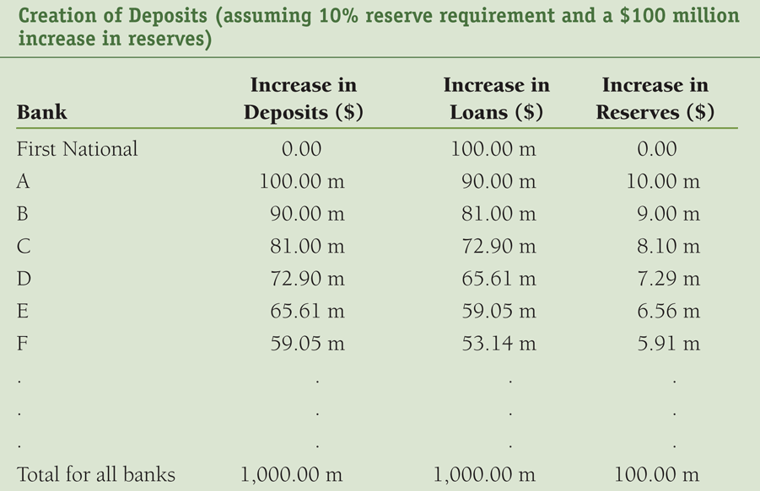

Monetary Policy
Money Supply
The Fed buys $100 million worth of First National’s Treasury bonds and the reserve requirement ratio is 10%

Slide 43




Monetary Policy
Money Supply
The Fed buys $100 million worth of First National’s Treasury bonds and the reserve requirement ratio is 10%

Slide 44
Monetary Policy
Money Supply
The Fed buys $100 million worth of First National’s Treasury bonds and the reserve requirement ratio is 10%
1/rrr
simple
money
multiplier

Slide 45
Monetary Policy
Money Supply
  It is the relationship between the quantity of money supplied and i.
  On any given day, the quantity of money is fixed independent of the interest rate.
MS
i
3.5
2.5
500 2300 M

Slide 46
Monetary Policy
Money Supply
  It is the relationship between the quantity of money supplied and i.
  On any given day, the quantity of money is fixed independent of the interest rate.
  Increased bank lending raises MS and lowers the interest rate (see previous slide)
MS
i
3.5
3.0
MD
500 2300 M

Slide 47
Monetary Policy
Money Supply
  It is the relationship between the quantity of money supplied and i.
  On any given day, the quantity of money is fixed independent of the interest rate.
  Increased bank lending raises MS and lowers the interest rate
  Expansionary monetary policy raise MS and lowers interest rates (see OMP slides)
MS
i
3.5
3.0
2.5
MD
500 2300 M

Slide 48
Monetary Policy
Demand for reserves
  The lower the federal funds rate (i_{ff} ), the lower the opportunity cost of holding reserves and the greater than quantity of excess reserves held.
Federal Funds Market
i_{ff}
5
2
D^{R}
25
28
R

Slide 49
Monetary Policy
Demand for reserves
  The lower the federal funds rate (i_{ff} ), the lower the opportunity cost of holding reserves and the greater than quantity of excess reserves held.
  Q of reserves increases if the rrr is raised
Federal Funds Market
i_{ff}
2
D^{R}
28
R

Slide 50
Monetary Policy
Demand for reserves
  The lower the federal funds rate (i_{ff} ), the lower the opportunity cost of holding reserves and the greater than quantity of excess reserves held.
  Q of reserves increases if the rrr is raised
Federal Funds Market
i_{ff}
2
D^{R}
28
30
R

Slide 51
Monetary Policy
Demand for reserves
  The lower the federal funds rate (i_{ff} ), the lower the opportunity cost of holding reserves and the greater than quantity of excess reserves held.
  Q of reserves increases if the rrr is raised, checking deposits increase
Federal Funds Market
i_{ff}
2
D^{R}
28
30
R

Slide 52
Monetary Policy
Demand for reserves
  The lower the federal funds rate (i_{ff} ), the lower the opportunity cost of holding reserves and the greater than quantity of excess reserves held.
  Q of reserves increases if the rrr is raised, checking deposits increase, or a banking shock occurs
Federal Funds Market
i_{ff}
2
D^{R}
28
30
R

Slide 53
Monetary Policy
Supply of reserves
  The horizontal section is determined when the Fed sets the discount rate (i_{d} = 3%).
Federal Funds Market
i_{ff}
3
R
Notes:
A bank that can’t meet its reserve requirement (R_{R} ) borrows from a bank that has excess reserves in the federal funds market and Q^{S} remains unchanged
When banks borrow from the Fed, discount loans rise, borrowed reserves (R_{B}) increase, the quantity of reserves supplied increases.
When banks sell US Treasury securities to the Fed, non-borrowed reserves (R_{N}) increase, which increases the quantity of reserves.
Hence, the supply of reserves is the sum
If the federal funds rate is less than the discount rate (i_{ff} < i_{d}), banks will not borrow from the Fed because
“Insurance” purchased from the Fed is more expensive than from other banks
If the federal funds rate is more than the discount rate (i_{ff} > i_{d}), banks will want to borrow from the Fed instead of other banks
“Insurance” purchased from other banks is more expensive than from the Fed.

Slide 54
Monetary Policy
Supply of reserves
  The horizontal section is determined when the Fed sets the discount rate (i_{d} = 3%).
  The vertical section is the sum or borrowed reserves (R_{b} = $25b) and non-borrowed reserves (R_{n} = $3b)
Federal Funds Market
i_{ff}
3
28
R
Notes:
A bank that can’t meet its reserve requirement (R_{R} ) borrows from a bank that has excess reserves in the federal funds market and Q^{S} remains unchanged
When banks borrow from the Fed, discount loans rise, borrowed reserves (R_{B}) increase, the quantity of reserves supplied increases.
When banks sell US Treasury securities to the Fed, non-borrowed reserves (R_{N}) increase, which increases the quantity of reserves.
Hence, the supply of reserves is the sum
If the federal funds rate is less than the discount rate (i_{ff} < i_{d}), banks will not borrow from the Fed because
“Insurance” purchased from the Fed is more expensive than from other banks
If the federal funds rate is more than the discount rate (i_{ff} > i_{d}), banks will want to borrow from the Fed instead of other banks
“Insurance” purchased from other banks is more expensive than from the Fed.

Slide 55
Monetary Policy
Supply of reserves
  The horizontal section is determined when the Fed sets the discount rate (i_{d} = 3%).
  The vertical section is the sum or borrowed reserves (R_{b} = $25b) and non-borrowed reserves (R_{n} = $3b)
Federal Funds Market
i_{ff}
3
S^{R}
28
R
Notes:
A bank that can’t meet its reserve requirement (R_{R} ) borrows from a bank that has excess reserves in the federal funds market and Q^{S} remains unchanged
When banks borrow from the Fed, discount loans rise, borrowed reserves (R_{B}) increase, the quantity of reserves supplied increases.
When banks sell US Treasury securities to the Fed, non-borrowed reserves (R_{N}) increase, which increases the quantity of reserves.
Hence, the supply of reserves is the sum
If the federal funds rate is less than the discount rate (i_{ff} < i_{d}), banks will not borrow from the Fed because
“Insurance” purchased from the Fed is more expensive than from other banks
If the federal funds rate is more than the discount rate (i_{ff} > i_{d}), banks will want to borrow from the Fed instead of other banks
“Insurance” purchased from other banks is more expensive than from the Fed.

Slide 56
Monetary Policy
Equilibrium in normal mode
  It is determined by the intersection of supply and demand.
Federal Funds Market
i_{ff}
3
S^{R}
D^{R}
28
R

Slide 57

Monetary Policy
Equilibrium in normal mode
  It is determined by the intersection of supply and demand.
  Equilibrium quantity of reserves equals $28b
Federal Funds Market
i_{ff}
3
S^{R}
D^{R}
28
R

Slide 58
Monetary Policy
Equilibrium in normal mode
  It is determined by the intersection of supply and demand.
  Equilibrium quantity of reserves equals $28b
  Equilibrium federal funds rate equals 2%
Federal Funds Market
i_{ff}
3
S^{R}
2
D^{R}
28
R

Slide 59
Monetary Policy
Changing the discount rate
  The Fed raises the discount rate to 4%.
Federal Funds Market
i_{ff}
4
3
S^{R}
2
D^{R}
28
R

Slide 60
Monetary Policy
Changing the discount rate
  The Fed raises the discount rate to 4%.
Federal Funds Market
i_{ff}
4
S^{R}
2
D^{R}
28
R

Slide 61
Monetary Policy
Changing the discount rate
  The Fed raises the discount rate to 4%.
  The equilibrium does not change when the Fed lowers the discount rate back to 3%.
Federal Funds Market
i_{ff}
3
S^{R}
2
D^{R}
28
R

Slide 62
Monetary Policy
Changing the required reserve ratio
  When the Fed raises rrr, demand for reserves shifts out
Federal Funds Market
i_{ff}
3
S^{R}
2
D^{R}
28
R

Slide 63
Monetary Policy
Changing the required reserve ratio
  When the Fed raises rrr, demand for reserves shifts out
Federal Funds Market
i_{ff}
3
S^{R}
2
D^{R}
28
R

Slide 64
Monetary Policy
Changing the required reserve ratio
  When the Fed raises rrr, demand for reserves shifts out
  i_{ff} rises to i_{d}
Federal Funds Market
i_{ff}
3
S^{R}
D^{R}
28
R

Slide 65
Monetary Policy
Changing the required reserve ratio
  When the Fed raises rrr, demand for reserves shifts out
  i_{ff} rises to i_{d} provided the Fed adds $5b to reserves by issuing $5b in discount loans.
Federal Funds Market
i_{ff}
3
S^{R}
D^{R}
28
32
R

Slide 66
Monetary Policy
Changing the required reserve ratio
  When the Fed raises rrr, demand for reserves shifts out
  i_{ff} rises to i_{d} provided the Fed adds $5b to reserves by issuing $5b in discount loans.
  The equilibrium quantity of reserves increases to $32b.
Federal Funds Market
i_{ff}
3
S^{R}
D^{R}
28
32
R

Slide 67
Monetary Policy
Open Market Purchase
  In normal mode with i_{d} = 3% and the target i_{ff} = 2%, the equilibrium quantity of reserves equals $28b
Federal Funds Market
i_{ff}
3
S^{R}
2
D^{R}
28
R

Slide 68
Monetary Policy
Open Market Purchase
  In normal mode with i_{d} = 3% and the target i_{ff} = 2%, the equilibrium quantity of reserves equals $28b
  The Fed announces it will lower the target federal funds rate to 1.5%
Federal Funds Market
i_{ff}
3
S^{R}
2
1.5
D^{R}
28
R

Slide 69
Monetary Policy
Open Market Purchase
  In normal mode with i_{d} = 3% and the target i_{ff} = 2%, the equilibrium quantity of reserves equals $28b
  The Fed announces it will lower the target federal funds rate to 1.5%
  It does this by buying $0.5b worth of bonds from banks
Federal Funds Market
i_{ff}
3
S^{R}
2
1.5
D^{R}
28
28.5
R

Slide 70
Monetary Policy
Open Market Purchase
  In normal mode with i_{d} = 3% and the target i_{ff} = 2%, the equilibrium quantity of reserves equals $28b
  The Fed announces it will lower the target federal funds rate to 1.5%
  It does this by buying $0.5b worth of bonds from banks
  Since the Fed sets i_{d} one pct. point higher than its target, it announces i_{d} is now 3.5%.
Federal Funds Market
i_{ff}
2.5
S^{R}
1.5
D^{R}
28
28.5
28.5
R

Slide 71
Monetary Policy
Open Market Purchase
  With $0.5b more bonds in the banking system,
Market for money
i
MS
3.85
MD
500
M

Slide 72
Monetary Policy
Open Market Purchase
  With $0.5b more bonds in the banking system, MS increases by $5b (= 0.5 × m) via increased lending
Market for money
i
MS
3.85
MD
500
505
M

Slide 73
Monetary Policy
Open Market Purchase
  With $0.5b more bonds in the banking system, MS increases by $5b (= 0.5 × m) via increased lending, and the nominal rate falls to 2.75%
Market for money
i
MS
3.85
2.85
MD
500
505
M

Slide 74
Monetary Policy
Open Market Purchase
  With $0.5b more bonds in the banking system, MS increases by $5b (= 0.5 × m) via increased lending, and the nominal rate falls to 2.75%
  If inflation remains unchanged, r will fall by 1 pct. point
Market for money
i
MS
3.85
2.85
MD
500
505
M

Slide 75
Monetary Policy
Open Market Purchase
  In the Aggregate Market Model, if r will falls by 1 pct. point, AD increases
Aggregate Market Model
PL
LRAS
SRAS
215
AD
14
15
Y

Slide 76
Monetary Policy
Open Market Purchase
  In the Aggregate Market Model, if r will falls by 1 pct. point, AD increases
  u falls to u_{n}
Aggregate Market Model
PL
LRAS
SRAS
215
AD
14
15
Y

Slide 77
Monetary Policy
Open Market Purchase
  In the Aggregate Market Model, if r will falls by 1 pct. point, AD increases
  u falls to u_{n}, Real GDP rises to its potential level
Aggregate Market Model
PL
LRAS
SRAS
215
AD
14
15
Y

Slide 78
Monetary Policy
Open Market Purchase
  In the Aggregate Market Model, if r will falls by 1 pct. point, AD increases
  u falls to u_{n}, Real GDP rises to its potential level, and the price level rises to 225
Aggregate Market Model
PL
LRAS
SRAS
225
215
AD
14
15
Y

Slide 79
Monetary Policy
Open Market Sale
  In normal mode with i_{d} = 3% and the target i_{ff} = 2%, the equilibrium quantity of reserves equals $28b
  The Fed announces it will raise the target federal funds rate to 3%
  It does this by selling $1b worth of bonds to banks
  Since the Fed sets i_{d} one pct. point higher than its target, it announces i_{d} is now 4%.
Federal Funds Market
i_{ff}
3
S^{R}
2
D^{R}
27
28
R

Slide 80
Monetary Policy
Open Market Sale
  With $1b fewer bonds in the banking system, MS decreases by $10b (= 1 × m) via decreased lending, and the nominal rate rises to 5.03%
  If inflation remains unchanged, r will rise by 1.18 pct. points.
Market for money
i
MS
5.03
3.85
MD
490
500
M

Slide 81
Monetary Policy
Open Market Sale
  In the Aggregate Market Model, if r rises by 1.18 pct. points, AD decreases
  u rises to u_{n}, Real GDP falls down to its potential level, and the price level falls to 225
Aggregate Market Model
PL
LRAS
SRAS
265
225
AD
15
16
Y

Slide 82
Monetary Policy
Interest on reserves
  In 10/08, the Fed began paying interest on reserves (i_{or})
Federal Funds Market
i_{ff}
D^{R}
1.5
S^{R}
0.5
0
Q

Slide 83
Monetary Policy
Interest on reserves
  In 10/08, the Fed began paying interest on reserves (i_{or})
  After the Fed purchased of trillions of dollars in securities, reserves supply increased
  The federal funds rate may have went negative.
  Setting interest on reserves put a price floor on the federal funds rate
Federal Funds Market
i_{ff}
D^{R}
Crisis mode
1.5
S^{R}
0.5
0.5
0
Q
-0.9

Slide 84
Monetary Policy
Interest on reserves
  In 10/08, the Fed began paying interest on reserves (i_{or})
  After the Fed purchased of trillions of dollars in securities, reserves supply increased
  The federal funds rate may have went negative.
  Crisis mode allows the Fed to buy or sell as many securities as it wants without changing the federal funds rate.
Federal Funds Market
i_{ff}
D^{R}
1.5
S^{R}
0.5
0
Q

Slide 85
Monetary Policy
Interest on reserves
  In 10/08, the Fed began paying interest on reserves (i_{or})
  After the Fed purchased of trillions of dollars in securities, reserves supply increased
  The federal funds rate may have went negative.
  Crisis mode allows the Fed to buy or sell as many securities as it wants without changing the federal funds rate.
Federal Funds Market
i_{ff}
D^{R}
1.5
S^{R}
0.5
0
Q

Slide 86
Monetary Policy
Interest on reserves
  In 10/08, the Fed began paying interest on reserves (i_{or})
  After the Fed purchased of trillions of dollars in securities, reserves supply increased
  The federal funds rate may have went negative.
  Crisis mode allows the Fed to buy or sell as many securities as it wants without changing the federal funds rate.
Federal Funds Market
i_{ff}
D^{R}
1.5
S^{R}
0.5
0
Q

Slide 87
Monetary Policy
Interest on reserves
  In 10/08, the Fed began paying interest on reserves (i_{or})
  After the Fed purchased of trillions of dollars in securities, reserves supply increased
  The federal funds rate may have went negative.
  Crisis mode allows the Fed to buy or sell as many securities as it wants without changing the federal funds rate.
Federal Funds Market
i_{ff}
D^{R}
1.5
S^{R}
0.5
0
Q

Slide 88
Monetary Policy
Interest on reserves
  In 10/08, the Fed began paying interest on reserves (i_{or})
  After the Fed purchased of trillions of dollars in securities, reserves supply increased
  The federal funds rate may have went negative.
  Crisis mode allows the Fed to buy or sell as many securities as it wants without changing the federal funds rate.
Federal Funds Market
i_{ff}
D^{R}
1.5
S^{R}
0.5
0
Q

Slide 89
Monetary Policy
Interest on reserves
  The Fed raises the federal funds rate by announcing a hike in i_{or} and i_{d}
Federal Funds Market
i_{ff}
D^{R}
2.75
1.75
1.5
S^{R}
0.5
0
Q

Slide 90
Monetary Policy
Interest on reserves
  The Fed raises the federal funds rate by announcing a hike in i_{or} and i_{d}
  The Fed lowers the federal funds rate by announcing reductions in i_{or} and i_{d}
  To go back to normal mode, the Fed will allow reserves demand to rise (via economic growth), conduct several controlled OMSs, and adjust i_{or} higher and higher, while it monitors inflation
Federal Funds Market
i_{ff}
4
S^{R}
3
1.5
0.5
0
Q

Slide 91
Hyperinflation & Discretionary MP
Government expenditures is paid for by
Raising tax revenue
Treasuries can print money
    In the U.S., the Fed buys bonds directly from Treasury
Treasuries can sell more bonds
    If the deficit is financed by selling bonds to the public, there is no effect on the MB = R + C, and on the MS
    If the deficit is financed by the Fed buying bonds from banks, the MB and MS increase
    $1 could buy 11% more goods in 1912 than in 1776
    $1 could buy 95% fewer goods in 2008 than in 1913
$1m held from 1913 to 2008 is worth $50k
www.lewrockwell.com/2009/07/erik-voorhees/the-record-of-the-federal-reserve/
Notes:
After the Fed, if in 1913, you sat on your savings pile of $1,000,000 for95 years, it would then be worth only $50,000 in purchasing power (it will have depreciated in value by 95%)

Slide 92
Hyperinflation & Discretionary MP
Hyperinflation is a period of high inflation (> 50% per month)
Larry Allen’s The Encyclopedia of Money:
Bolshevik Revolution
    Prior to the 1917, prices rose 2 to 3 times faster than wages.
    After 1917, prices rose by
    92,300% from 2013 to 1919
    64,823,000,000% from 2013 to 1923
Post WWI Germany
    In 1914, there were 6,323 million marks in circulation
    By 1923 there were 17,393,000 million.
    A newspaper costing one mark in May 1922 cost 1,000 marks 16 months later, and 70 million marks a year and a half later.
    At its worst,
    Customers rolled wheelbarrows full of money to the grocery store
    Customers and restaurants negotiated the cost of meals in advance
    Printed money was bailed like hay to heat one’s home.
    It took about 4 days for prices to double

Slide 93
Hyperinflation & Discretionary MP
Hyperinflation is a period of high inflation (> 50% per month)
Erich Maria Remarque’s The Black Obelisk:
  Workmen are given their pay twice a day now--in
  the morning and in the afternoon, with a recess
  of a half-hour each time so that they can rush
  out and buy things--for if they waited a few
  hours the value of their money would drop
Steve Hanke’s R.I.P. Zimbabwe Dollar:
The time it took for prices to double in
  1994 Yugoslavia, 33.6 hours
  2008 Zimbabwe, 24.7 hours
  1946 Hungary, 15.6 hours

Slide 94
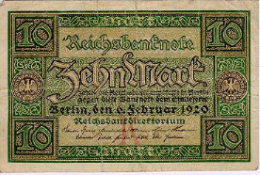
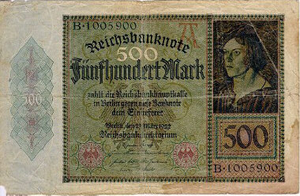
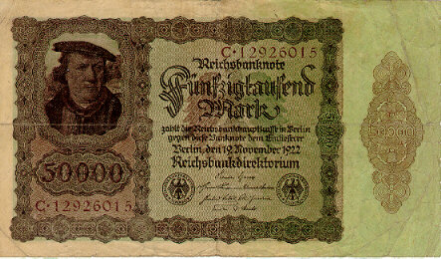
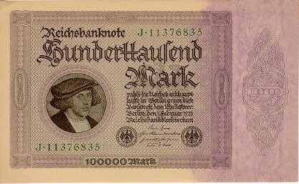
Hyperinflation & Discretionary MP
Hyperinflation in the Weimar Republic (Germany, post WWI)
Feb., 1920
March,1922
Nov.,1922
Feb., 1923

Slide 95
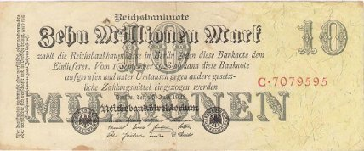
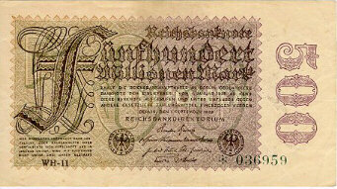
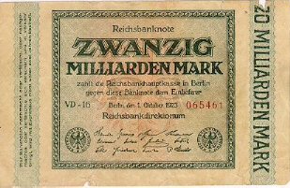
Hyperinflation & Discretionary MP
Hyperinflation in the Weimar Republic (Germany, post WWI)
July, 1923
Sept., 1923
Oct., 1923
Why did this happen?
  In Nov. of 1918, there were 29,200,000,000 paper marks in circulation
  A year later, 497,000,000,000,000,000,000 paper marks in circulation
  That was a massive increase in the money supply, an increase of
1,702,054,794,421%

Slide 96

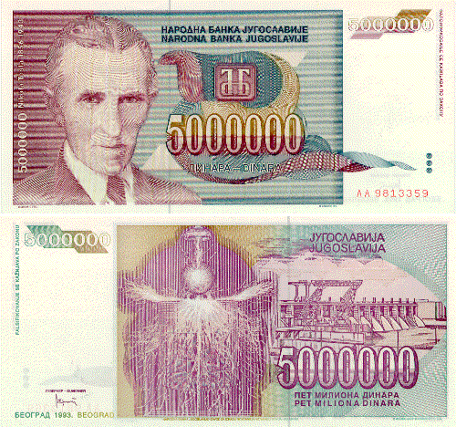
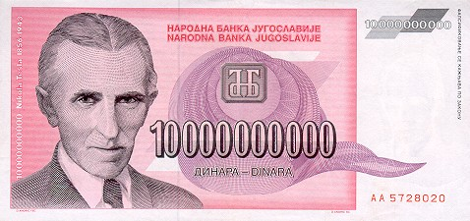
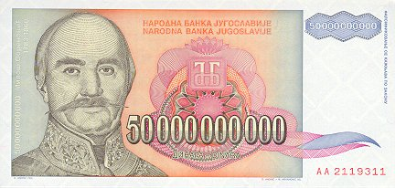
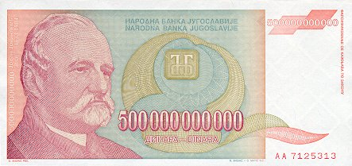
Hyperinflation & Discretionary MP
Yugoslavia had inflation problems in the 1980’s, but in 1993 things really got bad.
$1 = 900 Dinar (1/1/93)
$1 = 2,000,000 Dinar (11/12/93)
$1 = 13,000,000 Dinar (11/23/93)
$1 = 64,000,000 Dinar (11/31/93 )
$1 = 6,400,000,000 Dinar (12/15/93)
PRICES WERE DOUBLING EVERY DAY
$1 = 12,000,000,000,000,000,000,000 Dinar (1/24/94)

