Slide 1

The consequences of money creation by central banks
that
we
are
all
Austrian economists
NOW!

Slide 2
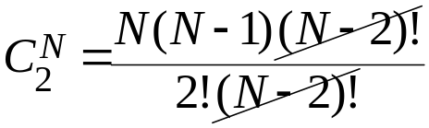
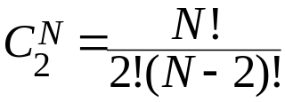
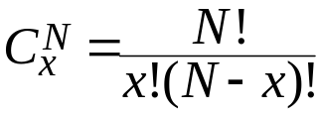
Money
In the absence of money, goods and services are exchanged in a barter system where individuals directly exchange the surplus from the fruits of their labor.
  The following gives the number of barter prices there would be in an economy with N goods, with x = 2 because exchanges are done in pairs:
Notes:
Double coincidence of wants
be widely accepted
be divisible
be easy to carry
not deteriorate quickly

Slide 3

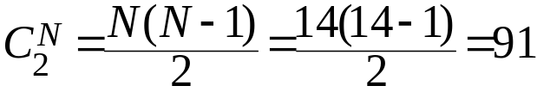
Money
In the absence of money, goods and services are exchanged in a barter system where individuals directly exchange the surplus from the fruits of their labor.
  The following gives the number of barter prices there would be in an economy with N goods, with x = 2 because exchanges are done in pairs:
  Among competing forms of money, the least marketable tend
  to be one by one rejected until at last only a single commodity
  remained, which was universally employed as a medium of exchange – Mises, 1953, pp. 32-33
  When the inhabitants of one country became more dependent on those of another,
  and they imported what they needed, and exported what they had too much of,
  money necessarily came into use – Aristotle’s Politics
  The winner of this contest is durable, divisible, transportable, and difficult to counterfeit.
Instead of 14 prices in a 14-good economy when people use money, there are 91
Notes:
Double coincidence of wants
be widely accepted
be divisible
be easy to carry
not deteriorate quickly

Slide 4
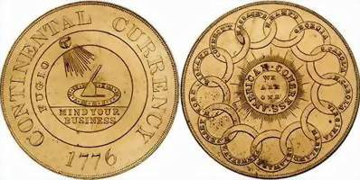
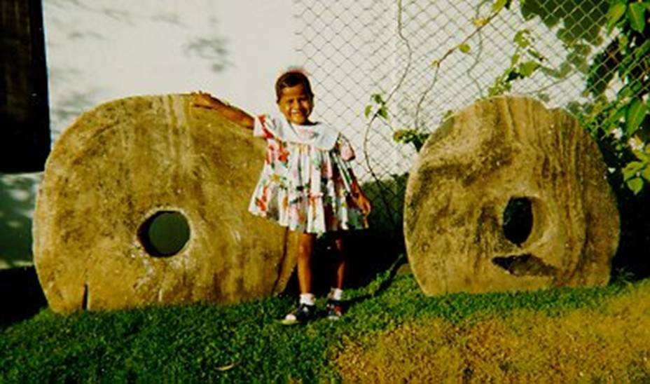

Money
Commodity Money:
The Shawshank Redemption
In Time
Paper Money is backed by a commodity
  Iron Chinese coins were used as currency Szechwan, China (Lui, 1983)
  In the 10th century, their bank receipts (chiao-tzu) circulated as paper money
  Chiao-tzu became fiat money after the Szechwan gov’t took it over in 1023
Gold coins in 1776-Colonial America
Stone Money, Island of Yap
“Tiger Tongue” from Siam, Bronze Coin
    Coat check tickets?
Notes:
Coins were first minted between 700 and 500 BC (Weatherford, 1997)

Slide 5
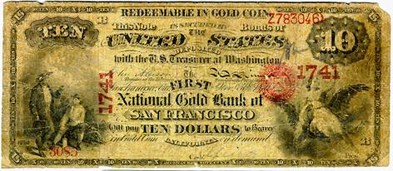
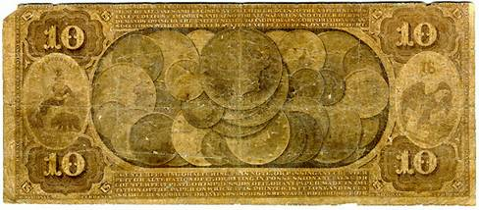
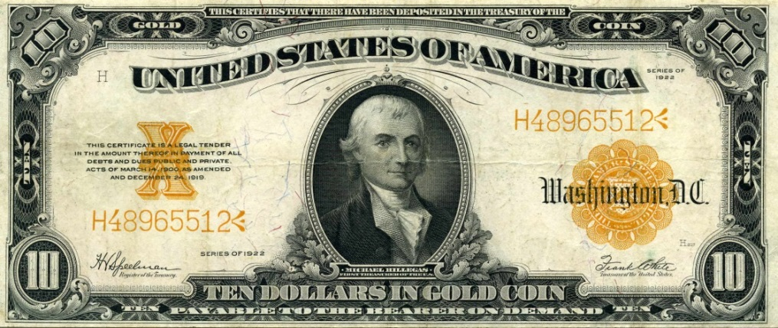
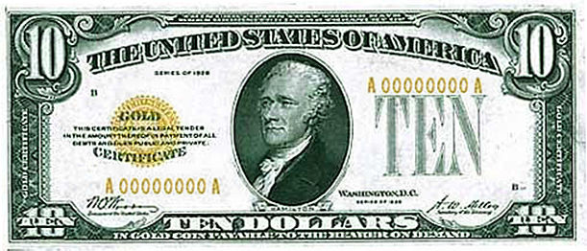
Money
Paper Money backed by Gold
Notes:
chiao-tzu was the first paper money
issued in 10th century Szechwan, China (Lui, 1983).
It was a bank receipt for iron Chinese coins deposited in Szechwan banks.

Slide 6
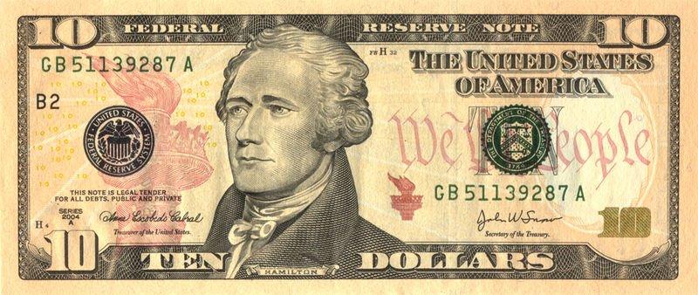
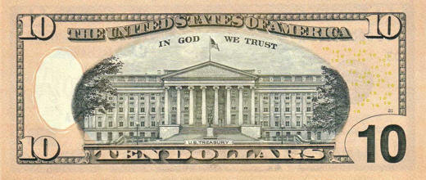
Money
Paper Money backed by Gold
Fiat
l
Notes:
When the Szechwan government took control of this money in 1023, chiao-tzu became the world’s first fiat money, money backed not by commodities but by government decree.
… in the U.S.’s case, backed by God
In 1931, the British Pound became fiat money when the United Kingdom abandoned the gold standard.
In the U.S., converting the dollar into fiat money took nearly forty years perhaps a result of the classical-liberal founding principles
FDR ended the gold standard in domestic exchanges and restricted private ownership of gold with the Emergency Banking Act of 1933, EO 6102, and the Gold Reserve Act of 1934.
President Nixon completed the process, ending he gold standard in foreign exchanges, when he issued EO 11615 in 1971.
Meanwhile, In God We Trust began appearing on U.S. paper money in 1957.
Hence, presidents from FDR to Nixon removed the ‘l’ in ‘gold’ on the dollar, which slowly transitioned it from the gold standard to the God standard.

Slide 7
Money
Paper Money is government decreed money.
Fiat
Louisiana House Bill 195 bans cash on all second-hand transactions, which passed near unanimously with one nay vote in the senate. (www.forbes.com)
Notes:
When the Szechwan government took control of this money in 1023, chiao-tzu became the world’s first fiat money, money backed not by commodities but by government decree.
… in the U.S.’s case, backed by God
In 1931, the British Pound became fiat money when the United Kingdom abandoned the gold standard.
In the U.S., converting the dollar into fiat money took nearly forty years perhaps a result of the classical-liberal founding principles
FDR ended the gold standard in domestic exchanges and restricted private ownership of gold with the Emergency Banking Act of 1933, EO 6102, and the Gold Reserve Act of 1934.
President Nixon completed the process, ending he gold standard in foreign exchanges, when he issued EO 11615 in 1971.
Meanwhile, In God We Trust began appearing on U.S. paper money in 1957.
Hence, presidents from FDR to Nixon removed the ‘l’ in ‘gold’ on the dollar, which slowly transitioned it from the gold standard to the God standard.

Slide 8

Quantity Theory of Money
Irving Fisher’s equation of exchange
Mainstream economics defines inflation as a general increase in the prices of products
π = (PL_{is} – PL_{was}) / PL_{was}
Excessive growth in the quantity of money
Demand-pull inflation
Cost-push inflation
> 0
Notes:
Irving Fisher (1911) The Purchasing Power of Money
P = Price level
Y = real GDP
M = quantity of money
V = velocity of money, the number of times a 1$ bill is used to buy products in a specific period of time
The QTM assumes V is determined and stable.
If people use ATM machines, debit cards, interest bearing checking accounts, and e-payments more, the velocity of money increases.
If people begin using credit cards and charge accounts, V falls.
Samuelson: velocity is not constant because “You can lead a horse to water, but you can’t make him drink. You can force money on the system in exchange for government bonds, its close money substitute; but you can’t make the money circulate against new goods and new jobs.”
Austrian Economist Henry Hazlitt noted that when money is newly introduced, the price level increases by a smaller proportion than the increase in the supply of money, but that when the money has been in circulation for a while, that the price level has increased by a greater proportion than the supply of money. This is due to "fears . . . that the inflation will continue into the future, and that the value of the monetary unit will fall further." It’s not the velocity of money that determines the value of a currency, but rather the sum of individuals' value of the currency that determines the velocity of money.
Ludwig von Mises: "The main deficiency of the velocity of circulation concept is that it does not start from the actions of individuals but looks at the problem from the angle of the whole economic system. This concept in itself is a vicious mode of approaching the problem of prices and purchasing power. It is assumed that, other things being equal, prices must change in proportion to the changes occurring in the total supply of money available. This is not true."

Slide 9

Quantity Theory of Money
Velocity of money is constant in short run
Unemployment is too low
w and p rise
, u = u_{n}
and the Fed lowers i to increase M
LRAS
15.5
14.5
SRAS
AD
15
16
Notes:
an increase in the quantity of Money caused by Fed action that lowers interest rates, will push AD out

Slide 10
Quantity Theory of Money
Velocity of money is constant in short run
Unemployment is too low
w and p rise
, u = u_{n}
and the Fed lowers i to increase M
the PL increases
No affect on GDP
LRAS
16.5
15.5
14.5
SRAS
AD
15
16
Inflation is always and everywhere a monetary phenomenon in the sense that it is and can be produced only by a more rapid increase in the quantity of money than in output.
Milton Friedman
Notes:
an increase in the quantity of Money caused by Fed action that lowers interest rates, will push AD out

Slide 11
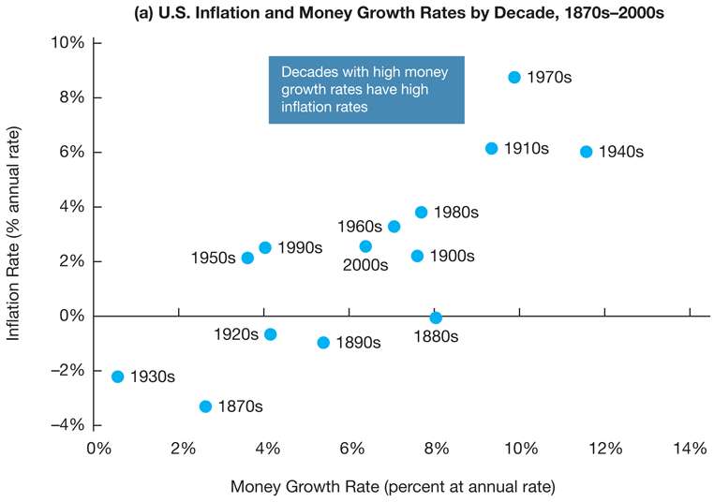
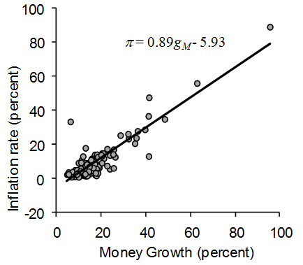
Quantity Theory of Money
Sources: For panel (a), Milton Friedman and Anna Schwartz, Monetary trends in the United States and the United Kingdom: Their Relation to Income, Prices, and Interest Rates, 1867–1975, Federal Reserve Economic Database (FRED), Federal Reserve Bank of St. Louis, http://research.stlouisfed.org/fred2/categories/25 and Bureau of Labor Statistics at http://data.bls.gov/cgi-bin/surveymost?cu.
Source: IFS data for 120 countries, averaged over years 1996-2004
Notes:
Decades with high money growth rate in the US have high inflation.

Slide 12
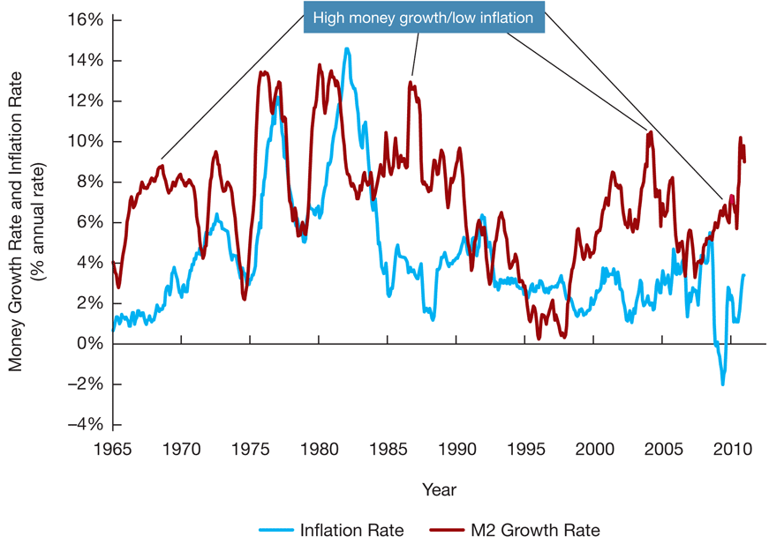
Quantity Theory of Money
High Money Growth & low inflation
Sources: FRED, Federal Reserve Economic Data, Federal Reserve Bank of St. Louis; Bureau of Labor Statistics, http://research.stlouisfed.org/fred2/categories/25; accessed September 30, 2010.

Slide 13
Quantity Theory of Money
… but high money growth is followed by accelerating inflation
Sources: FRED, Federal Reserve Economic Data, Federal Reserve Bank of St. Louis; Bureau of Labor Statistics, http://research.stlouisfed.org/fred2/categories/25; accessed September 30, 2010.

Slide 14
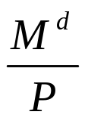
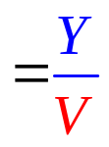
Money Demand
Fisher’s money demand (from Quantity Theory of Money): Fisher’s demand for money is not affected by i.
MD_{Fisher}
i
3.5
1900 2300 M

Slide 15


Money Demand
Keynes’ money demand (from Liquidity Preference Theory): people’s motives for holding money include transactions, precautionary, and speculative.
MD_{Fisher}
i
3.5
MD_{Keynes}
1900 2300 M

Slide 16

Money Demand
Friedman’s money demand (Permanent Income Hypothesis): Permanent income (LR average of current & future income) links i to M^{d} because people speculate that i will rise in the future if it is low today.
MD_{Fisher}
i
3.5
MD_{Keynes}
MD_{Friedman}
1900 2300 M

Slide 17
Money Demand
The compromise:
MD_{Fisher}
i
3.5
MD_{Keynes}
MD
MD_{Friedman}
1900 2300 M
2300

Slide 18
Money Demand
The compromise:
  The lower the nominal interest rate, the lower the opportunity cost of holding money, the greater is the quantity of real money demanded.
i
3.5
2.5
MD
1900 2300 M
2300

Slide 19
Money Demand
The compromise:
  The lower the nominal interest rate, the lower the opportunity cost of holding money, the greater is the quantity of real money demanded.
  M rises by 5% if PL rises by 5%
  real GDP (+)
  Financial technology: ATM, debit cards, interest checking
i
2.5
MD
1900 2300 M

Slide 20
Money Demand
The compromise:
  The lower the nominal interest rate, the lower the opportunity cost of holding money, the greater is the quantity of real money demanded.
  M rises by 5% if PL rises by 5%
  real GDP
  Financial technology: ATM, debit cards, interest checking
  credit cards
i
2.5
MD
1900 2300 M

Slide 21

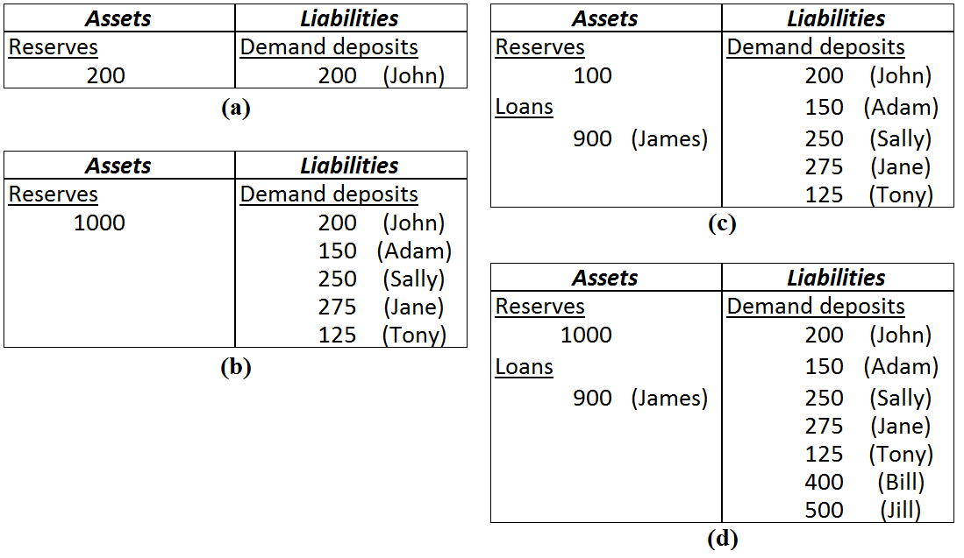
Historical Development of the Banking System
Money Supply
Notes:
In 1500-1600 London,
Goldsmiths began charging fees for safely storing gold coins.
The receipts were redeemable to only the depositor unless ‘or bearer’ was printed next to the bearer’s name.
The Bank of England began issuing paper pounds in 1694
Pounds circulated as money because they were redeemable in gold.
The pound became fiat money when the UK gold standard was abandoned in 1931

Slide 22
Money Supply
Historical Development of the Banking System
Bank of North America chartered in 1782
Controversy over the chartering of banks.
National Bank Act of 1863 creates a new banking system of federally chartered banks
  Office of the Comptroller of the Currency
  Dual banking system
Government’s perspective
The Mises Institutes’ perspective
Free Banking (Lawrence White)
Free Banking (Lawrence White)
Free Banking
The Mises Institute’s perspective

Slide 23
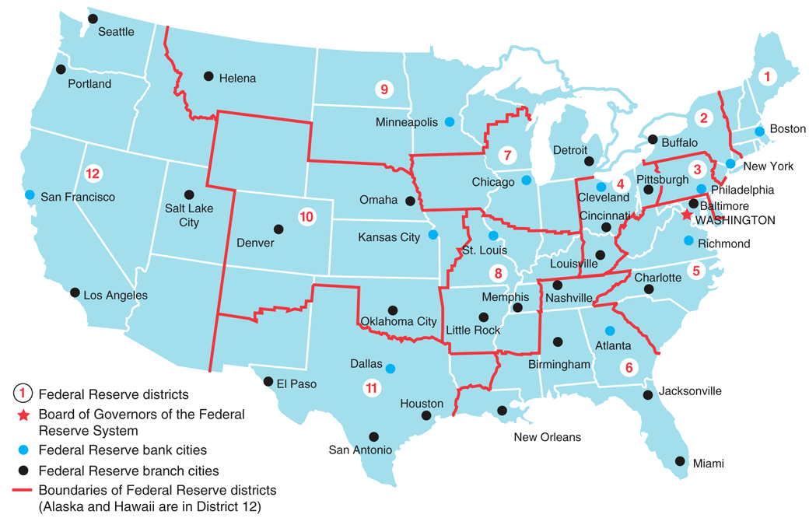
Money Supply
Historical Development of the Banking System
Federal Reserve System created in 1913
Notes:
The Fed
Regulates banks
Supervises the payments system
Sets reserve requirements
Is the lender of last resort
The Federal Reserve System (Fed) is
managed by the Board of Governors (7 members)
appointed by the President & confirmed by the Senate
each serves for 14 years, cannot serve more than 1 complete term
terms are staggered every two years
provides a modicum of certainty to markets
hinders political influence from elected officials
politically independent (to some degree)
Independence allows it to pursue policies that are ‘best’ for the economy, not the President or Congress
It is funded by check-clearing fees and the interest it collects from loans to commercial banks and government
Independence limited by
Presidential appointment & Senate confirmation
The Chair is selected every four years.
Biannual reports to Congress
GAO annual audits
BOG members testify before Congress or work with: CEA, Treasury, FAC, FDIC

Slide 24
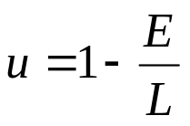
Money Supply
The Federal Open Market Committee (FOMC)
Includes 7 BOG members, the NY Fed Bank president, & 4 of the 11 other district bank presidents
meets once every six weeks (on Tuesdays) to set monetary policy for the Fed:
  low steady inflation: 2-3 percent per year (but $1 ≈ 1₵ after 100 years)
  full-employment
  u = u_{n} → Y ≈ Y_{p}
  u declines because
The Chair is Oz: The Great and Powerful
Spokesperson for the Fed and negotiates with Congress and the President
Sets the agenda for meetings
Speaks and votes first about monetary policy
Is it wise to have one person with this much power?
The curious task of economics is to demonstrate to men
how little they really know about what they imagine they can design.
F.A. Hayek

Slide 25
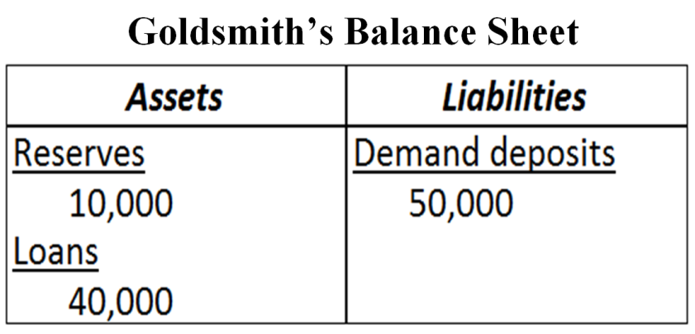
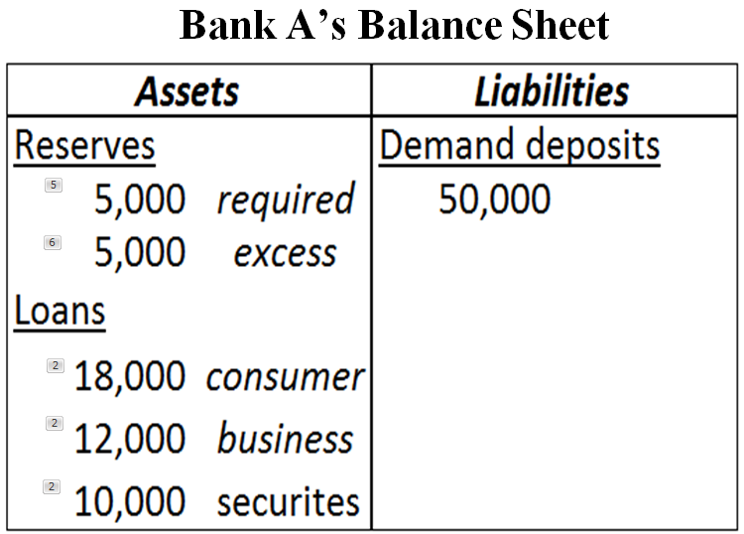


Money Supply
The Fed sets the required reserves ratio on checkable demand deposits
This makes banks’ T-accounts slightly different than the goldsmith’s
The bank has lent money to
      Consumers
      Businesses
      Government
The bank has lent out all but $10,000 of the $50,000 in checkable demand deposits.
      Reserves equal the sum of required reserves (R_{R}) & excess reserves (R_{E})
      The Fed requires banks to hold (or place on reserve) 10% of their checkable deposits
      The remaining money that is not lent out is called excess reserves

Slide 26
Money Supply
Nonbank Public’s Balance Sheet
Assets |  | Liabilities
Securities |  |  | C&I loans
Currency
Checkable Deposits |  |  | Net worth
The Fed’s Balance Sheet
Assets | Liabilities
Securities | Currency in circulation
Discount loans to Banks | Reserves
High-powered money
or
The Monetary Base (MB)
$3.6 trillion in 2014
Notes:
The Fed’s Balance sheet Liabilities
Currency in circulation: in the hands of the public
Reserves: bank deposits at the Fed and vault cash
Assets
Government securities held by the Fed earn interest
Discount loans: provide reserves to banks and earn the discount rate

Slide 27
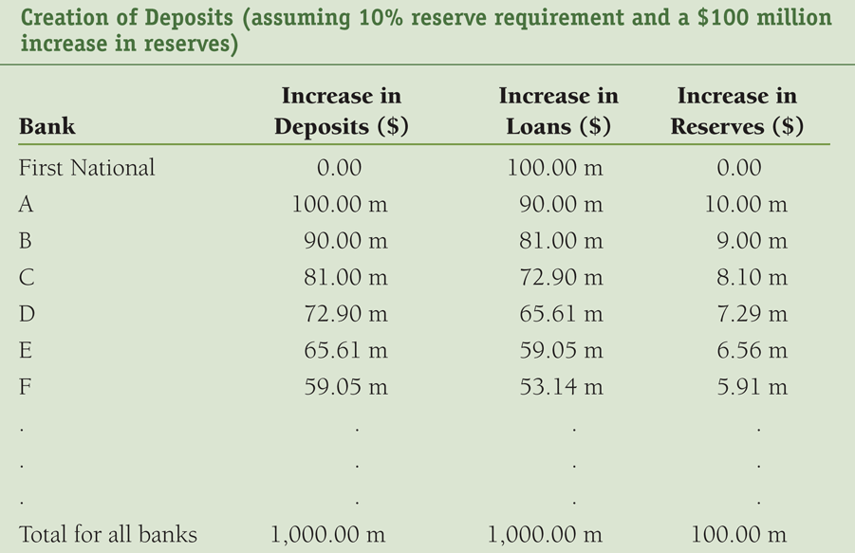





Money Supply
Simple money multiplier
The Fed buys $100 million worth of First National’s Treasury bonds and the reserve requirement ratio is 10%
simple
money
multiplier

Slide 28


Money Supply
Simple money multiplier
The Fed buys $100 million worth of First National’s Treasury bonds and the reserve requirement ratio is 10%
simple
money
multiplier

Slide 29
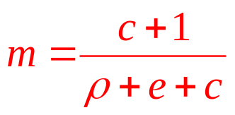
Money Supply
The money multiplier:

Slide 30
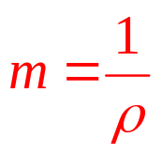
Money Supply
The money multiplier:
The simple money multiplier:

Slide 31
Money Supply
The consensus view:
  It is the relationship between the quantity of money supplied and i.
  Quantity of money supplied is determined by bank lending and the Fed.
  On any given day, the quantity of money is fixed independent of the interest rate.
MS
i
3.5
2.5
1900 2300 M

Slide 32
The Market for Money
Interest Rate Adjustment
  When the interest rate is above its equilibrium level, the quantity of money supplied exceeds the quantity of money demanded (or needed).
  People hold too much money, so they try to get rid of it by buying other financial assets.
  The demand for financial assets increases, the prices of these assets rise, and the interest rate falls.
MS
i
3.5
2.8
MD
1800
1900 2300 M

Slide 33
The Market for Money
Interest Rate Adjustment
  When the interest rate is below its equilibrium level, the quantity of money demanded (or needed) exceeds the quantity of money supplied.
  People are holding too little money, so they try to get more money by selling other financial assets.
  The demand for financial assets decreases, the prices of these assets fall, and the interest rate rises.
MS
i
2.8
2.5
MD
1900 2300 M
2000

Slide 34
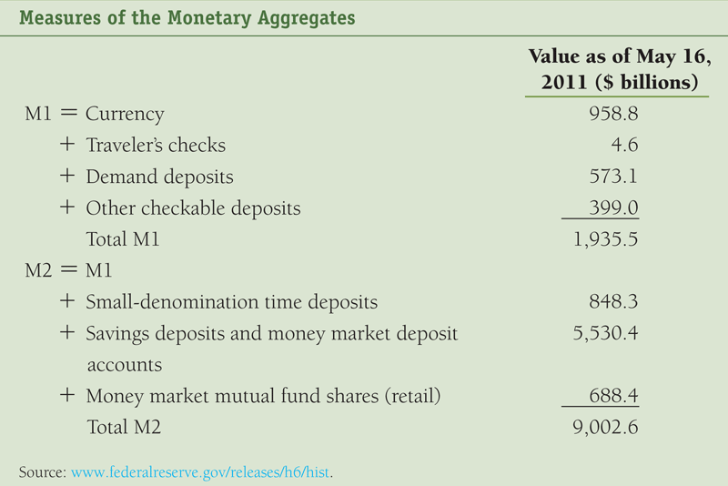

Equilibrium Quantity of Money
Notes:
Construct monetary aggregates using the concept of liquidity
M1 (most liquid assets)
M2 (adds to M1 other assets that are not so liquid)
M1 + small denomination CDs + savings deposits and money market deposit accounts + money market mutual fund shares.
money market deposit accounts = a cross between a checking and a savings account, which earn slightly higher interest than interest-earing checking accounts because the number of deposits or withdrawals are more limited
money market mutual fund shares = investment pools that buy safe, short-term securities like T-bills, CDs, commercial paper (an short term IOU issued by a firm needing money to finance accounts receivable or inventories).

Slide 35
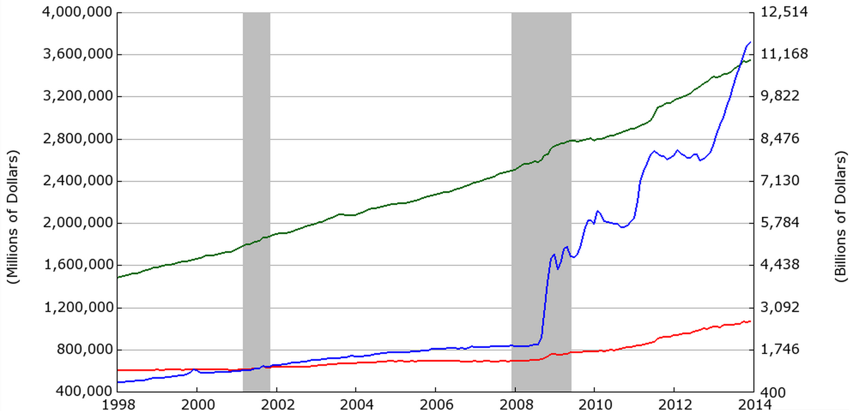
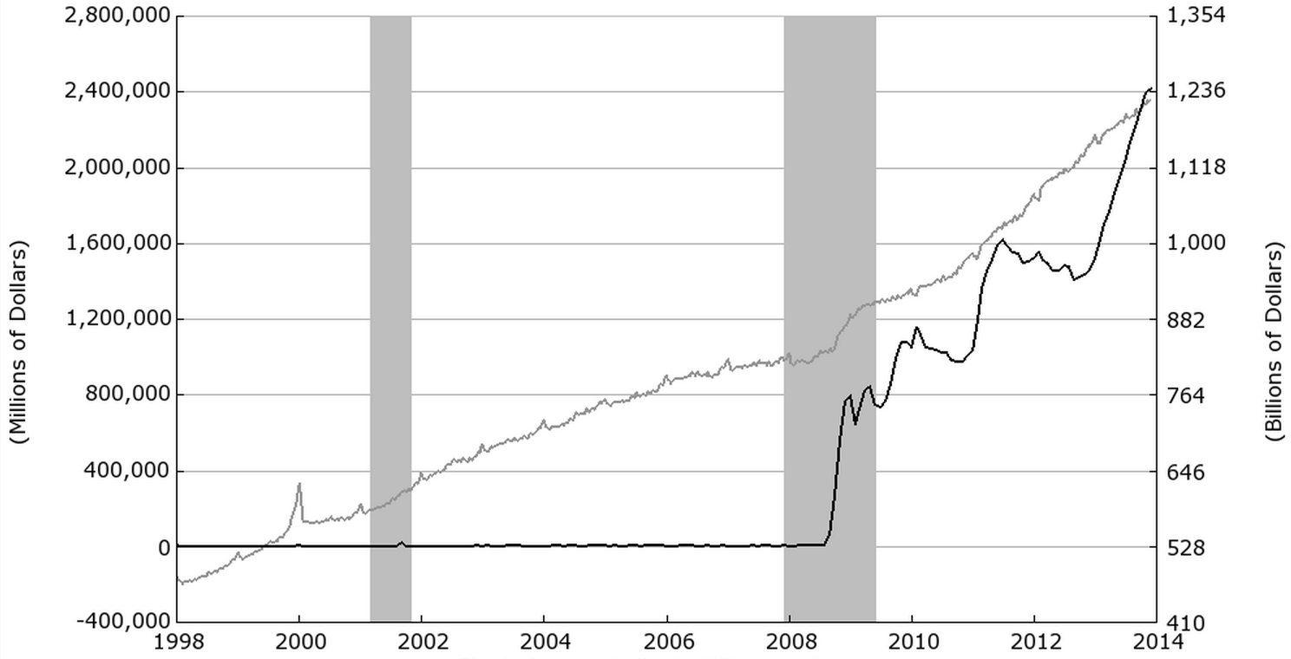
Equilibrium Quantity of Money
M2 (right)
C (right)
MB (left)
M1 (right)
R_{e} (left)
http://research.stlouisfed.org/fred2
http://research.stlouisfed.org/fred2
Notes:
MB = high-powered money = C + R

Slide 36



Demand for Reserves
Quantity Demanded for Excess Reserves ( ) provide banks with insurance against big withdrawals (caused by bank runs)
  The federal funds interest rate (i_{ff} ) is the cost of “big withdrawal” insurance.
  The cost of excess reserves is the opportunity cost of not making loans.
  If i_{ff} falls, the cost of excess reserves falls (the cost of big withdrawal insurance).
  Thus banks are more willing to purchase more “big-withdrawal” insurance
  Demand for Excess Reserves:
    S = shock parameter, which increases if
      in government intervention (e.g., w & p controls) because interfering with price signals can stifle innovation & entrepreneurialism.
      in economic growth (default risk is lower & C&I lending rises)
      ρ is adjusted up or down
      During bank panics

Slide 37






Demand for Reserves
Quantity of Required Reserves (R_{R} )
  The Federal Reserve (the Fed) requires banks to hold (not lend out) a percentage of the total amount of checkable deposits in their vaults (D)
  The percentage required is called the required reserves ratio ( ρ )
  Thus the quantity of required reserves is
Quantity Demanded for Reserves ( ) is
Demand for Reserves:
Slope = β = 1

Slide 38




Demand for Reserves
Example: Suppose ρ = 0.1, D = 50 (billion $), S = 25, and β = 1. Graph the demand for reserves in the graph below.
Federal Funds Market
i_{ff}
5
i_{ff} (percent) | (Billions $)
2 | 28
5 | 25
2
D^{R}
25
28
Q

Slide 39
Supply for Reserves
The supply curve has two components
vertical part:
horizontal:
Example: Suppose R_{B} = 0 (billion $), R_{N} = 28 (billion $) and i_{d} = 3 (percent).
R_{N} + R_{B}
= 28 + 0
= 28
i_{d}
= 3
Federal Funds Market
i_{ff}
3
S^{R}
D^{R}
28
Q
Notes:
A bank that can’t meet its reserve requirement (R_{R} ) borrows from a bank that has excess reserves in the federal funds market and Q^{S} remains unchanged
When banks borrow from the Fed, discount loans rise, borrowed reserves (R_{B}) increase, the quantity of reserves supplied increases.
When banks sell US Treasury securities to the Fed, non-borrowed reserves (R_{N}) increase, which increases the quantity of reserves.
Hence, the supply of reserves is the sum
If the federal funds rate is less than the discount rate (i_{ff} < i_{d}), banks will not borrow from the Fed because
“Insurance” purchased from the Fed is more expensive than from other banks
If the federal funds rate is more than the discount rate (i_{ff} > i_{d}), banks will want to borrow from the Fed instead of other banks
“Insurance” purchased from other banks is more expensive than from the Fed.

Slide 40
Federal funds market equilibrium
The equilibrium occurs when demand intersects supply, which can occur on the
Vertical section of supply (Normal Mode)
Horizontal section (Emergency Mode)
28
= 2
Federal Funds Market
i_{ff}
3
S^{R}
2
Equilibrium
D^{R}
28
Q

Slide 41
Discount Rate
Example (continued ): Suppose the Fed increases the discount rate to 3.3 (percent). Show the affect of this policy change in the figure below.
The horizontal section
i_{d} = 3.3
Federal Funds Market
i_{ff}
3.3
S^{R}
The vertical section
no change
3
S^{R}
Starting on 1/1/03 the Fed
began setting the discount
rate 100 basis points (1 pct.
point) above its federal funds
rate target
2
D^{R}
28
Notes:
Discount Policy and the Lender of Last Resort
Discount window
Primary credit: standing lending facility
Lombard facility
Secondary credit
Seasonal credit
Lender of last resort to prevent financial panics
Creates moral hazard problem
Advantages and Disadvantages of Discount Policy
Used to perform role of lender of last resort
Important during the subprime financial crisis of 2007-2008.
Cannot be controlled by the Fed; the decision maker is the bank
Discount facility is used as a backup facility to prevent the federal funds rate from rising too far above the target

Slide 42





Required Reserves Ratio
Example (continued ): Instead, suppose the Fed increases the required reserve ratio to 14%. Show the affect of this policy change in the figure below.
      When ρ is adjusted up or down S increases
.14
26
Federal Funds Market
i_{ff}
5
3
S^{R}
D^{R}
The new equilibrium:
i_{ff} = 3
2
D^{R}
28
30
Notes:
Depository Institutions Deregulation and Monetary Control Act of 1980 sets the reserve requirement the same for all depository institutions
3% of the first $48.3 million of checkable deposits; 10% of checkable deposits over $48.3 million
The Fed can vary the 10% requirement between 8% to 14%
Disadvantages of Reserve Requirements
No longer binding for most banks
Can cause liquidity problems
Increases uncertainty for banks

Slide 43
Required Reserves Ratio
Example (continued ): Instead, suppose the Fed increases the required reserve ratio to 14%. Show the affect of this policy change in the figure below.
In the past, the Fed has tried slowing the economy by increasing ρ.
Doing this creates a big collapse in bank lending to businesses and consumers.
In addition, the Fed has to make discount loans to banks.
So even though total reserves have increased via discount lending ($2 billion in the diagram above), this cash is sitting idle.
The effect is a reduction in money supply.
Federal Funds Market
i_{ff}
5
3
S^{R}
D^{R}
2
D^{R}
28
30

Slide 44
Required Reserves Ratio
Example (continued ): Instead, suppose the Fed increases the required reserve ratio to 14%. Show the affect of this policy change in the figure below.
Money
MS’
MS
This increases r provided inflation remains unchanged.
i₁
i₀
MD
M₁
M₀

Slide 45
Required Reserves Ratio
Example (continued ): Instead, suppose the Fed increases the required reserve ratio to 14 (percent). Show the affect of this policy change in the figure below.
Higher r decreases I and X, and both of these collapse AD.
This results in lower prices and real GDP.
In the past, small increases in ρ have put a “hot” economy (one that is growing too fast) into a recessionary gap.
The Fed has not changed the ρ since 1992
AD-AS-Y_{FE}
AS
PL₀
PL₁
AD
AD’
Y₁
Y_{F}
Y₀

Slide 46
Open Market Operations
The Fed conducts an Open Market Purchase (OMP) by buying Treasuries from banks
  Cash flows from the Fed to Banks
  The quantity of reserves in the federal funds market rises
  The federal funds interest rate declines
  This is exPansionary monetary policy
The Fed conducts an Open Market Sale (OMS) by selling Treasury bonds to banks
  The Fed has bonds to sell because it purchased them directly from
    Treasury in the primary market (this is called monetizing the debt)
    Banks in the secondary market in a previous OMP
  Banks give cash (reserves) to the Fed in exchange for Treasury bonds
  The quantity of reserves in the federal funds market declines
  The federal funds interest rate increases
  This is reStrictive monetary policy

Slide 47


Open Market Purchase
Example (continued ): Instead, suppose of changing i_{d} or ρ the Fed performs an OMP by buying a half of a billion dollars worth of bonds from banks (R_{N} = 28 + .5 = 28.5). Show the affect of this policy change in the figure below.
The horizontal section
no change
Federal Funds Market
i_{ff}
The vertical section
R_{N} + R_{B} = (28 + .5) + 0 = 28.5
3
S^{R}
S^{R}
2
New equilibrium
1.5
D^{R}
28
28.5
Q

Slide 48
Open Market Purchase
Example (continued ): Instead, suppose of changing i_{d} or ρ the Fed performs an OMP by buying a half (billion $) worth of bonds from banks. Show the affect of this policy change in the figure below.
Federal Funds Market
Starting on 1/1/03 the Fed
began setting the discount
rate 100 basis points (1 pct. point) above its federal funds rate target.
i_{ff}
3
S^{R}
S^{R}
2
1.5
D^{R}
28
28.5
Q

Slide 49
Open Market Purchase
Example (continued ): Instead, suppose of changing i_{d} or ρ the Fed performs an OMP by buying a half (billion $) worth of bonds from banks. Show the affect of this policy change in the figure below.
Federal Funds Market
Starting on 1/1/03 the Fed
began setting the discount
rate 100 basis points (1 pct. point) above its federal funds rate target.
So the Fed lowers the discount rate to 2.5
i_{ff}
3
S^{R}
S^{R}
2.5
S^{R}
1.5
D^{R}
28
28.5
Q

Slide 50
Open Market Purchase
Example (continued ): Instead, suppose of changing i_{d} or ρ the Fed performs an OMP by buying a half (billion $) worth of bonds from banks. Show the affect of this policy change in the figure below.
Increased R_{N} means banks have more cash to lend to consumers and business.
The money supply increases via increased lending
If m = 4, then
ΔMS = 4(0.5)
ΔMS = 2
If inflation remains unchanged, r will fall too, increasing I (and X).
Money
MS
MS’
3.85
2.75
MD
500
502

Slide 51
Open Market Purchase
Example (continued ): Instead, suppose of changing i_{d} or ρ the Fed performs an OMP by buying a half (billion $) worth of bonds from banks. Show the affect of this policy change in the figure below.
AD-AS-Y_{FE}
Increases in I and X, and lower r increase AD.
This results in higher GDP, lower unemployment, and higher prices
AS
225
215
AD’
AD
14
15

Slide 52


Open Market Sale
Example (continued ): Suppose the Fed performs an OMS by selling a half of a billion dollars worth of bonds to banks (R_{N} = 28 – .5 = 27.5). Show the affect of this policy change in the figure below.
The horizontal section
no change
Federal Funds Market
i_{ff}
The vertical section
R_{N} + R_{B} = (28 – .5) + 0 = 27.5
3
S^{R}
S^{R}
2.5
2
New equilibrium
D^{R}
27.5
28
Q

Slide 53
Open Market Sale
Example (continued ): Suppose the Fed performs an OMS by selling a half of a billion dollars worth of bonds to banks (R_{N} = 28 – .5 = 27.5). Show the affect of this policy change in the figure below.
Federal Funds Market
Starting on 1/1/03 the Fed
began setting the discount
rate 100 basis points (1 pct. points) above its federal funds rate target.
So the Fed raises the discount rate to 3.5
i_{ff}
3.5
S^{R}
3
S^{R}
S^{R}
2.5
D^{R}
27.5
28
Q

Slide 54
Open Market Sale
Example (continued ): Suppose the Fed performs an OMS by selling a half of a billion dollars worth of bonds to banks (R_{N} = 28 – .5 = 27.5). Show the affect of this policy change in the figure below.
Money
Lower R_{N} means banks have less cash to lend to consumers and business.
The money supply decreases via decreased lending
If m = 4, then
ΔMS = 4(-0.5)
ΔMS = -2
If inflation remains unchanged, r rises with i, and I (and X) will fall.
MS’
MS
3.75
2.75
MD
500
498

Slide 55
Open Market Sale
Example (continued ): Suppose the Fed performs an OMS by selling a half of a billion dollars worth of bonds to banks (R_{N} = 28 – .5 = 27.5). Show the affect of this policy change in the figure below.
Falling I and X, and rising r decrease AD.
This results in lower GDP, higher unemployment, and lower prices
AD-AS-Y_{FE}
AS
225
AD
215
AD’
15
16

Slide 56
Interest on Reserves
The Fed’s rescue of the financial system in 2008-2009 included purchasing enough securities to increase the supply of reserves so much that it would drive the federal funds rate negative.
Federal Funds Market
i_{ff}
D^{R}
To prevent this in October of 2008, the Fed began paying interest on reserves (i_{or}), which is currently about 0.25%
Crisis mode
i_{d}
S^{R}
i_{or}
i_{ff}
0
Q
-i_{ff}

Slide 57
Interest on Reserves
The Fed’s rescue of the financial system in 2008-2009 included purchasing enough securities to increase the supply of reserves so much that it would drive the federal funds rate negative.
Federal Funds Market
i_{ff}
D^{R}
This allows the Fed to buy
i_{d}
S^{R}
i_{or}
0
Q

Slide 58
Interest on Reserves
The Fed’s rescue of the financial system in 2008-2009 included purchasing enough securities to increase the supply of reserves so much that it would drive the federal funds rate negative.
Federal Funds Market
i_{ff}
D^{R}
This allows the Fed to buy or sell as many securities as it wants without changing the federal funds rate.
i_{d}
S^{R}
i_{or}
0
Q

Slide 59
Interest on Reserves
The Fed’s rescue of the financial system in 2008-2009 included purchasing enough securities to increase the supply of reserves so much that it would drive the federal funds rate negative.
Federal Funds Market
i_{ff}
D^{R}
This allows the Fed to buy or sell as many securities as it wants without changing the federal funds rate.
i_{d}
S^{R}
i_{or}
0
Q

Slide 60
Interest on Reserves
The Fed’s rescue of the financial system in 2008-2009 included purchasing enough securities to increase the supply of reserves so much that it would drive the federal funds rate negative.
Federal Funds Market
i_{ff}
D^{R}
This allows the Fed to buy or sell as many securities as it wants without changing the federal funds rate.
i_{d}
S^{R}
i_{or}
0
Q

Slide 61
Interest on Reserves
The Fed’s rescue of the financial system in 2008-2009 included purchasing enough securities to increase the supply of reserves so much that it would drive the federal funds rate negative.
Federal Funds Market
i_{ff}
D^{R}
This allows the Fed to buy or sell as many securities as it wants without changing the federal funds rate.
i_{d}
S^{R}
i_{or}
0
Q

Slide 62
Interest on Reserves
The Fed’s rescue of the financial system in 2008-2009 included purchasing enough securities to increase the supply of reserves so much that it would drive the federal funds rate negative.
Federal Funds Market
i_{ff}
D^{R}
The federal reserve can also raise and lower the federal funds rate by simply raising IOR and i_{d} simultaneously.
i_{d}
S^{R}
i_{or}
0
Q

Slide 63
Interest on Reserves
The Fed’s rescue of the financial system in 2008-2009 included purchasing enough securities to increase the supply of reserves so much that it would drive the federal funds rate negative.
Federal Funds Market
i_{ff}
D^{R}
The Fed will need to conduct several controlled OMS while carefully raising IOR to reduce its $2-3 trillion balance sheet while keeping a eye on inflation.
i_{d}
S^{R}
i_{ff}
This (should) return the federal funds market to normal mode.
0
Q

Slide 64
Hyperinflation & Discretionary MP
Government expenditures is paid for by
Raising tax revenue
Treasuries can print money
    In the U.S., the Fed buys bonds directly from Treasury
Treasuries can sell more bonds
    If the deficit is financed by selling bonds to the public, there is no effect on the MB = R + C, and on the MS
    If the deficit is financed by the Fed buying bonds from banks, the MB and MS increase
    $1 could buy 11% more goods in 1912 than in 1776
    $1 could buy 95% fewer goods in 2008 than in 1913
$1m held from 1913 to 2008 is worth $50k
www.lewrockwell.com/2009/07/erik-voorhees/the-record-of-the-federal-reserve/
Notes:
After the Fed, if in 1913, you sat on your savings pile of $1,000,000 for95 years, it would then be worth only $50,000 in purchasing power (it will have depreciated in value by 95%)

Slide 65
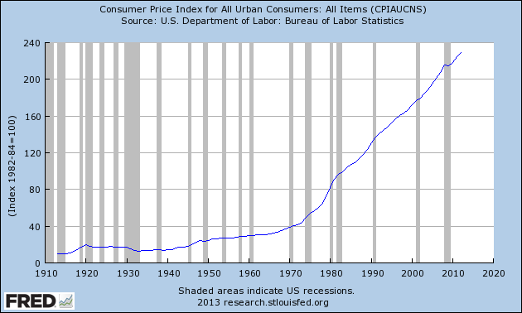
Hyperinflation & Discretionary MP
Example – CPI data from the FRED
Notes:
After the Fed, if in 1913, you sat on your savings pile of $1,000,000 for95 years, it would then be worth only $50,000 in purchasing power (it will have depreciated in value by 95%)

Slide 66
Hyperinflation & Discretionary MP
Hyperinflation is a period of high inflation (> 50% per month)
Larry Allen’s The Encyclopedia of Money:
Bolshevik Revolution
    Prior to the 1917, prices rose 2 to 3 times faster than wages.
    After 1917, prices rose by
    92,300% from 2013 to 1919
    64,823,000,000% from 2013 to 1923
Post WWI Germany
    In 1914, there were 6,323 million marks in circulation
    By 1923 there were 17,393,000 million.
    A newspaper costing one mark in May 1922 cost 1,000 marks 16 months later, and 70 million marks a year and a half later.
    At its worst,
    Customers rolled wheelbarrows full of money to the grocery store
    Customers and restaurants negotiated the cost of meals in advance
    Printed money was bailed like hay to heat one’s home.
    It took about 4 days for prices to double

Slide 67
Hyperinflation & Discretionary MP
Hyperinflation is a period of high inflation (> 50% per month)
Erich Maria Remarque’s The Black Obelisk:
  Workmen are given their pay twice a day now--in
  the morning and in the afternoon, with a recess
  of a half-hour each time so that they can rush
  out and buy things--for if they waited a few
  hours the value of their money would drop
Steve Hanke’s R.I.P. Zimbabwe Dollar:
The time it took for prices to double in
  1994 Yugoslavia, 33.6 hours
  2008 Zimbabwe, 24.7 hours
  1946 Hungary, 15.6 hours

Slide 68
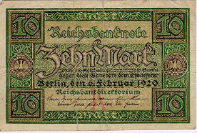
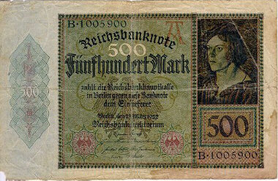
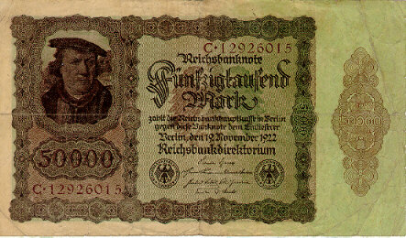
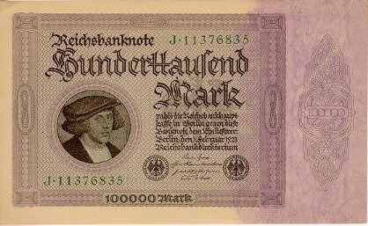
Hyperinflation & Discretionary MP
Hyperinflation in the Weimar Republic (Germany, post WWI)
Feb., 1920
March,1922
Nov.,1922
Feb., 1923

Slide 69
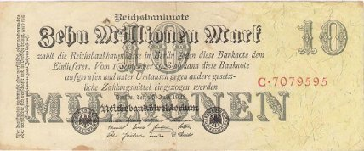
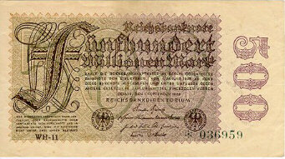
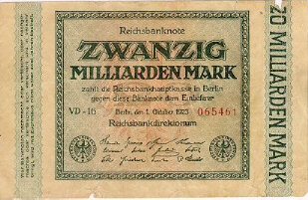
Hyperinflation & Discretionary MP
Hyperinflation in the Weimar Republic (Germany, post WWI)
July, 1923
Sept., 1923
Oct., 1923
Why did this happen?
  In Nov. of 1918, there were 29,200,000,000 paper marks in circulation
  A year later, 497,000,000,000,000,000,000 paper marks in circulation
  That was a massive increase in the money supply, an increase of
1,702,054,794,421%

Slide 70
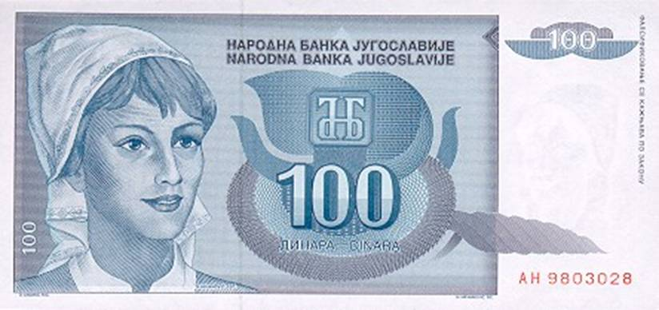
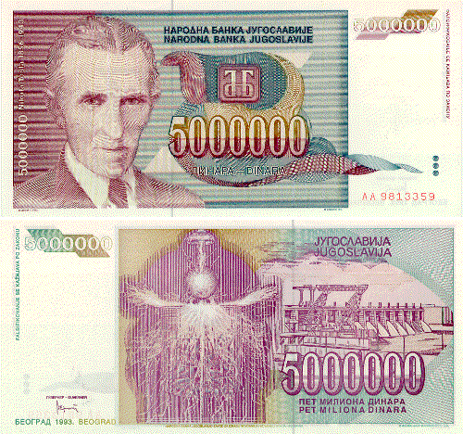
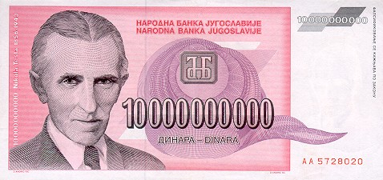
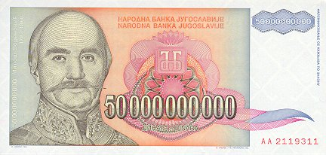
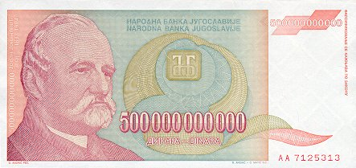
Hyperinflation & Discretionary MP
Yugoslavia had inflation problems in the 1980’s, but in 1993 things really got bad.
$1 = 900 Dinar (1/1/93)
$1 = 2,000,000 Dinar (11/12/93)
$1 = 13,000,000 Dinar (11/23/93)
$1 = 64,000,000 Dinar (11/31/93 )
$1 = 6,400,000,000 Dinar (12/15/93)
PRICES WERE DOUBLING EVERY DAY
$1 = 12,000,000,000,000,000,000,000 Dinar (1/24/94)

Slide 71
Keynes vs. Hayek
Keynes: advocate of proactive government intervention
Budget deficits in recessions
Surpluses in economic expansions
Both can be used to manage AD, ensuring full employment
Hayek: advocate of economic freedom
Government intervention results in less economic freedom
Economic efficiency
"The problem was that under central planning, there was no economic calculation--no way to make a rational decision to put this resource here or buy that good there, because there was no price system to weigh the alternatives."
“Socialism told us that we had been looking for improvement in the wrong direction.“
The thesis in The Road to Serfdom is
  Government intervention leads to more intervention
  Each intervention has unintended consequences, which distort markets
  Unintended consequences of well-intentioned policy generates the need for more interventions because consequences need to be corrected.
  It is this dynamic that leads society down the road to serfdom.
The tree and western wild fire analogies

Slide 72
Keynes vs. Hayek
Keynesians intervene in the short-run to steer the economy back to full-employment. They pursue policies that close short-run recessionary and inflationary gaps.
Hayekians are not concerned with short-run fluctuations, advocating instead for pro-growth, free-market (not pro-business) polices.

Slide 73
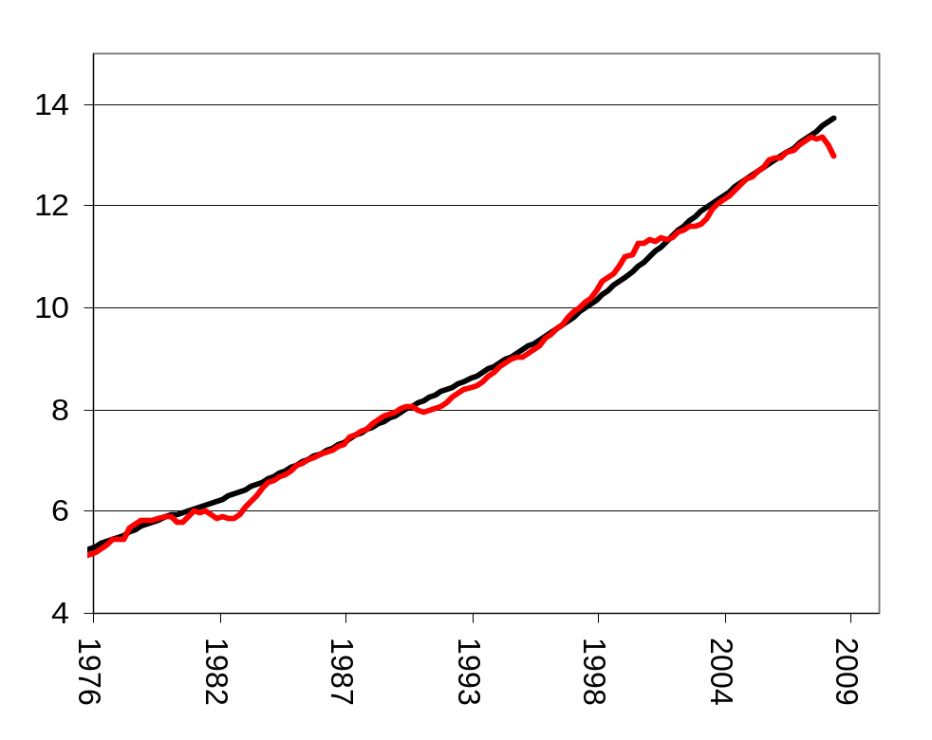
Keynes vs. Hayek
Keynesians intervene in the short-run to steer the economy back to full-employment. They pursue policies that close short-run recessionary and inflationary gaps.
Hayekians are not concerned with short-run fluctuations, advocating instead for pro-growth, free-market (not pro-business) polices.
Watch the “Fear the boom and bust” video on YouTube
PL
AD-AS-Y_{FE}
Hayek
AS
Keynes
AD
Y

