Slide 1
Fiscal Policy
Fiscal policy was introduced earlier with the calculation of multipliers.
AE multipliers imply fiscal policy is effective
  because PL price is held constant along AE
  SRAS’s slope = 0
Aggregate market model multipliers indicate it is ineffective
  because PL price is allowed to adjust up SRAS
  SRAS’s slope > 0
    Multiplier decrease as SRAS’s slope increases
    Fiscal policy is increasingly less effective as SRAS’s slope rises
SRAS’s slope splits macroeconomics in two
The classical school
  SRAS’s slope > 0
  SRAS intersects AD at LRAS due to resource markets clearing in LR
  The SR is irrelevant
The Keynesian school
  SRAS’s slope = 0 because p & w are rigid in SR
  SRAS intersects AD to the left or right of LRAS
  The SR is most important

Slide 2
Fiscal Policy
The classical school The Keynesian school
PL
LRAS
PL
LRAS
SRAS
115
115
SRAS
AD
AD
15
Y
15
Y

Slide 3
Fiscal Policy
The classical school The Keynesian school
PL
LRAS
PL
LRAS
SRAS
115
115
SRAS
AD
AD
15
Y
14
15
Y

Slide 4
Fiscal Policy
The classical school The Keynesian school
PL
LRAS
PL
LRAS
SRAS
115
115
SRAS
AD
AD
15
Y
15
16
Y

Slide 5
Fiscal Policy
Government bonds
The federal budget is the primary tool of fiscal policy.
Discretionary changes in fiscal policy are deliberate changes in G designed to affect the size of the budget deficit or surplus.
  Budget surplus: Present when total government spending is less than total taxes collected from businesses and consumers (G < T ).
    Surpluses reduce the magnitude of the government’s outstanding debt.
  Budget deficit: Present when total government spending exceeds total taxes collected from businesses and consumers (G > T ).
    Deficits are typically covered with borrowing.
  Changes in the size of the federal deficit or surplus are often used to gauge whether fiscal policy is stimulating or restraining AD, which arise from either:
    A change in the state of the economy, or,
    A change in discretionary fiscal policy.
Treasury borrows to cover deficits by auctioning bonds to banks, large firms, foreign governments, central banks and international organizations.

Slide 6

1926 China Treasury 5 Yuan Government Bond
Fiscal Policy
Government bonds

Slide 7

1949 Lebanon Treasury Bond
Fiscal Policy
Government bonds

Slide 8

1952 Former USSR victory treasury 10 rub bond
Fiscal Policy
Government bonds

Slide 9

1922 Weimar Republic German treasury bond
Fiscal Policy
Government bonds

Slide 10
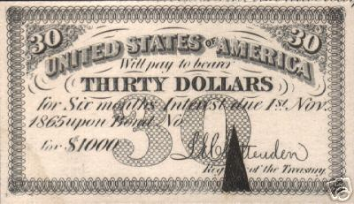
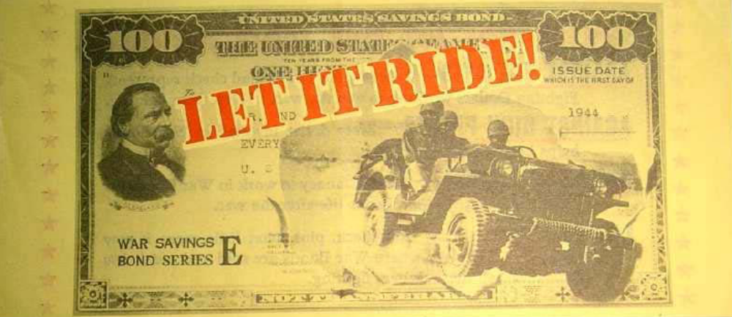
USA Treasury Bonds
Fiscal Policy
Government bonds

Slide 11
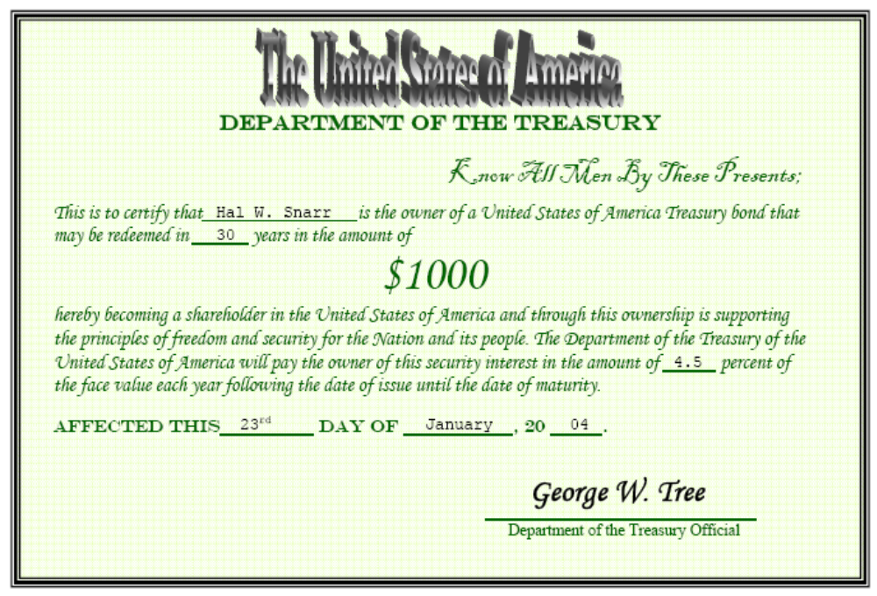
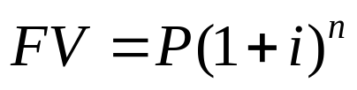
USA Treasury Bonds
Fiscal Policy
Government bonds
0
Mock Auction

Slide 12
Fiscal Policy
The Keynesian view
Keynesian theory highlights the potential of fiscal policy as a tool capable of reducing fluctuations in aggregate demand.
Following the Great Depression, Keynesians challenged the view that governments should always balance their budget.
Rather than balancing their budget annually, Keynesians argue that counter-cyclical policy should be used to offset fluctuations in aggregate demand.
  Expansionary fiscal policy – used when the economy is weak
    Recessionary gap exists if real GDP is less than potential output
    Annual budget deficits can close this gap if the government
      Increases government purchases of goods & services
      Cuts taxes
  Restrictive fiscal policy – used when strong demand threatens to cause inflation
    Inflationary gap exists if real GDP exceeds potential output
    Annual budget surpluses can close this gap if the government
      reduces government spending
      raises taxes

Slide 13
Fiscal Policy
Expansionary
The classical school The Keynesian school
PL
LRAS
PL
LRAS
SRAS
118
115
115
SRAS
AD
AD
15
16
Y
14
15
Y

Slide 14

Fiscal Policy
Expansionary
The classical school The Keynesian school
PL
LRAS
PL
LRAS
121
SRAS
118
115
115
SRAS
AD
AD
15
16
Y
14
15
Y

Slide 15
Fiscal Policy
Restrictive
The classical school The Keynesian school
PL
LRAS
PL
LRAS
SRAS
115
115
SRAS
113
AD
AD
14
15
Y
15
16
Y

Slide 16

Fiscal Policy
Restrictive
The classical school The Keynesian school
PL
LRAS
PL
LRAS
SRAS
115
115
SRAS
113
AD
111
AD
14
15
Y
15
16
Y
Notes:
The resulting fiscal surplus can then be used to pay off budget deficits that were used to close recessionary gaps

Slide 17
Shortcomings of Fiscal Policy
Forecasting
In the 1970s,
there were inflationary recessions
there was stagflation
wages and prices are not rigid as Keynesians believed
SRAS slopes upward
Even if the Keynesian view that fiscal policy can close output gaps is valid, doing so is futile because
Predicting the size of the stimulus (ΔG or -ΔT) is difficult
Forecasting is increasingly unreliable the further into the future predictions are made
Undershooting
Overshooting

Slide 18
Shortcomings of Fiscal Policy
Forecasting
PL
LRAS
SRAS
Undershooting a recessionary gap
109
108
AD
14
15
Y
Notes:
If the initial stimulus was too large with the economy at point A, AD will shift along SRAS to a point that is to the right of point B.
This induces an inflationary gap, and requires a withdrawal of stimulus or tighter money from the Fed to avert SRAS from eventually self-adjusting up due to resources being overemployed.

Slide 19
Shortcomings of Fiscal Policy
Forecasting
PL
LRAS
SRAS
Overshooting a recessionary gap
116
108
AD
14
15
16
Y
Notes:
If the initial stimulus was too large with the economy at point A, AD will shift along SRAS to a point that is to the right of point B.
This induces an inflationary gap, and requires a withdrawal of stimulus or tighter money from the Fed to avert SRAS from eventually self-adjusting up due to resources being overemployed.

Slide 20
Shortcomings of Fiscal Policy
Forecasting
PL
LRAS
SRAS
Overshooting a recessionary gap
121
Can cause inflation
116
108
AD
14
15
16
Y

Slide 21
Shortcomings of Fiscal Policy
Forecasting
PL
LRAS
SRAS
Undershooting an inflationary gap
116
115
AD
15
16
Y
Notes:
If the initial stimulus was too large with the economy at point A, AD will shift along SRAS to a point that is to the right of point B.
This induces an inflationary gap, and requires a withdrawal of stimulus or tighter money from the Fed to avert SRAS from eventually self-adjusting up due to resources being overemployed.

Slide 22
Shortcomings of Fiscal Policy
Forecasting
PL
LRAS
SRAS
Overshooting an inflationary gap
116
108
AD
14
15
16
Y
Notes:
If the initial stimulus was too large with the economy at point A, AD will shift along SRAS to a point that is to the right of point B.
This induces an inflationary gap, and requires a withdrawal of stimulus or tighter money from the Fed to avert SRAS from eventually self-adjusting up due to resources being overemployed.

Slide 23
Shortcomings of Fiscal Policy
Forecasting
PL
LRAS
SRAS
Overshooting an inflationary gap
Can cause deflation
116
108
106
AD
14
15
16
Y

Slide 24
Shortcomings of Fiscal Policy
Policy lag
Even if fiscal stimulus is predictable, there are delays in its implementation.
It takes time to observe recessionary gaps because GDP & unemployment are not observed in the present
Months of observations are needed to make an accurate prognosis
After a problem has been diagnosed, it takes time to decide the best course of action
  Congress must debate, compromise, amend, and vote
  Enacting it is challenging if the President’s party does not control Congress
  If the President’s party controls Congress, the Senate minority can stop legislation with a 41 vote filibuster.
After fiscal policy is signed into law, its effects are further delayed by
  revenue from new taxes collected a year or more after a change
  bureaucratic red tape that includes departments
    altering budgets
    adjusting spending habits
    screening grant or transfer payment applicants.
    Sometimes its implementation is purposely lagged by several years
      EGTRRA
      ACA
  The multiplier theory implies the economic benefits of fiscal stimulus take time to unwind.
Fiscal policy can destabilize the economy

Slide 25
Shortcomings of Fiscal Policy
Policy lag
PL
LRAS
SRAS
114
110
AD
13
15
Y
Suppose there is a slump in private investment
Notes:
If the initial stimulus was too large with the economy at point A, AD will shift along SRAS to a point that is to the right of point B.
This induces an inflationary gap, and requires a withdrawal of stimulus or tighter money from the Fed to avert SRAS from eventually self-adjusting up due to resources being overemployed.

Slide 26
Shortcomings of Fiscal Policy
Policy lag
PL
LRAS
SRAS
114
112
110
AD
13
14
15
Y
While Congress is debating the type and size of fiscal policy, suppose private investment bounces back a little
Notes:
If the initial stimulus was too large with the economy at point A, AD will shift along SRAS to a point that is to the right of point B.
This induces an inflationary gap, and requires a withdrawal of stimulus or tighter money from the Fed to avert SRAS from eventually self-adjusting up due to resources being overemployed.

Slide 27
Shortcomings of Fiscal Policy
Policy lag
PL
LRAS
SRAS
114
112
110
AD
13
14
15
Y
After each house of Congress has finalized their bills, suppose expectations of the future improve as the two chambers reconcile their bills.

Slide 28
Shortcomings of Fiscal Policy
Policy lag
PL
LRAS
SRAS
114
114
112
110
AD
13
14
15
17
Y
With the recessionary gap closed, the President signs the stimulus into law, and the checks get mailed.

Slide 29
Shortcomings of Fiscal Policy
Policy lag
PL
LRAS
SRAS
116
114
112
110
AD
13
14
15
17
Y
If the Fed does not dampen overstimulated AD with higher r, w & p get bid up due to unemployment being below its natural rate.

Slide 30
Shortcomings of Fiscal Policy
Policy lag
PL
LRAS
118
SRAS
116
114
112
110
AD
13
14
15
17
Y
SRAS decreases until the induced inflationary gap is closed.

Slide 31
Shortcomings of Fiscal Policy
Crowding-out
Decline in
private investment
Increase in budget deficit
Higher real
interest rates
Inflow of financial
capital from abroad
Appreciation
of the dollar
Decline in
net exports
Increased government borrowing to finance an enlarged budget deficit places upward pressure on real interest rates, which retards private investment.
In an open economy, high interest rates attract foreign capital.
As foreigners buy more dollars to buy U.S. bonds and other financial assets, the dollar appreciates.
The appreciation of the dollar causes net exports to fall.
Lower exports and private investment dampens the expansionary impact of a budget deficit.

Slide 32

Shortcomings of Fiscal Policy
Rational expectations
PL
SRAS
AD
P₁
Y₁
New Classical: budget deficits merely substitute future taxes for current taxes.
If households do not anticipate higher future taxes, AD would increase.
However, households fully anticipate higher future taxes.
They save instead of spend, which means AD remains unchanged.
Notes:
The Chicago School -- The New Classical view stresses that:
Debt financing substitutes higher future taxes for lower current taxes
Thus, budget deficits affect the timing of taxes not their magnitude
when debt is substituted for taxes:
People save the increased income to pay higher future taxes
Hence, budget deficits do not stimulate AD
The real interest rate is unaffected by deficits as people save more in order to pay the higher future taxes.
Fiscal policy is completely impotent because it does not affect output, employment, or real interest rates

Slide 33
Shortcomings of Fiscal Policy
Rational expectations
Loanable Funds Market
S₁
S₂
r
The Chicago School: monetary policy should grown MS at a slow, steady rate because fiscal policy exerts no effect on r, Y, or u
r₁
D₂
D₁
Q₁
Q₂
To finance a budget deficit, the government borrows in the loanable funds market.
Under the new classical view, people save to pay expected higher future taxes.
This permits the government to borrow the funds to finance the deficit without pushing up the interest rate.
Notes:
The Chicago School

Slide 34
Shortcomings of Fiscal Policy
Vote buying
Political incentives also influence fiscal policy.
  Legislators are delighted to spend money on programs that directly benefit their own constituents but are reluctant to raise taxes because they impose a visible cost on voters.
  Politicians are half-Keynesians
    Keynesians are proponents of budget deficits in recessionary gaps
      Democrats push for higher G to stimulate the economy
      Republicans propose cuts in T to stimulate the economy
      Both are Keynesians during recessions
    Keynesians are proponents of budget surpluses in inflationary gaps.
      Democrats are against cuts in G
      Republicans are against higher T
      Neither are Keynesians during expansions
  There is a political bias towards spending and budget deficits. Predictably, deficits will be far more common than surpluses.

Slide 35
Shortcomings of Fiscal Policy
Automatic Stabilizers
Discretionary fiscal policy (even if it is effective) is unnecessary because there are automatic fiscal stabilizers:
  They increase the budget deficit (or reduce the surplus) during a recession
  They increase the surplus (or reduce the deficit) during an economic boom.
  The major advantage of automatic stabilizers is that they institute counter-cyclical fiscal policy without the delays associated with legislative action.
  Examples include
    Corporate profit tax
    Unemployment compensation
    SNAP
    Progressive income taxation
Notes:
As growth accelerates, incomes rise.
With more and more people paying an increasing proportion of income in taxes because they find themselves in higher and higher income tax brackets.
This dampens consumption expenditure, and limits the peak of the business-cycle.
As the economy approaches the trough in the business cycle, more and more people are paying less in income taxes
because they find themselves in lower and lower income tax brackets
Or receiving transfer payments from UI or SNAP.
As the deficit automatically widens without legislative delay, immediate stimulus is injected into the economy
This pushes real GDP back toward its potential level.
The additional tax revenue accruing to Treasury during an expansion automatically pays down the fiscal deficit resulting from an economic contraction.

Slide 36
Shortcomings of Fiscal Policy
Modern synthesis
A modern synthesis view about the efficacy of fiscal policy emerged from the economic debates of the 1970s and 1980s.
  Predicting discretionary fiscal policy’s size and properly timing it is
  difficult to achieve
  of crucial importance.
  Automatic stabilizers reduce the fluctuation of aggregate demand and help to direct the economy toward full-employment.
  Fiscal policy is much less potent than the early Keynesian view implied.

Slide 37
Supply-side Fiscal Policy
From a supply-side viewpoint, the marginal tax rate is of crucial importance:
  A reduction in marginal tax rates increases the reward derived from added work, investment, saving, and other activities that become less heavily taxed.
  High marginal tax rates will tend to retard total output because they
    discourage work effort and reduce the productive efficiency of labor
    adversely affect the rate of capital formation and the efficiency of its use
    encourage individuals to substitute less desired tax-deductible goods for more desired non-deductible goods.
Federal regulations, tax code, capital gains tax rates, double taxation on domestic corporate profits, and triple taxation of overseas domestic profits can also be considered supply-side taxes.
If supply-side policy is adopted to increase Y_{p} by raising the LR production factors (Z, K, R, L), the changes should be permanent.

Slide 38
Supply-side Fiscal Policy
People will not work and firms will not produce anything if the tax rate is 100%.
If no one works and nothing is produce, the economy generates no income.
Hence,
Tax Revenue = 0
People pay no income taxes when the tax rate is 0%.
Hence,
Tax Revenue = 0
2.5
Tax Revenue
(in trillions of $)
2.0
1.5
1.0
0.5
0
0
20
40
60
80
100
tax rate (percent)

Slide 39
Supply-side Fiscal Policy
If tax revenue is 0 when the tax rate is 0% or 100%, there is a tax rate where tax revenue reaches a maximum value.
According to the diagram below, the optimal tax rate is 30%.
This tax rate generates $2.5 trillion in tax revenue.
2.5
Tax Revenue
(in trillions of $)
2.0
1.5
1.0
0.5
0
0
20
40
60
80
100
tax rate (percent)

Slide 40
Supply-side Fiscal Policy
If the tax rate is 60%,
tax revenue is $1.7 trillion.
If the tax rate is cut to 30%,
tax revenue increases to $2.5 trillion.
2.5
2.5
Tax Revenue
(in trillions of $)
2.0
1.7
1.5
1.0
0.5
0
0
20
30
40
60
60
80
100
tax rate (percent)

Slide 41
Supply-side Fiscal Policy
If the tax rate is 30%,
tax revenue is $2.5 trillion.
If the tax rate is raised to 60%,
tax revenue decreases to $1.7 trillion.
2.5
2.5
Tax Revenue
(in trillions of $)
2.0
1.7
1.5
1.0
0.5
0
0
20
30
40
60
60
80
100
tax rate (percent)

Slide 42
Supply-side Fiscal Policy
The Laffer Curve also suggests that when tax rates are “low,” a tax cut lowers tax revenue.
2.5
2.5
Tax Revenue
(in trillions of $)
2.0
1.6
1.5
1.0
0.5
0
0
10
20
30
40
60
80
100
tax rate (percent)

Slide 43

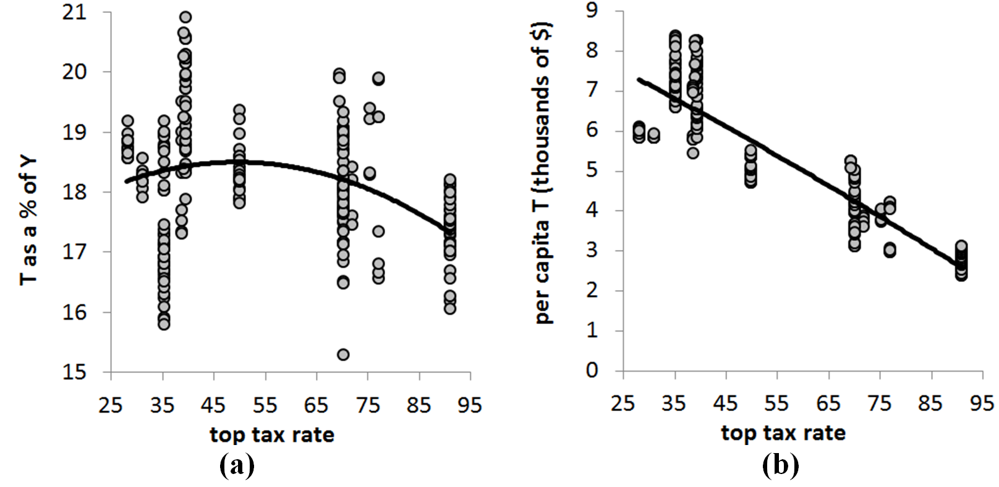
Supply-side Fiscal Policy
Is t * = 50% or is t * < 25%
Source: quarterly data covering the 1954-2012 period from FRED and taxfoundation.org

Slide 44
Supply-side Fiscal Policy
Changes in marginal tax rates may exert an impact on AS because the changes will influence the relative attractiveness of productive activity in comparison to leisure and tax avoidance.
Impact of supply-side effects:
  Usually take place over a lengthy time period.
  There is some evidence that countries with high taxes grow more slowly—France versus United Kingdom.
  There is evidence they are important for taxpayers facing extremely high tax rates – say rates of 40 percent or above.

Slide 45

Supply-side Fiscal Policy
LRAS
LRAS
PL
SRAS
SRAS
P₀
AD
AD
AD
Y₀
Y₁
Permanent reductions supply-side taxes raise the incentive to earn and use resources efficiently.
SRAS and LRAS increase, which is followed by an increase in AD (Say’s Law)
Over time permanent lower (competitive) taxes promote more rapid (sustainable) growth.
If the government temporarily T or temporarily raised G, AD expands by more than supply, resulting in inflation.

Slide 46
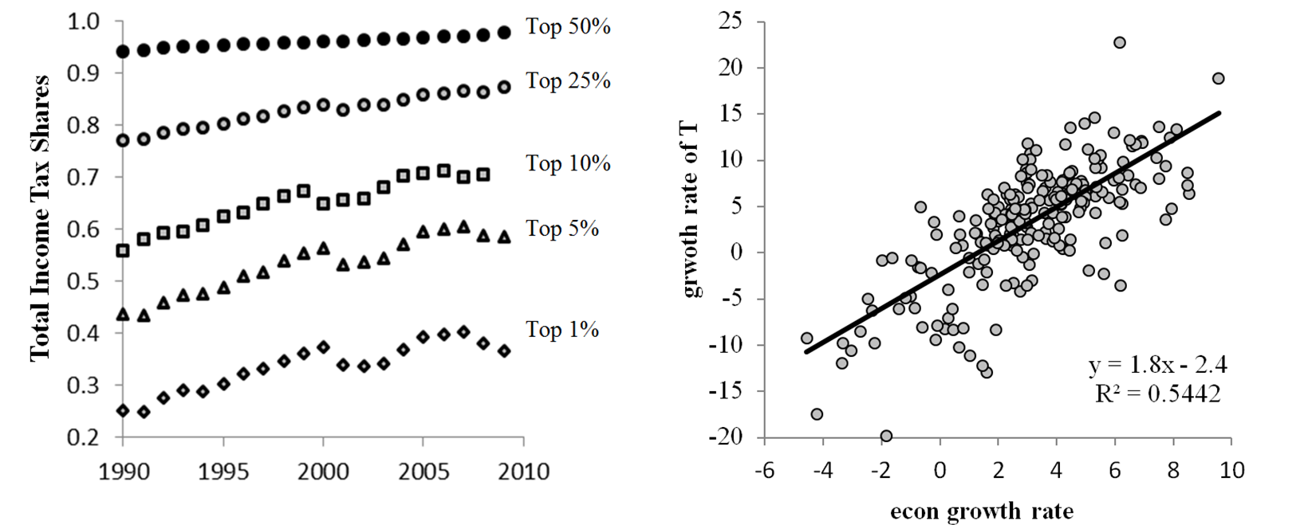
Supply-side Fiscal Policy
1986
Top rate cut from
50% to 30%
1990-93
Top rate raised from
30% to 39%
1997
Capital gains
tax rate cut
2003
Income, Estate, and Capital Gains tax rate cuts

Slide 47
Austrian Economics and Fiscal Policy
The Austrian school of economics
is an offshoot of classical economics
advocates for a limited role for government in the economy
is associated with classical (not present day political) liberalism.
does not acknowledge the need for taxes and minimal intervention by the State
generally does not don’t acknowledge macroeconomics existence
  The appropriate unit of analysis is at the individual level
  Austrians comment on macroeconomic issues
  fiscal and monetary stimulus should not be perused
    FP an MP are not a cure
    RP and MP treat symptoms
  Its solution for persistently high unemployment is the eliminate of policies that make wages and prices rigid
  UI compensation
  the minimum wage
  pro-labor policy
  pro-business policy
  public assistance
  price controls in farm bills
  Interest rate targeting

Slide 48
Austrian Economics and Fiscal Policy
The Austrian school of economics
Its solution for an inflationary gap is laissez faire, too.
  The Fed raises i to close the gap because firms would bid up w & p
  Innovation is inhibited by this
  In the absence of fiscal or monetary intervention, allowing low unemployment to persist
    drives cost-saving innovation
    firms employ individuals who find creative ways to lower production costs
    Greater entrepreneurialism and technological adv. raise LRAS & SRAS
    u rises to just equal u_{n} as workers are replaced by labor-saving technologies

Slide 49
Austrian Economics and Fiscal Policy
LRAS
PL
SRAS
118
Doing nothing
in the short run
115
AD
12 15 Y

Slide 50
Austrian Economics and Fiscal Policy
LRAS
PL
SRAS
121
Doing nothing
in the short run
118
115
AD
12 15 Y

Slide 51
Austrian Economics and Fiscal Policy
LRAS
PL
SRAS
118
Worrying about a
higher price level
115
AD
12 15 Y

Slide 52
Austrian Economics and Fiscal Policy
LRAS
PL
SRAS
118
Worrying about a
higher price level
115
105
AD
11
12 15 Y

Slide 53
Austrian Economics and Fiscal Policy
LRAS
PL
SRAS
Doing nothing
over the long run
115
AD
12 15 Y

Slide 54
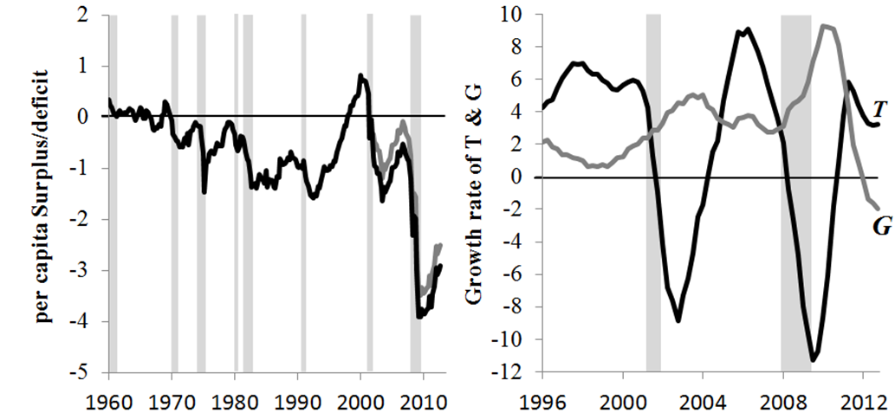
Fiscal Policy & Economic Performance
Notes:
During the 1960s & 70s, budget deficits were generally small except during recessions.
Budget deficits generally increased during recessions and shrank during expansions, primarily as the result of automatic stabilizers rather than discretionary policy changes.
Reductions in income tax rates and sharp increases in defense expenditures led to large deficits during the 1980s.
While increases in defense spending expanded the deficit in the 1980s, the opposite was true during the 1990s.
The deficit shrank during the 1990s and by the end of the decade federal budget surpluses were present.
The combination of the 2001 recession and the economy’s sluggish recovery, the Bush Administration’s tax cut, and increases in defense spending quickly moved the budget from surplus to deficit at the beginning of the new century.
In the final year of the Bush Administration, TARP bailouts and tax rebate checks pushed the deficit near $1 trillion
The Obama administration announced ten years of trillion dollar annual deficits.

Slide 55
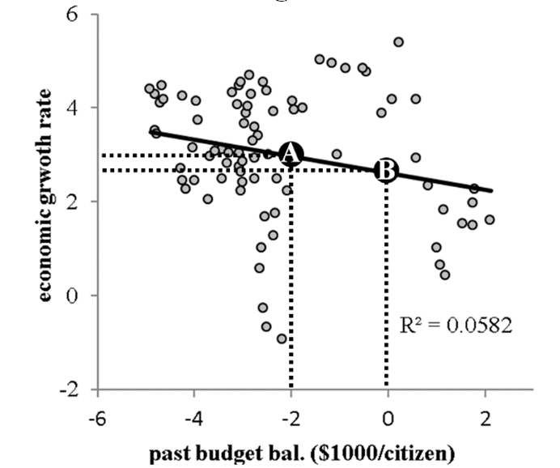
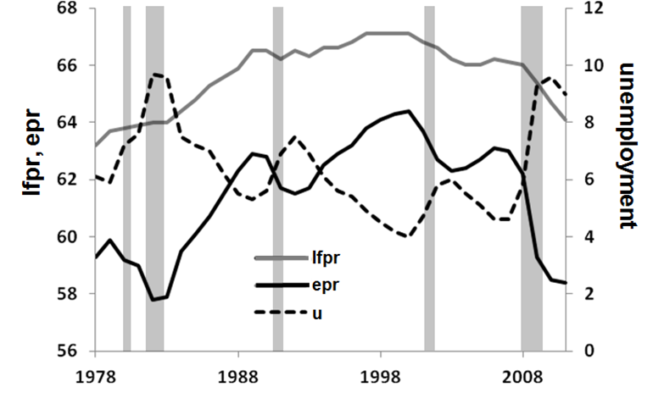
Fiscal Policy & Economic Performance
Fiscal policy lag implies past budget deficits should impact growth.
Correlations of growth & lags of the growth rate of budget balances is 0
Correlations of growth & per capita budget balance is 0
Strongest correlation: per capita budget balance is lagged eight quarters (See above).
Increasing the budget deficit by $2000 per citizen => 0.35-pct-pt increase in growth 2 years later

Slide 56
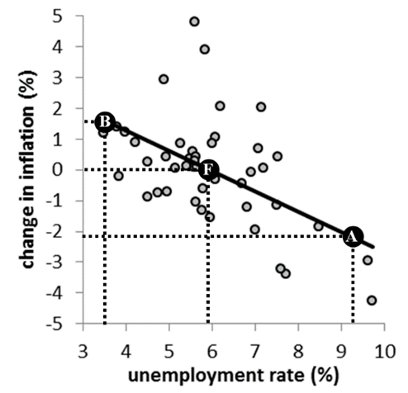
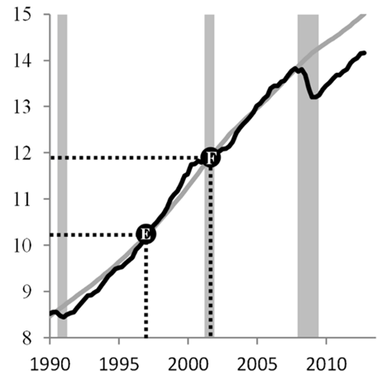
Fiscal Policy & Economic Performance
Given the weak correlation between growth and lags of these budget measures, should other policies perhaps be pursued?
Notes:
Due to fiscal policy lag, past values of annual budget deficits should impact current economic growth. However, correlations between economic growth rates and quarterly lags of the growth rate of budget balances are essentially zero. A similar story plays out when correlations of economic growth rates and lags of the per capita budget balance are computed. The strongest correlation occurs when the per capita budget balance is lagged eight quarters. This relationship is shown in Figure 42 for the 1986 to 2005 period. The trendline in the figure implies that raising the budget deficit by $2000 per citizen leads to a modest 0.35-percentage-point increase in economic growth two years later.

