Slide 1
Aggregate Demand
Simulated AD
AE = [W + Y_{e} – PL – r – mpc ∙ T + I + G + X ] + { mpc – mpm }Y
Y = [W + Y_{e} – PL – r – mpc ∙ T + I + G + X ] + { mpc – mpm }Y
PL = [W + Y_{e} – r – mpc ∙ T + I + G + X ] + { mpc – mpm }Y – 1 Y
PL = [W + Y_{e} – r – mpc ∙ T + I + G + X ] + { mpc – mpm – 1 }Y
PL = [W + Y_{e} – r – mpc ∙ T + I + G + X ] – {– mpc + mpm + 1 }Y
PL = [W + Y_{e} – r – mpc ∙ T + I + G + X ] – {1 – mpc + mpm }Y
PL = [W + Y_{e} – r – mpc ∙ T + I + G + X ] – {mps + mpm }Y
Marginal propensity to save
Marginal propensity to save

Slide 2
Aggregate Demand
Simulated AD
AE = [W + Y_{e} – PL – r – mpc ∙ T + I + G + X ] + { mpc – mpm }Y
Y = [W + Y_{e} – PL – r – mpc ∙ T + I + G + X ] + { mpc – mpm }Y
PL = [W + Y_{e} – r – mpc ∙ T + I + G + X ] + { mpc – mpm }Y – 1 Y
PL = [W + Y_{e} – r – mpc ∙ T + I + G + X ] + { mpc – mpm – 1 }Y
PL = [W + Y_{e} – r – mpc ∙ T + I + G + X ] – {– mpc + mpm + 1 }Y
PL = [W + Y_{e} – r – mpc ∙ T + I + G + X ] – {1 – mpc + mpm }Y
PL = [W + Y_{e} – r – mpc ∙ T + I + G + X ] – {mps + mpm }Y

Slide 3
Aggregate Demand
Simulated AD
Example: Suppose consumer wealth is $8 trillion (W = 8), expected future consumer income is $12 trillion (Y_{e} = 12), the price level is $14.5 thousand (PL = 14.5), the real rate of interest is 3.5 percent (r = 3.5), net tax revenues is $3 trillion (T = 3), investment expenditures total $2.75 trillion (I = 2.75), government expenditure is $3 trillion (G = 3), exports are $2 trillion (X = 2), mpc = 0.75, and mpm = 0.25. Derive the AE equation.
First, ignore the fact that PL = 8 because AD is
the relationship between real GDP and PL
PL = [W + Y_{e} – r – mpc ∙ T + I + G + X ] – { mps + mpm }∙ Y
Notes:
wealth is $8 trillion
expected future income is $12 trillion
the price level is $14.5 thousand
the real rate of interest is 3.5 percent
net tax revenue is $3 trillion
government expenditure is $3 trillion
investment expenditures total $2.75 trillion
exports total $2 trillion

Slide 4
Aggregate Demand
Simulated AD
Example: Suppose consumer wealth is $8 trillion (W = 8), expected future consumer income is $12 trillion (Y_{e} = 12), the price level is $14.5 thousand (PL = 14.5), the real rate of interest is 3.5 percent (r = 3.5), net tax revenues is $3 trillion (T = 3), investment expenditures total $2.75 trillion (I = 2.75), government expenditure is $3 trillion (G = 3), exports are $2 trillion (X = 2), mpc = 0.75, and mpm = 0.25. Derive the AE equation.
First, ignore the fact that PL = 8 because AD is
the relationship between real GDP and PL
PL = [8 + Y_{e} – r – mpc ∙ T + I + G + X ] – { mps + mpm }∙ Y

Slide 5
Aggregate Demand
Simulated AD
Example: Suppose consumer wealth is $8 trillion (W = 8), expected future consumer income is $12 trillion (Y_{e} = 12), the price level is $14.5 thousand (PL = 14.5), the real rate of interest is 3.5 percent (r = 3.5), net tax revenues is $3 trillion (T = 3), investment expenditures total $2.75 trillion (I = 2.75), government expenditure is $3 trillion (G = 3), exports are $2 trillion (X = 2), mpc = 0.75, and mpm = 0.25. Derive the AE equation.
First, ignore the fact that PL = 8 because AD is
the relationship between real GDP and PL
PL = [8 + 12 – r – mpc ∙ T + I + G + X ] – { mps + mpm }∙ Y

Slide 6
Aggregate Demand
Simulated AD
Example: Suppose consumer wealth is $8 trillion (W = 8), expected future consumer income is $12 trillion (Y_{e} = 12), the price level is $14.5 thousand (PL = 14.5), the real rate of interest is 3.5 percent (r = 3.5), net tax revenues is $3 trillion (T = 3), investment expenditures total $2.75 trillion (I = 2.75), government expenditure is $3 trillion (G = 3), exports are $2 trillion (X = 2), mpc = 0.75, and mpm = 0.25. Derive the AE equation.
First, ignore the fact that PL = 8 because AD is
the relationship between real GDP and PL
PL = [8 + 12 – 3.5 – mpc ∙ T + I + G + X ] – { mps + mpm }∙ Y

Slide 7
Aggregate Demand
Simulated AD
Example: Suppose consumer wealth is $8 trillion (W = 8), expected future consumer income is $12 trillion (Y_{e} = 12), the price level is $14.5 thousand (PL = 14.5), the real rate of interest is 3.5 percent (r = 3.5), net tax revenues is $3 trillion (T = 3), investment expenditures total $2.75 trillion (I = 2.75), government expenditure is $3 trillion (G = 3), exports are $2 trillion (X = 2), mpc = 0.75, and mpm = 0.25. Derive the AE equation.
First, ignore the fact that PL = 8 because AD is
the relationship between real GDP and PL
PL = [8 + 12 – 3.5 – 0.75 ∙ T + I + G + X ] – { 0.25 + mpm }∙ Y

Slide 8
Aggregate Demand
Simulated AD
Example: Suppose consumer wealth is $8 trillion (W = 8), expected future consumer income is $12 trillion (Y_{e} = 12), the price level is $14.5 thousand (PL = 14.5), the real rate of interest is 3.5 percent (r = 3.5), net tax revenues is $3 trillion (T = 3), investment expenditures total $2.75 trillion (I = 2.75), government expenditure is $3 trillion (G = 3), exports are $2 trillion (X = 2), mpc = 0.75, and mpm = 0.25. Derive the AE equation.
First, ignore the fact that PL = 8 because AD is
the relationship between real GDP and PL
PL = [8 + 12 – 3.5 – 0.75 ∙ 3 + I + G + X ] – { 0.25 + mpm }∙ Y

Slide 9
Aggregate Demand
Simulated AD
Example: Suppose consumer wealth is $8 trillion (W = 8), expected future consumer income is $12 trillion (Y_{e} = 12), the price level is $14.5 thousand (PL = 14.5), the real rate of interest is 3.5 percent (r = 3.5), net tax revenues is $3 trillion (T = 3), investment expenditures total $2.75 trillion (I = 2.75), government expenditure is $3 trillion (G = 3), exports are $2 trillion (X = 2), mpc = 0.75, and mpm = 0.25. Derive the AE equation.
First, ignore the fact that PL = 8 because AD is
the relationship between real GDP and PL
PL = [8 + 12 – 3.5 – 0.75 ∙ 3 + 2.75 + G + X ] – { 0.25 + mpm }∙ Y

Slide 10
Aggregate Demand
Simulated AD
Example: Suppose consumer wealth is $8 trillion (W = 8), expected future consumer income is $12 trillion (Y_{e} = 12), the price level is $14.5 thousand (PL = 14.5), the real rate of interest is 3.5 percent (r = 3.5), net tax revenues is $3 trillion (T = 3), investment expenditures total $2.75 trillion (I = 2.75), government expenditure is $3 trillion (G = 3), exports are $2 trillion (X = 2), mpc = 0.75, and mpm = 0.25. Derive the AE equation.
First, ignore the fact that PL = 8 because AD is
the relationship between real GDP and PL
PL = [8 + 12 – 3.5 – 0.75 ∙ 3 + 2.75 + 3 + X ] – { 0.25 + mpm }∙ Y

Slide 11
Aggregate Demand
Simulated AD
Example: Suppose consumer wealth is $8 trillion (W = 8), expected future consumer income is $12 trillion (Y_{e} = 12), the price level is $14.5 thousand (PL = 14.5), the real rate of interest is 3.5 percent (r = 3.5), net tax revenues is $3 trillion (T = 3), investment expenditures total $2.75 trillion (I = 2.75), government expenditure is $3 trillion (G = 3), exports are $2 trillion (X = 2), mpc = 0.75, and mpm = 0.25. Derive the AE equation.
First, ignore the fact that PL = 8 because AD is
the relationship between real GDP and PL
PL = [8 + 12 – 3.5 – 0.75 ∙ 3 + 2.75 + 3 + 2 ] – { 0.25 + mpm }∙ Y

Slide 12
Aggregate Demand
Simulated AD
Example: Suppose consumer wealth is $8 trillion (W = 8), expected future consumer income is $12 trillion (Y_{e} = 12), the price level is $14.5 thousand (PL = 14.5), the real rate of interest is 3.5 percent (r = 3.5), net tax revenues is $3 trillion (T = 3), investment expenditures total $2.75 trillion (I = 2.75), government expenditure is $3 trillion (G = 3), exports are $2 trillion (X = 2), mpc = 0.75, and mpm = 0.25. Derive the AE equation.
First, ignore the fact that PL = 8 because AD is
the relationship between real GDP and PL
PL = [8 + 12 – 3.5 – 0.75 ∙ 3 + 2.75 + 3 + 2 ] – { 0.25 + 0.25 }∙ Y

Slide 13
Aggregate Demand
Simulated AD
Example: Suppose consumer wealth is $8 trillion (W = 8), expected future consumer income is $12 trillion (Y_{e} = 12), the price level is $14.5 thousand (PL = 14.5), the real rate of interest is 3.5 percent (r = 3.5), net tax revenues is $3 trillion (T = 3), investment expenditures total $2.75 trillion (I = 2.75), government expenditure is $3 trillion (G = 3), exports are $2 trillion (X = 2), mpc = 0.75, and mpm = 0.25. Derive the AE equation.
First, ignore the fact that PL = 8 because AD is
the relationship between real GDP and PL
PL = 22 – 0.5∙Y[

Slide 14
Aggregate Demand
Simulated AD
Example:
PL = 22 – 0.5 Y
By assumption, aggregate planned expenditure equals real GDP (Y = AE ).
Recall that in the AE model, Y = 15 when PL = 14.5 at the Keynesian equilibrium point.
PL
22
14.5
AD
0
15
Y

Slide 15
Aggregate Demand
Simulated AD
Example:
With real GDP held constant at 15 trillion dollars, show what happens to the consumption model when
  consumer wealth rises to 8.5 trillion dollars
  expected future income decreases to 11.5 trillion dollars
  price level increases to 15.5 thousand dollars
  mpc increases to 0.8
  real rate of interest increases by 0.5 pct. points
  tax revenue is cut by 0.5 trillion dollars. Compute the budget balance.
  government expenditure is raised by 0.5 trillion dollars. Compute the budget balance.
  What is monetary policy, and who conducts it?
  What is fiscal policy, and who conducts it?
Notes:
wealth is $8 trillion
expected future income is $12 trillion
the price level is $14.5 thousand
the real rate of interest is 3.5 percent
net tax revenue is $3 trillion
government expenditure is $3 trillion
investment expenditures total $2.75 trillion
exports total $2 trillion

Slide 16



Long Run Aggregate Supply
Simulated LRAS
Example:
  Suppose the economy’s production function shows the volume of output that can be produced by its labor force (L) given its physical capital (K), land and natural resources (R), and technology and entrepreneurial talent (Z).
  Suppose R = 0.4 (trillion dollars of land, oil, coal, natural gas…), K = 2.5 (trillion dollars of physical capital like machines, roads, networks…) and z = 1.25 (percent of all knowledge in the universe is known on Earth).
    What is the economy’s short-run production function?

Slide 17

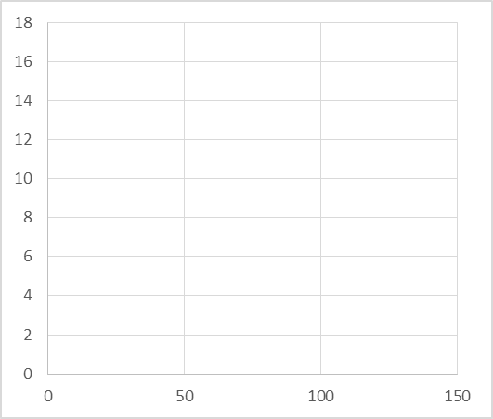
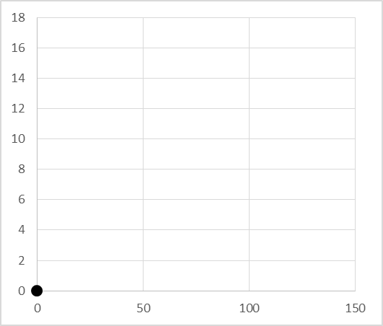
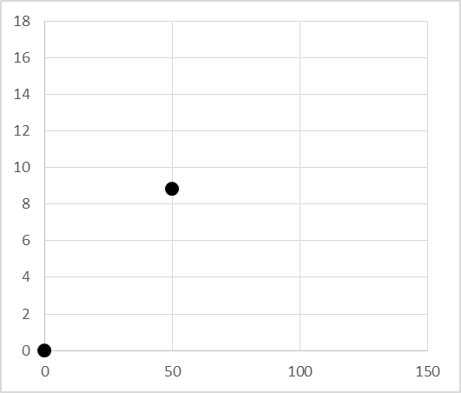
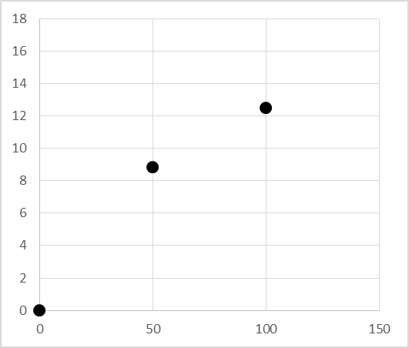
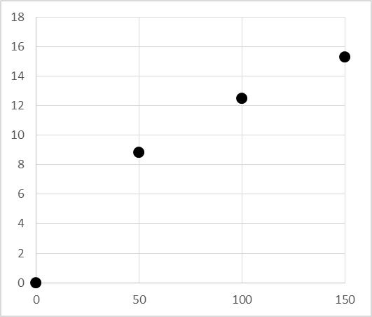
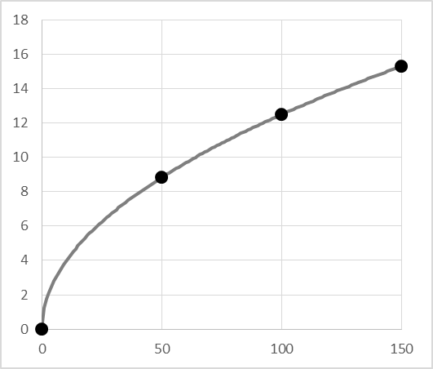
Long Run Aggregate Supply
Simulated LRAS
Example (continued):
  2. Graph the economy’s short-run production function.
L | Y
0 | 0
50 | 8.839
100 | 12.500
150 | 15.309
L

Slide 18
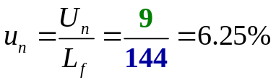

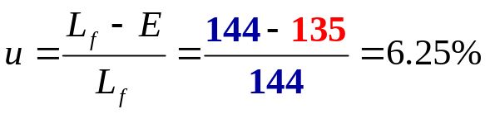


Long Run Aggregate Supply
Simulated LRAS
Example (continued):
  3. Suppose there are 9 million workers that are frictionally or structurally unemployed, and 135 million of the 144 million in the labor force are employed. Compute u, u_{n}, u_{c}, real GDP, and Y_{p.}
15
15
L
144
144

Slide 19


Long Run Aggregate Supply
Simulated LRAS
Example (continued):
  4. Graph LRAS.
PL
LRAS
30
20
10
0
15
Y

Slide 20
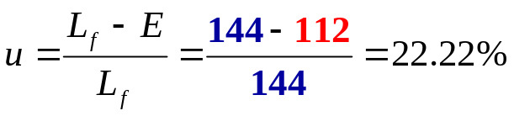


Long Run Aggregate Supply
Simulated LRAS
Example (continued):
  4. Suppose there are 9 million workers that are frictionally or structurally unemployed, and 112 million of the 144 million in the labor force are employed. Compute u, u_{n}, u_{c}, real GDP, and Y_{p.}
15
13.75
Unemployment is too high
GDP is lower than what it should be
L
121
144

Slide 21
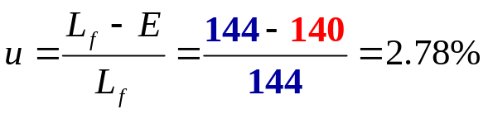


Long Run Aggregate Supply
Simulated LRAS
Example (continued):
  5. Suppose there are 9 million workers that are frictionally or structurally unemployed, and 140 million of the 144 million in the labor force are employed. Compute u, u_{n}, u_{c}, real GDP, and Y_{p.}
15.26
15
Unemployment is too low
GDP is higher than what it should be
L
144
149

Slide 22

Long Run Aggregate Supply
Simulated LRAS
Example:
With the labor force equal to 144 million workers, show what happens if
  Resources rises by 0.5 trillion dollars
  Physical capital increases by 0.5 trillion dollars
  The number of laborers falls by 12 million
  Nominal wage rates rise by 1 dollar per hour
  Nominal prices of other inputs increases by 1 dollar per hour
  Supply side taxes are cut by 1 percentage point.
  What is monetary policy, and who conducts it?
  What is fiscal policy, and who conducts it?
Notes:
R = 0.4
K = 2.5
z = 1
L = 144
W =2.25
P = 0.75
T = 5

Slide 23
Short Run Aggregate Supply
SRAS is the relationship between the quantity of real GDP supplied and PL when all other influences on production plans remain the same
The SRAS curve is positively sloped (b)
  Firms maximize profits. If prices increase while all other costs are constant, production rises because it is more profitable. Firm supply, industry supply and SRAS slope up.
  Alternatively, when PL rises with constant wages, real wages falls, employment rises, and quantity of real GDP supplied rises.
Shifters of SRAS are contained in its intercept:
  The money wage rate changes (w).
  The money prices of other resources change (p).
  Government changes supply-side taxes (t)
  Factors that change Y_{p}
Simulated SRAS has a slope of 1:
PL = [ w + p + t – b·Y_{p} ] + b·Y

Slide 24
Short Run Aggregate Supply
Simulated SRAS
Example: In addition to R = 0.4 (trillion dollars of resources…), K = 2.5 (trillion dollars of physical capital), Z = 1.25 (percent of all knowledge is known to man), U_{n} = 9 (million frictionally or structurally unemployed workers), E = 135 (million), and L = 144 (million), suppose nominal wages are 7 (dollars per hour), the nominal price of other production factors is 3 (dollars per hour), the supply-side tax rate is 9 (percent), and slope is 1.
  1. Graph the potential GDP you computed in part (3) with AD
Y_{p} = 15
PL = [ w + p + t – b·Y_{p} ] + b·Y

Slide 25
Short Run Aggregate Supply
Simulated SRAS
Example: In addition to R = 0.4 (trillion dollars of resources…), K = 2.5 (trillion dollars of physical capital), Z = 1.25 (percent of all knowledge is known to man), U_{n} = 9 (million frictionally or structurally unemployed workers), E = 135 (million), and L = 144 (million), suppose nominal wages are 7 (dollars per hour), the nominal price of other production factors is 3 (dollars per hour), the supply-side tax rate is 9 (percent), and slope is 1.
  1. Graph the potential GDP you computed in part (3) with AD
Y_{p} = 15
PL = [ w + p + t – Y_{p} ] + Y

Slide 26
Short Run Aggregate Supply
Simulated SRAS
Example: In addition to R = 0.4 (trillion dollars of resources…), K = 2.5 (trillion dollars of physical capital), Z = 1.25 (percent of all knowledge is known to man), U_{n} = 9 (million frictionally or structurally unemployed workers), E = 135 (million), and L = 144 (million), suppose nominal wages are 7 (dollars per hour), the nominal price of other production factors is 3 (dollars per hour), the supply-side tax rate is 9 (percent), and slope is 1.
  1. Graph the potential GDP you computed in part (3) with AD
Y_{p} = 15
PL = [ w + p + t – 15 ] + Y

Slide 27
Short Run Aggregate Supply
Simulated SRAS
Example: In addition to R = 0.4 (trillion dollars of resources…), K = 2.5 (trillion dollars of physical capital), Z = 1.25 (percent of all knowledge is known to man), U_{n} = 9 (million frictionally or structurally unemployed workers), E = 135 (million), and L = 144 (million), suppose nominal wages are 7 (dollars per hour), the nominal price of other production factors is 3 (dollars per hour), the supply-side tax rate is 9 (percent), and slope is 1.
  1. Graph the potential GDP you computed in part (3) with AD
Y_{p} = 15
PL = [ 7 + r + t – 15 ] + Y

Slide 28
Short Run Aggregate Supply
Simulated SRAS
Example: In addition to R = 0.4 (trillion dollars of resources…), K = 2.5 (trillion dollars of physical capital), Z = 1.25 (percent of all knowledge is known to man), U_{n} = 9 (million frictionally or structurally unemployed workers), E = 135 (million), and L = 144 (million), suppose nominal wages are 7 (dollars per hour), the nominal price of other production factors is 3 (dollars per hour), the supply-side tax rate is 9 (percent), and slope is 1.
  1. Graph the potential GDP you computed in part (3) with AD
Y_{p} = 15
PL = [ 7 + 3 + t – 15 ] + Y

Slide 29
Short Run Aggregate Supply
Simulated SRAS
Example: In addition to R = 0.4 (trillion dollars of resources…), K = 2.5 (trillion dollars of physical capital), Z = 1.25 (percent of all knowledge is known to man), U_{n} = 9 (million frictionally or structurally unemployed workers), E = 135 (million), and L = 144 (million), suppose nominal wages are 7 (dollars per hour), the nominal price of other production factors is 3 (dollars per hour), the supply-side tax rate is 9 (percent), and slope is 1.
  1. Graph the potential GDP you computed in part (3) with AD
Y_{p} = 15
PL = [ 7 + 3 + 9 – 15 ] + Y

Slide 30
Short Run Aggregate Supply
Simulated SRAS
Example: In addition to R = 0.4 (trillion dollars of resources…), K = 2.5 (trillion dollars of physical capital), Z = 1.25 (percent of all knowledge is known to man), U_{n} = 9 (million frictionally or structurally unemployed workers), E = 135 (million), and L = 144 (million), suppose nominal wages are 7 (dollars per hour), the nominal price of other production factors is 3 (dollars per hour), the supply-side tax rate is 9 (percent), and slope is 1.
  1. Graph the potential GDP you computed in part (3) with AD
Y_{p} = 15
PL = 4 + Y

Slide 31
Short Run Aggregate Supply
Simulated SRAS
Example (continued):
  2. Graph SRAS
PL = 4 + Y
PL
SRAS
16
4
12
Y

Slide 32
Short Run Aggregate Supply
Simulated SRAS
Example (continued):
  3. Graph SRAS and LRAS
PL = 4 + Y
PL
LRAS
SRAS
19
16
12
15
Y

Slide 33

Short Run Aggregate Supply
Simulated SRAS
Example (continued):
  4. Suppose supply-side taxes are temporarily lowered by 2 pct. points.
PL
LRAS
SRAS
19
SRAS’
PL = [ 7 + 3 + 9 – 15 ] + Y
PL = 2 + Y
2
15
Y

Slide 34


Short Run Aggregate Supply
Simulated SRAS
Example (continued):
  5. Suppose the labor force increases to 184.96 million workers.
184.96
PL
LRAS
SRAS
19
Y_{p} = 17 (trillion $)
PL = [7 + 3 + 9 – 15] + Y
17
15
Y

Slide 35
Short Run Aggregate Supply
Simulated SRAS
Example (continued):
  5. Suppose the labor force increases to 184.96 million workers.
184.96
PL
LRAS
SRAS
19
SRAS’
Y_{p} = 17 (trillion $)
17
PL = [7 + 3 + 9 – 15] + Y
PL = 2 + Y
17
15
Y

Slide 36

Short Run Aggregate Supply
Simulated SRAS
Example (continued): With the labor force equal to 144 million workers, show what happens if
  Resources rises by 0.5 trillion dollars
  Physical capital increases by 0.5 trillion dollars
  The number of laborers falls by 12 million
  Nominal wage rates rise by 1 dollar per hour
  Nominal prices of other inputs increases by 1 dollar per hour
  Supply side taxes are cut by 1 percentage point.
  What is monetary policy, and who conducts it?
  What is fiscal policy, and who conducts it?
Notes:
R = 0.4
K = 2.5
z = 1
L = 144
W =2.25
P = 0.75
T = 5

Slide 37

Aggregate Market Model
Equilibrium
Example (continued):
  1. Graph LRAS, SRAS and AD
  Y_{p} = 15 PL = 22 – 0.5 Y
PL
LRAS
22
14.5
AD
15
Y

Slide 38
Aggregate Market Model
Equilibrium
Example (continued):
  1. Graph LRAS, SRAS and AD
  Y_{p} = 15 PL = 22 – 0.5 Y PL = 4 + Y
PL
LRAS
SRAS
19
AD
4
15
Y

Slide 39
Aggregate Market Model
Equilibrium
Example (continued):
  1. Graph LRAS, SRAS and AD
  Y_{p} = 15 PL = 22 – 0.5 Y PL = 4 + Y
PL
LRAS
SRAS
  4 + Y = 22 – 0.5 Y
  Y = 18 – 0.5 Y
16
  1.5Y = 18
AD
  Y = 12
  PL = 4 + Y
  PL = 4 + 12
  PL = 16
12
15
Y

Slide 40
Aggregate Market Model
Equilibrium
Example (continued):
  1. Graph LRAS, SRAS and AD
  Y_{p} = 15 PL = 22 – 0.5 Y PL = 4 + Y
PL
LRAS
SRAS
Recessionary gap
16
AD
  PL = 22 – 0.5 Y
  PL = 22 – 0.5(12)
  PL = 16
12
15
Y

Slide 41
Aggregate Market Model
Equilibrium
Example (continued):
  1. Graph LRAS, SRAS and AD
PL = [w + p + t – b Y_{p} ] + b Y
PL
LRAS
SRAS
Factories, resources, and workers are not being fully utilized.
Unemployment is higher than its natural rate.
The surplus of workers bids down wages.
Demand for other production inputs falls, which pushes their prices lower
SRAS stops increasing (shifting down) when the gap is closed.
Recessionary gap
16
14.5
AD
12
15
Y

Slide 42
Aggregate Market Model
Equilibrium
Example (continued):
  1. Graph LRAS, SRAS and AD
PL
LRAS
SRAS
Allowing the gap to close on its on is called laissez faire policy.
Recessionary gaps tend to close slowly.
The federal min wage was enacted in 1938.
John L. Lewis (UMW, CIO, USWA) organized millions of workers in the 1930s.
TANF, SNAP…
Recessionary gap
16
14.5
AD
12
15
Y

Slide 43
Aggregate Market Model
Equilibrium
Example (continued):
  1. Graph LRAS, SRAS and AD
PL
LRAS
SRAS
Deflation sounds good because lower prices raise purchasing power.
However, deflation causes hardships for those whose net worth is mostly held in illiquid assets (homes).
Deflation amplifies debt since it was incurred when wages were higher. The same payment with a lower wage reduces purchasing power.
Deflation amplifies a loan's interest rate.
Recessionary gap
16
14.5
AD
12
15
Y

Slide 44

Aggregate Market Model
Equilibrium
Example (continued):
  2. Graph LRAS, SRAS and AD
  Y_{p} = 15 PL = 22 – 0.5 Y PL = -5 + Y
PL
LRAS
SRAS
AD
10
15
Y

Slide 45
Aggregate Market Model
Equilibrium
Example (continued):
  2. Graph LRAS, SRAS and AD
  Y_{p} = 15 PL = 22 – 0.5 Y PL = -5 + Y
PL
LRAS
  -5 + Y = 22 – 0.5 Y
  Y = 27 – 0.5 Y
SRAS
  1.5Y = 27
13
AD
  Y = 18
  PL = -5 + Y
  PL = -5 + 18
  PL = 13
15
18
Y

Slide 46
Aggregate Market Model
Equilibrium
Example (continued):
  2. Graph LRAS, SRAS and AD
  Y_{p} = 15 PL = 22 – 0.5 Y PL = -5 + Y
PL
LRAS
Inflationary
gap
SRAS
13
AD
  PL = 22 – 0.5 Y
  PL = 22 – 0.5(18)
  PL = 13
15
18
Y

Slide 47
Aggregate Market Model
Equilibrium
Example (continued):
  2. Graph LRAS, SRAS and AD
PL = [w + p + t – b Y_{p} ] + b Y
PL
LRAS
Factories and workers are overemployed.
Unemployment is lower than its natural rate.
Tight labor markets push wages up.
Demand for other production inputs is high, which pushes their prices higher
SRAS stops decreasing (shifting up) when the gap is closed.
Allowing the gap to close on its on is called laissez faire policy.
Inflationary gaps tend to close much faster than recessionary gaps.
Inflationary
gap
SRAS
14.5
13
AD
15
18
Y

Slide 48
Aggregate Market Model
Equilibrium
Example (continued):
  3. Graph LRAS, SRAS and AD
  Y_{p} = 15 PL = 22 – 0.5 Y PL = -0.5 + Y
PL
LRAS
SRAS
No output gap
14.5
AD
-0.5
15
Y

Slide 49
Aggregate Market Model
Equilibrium
Example (continued):
  3. Graph LRAS, SRAS and AD
  Y_{p} = 15 PL = 22 – 0.5 Y PL = -0.5 + Y
PL = [W + Y_{e} – r – mpc ∙ T + I + G + X] – {0.25 + 0.25}∙ Y
PL
LRAS
SRAS
16.5
Induced Inflationary gap
14.5
AD
15
17
Y

Slide 50
Aggregate Market Model
Equilibrium
Example (continued):
  3. Graph LRAS, SRAS and AD
  Y_{p} = 15 PL = 22 – 0.5 Y PL = -0.5 + Y
PL = [w + p + t – Y_{p} ] + Y
PL
LRAS
If nothing is done to combat this stimulus, w rises as labor markets tighten.
SRAS
16.5
Induced Inflationary gap
Hence, the increase in GDP was only temporary.
14.5
AD
15
17
Y

Slide 51
Aggregate Market Model
Equilibrium
Example (continued):
  3. Graph LRAS, SRAS and AD
  Y_{p} = 15 PL = 22 – 0.5 Y PL = -0.5 + Y
PL = [w + p + t – Y_{p} ] + Y
PL
LRAS
If nothing is done to combat this stimulus, w rises as labor markets tighten.
SRAS
17.5
16.5
Induced Inflationary gap
Hence, the increase in GDP was only temporary.
Prices soar even more.
14.5
AD
15
17
Y

Slide 52
Aggregate Market Model
Equilibrium
Example (continued):
  1. To reduce the recessionary gap, the Congress & president agree to raise G by $0.5t.
PL = [8 + 12 – 3.5 – 0.75 ∙ 3 + 2.75 + 3 + 2 ] – { 0.25 + 0.25 }∙ Y
3.5
PL
LRAS
SRAS
Raising G by $0.5t, shifts AD, and reduces the recessionary gap.
Real GDP increases by just $0.333t.
The G-multiplier is
0.333
0.5
or 0.67
The budget deficit increases to $0.5t.
The price level rises by 2%
PL = 22.5 – 0.5 Y
16.333
16
AD
12
15
Y
12.333

Slide 53
Aggregate Market Model
Equilibrium
Example (continued):
  1. To reduce the recessionary gap more, congress and the president cut tax revenues by $0.677t.
PL = [8 + 12 – 3.5 – 0.75 ∙ 3 + 2.75 + 3.5 + 2 ] – { 0.25 + 0.25 }∙ Y
2.333
Cutting T by $0.667t, shifts AD, and closes the recessionary gap.
Real GDP increases by $0.333t.
The T-cut-mult is
0.333
0.667
or 0.5
The budget deficit increases from $0.5t to $1.167t.
The price level rises by 2%
PL
LRAS
SRAS
PL = 23 – 0.5 Y
16.667
16.333
16
AD
12.667
12
15
Y
12.333

