Slide 1
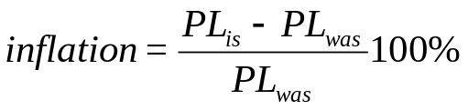
Macroeconomic indicator 1
Inflation is the percentage change in the Price Level (PL) from one year to the next.
The Consumer Price Index (CPI) is a common measure of the PL
BLS calculates the CPI every month by computing a weighted average of the prices paid by urban consumers for a fixed market basket of consumer goods and services.
CPI is calculated each month by holding quantities in the basket constant over time.
The CPI basket in 2007 is based on information obtained from the Consumer Expenditure Survey conducted during 2005.
The survey is used to assign weights to each item in the CPI basket to reflect the average urban household’s consumption behavior.
Because the CPI is used to measure price changes, it is important that the prices recorded refer to exactly the same items.
We can use these numbers in the CPI to compare what a fixed basket of goods costs this month with what it cost in some previous month.
CPI = PL in a given year X 100%
PL in the base year

Slide 2
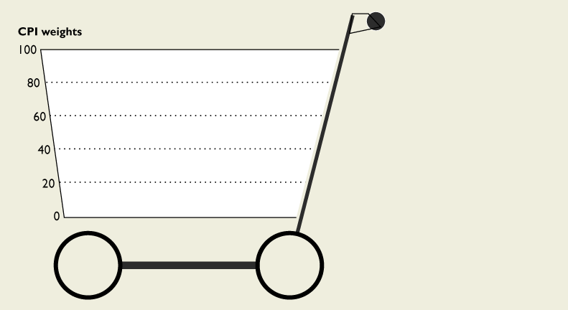
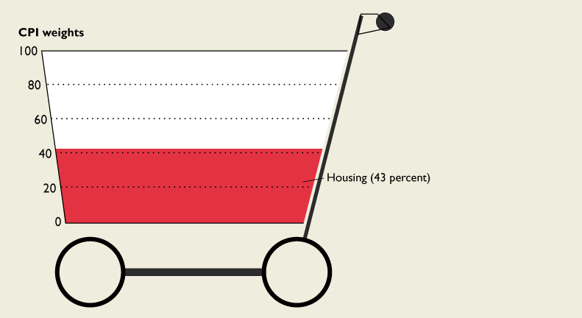
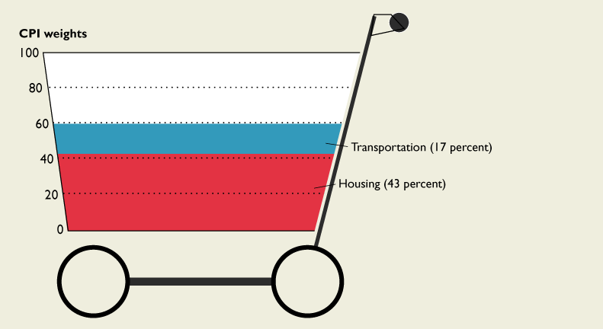
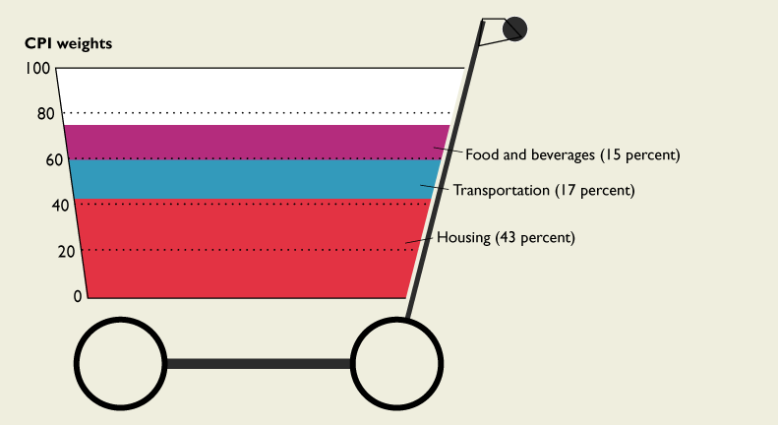
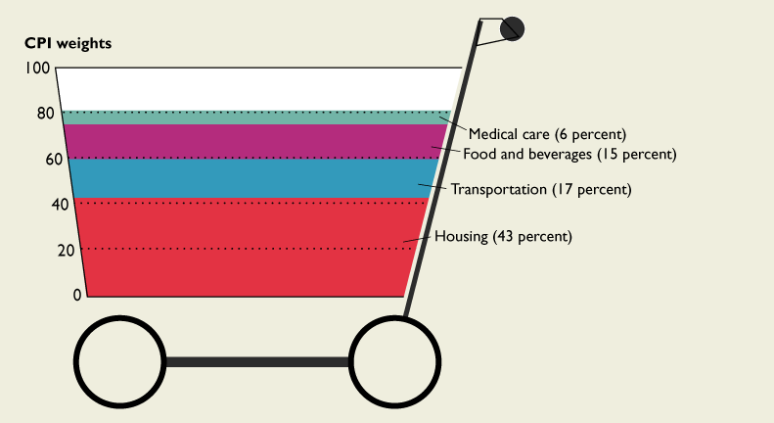
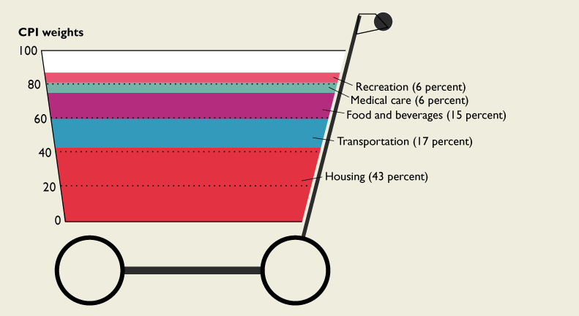
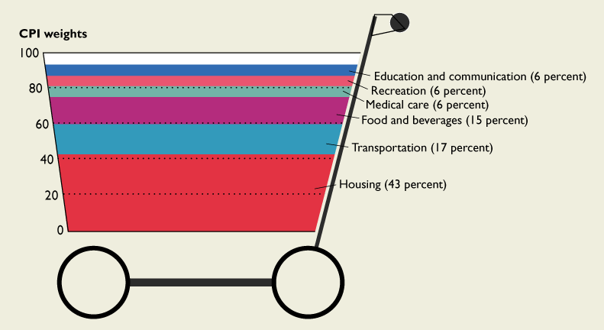
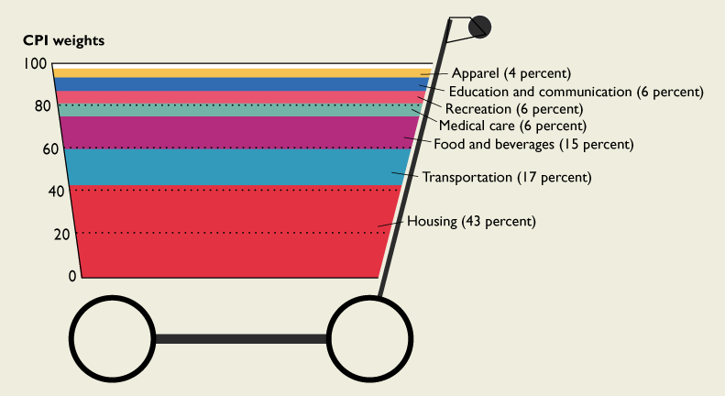

Inflation
Consumer Price Index
The CPI uses a weighted average of the cost (in dollars) of goods and services
The figure below shows the weights used in the CPI market basket
The CPI market basket is a collection of 80,000 consumer goods and services that an average household buys in 30 metro areas.
The CPI for a given year equals the PL in that year divided by the PL in the base year.
Notes:
Ask your students to make an estimate of their own baskets and compare them with the BLS basket.

Slide 3
Inflation
Suppose I am the “typical” urban consumer and that the government interviews me to determine what goods should be in the CPI market basket.
Good | Average quantity purchased per month | Price on 11/06 | Total Cost
gallons of milk | 4 | 2 | 8
TVs | 0.01 | 400 | 4
Computers | 0.01 | 1000 | 10
Towncars | 0.005 | 50,000 | 250
Snickers | 15 | 0.50 | 7.50
32 oz Pepsi | 30 | 1 | 30
6 packs of Busch Light | 2 | 6 | 12
Socks | 4 | 2 | 8
Chickens | 5 | 3 | 15
Rib-eye steaks | 10 | 10 | 100
Boxes of Raisin Bran | 4 | 3 | 12
Cable TV | 1 | 40 | 40
Pay-per view CFB games | 5 | 15 | 75
Cost of the CPI basket in 11/06 =
$571.5
PL_{11/06} =

Slide 4
Inflation
  PL_{current year}
  CPI_{current year} = 100%
  PL_{base year}
Month | PL | CPI
4/1/1983 | 279.93 | 98.70
5/1/1983 | 281.63 | 99.30
6/1/1983 | 282.48 | 99.60
7/1/1983 | 283.62 | 100.00
8/1/1983 | 284.47 | 100.30
9/1/1983 | 285.89 | 100.80
10/1/1983 | 286.74 | 101.10
11/1/1983 | 287.30 | 101.30
8/1/2006 | 578.87 | 204.10
9/1/2006 | 576.03 | 203.10
10/1/2006 | 572.92 | 202.00
11/1/2006 | 571.50 | 201.70
12/1/2006 | 572.92 | 202.00
1/1/2007 | 574.66 | 202.62
2/1/2007 | 577.73 | 203.70
Base year = 1983
100 X
/283.62 =
100 X
/283.62 =
100 X
/283.62 =
100 X
/283.62 =
100 X
/283.62 =
100 X
/283.62 =
100 X
/283.62 =
100 X
/283.62 =
Numbers in the CPI are percentages
100 X
/283.62 =
100 X
/283.62 =
100 X
/283.62 =
100 X
/283.62 =
100 X
/283.62 =
100 X
/283.62 =
100 X
/283.62 =

Slide 5
Inflation
The inflation rate
Month | CPI | Inflation
7/1/2008 | 219.96
8/1/2008 | 219.09
9/1/2008 | 218.78
10/1/2008 | 216.57
11/1/2008 | 212.43
12/1/2008 | 210.23
1/1/2009 | 211.14
2/1/2009 | 212.19
3/1/2009 | 212.71
4/1/2009 | 213.24
5/1/2009 | 213.86
6/1/2009 | 215.69
7/1/2009 | 215.35 | -2.10
8/1/2009 | 215.83 | -1.48
9/1/2009 | 215.97 | -1.29
10/1/2009 | 216.18 | -0.18
  CPI_{is} – CPI_{was}
  Inflation = 100%
  CPI_{was}
Inflation is a positive percent increase in the price level.
Disinflation occurs when inflation decreases overtime.
Deflation is a negative percent change in the price level.

Slide 6
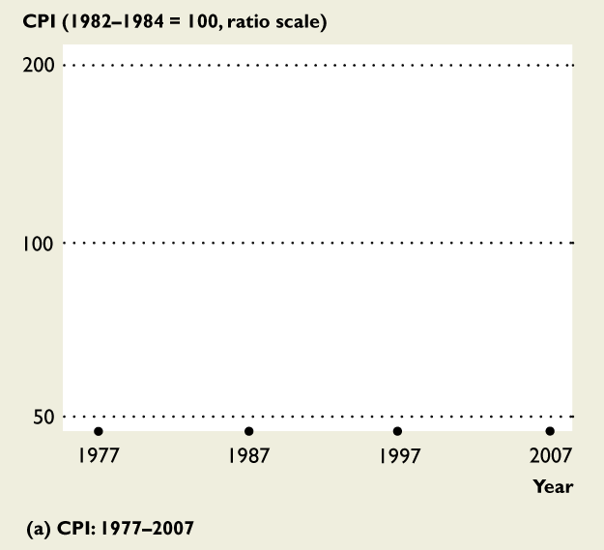
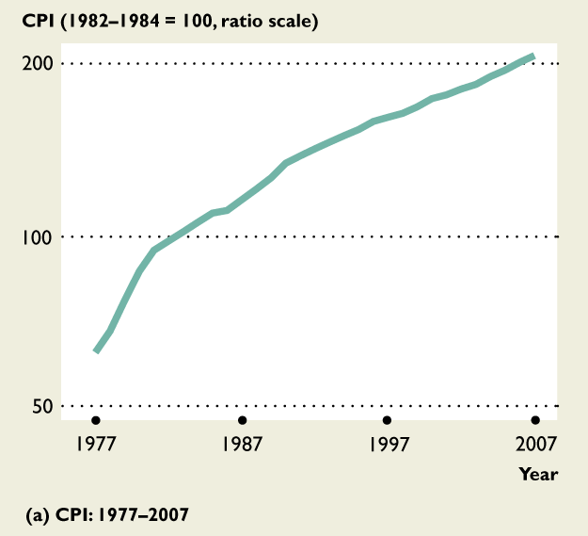
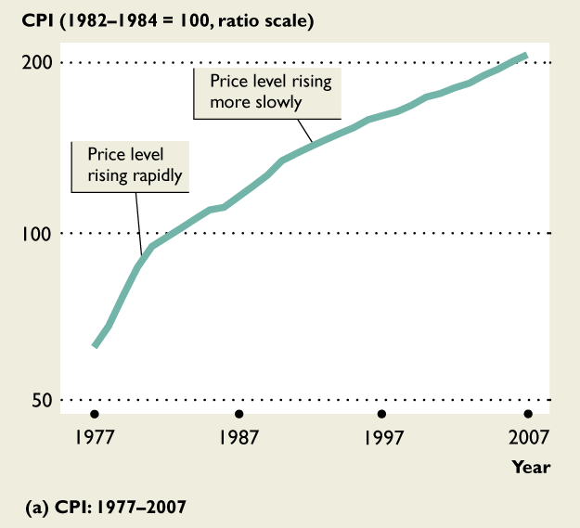
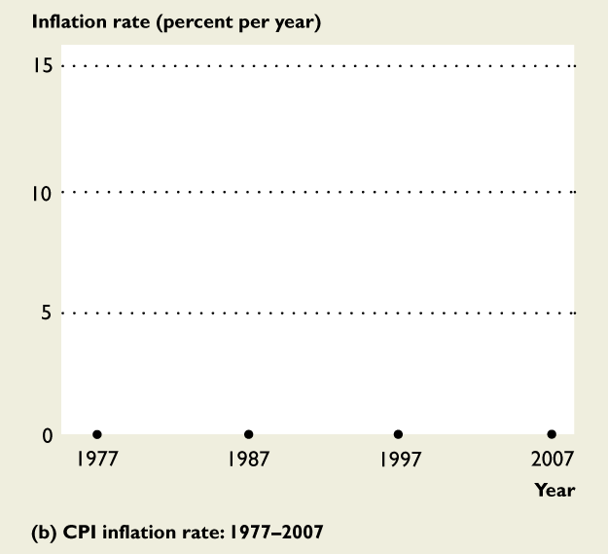
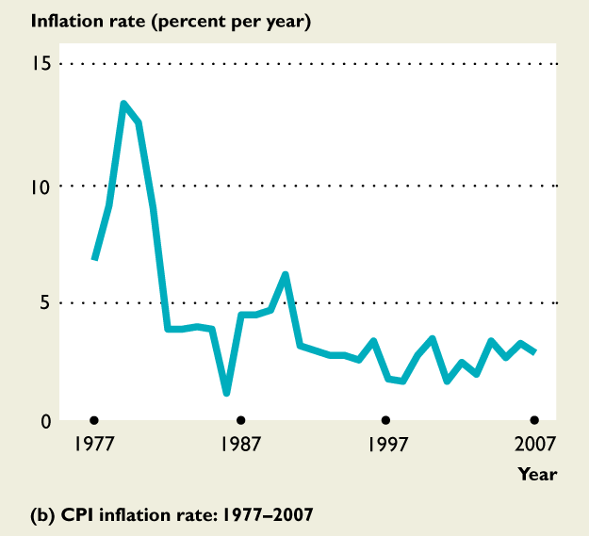
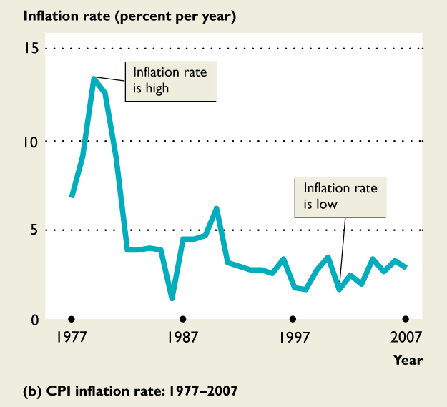
Inflation
Consumer Price Index
In part (a), the price level has increased every year.
The steeper the CPI curve the higher the inflation rate.
The flatter the CPI curve the lower the inflation rate.
From the late 1970s there has been disinflation.

Slide 7
Inflation
Although the CPI is used as a Cost Of Living Adjustment (COLA) it’s not a COLA because
It does not measure all the components of the cost of living
Some components are not measured exactly
So the CPI is possibly a biased measure.
New Goods Bias
  New goods do a better job than the old goods that they replace, but cost more.
  The arrival of new goods puts an upward bias into the CPI.
Quality Change Bias
  Better cars and televisions cost more than the versions they replace.
  A price rise due to improved quality is not inflation but get measured as inflation.
Commodity Substitution Bias
  If beef’s price of rises faster than chicken’s, people buy more chicken and less beef.
  The CPI basket doesn’t change to allow for the effects of substitution.
Outlet Substitution Bias
  If prices rise more rapidly, people use discount stores more frequently.
  The CPI basket doesn’t change to allow for the effects of outlet substitution.
The Boskin Commission estimated the bias to be 1.1 percentage points per year. To reduce the
bias in the CPI the BLS now updates the CPI basket every 2 years.

Slide 8
Inflation
Distortion of private contracts is a consequence of the bias in the CPI are
Many wage contracts are linked to the CPI.
If the CPI is biased, these contracts might deliver an outcome different from that intended by the parties.
Example: Suppose that the UAW and GM sign a 3 year wage deal: In the first year, the wage will be $30 which rises by the inflation rate in the next two years. Assume this contract will affect 30,000 GM employees, each working 40 hours per week, 50 weeks per year. Assume actual inflation is 2% per year but bias in the calculation pushes it up to 5%.
The contract results in the following wages
using biased inflation using actual inflation
w₁ = 30 w₁ = 30
w₂ = 30(1.05) = 31.50 w₂ = 30(1.02) = 30.60
w₃ = 31.50(1.05) = 33.08 w₃ = 30.60(1.02) = 31.21
Total hours worked at GM per year = (30,000)(40)(50) = 60,000,000 hours
Total labor expenses using biased inflation
(30)(60m) + (31.50)(60m) + (33.08)(60m) = $5,674,800,000
Total labor expenses using unbiased inflation (that only my mom and God know)
(30)(60m) + (30.60)(60m) + (31.21)(60m) = $5,508,600,000
$166,200,000

Slide 9
Inflation
Bias in the CPI increases in government outlays
Close to a third of federal government outlays are linked directly to the CPI.
The CPI is used to adjust
  48 million Social Security benefit payments
  22 million food stamp payments
  4 million pensions for retired military personnel, federal civil servants, and their surviving spouses
  the budget for 27 million school lunches.
Bias in the CPI decreases tax revenue
The CPI is used to adjust the income levels at which higher tax rates apply.
Because tax rates on large incomes are higher than those on small incomes as incomes rise, the burden of taxes would rise relentlessly if these adjustments were not made.
The upward bias means tax adjustments over-compensate for rising prices, moving people from higher tax brackets to lower ones, resulting in a decrease in the amount paid in taxes.

Slide 10
Inflation
Nominal price and real price
  To compare dollar amounts at different dates, we need to know the CPI at those dates.
  The price of a Hershey bar in 1936 cost 5 cents (1.5 oz) but now costs $1.10 (1.55oz) (see: http://www.foodtimeline.org/foodfaq5.html)
Nominal Price
Nominal Price
Price of a 1936 Hersey in 1936$
= 5 cents
CPI₂₀₀₉
CPI₁₉₃₆
Price of a 1936 Hersey in 2009$
= Price₁₉₃₆ X
The real
price of a candy bar purchased then valued in 2009 $
= 5 cents x
216.18
14
= 77 cents
Notes:
Spend time helping students appreciate the distinction between real values and nominal values.

Slide 11
Inflation
Nominal wage and real wage
  Suppose you made $16.73 per hour in 2006.
  This is the nominal wage valued in 2006 dollars
  If you want to compare wages from year to year you have to convert them into real values
Nominal wage
Nominal wage
2006 wage rate in 2006$
= 16.73
CPI₁₉₈₃
CPI₂₀₀₆
2006 wage rate in 1983$
= wage₂₀₀₆ X
100
201.6
The real wage rate earned in 2006 valued in 1983 $
= 16.73 X
= $8.30
Notes:
Spend time helping students appreciate the distinction between real values and nominal values.

Slide 12
Inflation
Other price indices
The GDP deflator is an average of prices of all the goods and services included in Gross Domestic Product (GDP is the dollar value of our economy’s total ouput)
GDP deflator = × 100%
  Since the GDP deflator is a measure of the price level its percentage change is a measure of the inflation rate.
  The GDP deflator
    uses information on current year quantities
    it includes new goods
    it includes quality improvements
    allows for substitution effects of commodities
    allows for substitution effects of retail outlets
  The GDP deflator is less affected by the biases of the CPI.
  However, CPI bias is injected into the deflator because when the Commerce Department estimates quantities it divides expenditures by price indexes, one of which is the CPI.
The PCE deflator is similar to the GDP deflator but is an average of current prices of all the goods and services included in the consumption expenditure component of GDP.
Nominal GDP
Real GDP

Slide 13
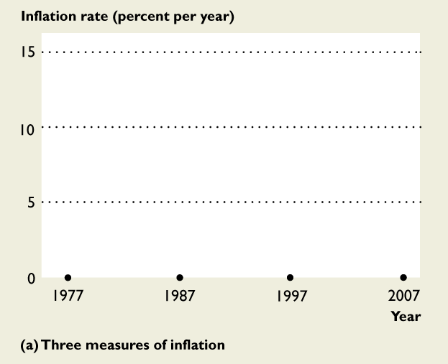
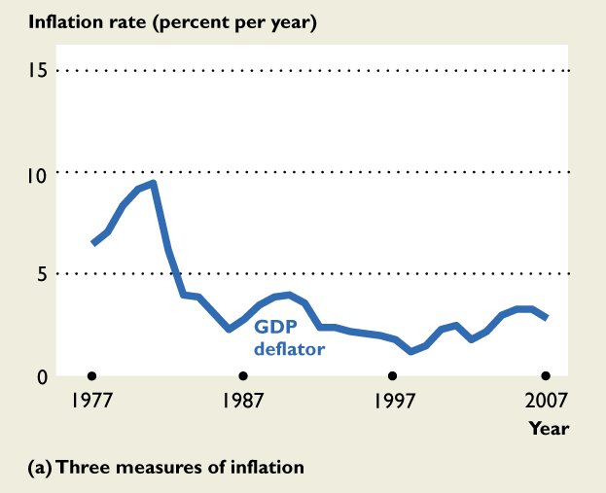
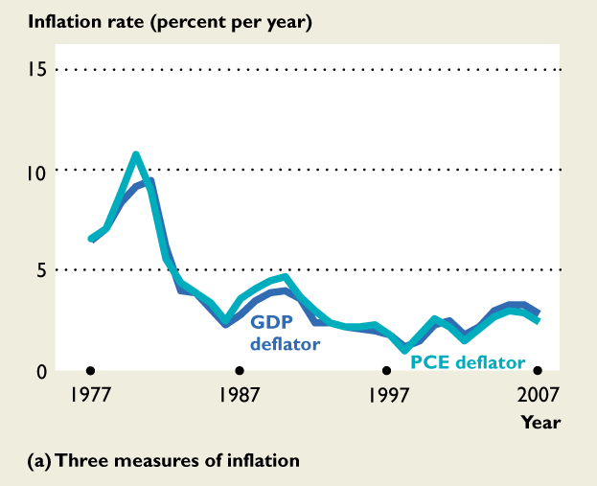
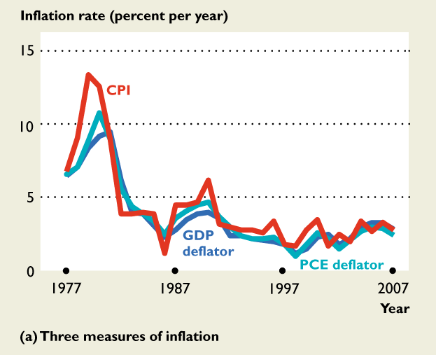
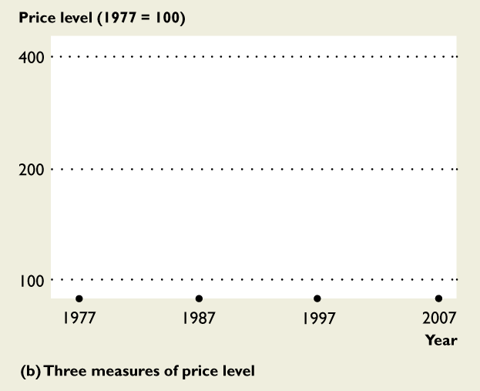
Inflation
Comparing Price Indices
The three measures of the inflation rate fluctuate together, but the CPI measure rises more rapidly than the GDP deflator measure or the PCE deflator measure.

Slide 14
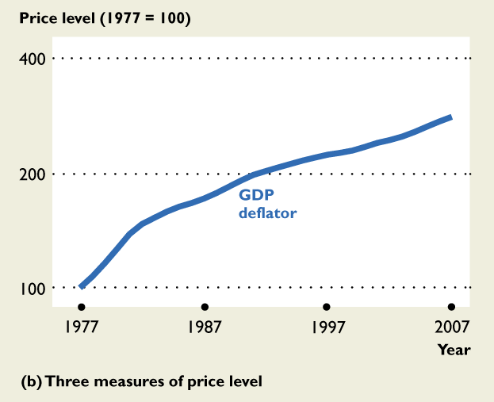
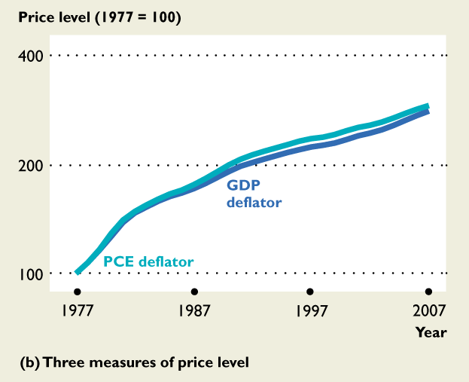
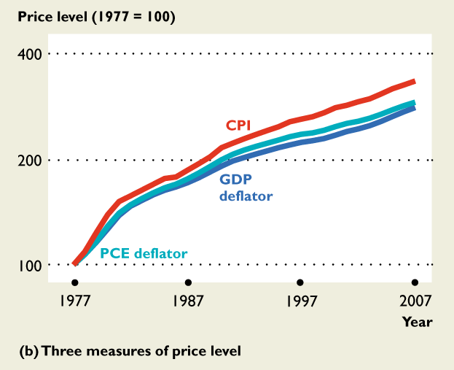
Inflation
Comparing Price Indices
The three measures of the inflation rate fluctuate together, but the CPI measure rises more rapidly than the GDP deflator measure or the PCE deflator measure.
In part (b), the CPI measure of the price level is the highest and the PCE deflator lies between the CPI and the GDP deflator.
The CPI measure overstates the inflation rate.

Slide 15
Inflation
Costs of expected inflation
Menu costs – change posted prices
Shoe leather costs – make more trips to the bank and search costs
Psychic dislike – people don’t like paying more for the same stuff
Inflation taxes – fixed interest rates
Inflation decreases the purchasing power of the dollar
The dollar does not go as far as it use to
The nominal value of some thing is in current dollars.
The real value of some thing is measured in the dollars of a given reference base year (e.g., CPI’s base year is 1983, GDP Deflator’s base year is 2005).
Macroeconomics makes a big issue of the distinction between nominal values and real values:
  Nominal price and real price
  Nominal wage rate and real wage rate
  Nominal interest rate and real interest rate
  Nominal GDP and real GDP

Slide 16
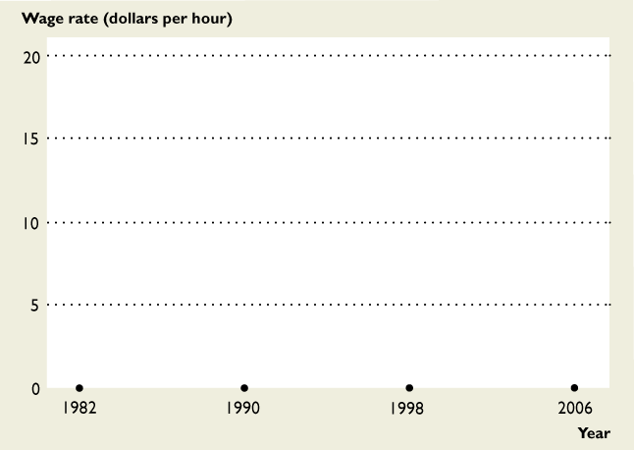
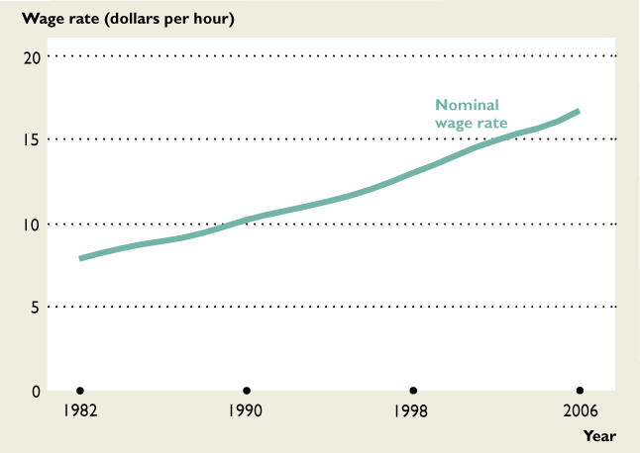
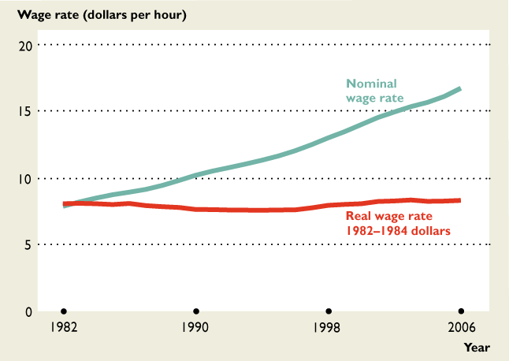
Inflation
The figure shows nominal and real wage rates: 1982–2006.
The nominal wage rate has increased every year since 1982.
The real wage rate decreased slightly from 1982 through the mid-1990s, after which increased slightly.

Slide 17

Inflation
Nominal and Real Interest Rates
  Nominal interest rate is the percentage return on a loan expressed in dollars.
  Real interest rate is the percentage return on a loan, calculated by purchasing power—the nominal interest rate adjusted for the effects of inflation.
  Real rate of return (r) is the nominal interest rate (i) less inflation (π)

Slide 18
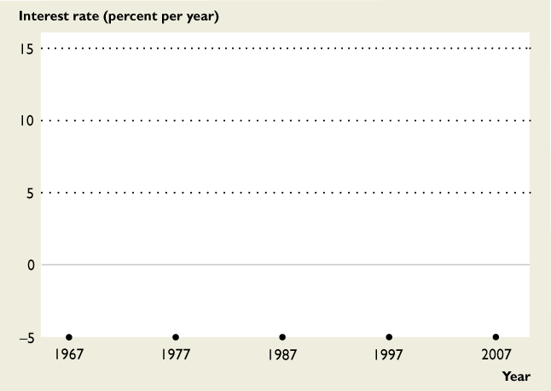
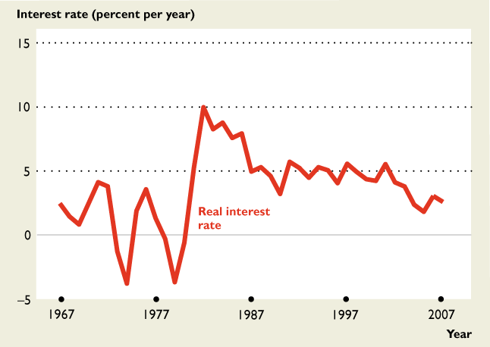
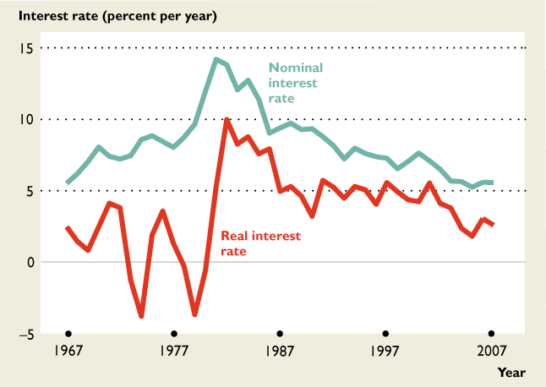
Inflation
Nominal and Real Interest Rates
  Nominal interest rate is the percentage return on a loan expressed in dollars.
  Real interest rate is the percentage return on a loan, calculated by purchasing power—the nominal interest rate adjusted for the effects of inflation.
  Real rate of return (r) is the nominal interest rate (i) less inflation (π)
The figure shows real and nominal interest rates: 1967–2007.
During the 1970s, the real interest rate became negative.
The nominal interest rate increased during the high-inflation 1980s.
Inflation = 6 – 2.5 = 3.5%
Inflation = 10 – (-4) = 14%

Slide 19
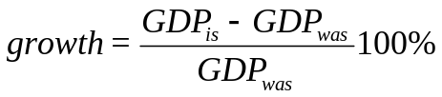
Macroeconomic indicator 2
  Economic growth
  The economic growth rate = the percent change in real Gross Domestic Product (GDP)
  Nominal GDP (nGDP) is the market value of all the final goods and services produced within a country exchanged in formal/legal markets during a given time period
    Nominal GDP is the economy’s output valued at the current year’s prices
    Real GDP is the economy’s output valued at the base year’s prices
  The percent change in nominal GDP ≈ growth + inflation
  In practice, nominal GDP is computed using the income or expenditure approaches:
    nGDP = Wages + Interest + Rents + Profits
    + Indirect taxes – Subsidies + Depreciation
    + Statistical discrepancy
    nGDP = C + I + G + X – M
Net Domestic Product
at factor cost

Slide 20
Economic growth
Inclusions/exclusions in nGDP
Only the final goods and services count; e.g.,
  Only the Dell computer you buy is counted, the parts inside the computer do not get counted
  An Intel chip sold to your computer geek neighbor George is counted in GDP.
  The 2008 Toyota you buy is counted, the tires that came with it are not counted.
Only goods that pass through organized/legal markets are counted.
  Illegal gambling and drugs are not counted, neither are garage sales.
    The “underground” economy is estimated by many to be more than 10% of GDP.
  Leisure is not counted
  GDP would be 44% higher if unpaid housework was included (Ann Chadeau, “What is Households’ Non-Market Production Worth?” OECD Economic Studies 18, 1992, pp. 85-103)
Only those goods produced within the boundaries of the USA are counted
Sales of used goods and existing homes are not counted
Purchases of stocks and bonds are not counted (these are loans not goods or services)
Wars and natural disasters over state GDP
Pollution (a bad) is not deducted from GDP

Slide 21
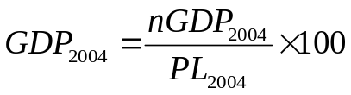
Economic growth
Nominal GDP and Real GDP
Year | GDP in billions of current dollars | GDP implicit price deflator (%) | GDP in billions of chained 2005$
1997 | 8,332.40 | 84.56 | 9,854.30
1998 | 8,793.50 | 85.51 | 10,283.50
1999 | 9,353.50 | 86.77 | 10,779.80
2000 | 9,951.50 | 88.65 | 11,226.00
2001 | 10,286.20 | 90.65 | 11,347.20
2002 | 10,642.30 | 92.12 | 11,553.00
2003 | 11,142.10 | 94.10 | 11,840.70
2004 | 11,867.80 | 96.77 | 12,263.80
2005 | 12,638.40 | 100.00 | 12,638.40
2006 | 13,398.90 | 103.26 | 12,976.20
2007 | 14,077.60 | 106.21 | 13,254.10
2008 | 14,441.40 | 108.48 | 13,312.20
100 =
100 =
100 =
100 =
100 =
100 =
100 =
100 =
100 =
100 =
100 =
100 =

Slide 22
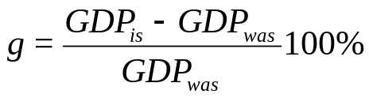
Economic growth
The economic growth rate
Year | Real GDP | Econ growth rate
1997 | 9,854.30 | –
1998 | 10,283.50 | 4.36
1999 | 10,779.80 | 4.83
2000 | 11,226.00 | 4.14
2001 | 11,347.20 | 1.08
2002 | 11,553.00 | 1.81
2003 | 11,840.70 | 2.49
2004 | 12,263.80 | 3.57
2005 | 12,638.40 | 3.05
2006 | 12,976.20 | 2.67
2007 | 13,254.10 | 2.14
2008 | 13,312.20 | 0.44
An expansion occurs when the economic growth rate is positive.
A recession occurs when g is negative for 2 consecutive quarters.
A depression is a long lasting (persistent) recession that last for years.

Slide 23
Economic growth
Standard of Living over time
If the economic growth rate exceeds the grow rate of the population the current generation is better than previous generations
  In 1967, real GDP in the United States was $3942.5 billion and the population of the United States was 198.712 million.
Real GDP per person in 1967 = $19,840
  In 2008, real GDP in the United States was $13,312.2 billion and the population of the United States was 304.06 million.
Real GDP per person in 2008 = $43,781
If the population growth rate exceeds a country’s economic growth rate the current generation is worse off than previous generations.

Slide 24
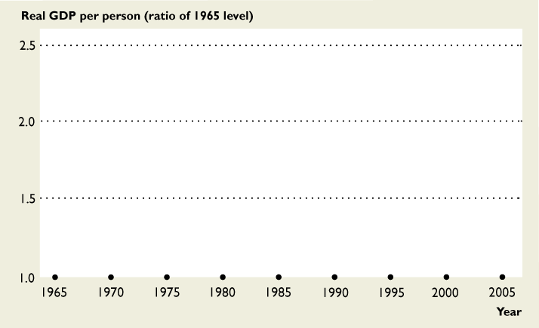
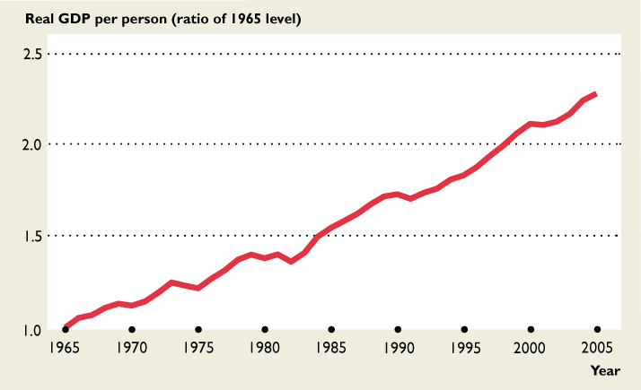
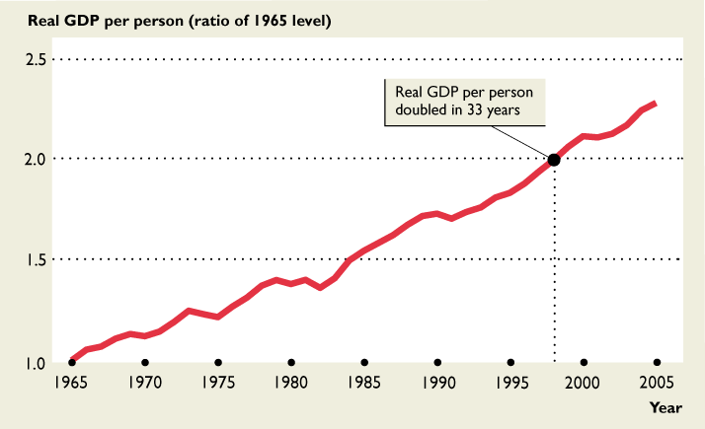
Economic growth
Standard of Living over time
The figure shows the long-term trend in U.S. real GDP per person.
Real GDP per person doubled in the 33 years from 1965 to 1998.
In most years, the real GDP per person increases
Sometimes it doesn’t change.

Slide 25
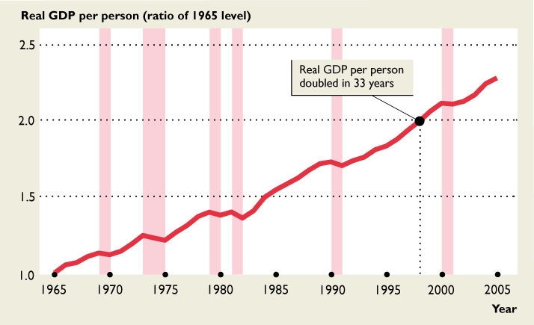
Economic growth
The business cycle
Fluctuations in the pace of expansion of real GDP is called the business cycle.
The business cycle is a periodic irregular up-and down movement in the output of the economy.
The four stages of a business cycle are expansion, peak, recession, and trough.
The shaded periods show the recessions—periods of falling production that lasts for at least six months.

Slide 26
Inflation and Economic growth
The PL and GDP are determined by aggregate demand (AD) and aggregate supply (AD)
  AS is the relationship between the quantity of GDP supplied and the PL
AS
  PL and real GDP are determined by the intersection of AS and AD
PL
  AD is the relationship between quantity of GDP demanded and PL
AD
AD
GDP
  If AD increases, inflation and economic growth occur.

Slide 27
Inflation and Economic growth
The PL and GDP are determined by aggregate demand (AD) and aggregate supply (AD)
AS
PL
AD
AD
GDP
  If AD decreases, deflation occurs and economic growth is negative.

Slide 28
Macroeconomic indicator 3
  Unemployment rate
  The Current Population Survey is a joint project of the BLS and the Bureau of the Census
  Every month, 1,600 CPS interviewers survey 60,000 households to establish job market status of each member of the household.
  Working-age population (WAP) = all people aged 16 years and over not jailed, hospitalized, institutionalized nor in the U.S. Armed Forces. (WAP = L + those not in L )
  Labor force (L) is the number of people employed plus the number unemployed (L = E + U ).
  The CPS counts as employed (E ) all those in the WAP who, during the prior week, either
    Worked at least 1 hour in a paid job or 15 hours unpaid in family business.
    Were not working but who had jobs from which they were temporarily absent.
  The CPS counts as unemployed (U ) all those in the WAP who, during the prior week,
    Weren’t working but were available for work,
    Looked for work during the previous 4 weeks OR were waiting to be recalled to a job from which they had been laid off.
  The unemployment rate:
U .
L
u = x 100%

Slide 29
Unemployment rate
U = L – E
U .
L
u = x 100%
Year | Labor Force | Employed | Unemployed | u
2001 | 143,768,917 | 136,939,333 | 6,829,583 | 4.75
2002 | 144,856,083 | 136,480,917 | 8,375,167 | 5.78
2003 | 146,499,500 | 137,729,250 | 8,770,250 | 5.99
2004 | 147,379,583 | 139,239,750 | 8,139,833 | 5.52
2005 | 149,291,750 | 141,713,500 | 7,578,250 | 5.08
2006 | 151,412,500 | 144,420,083 | 6,992,417 | 4.62
2007 | 153,126,333 | 146,049,500 | 7,076,833 | 4.62
2008 | 154,329,250 | 145,368,417 | 8,960,833 | 5.81
=
Types of unemployment
Frictional (u_{f} ): workers temporarily between jobs because of a move/career change.
Structural (u_{s} ): workers displaced by automation.
Cyclical (u_{c} ): workers who loose their jobs due to recession.
u = u_{f} + u_{s} + u_{c}
Natural rate of unemployment (u_{n} ≈ 5%): It’s the rate at which inflation remains constant.
u_{f} + u_{s} = 5%
u_{c} = 0.81%

Slide 30
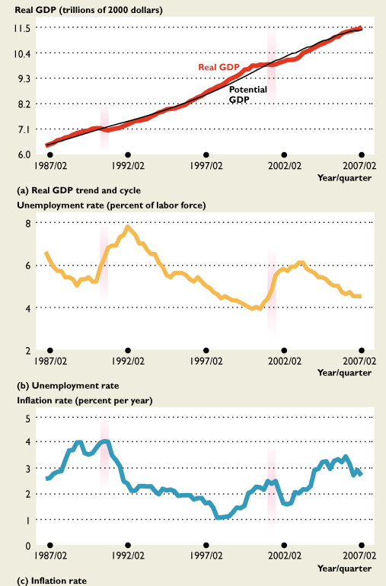
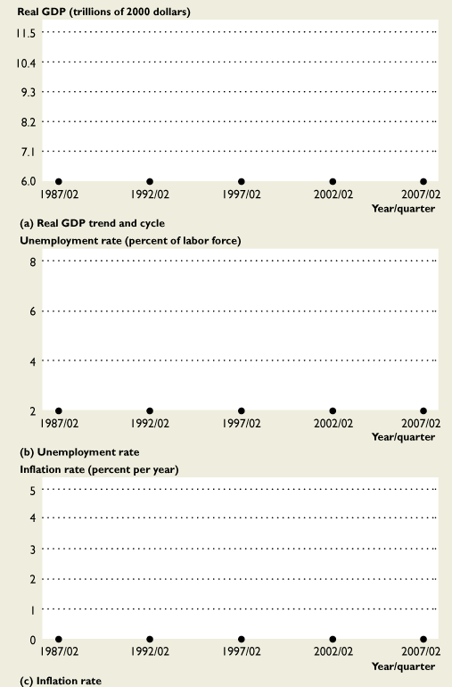
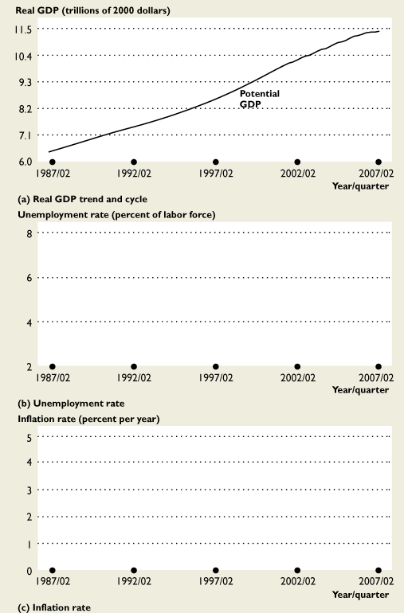
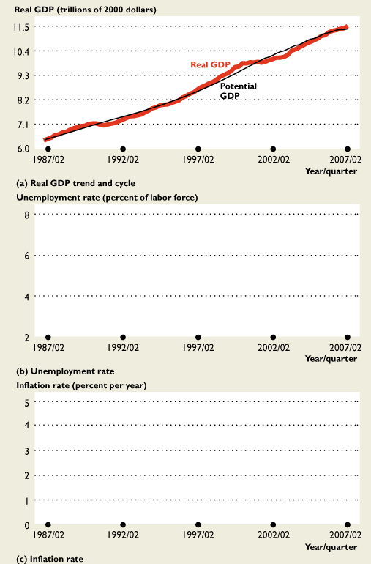
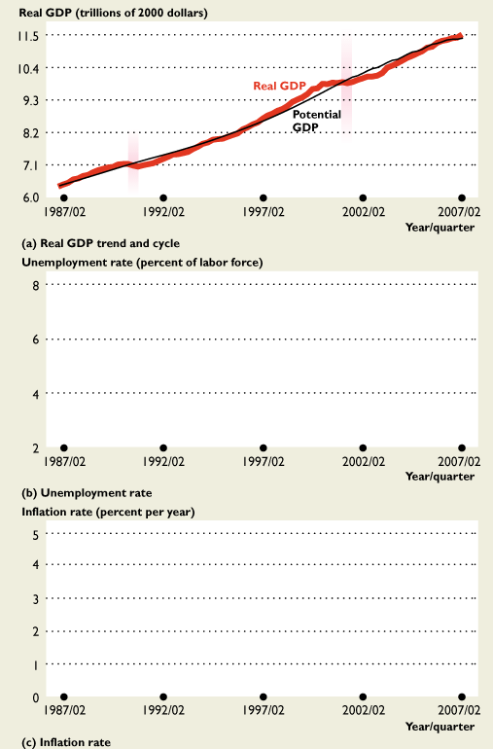
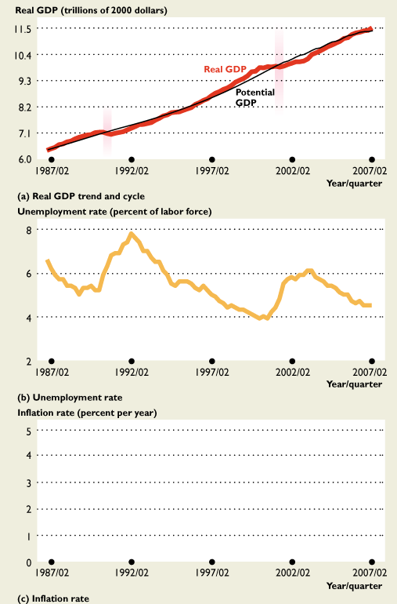
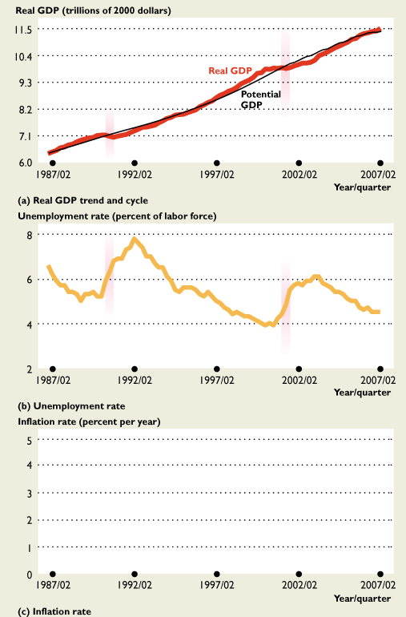
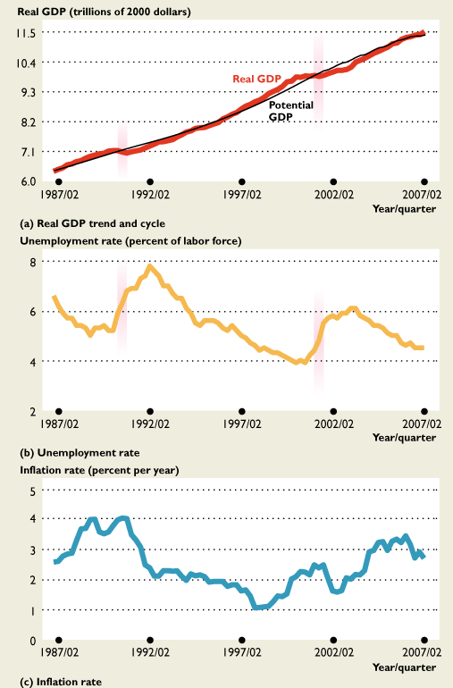
Inflation, Economic growth and Unemployment
The business cycle
Recessions began in mid-1990 and in first quarter of 2001.
The longest expansion in U.S. history ran from the March 1991 to March 2001.
When GDP decreased in the recession (a),
The unemployment rate increased (b).
And a little later, the inflation rate decreased (c).
As real GDP increased back toward potential GDP, the unemployment rate fell toward the natural unemployment rate and the inflation rate fell.
The figure shows the recent cycles in real GDP.

Slide 31
Unemployment rate
  Changes in unemployment
  Unemployment depends on the difference between real GDP and potential GDP
  Potential GDP is the level of real GDP that the economy would have produced if its labor and capital were fully employed.
    Full employment occurs when real GDP = potential GDP
    Graphically, it is a vertical line in the AD-AS model
      The real wage rate makes the quantity of labor demanded equal to the quantity of labor supplied.
      Along the potential GDP line, when the price level changes the money wage rate changes to keep the real wage rate at the full-employment level.
    When the economy grows more slowly than its potential, it fails to generate new jobs for its ever growing labor force
Y < Y_{p} → u > u_{n}
    When the economy grows faster than its potential, the unemployment rate falls.
Y > Y_{p} → u < u_{n}
    Full employment is reached when u_{c} = 0, which implies u = u_{n} ≈ 5%

Slide 32
Inflation, Economic growth and Unemployment
Recessionary Gap
  A recessionary gap occurs when GDP is less than potential GDP.
  Resources, capital, and workers are not being fully utilized, and so u is high.
  As a result, there is downward pressure on wages
LRAS
Note: Unemployment insurance replaces a portion of a newly unemployed worker’s income. Designed to prevent the “next” Great Depression.
PL
SRAS
AD
GDP
Y_{p}

Slide 33
Inflation, Economic growth and Unemployment
Inflationary Gap
  An inflationary gap occurs when GDP exceeds potential GDP.
  Workers are working overtime and firms are competing for their labor, resulting in low u
  As a result, there is upward pressure on wages
PL
LRAS
SRAS
AD
Y_{FE}
GDP

Slide 34
Inflation, Economic growth and Unemployment
The business cycle
Recessions began in mid-1990 and in first quarter of 2001.
The longest expansion in U.S. history ran from the March 1991 to March 2001.
The figure shows the recent cycles in real GDP.

Slide 35
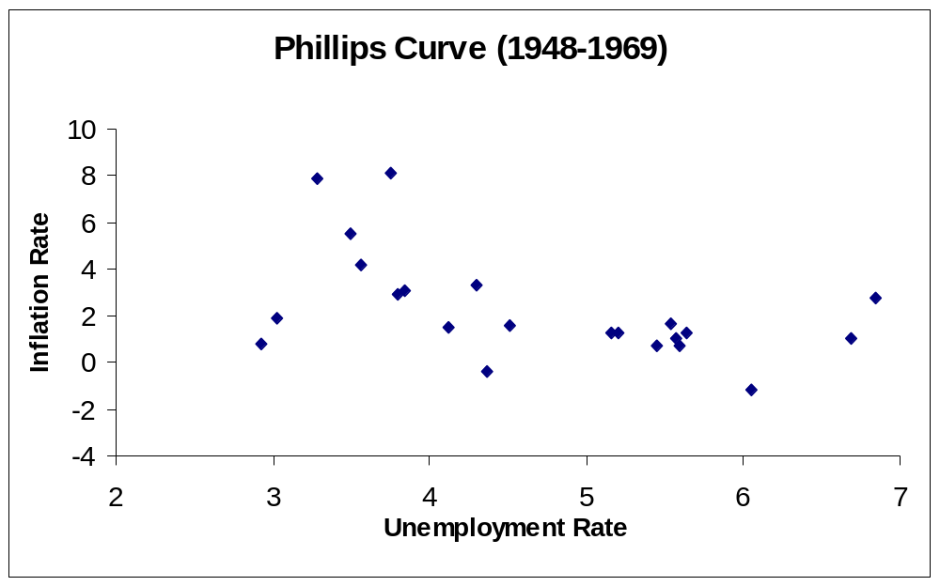
Inflation, Economic growth and Unemployment
Source: http://www.bls.gov/

Slide 36
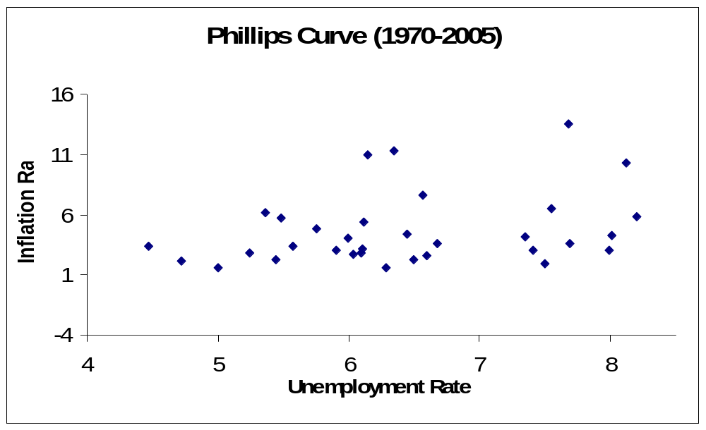
Inflation, Economic growth and Unemployment
Source: http://www.bls.gov/

Slide 37
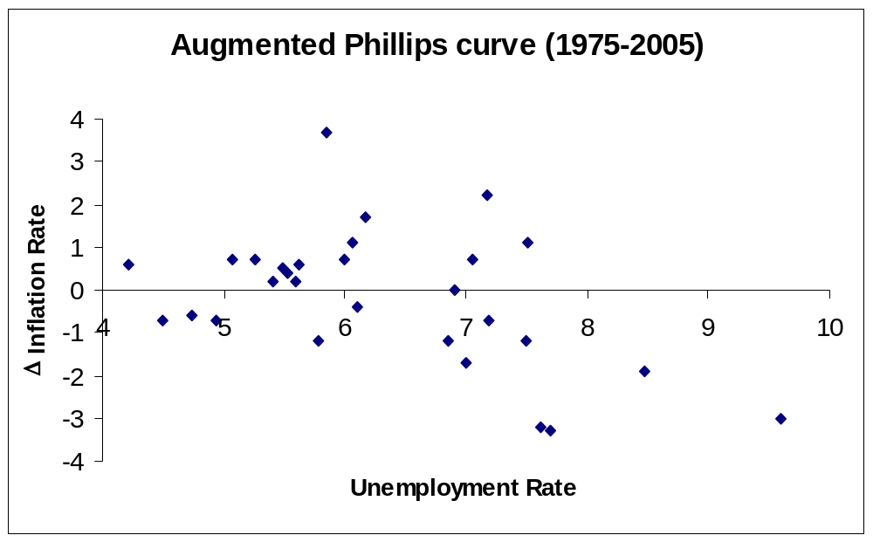
Inflation, Economic growth and Unemployment
NAIRU or Natural Rate of unemployment
Source: http://www.bls.gov/

