Slide 1
Did welfare reform increase participant employment?
Hal W. Snarr
Westminster College
12/2/13

Slide 2
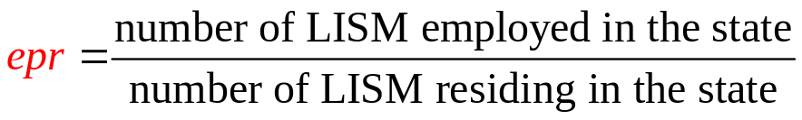







Did welfare reform increase participant employment?
  The variable above depends on
  lnPAYT natural log of the real value of state’s welfare payment (β₁ < 0)
  D₂₀₀₀ = 1 if the year is 2000, = 0 if it is 1994 (β₂ > 0)
  D_{full} = 1 if state adopted full sanction policy, = 0 if not (β₃ > 0)
  BLK share of state population that is black (β₄ ≠ 0)
  DROP share of state population that is HS drop out (β₅ < 0)
  U share of state labor force that is unemployed (β₆ < 0)
$$−$$
$$+$$
$$+$$
$$±$$
$$−$$
$$−$$

Slide 3
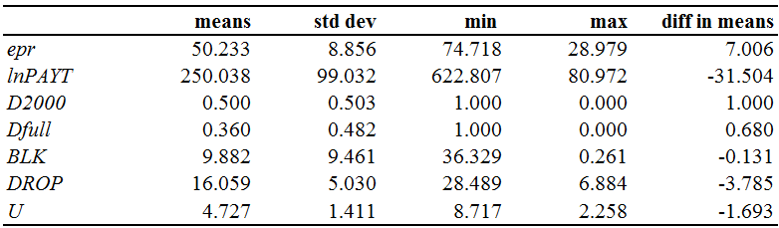
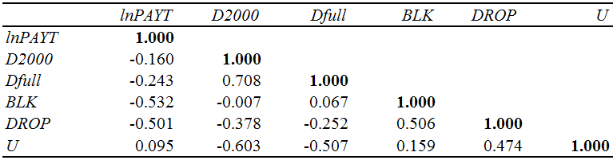
Descriptive Statistics

Slide 4
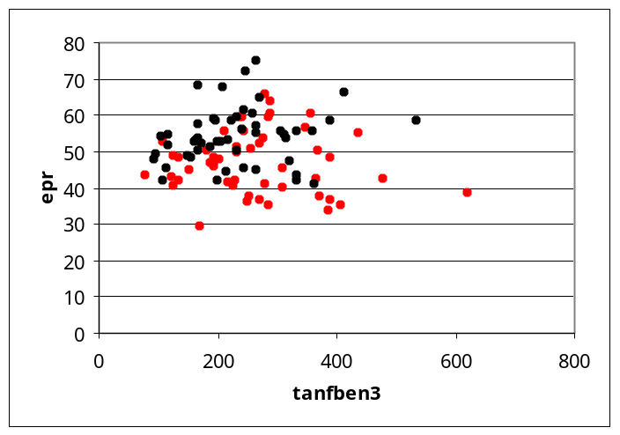
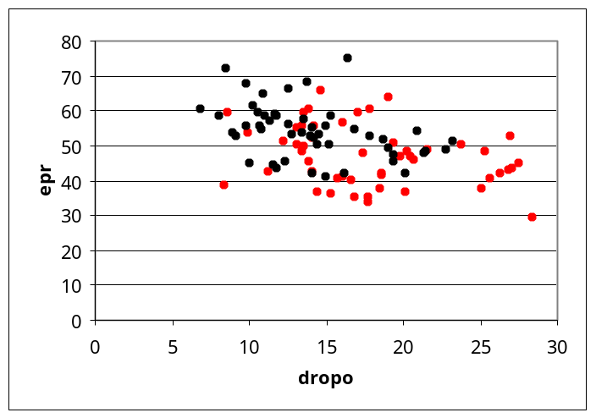
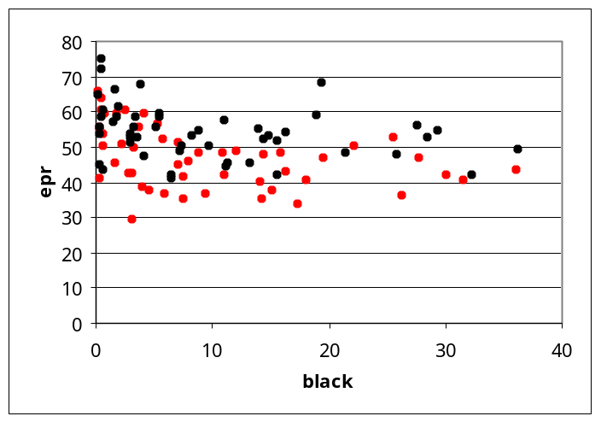
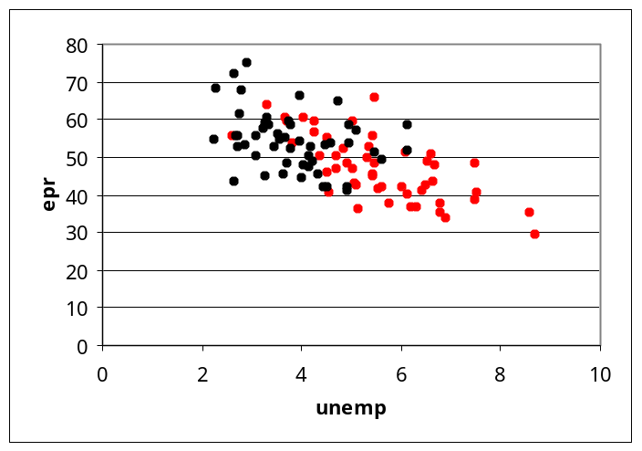
Scatterplots
(1994, 2000)

Slide 5
Regression Results
R Square | 0.0008
Adjusted R Square | -0.0094
Standard Error | 8.8978
Observations | 100
ANOVA
 | df | SS | MS | F
Regression | 1 | 6.031 | 6.031 | 0.076
Residual | 98 | 7758.733 | 79.171
Total | 99 | 7764.764
 | Coefficients | Standard Error | t Stat | P-value
Intercept | 46.9192 | 12.038 | 3.897 | 0.000
lnPAYT | 0.6087 | 2.206 | 0.276 | 0.783
r ²·100% of the variability in
y
can be explained by the model.
0%
epr of LISM
Error

Slide 6
Regression Results
R Square | 0.517
Adjusted R Square | 0.486
Standard Error | 6.347
Observations | 100
ANOVA
 | df | SS | MS | F
Regression | 6 | 4018.075 | 669.679 | 16.623
Residual | 93 | 3746.689 | 40.287
Total | 99 | 7764.764
 | Coefficients | Standard Error | t Stat | P-value
Intercept | 104.529 | 15.743 | 6.640 | 0.000
lnPAYT | −5.709 | 2.461 | −2.320 | 0.023
D2000 | −2.821 | 2.029 | −1.390 | 0.168
Dfull | 3.768 | 1.927 | 1.955 | 0.054
BLK | −0.291 | 0.089 | −3.256 | 0.002
DROP | −0.374 | 0.202 | −1.848 | 0.068
U | −3.023 | 0.618 | −4.888 | 0.000
r ²·100% of the variability in
y
can be explained by the model.
49%
epr of LISM
Error

Slide 7
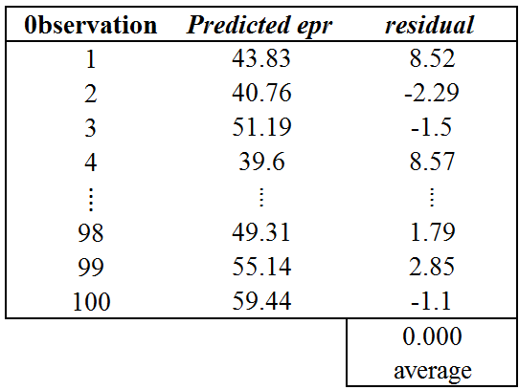
Error Properties
Zero Mean

Slide 8
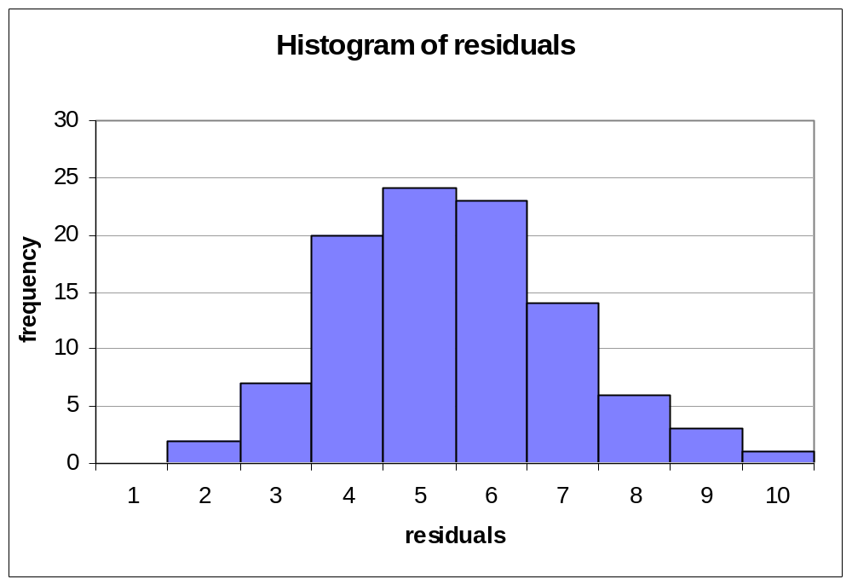
Error Properties
Normality
-20 -16 -12 -8 -4 0 4 8 12 16 20
If the errors are not normally distributed and the sample size is small,
F stat may not follow the F distribution. It’s p-value may be invalid
t stats may not follow the t distribution. Their p-values may be invalid

Slide 9
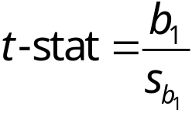
Error Properties
The regression model is linear
okay
If the data are not linearly related,
Standard errors of estimated coefficients are okay
Estimated coefficients are biased

Slide 10
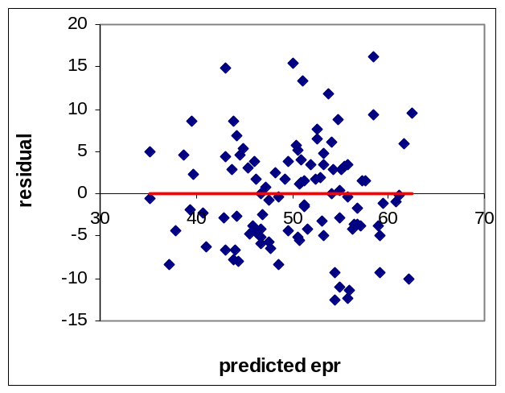
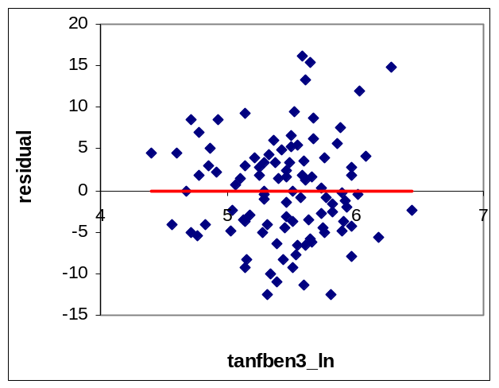
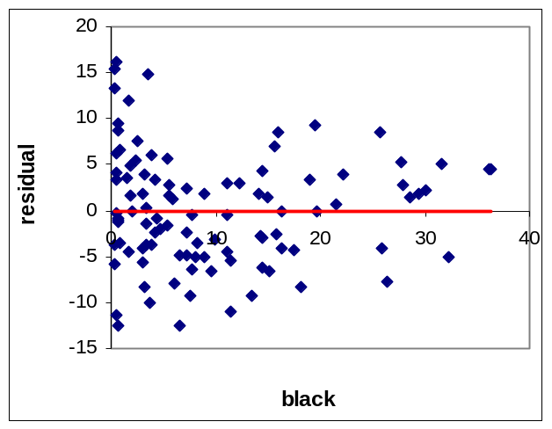
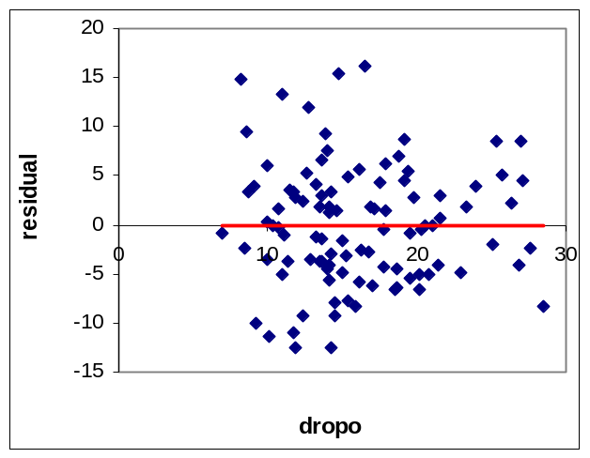
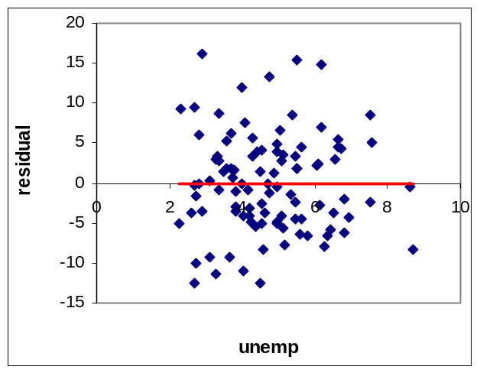
Error Properties
Homoscedasticity
okay
okay
Non-constant variance in black?
okay
okay
If errors are not homoscedastic,
Estimated coefficients are okay
Coefficient standard errors are wrong

Slide 11
Error Properties
No autocorrelation
This is generally not an issue if the dataset is cross-sectional
Because my data varies in time, the DW stat must be close to 2.
DW stat = 0.77
Autocorrelation in the errors is likely
If autocorrelation is a problem,
Estimated coefficients are okay
Their standard errors may be inflated

Slide 12
Error Properties
No autocorrelation
This is generally not an issue if the dataset is cross-sectional
Because my data varies in time, the DW stat must be close to 2.
DW stat = 0.77
Autocorrelation in the errors is likely
If autocorrelation is a problem,
Estimated coefficients are okay
Their standard errors may be inflated
Since the errors may be heteroscedastic or autocorrelated, F & t tests are unreliable.
Excel cannot account for the two, but regression packages (Stata or SAS) can
Newey-West standard errors (autocorrelation & heteroscedasticity)
Eicker-Huber-White standard errors (heteroscedasticity)

Slide 13
Hypothesis Testing
R Square | 0.517
Adjusted R Square | 0.486
Standard Error | 6.347
Observations | 100
ANOVA
 | df | SS | MS | F stat
Regression | 6 | 4018.075 | 669.679 | 16.623
ERROR | 93 | 3746.689 | 40.287
Total | 99 | 7764.764
 | Coefficients | Standard Error | t Stat | P-value
Intercept | 104.529 | 15.743 | 6.640 | 0.000
lnPAYT | −5.709 | 2.461 | −2.320 | 0.023
D2000 | −2.821 | 2.029 | −1.390 | 0.168
Dfull | 3.768 | 1.927 | 1.955 | 0.054
BLK | −0.291 | 0.089 | −3.256 | 0.002
DROP | −0.374 | 0.202 | −1.848 | 0.068
U | −3.023 | 0.618 | −4.888 | 0.000
Testing for model significance
H₀: β₁ = β₂ = β₃ = β₄ = β₅ = β₆ = 0
Reject H₀
column
2.20
α = .05 & row

Slide 14
Hypothesis Testing
R Square | 0.517
Adjusted R Square | 0.486
Standard Error | 6.347
Observations | 100
ANOVA
 | df | SS | MS | F stat
Regression | 6 | 4018.075 | 669.679 | 16.623
ERROR | 93 | 3746.689 | 40.287
Total | 99 | 7764.764
 | Coefficients | Standard Error | t Stat | P-value
Intercept | 104.529 | 15.743 | 6.640 | 0.000
lnPAYT | −5.709 | 2.461 | −2.320 | 0.023
D2000 | −2.821 | 2.029 | −1.390 | 0.168
Dfull | 3.768 | 1.927 | 1.955 | 0.054
BLK | −0.291 | 0.089 | −3.256 | 0.002
DROP | −0.374 | 0.202 | −1.848 | 0.068
U | −3.023 | 0.618 | −4.888 | 0.000
Testing for coefficient significance
H₀: β_{i} = 0
α = .05
α /2 = .025 (column)
row
Reject H₀
-1.986 1.986

Slide 15
Hypothesis Testing
R Square | 0.517
Adjusted R Square | 0.486
Standard Error | 6.347
Observations | 100
ANOVA
 | df | SS | MS | F stat
Regression | 6 | 4018.075 | 669.679 | 16.623
ERROR | 93 | 3746.689 | 40.287
Total | 99 | 7764.764
 | Coefficients | Standard Error | t Stat | P-value
Intercept | 104.529 | 15.743 | 6.640 | 0.000
lnPAYT | −5.709 | 2.461 | −2.320 | 0.023
D2000 | −2.821 | 2.029 | −1.390 | 0.168
Dfull | 3.768 | 1.927 | 1.955 | 0.054
BLK | −0.291 | 0.089 | −3.256 | 0.002
DROP | −0.374 | 0.202 | −1.848 | 0.068
U | −3.023 | 0.618 | −4.888 | 0.000
Testing for coefficient significance
H₀: β_{i} = 0
α = .05
α /2 = .025 (column)
Reject H₀
DNR H₀
-1.986 1.986

Slide 16
Hypothesis Testing
R Square | 0.517
Adjusted R Square | 0.486
Standard Error | 6.347
Observations | 100
ANOVA
 | df | SS | MS | F stat
Regression | 6 | 4018.075 | 669.679 | 16.623
ERROR | 93 | 3746.689 | 40.287
Total | 99 | 7764.764
 | Coefficients | Standard Error | t Stat | P-value
Intercept | 104.529 | 15.743 | 6.640 | 0.000
lnPAYT | −5.709 | 2.461 | −2.320 | 0.023
D2000 | −2.821 | 2.029 | −1.390 | 0.168
Dfull | 3.768 | 1.927 | 1.955 | 0.054
BLK | −0.291 | 0.089 | −3.256 | 0.002
DROP | −0.374 | 0.202 | −1.848 | 0.068
U | −3.023 | 0.618 | −4.888 | 0.000
Testing for coefficient significance
H₀: β_{i} = 0
α = .05
α /2 = .025 (column)
Reject H₀
DNR H₀
DNR H₀
-1.986 1.986

Slide 17
Hypothesis Testing
R Square | 0.517
Adjusted R Square | 0.486
Standard Error | 6.347
Observations | 100
ANOVA
 | df | SS | MS | F stat
Regression | 6 | 4018.075 | 669.679 | 16.623
ERROR | 93 | 3746.689 | 40.287
Total | 99 | 7764.764
 | Coefficients | Standard Error | t Stat | P-value
Intercept | 104.529 | 15.743 | 6.640 | 0.000
lnPAYT | −5.709 | 2.461 | −2.320 | 0.023
D2000 | −2.821 | 2.029 | −1.390 | 0.168
Dfull | 3.768 | 1.927 | 1.955 | 0.054
BLK | −0.291 | 0.089 | −3.256 | 0.002
DROP | −0.374 | 0.202 | −1.848 | 0.068
U | −3.023 | 0.618 | −4.888 | 0.000
Testing for coefficient significance
H₀: β_{i} = 0
α = .05
α /2 = .025 (column)
Reject H₀
DNR H₀
DNR H₀
Reject H₀
-1.986 1.986

Slide 18
Hypothesis Testing
R Square | 0.517
Adjusted R Square | 0.486
Standard Error | 6.347
Observations | 100
ANOVA
 | df | SS | MS | F stat
Regression | 6 | 4018.075 | 669.679 | 16.623
ERROR | 93 | 3746.689 | 40.287
Total | 99 | 7764.764
 | Coefficients | Standard Error | t Stat | P-value
Intercept | 104.529 | 15.743 | 6.640 | 0.000
lnPAYT | −5.709 | 2.461 | −2.320 | 0.023
D2000 | −2.821 | 2.029 | −1.390 | 0.168
Dfull | 3.768 | 1.927 | 1.955 | 0.054
BLK | −0.291 | 0.089 | −3.256 | 0.002
DROP | −0.374 | 0.202 | −1.848 | 0.068
U | −3.023 | 0.618 | −4.888 | 0.000
Testing for coefficient significance
H₀: β_{i} = 0
α = .05
α /2 = .025 (column)
Reject H₀
DNR H₀
DNR H₀
Reject H₀
DNR H₀
-1.986 1.986

Slide 19
Hypothesis Testing
R Square | 0.517
Adjusted R Square | 0.486
Standard Error | 6.347
Observations | 100
ANOVA
 | df | SS | MS | F stat
Regression | 6 | 4018.075 | 669.679 | 16.623
ERROR | 93 | 3746.689 | 40.287
Total | 99 | 7764.764
 | Coefficients | Standard Error | t Stat | P-value
Intercept | 104.529 | 15.743 | 6.640 | 0.000
lnPAYT | −5.709 | 2.461 | −2.320 | 0.023
D2000 | −2.821 | 2.029 | −1.390 | 0.168
Dfull | 3.768 | 1.927 | 1.955 | 0.054
BLK | −0.291 | 0.089 | −3.256 | 0.002
DROP | −0.374 | 0.202 | −1.848 | 0.068
U | −3.023 | 0.618 | −4.888 | 0.000
Testing for coefficient significance
H₀: β_{i} = 0
α = .05
α /2 = .025 (column)
Reject H₀
DNR H₀
DNR H₀
Reject H₀
DNR H₀
Reject H₀
-1.986 1.986

Slide 20



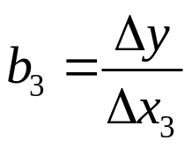
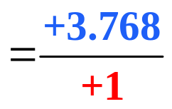

Interpretation of Results
Estimated coefficient b₁ is significant:
Increasing monthly benefit levels for a family of three by 10% would result in a .54 percentage point reduction in the epr of LISM
Estimated coefficient b₂ is insignificant:
Welfare reform in general had no effect on the epr of LISM.
Estimated coefficient b₃ is significant (at α = 0.10):
The epr of LISM is 3.768 percentage points higher in states that adopted the full sanction policy

Slide 21
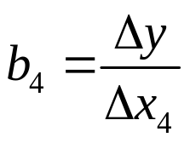
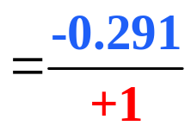

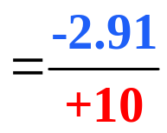


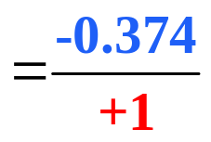
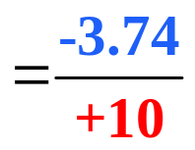

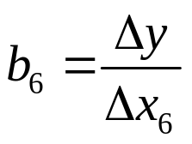
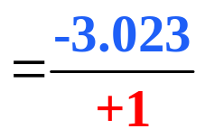

Interpretation of Results
Estimated coefficient b₄ is significant:
Each 10 pct. point increase in the share of blacks is associated with a 2.91 percentage point decline in the epr of LISM.
Estimated coefficient b₅ is significant (at α = 0.10) :
Each 10 pct. point increase in the HS dropout rate is associated with a 3.74 percentage point decline in the epr of LISM.
Estimated coefficient b₆ is significant:
Each 1 pct. point increase in unemployment is associated with a 3.023 percentage point decline in the epr of LISM.

Slide 22
Conclusions
Increasing monthly benefit levels for a family of three reduces the epr of LISM
Welfare reform in general had no effect on the epr of LISM.
The epr of LISM is higher in states that adopted the full sanction policy.
Culture and urbanity matter.
States with higher HS dropout rates have lower LISM employment rates.
States with higher unemployment have lower LISM employment rates.

