Slide 1
Microeconomics versus Macroeconomics
Microeconomics – study of individual behavior
    Billions of individuals have millions/billions of demand curves shifting around in their heads
    Millions of firms have supply curves for the products they sell
Macroeconomics – study of aggregate behavior
    There is only one demand curve because in macro we ‘combine’ all demand curves into one
    There is only one supply curve because in macro we ‘combine’ all supply curves into one

Slide 2
The Demand Curve
A Demand Curve shows the quantity of a good that consumers will purchase at alternative prices, holding all else constant.
Quantity Demanded (Q_{D}) is the amount of a good consumers will purchase at a given price (P), holding all else constant.
A movement along a demand curve is the change in quantity demanded that occurs when its price changes, holding all else constant
The Law of Demand is the economic principle that says that the lower the price of a good the larger the quantity consumers wish to purchase, holding all else constant.
How do we test this theory?
We collect data by asking questions like: How many Big Macs will you buy per week when the price is P = $10.10? How many Big Macs will you buy per week when the price is P = $0.10?

Slide 3
The Demand Curve
Individual | P₀ = 10.10 | P₁ = 0.10
1 | 0 | 15
2 | 1 | 10
3 | 0 | 2
4 | 0 | 3
5 | 0 | 10
6 | 0 | 3
7 | 1 | 2
8 | 0 | 10
9 | 0 | 15
10 | 0 | 20
11 | 10 | 22
Total | 12 | 112

Slide 4
The Demand Curve
According to our data,
When P₀ = $0.10, Q_{D} = 112
10.10
Price
12
Quantity

Slide 5
The Demand Curve
According to our data,
When P₁ = $10.10, Q_{D} = 12
10.10
Price
0.10
D
12
112
Quantity

Slide 6
The Demand Curve
The following equation fits these two points.
P = 11.3 − 0.1Q
Big Mac Demand
Moving from this point …
… to this point is a movement along a demand curve
10.10
Price
0.10
D
12
112
Quantity

Slide 7
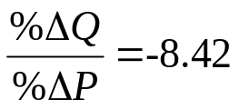

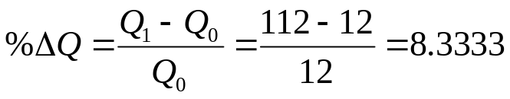
The Demand Curve
The elasticity of Big Mac demand is computed as follows.
Big Mac Demand
10.10
Price
0.10
D
112
12
112
12
Quantity

Slide 8
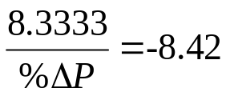
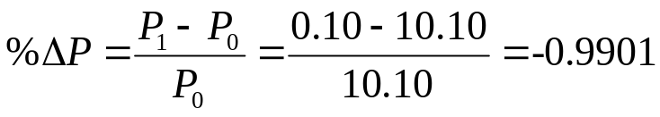
The Demand Curve
The elasticity of Big Mac demand is computed as follows.
Big Mac Demand
10.10
10.10
Price
0.10
0.10
D
12
112
Quantity

Slide 9
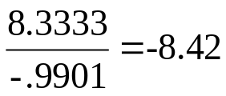
The Demand Curve
The elasticity of Big Mac demand is computed as follows.
Big Mac Demand
10.10
Price
0.10
D
12
112
Quantity

Slide 10
The Demand Curve
A shift of a demand curve is a change in the location of the demand curve
If demand of a good increases when income increases, the good is a normal good
Big Mac Demand
Price
2.30
D
D’
90
135
Quantity

Slide 11
The Demand Curve
A shift of a demand curve is a change in the location of the demand curve
If demand of a good decreases when income increases, the good is an inferior good
Big Mac Demand
Price
2.30
D
D
65
90
Quantity

Slide 12
The Demand Curve
A shift of a demand curve is a change in the location of the demand curve
If the price of McDonald’s fries falls (Q_{D} for fries would increase), demand
for Big Macs increases. Big Macs and fries are complements.
Big Mac Demand
Price
2.30
D
D’
90
145
Quantity

Slide 13
The Demand Curve
A shift of a demand curve is a change in the location of the demand curve
If the price of Burger King Whoppers falls (Q_{D} for Whoppers increases), demand for Big Macs decreases. Big Macs and Whoppers are substitutes.
Big Mac Demand
Price
2.30
D
D’
75
90
Quantity

Slide 14
The Demand Curve
A shift of a demand curve is a change in the location of the demand curve
Taste/preference shifts: The low carbohydrate diet craze might have changed how people felt about eating foods high in carbohydrates and calories.
Big Mac Demand
Price
2.30
D
D’
75
90
Quantity

Slide 15
The Demand Curve
A shift of a demand curve is a change in the location of the demand curve
If the population increases, demand for Big Macs might increase as well.
Big Mac Demand
Price
2.30
D
D’
90
105
Quantity

Slide 16
The Supply Curve
A Supply Curve (or simply supply) shows the quantity of a good that firms will produce at alternative prices, holding all else constant.
Quantity Supplied (Q_{S}) is the amount of a particular type of good firms will want to produce at a given price, holding all else constant.
A movement along a supply curve is the change in quantity supplied that occurs when its price changes, holding all else constant.
The Law of Supply is the economic principle that says that the higher the price of a good the larger the quantity firms wish to produce, holding all else constant.
We test this theory by asking questions.
You have on old oil well in Mississippi which produces 10,000 barrels per year. There are 9 other people in the area that have identical oil wells. How many barrels of oil will you pump out of the ground if the crude oil price is
P = $15? How many barrels of oil will you pump out of the ground if the crude oil price is P = $115?

Slide 17
The Supply Curve
Individual | P = 15 | P = 115
1 | 0 | 10,000
2 | 0 | 10,000
3 | 0 | 10,000
4 | 0 | 10,000
5 | 0 | 10,000
6 | 0 | 10,000
7 | 0 | 10,000
8 | 0 | 10,000
9 | 0 | 10,000
10 | 0 | 10,000
Total | 0 | 100,000

Slide 18
The Supply Curve
According to our data,
When P = $15, Q_{S} = 0
Revenue = P·Q = 0
Price
15
0
Quantity

Slide 19
The Supply Curve
According to our data,
When P = $115, Q_{S} = 100,000
Revenue = P·Q = $11,500,000
Crude Oil Supply
S
115
Price
15
0
100,000
Quantity

Slide 20
The Supply Curve
The following equation fits these two points.
P = 15 + 0.001Q
Crude Oil Supply
S
115
Moving from this point …
…to this point is a movement along a supply curve
Price
15
0
100,000
Quantity

Slide 21
The Supply Curve
A shift in supply is a change in the location of the supply curve
If the price of related good (natural gas) falls (Q_{S} of natural gas falls), supply of crude oil increases.
Crude Oil Supply
S
S’
Price
85
350,000
700,000
Quantity

Slide 22
The Supply Curve
A shift in supply is a change in the location of the supply curve
If the price of an input to production (workers’ wages) falls, supply of crude oil increases.
Crude Oil Supply
S
S’
Price
85
350,000
700,000
Quantity

Slide 23
The Supply Curve
A shift in supply is a change in the location of the supply curve
If technology improves (McFlurry Spoon/stirrer), McFlurry supply increases.
McFlurry Supply
S
S’
Price
2.50
10,150,000
11,400,000
Quantity

Slide 24
The Supply Curve
A shift in supply is a change in the location of the supply curve
If government intervenes by mandating health insurance companies to cover preexisting conditions, the supply of health insurance policies will decrease.
Health Insurance Policy Supply
S
S’
Price
2.50
84,000
115,000
Quantity

Slide 25


Law of Supply and Demand
The Law of Supply and Demand states that in a free market the forces of supply and demand generally push the price toward the level at which quantity supplied (Q_{S}) equals quantity demanded (Q_{D}).
Use the following model to explain why the price of gasoline is so high.
Assume the daily demand and supply for gasoline is given by
Q_{D} (millions) | P ($) |  | Q_{S} (millions) | P ($)
100 | 6.10 |  | 300 | 0.30
500 | 1.10 |  | 500 | 5.30

Slide 26
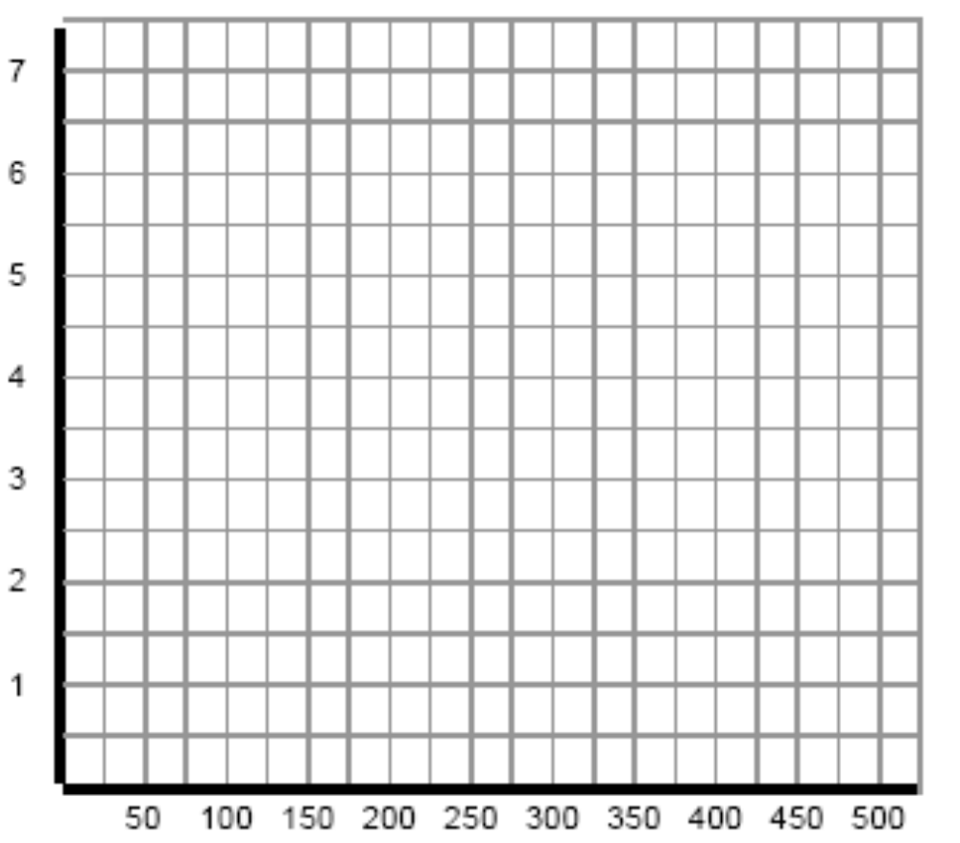
Law of Supply and Demand
Gasoline Market
P
($)
S
D
Q (millions)

Slide 27








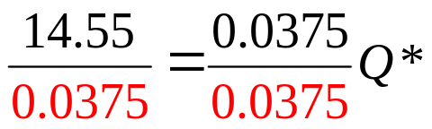



Law of Supply and Demand
Compute the equilibrium price and quantity of gasoline

Slide 28
Law of Supply and Demand
Gasoline Market
P
S
D
Q (millions)

Slide 29
Law of Supply and Demand
Use supply and demand analysis to explain why gas prices jumped after Hurricane Katrina.
How does a spike in gasoline prices encourage Americans to conserve gasoline during
after natural disasters such as Katrina?
Katrina shut down Gulf Coast refineries, pipe lines and Gulf of Mexico deep water oil wells.
Gasoline
S
S
3.92
Demand for gasoline increases because people are trying to get out of harms way or they “hoard”.
Price
2.50
D
D
372
388
Q (millions)

Slide 30

Law of Supply and Demand
Using supply and demand analysis, explain why the government should or should not intervene and impose a price ceiling on gasoline after natural disasters such as Katrina.
Suppose the government decides that the P is too high. It may impose a ceiling on the price gas stations charge.
Gasoline
S
3.92
The government’s “good intentions” result in long lines at the gas pump
(a shortage).
Price
2.50
D
372
Q (millions)

Slide 31
Law of Supply and Demand
Using supply and demand analysis, explain how does the Strategic Petroleum Reserve (SPR) contribute to higher gasoline prices.
The SPC (underground salt caverns in TX, LA and MS) is the D of E’s emergency supply of oil, holding up to 727,000,000 barrels of crude oil (a 60-day supply).
Crude Oil
In a past State of the Union, Bush announced he would double the SPR for national security.
This increases the price of crude oil.
S
Price
D
D
Q

Slide 32
Law of Supply and Demand
Using supply and demand analysis, explain how does the Strategic Petroleum Reserve (SPR) contribute to higher gasoline prices.
The higher crude oil prices raise the cost of refining gasoline, which decreases its supply.
This results in a higher gas price.
Gasoline
S
S
Price
D
Q

Slide 33
Gasoline Facts
Law of Supply and Demand
In 2005, the U.S. imported 3,695,971,000 barrels of crude oil.
Refineries convert crude oil into gasoline, diesel fuel, asphalt base, heating oil, kerosene. The U.S. has not built a new refinery since 1976.
Gasoline tax in NC amounts to 48.6 cents per gallon, while in NY it amounts to 60.1 cents. 20 gallons of gas/week over 52 weeks means you pay $505.44 in gasoline taxes each year in North Carolina versus $625.04 in New York.
The U.S. economy consumes about 388,000,000 gallons per day.
  Or 150,544,000,000 gallons per year
  US consumers paid $27.1 billion in Federal gasoline taxes last year at the pump.
Exxon Mobile’s 2007 pre-tax profit was about $70 billion, assuming a 35 percent tax rate, Exxon Mobil’s federal income tax bill was
($70)(0.35) billion = $31.85 billion
This is about 10% of all corporate income
taxes collected by the federal government.

Slide 34
Why is there a shortage of math teachers?
Law of Supply and Demand
Mathematics
History
LS (mathematicians)
LS (historians)
$60k
$30k
LD
$20k
LD
_{100k}
100k
shortage
surplus

Slide 35
Law of Supply and Demand
How does increasing the minimum wage affect workers and firms?
Low skilled labor market
LS (workers)
w_{min}
w_{min}
w*
LD (firms)
E
E
E*
LF
LF
unemployment
unemployment

Slide 36
Law of Supply and Demand
Is there a cost to immigration?
Low skilled labor market
LS (workers)
A flood of low skilled workers into an economy…
w*
w*
LD (firms)
E*
E*

Slide 37
Law of Supply and Demand
Is Lebron James over paid?
There are 41 Cleveland home games a season and the stadium the team plays in seats about 20,000 fans.
Before Lebron Cleveland averaged 12,000 fans per game at an average ticket price of about $40 per ticket.
After Lebron the team nearly sold out every game at an average ticket price of $41 per ticket.
Suppose this increase in fan interest is attributable entirely to Lebron (8,000 additional fans do not attend games to see the new white guy sitting at the end of the bench).
Demand for Cavalier home basketball games jumps from D_{BL} to D_{AL} as a result of adding Lebron to their roster.

Slide 38
Law of Supply and Demand
Is Lebron James over paid?
Low skilled labor market
S
Lebron is drafted…
41
40
D_{AL}
D_{BL}
12000
20000
Empty seats

Slide 39
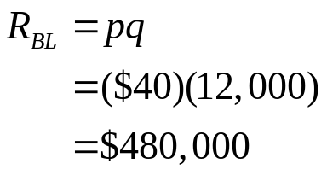
Law of Supply and Demand
Is Lebron James over paid?
Low skilled labor market
S
Revenue per home game:
41
40
D_{BL}
D_{AL}
12000
20000

Slide 40
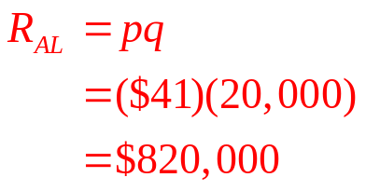
Law of Supply and Demand
Is Lebron James over paid?
Low skilled labor market
S
Revenue per home game:
41
40
D_{BL}
D_{AL}
12000
20000

Slide 41


Law of Supply and Demand
Is Lebron James over paid?
Total revenue for all 41 home games:
Marginal Revenue of adding Lebron (MR):
Adding one Lebron increases total home game revenue by $13.94 million while the marginal cost of hiring one Lebron (MC) is $6 million a year.
Cleveland would love to continue hiring more Lebrons until MR = MC.

Slide 42
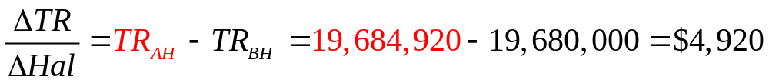
Law of Supply and Demand
Is Lebron James over paid?
How many additional fans would come to Cleveland home games to watch me sit at the end of the bench?
Maybe my mom, wife and grandmother. This increase in the quantity demand is so small that it would have no effect on the price of a ticket.
Marginal Revenue of adding me (MR):
Adding one Hal increases total home game revenue by $4,920 while the marginal cost of hiring one Hal (MC) is $250,000 a year.
Since MR < MC Cleveland would not hire an additional Hal. In fact, the team prefers cutting him from the squad.

Slide 43
Macroeconomics Models
  Production Possibilities Frontier
  Consumption Possibilities Frontier
  Free Trade
  Aggregate Demand and Aggregate Supply (PowerPoint lecture 4)
    Aggregate Demand is the relationship between the quantity of real GDP demanded and the price level when all other influences on expenditure plans remain the same
    Aggregate Supply is the relationship between the quantity of real GDP supplied and PL when all other influences on production plans remain the same
    AS and AD determine equilibrium real GDP and the PL

Slide 44
Production Possibilities Frontier
  A Production possibilities frontier (PPF) is a depiction of all different combinations of two goods that a society can produce with fixed amount of resources and the best available technology.
  The PPF models scarcity and choice.
  The PPF models opportunity cost (OC). OC of using a resource in a particular way is the value of the resource in its best alternative use
  Assumptions
    only produce two goods
    use best available technology
    use all available resources
  The PPF puts 3 features of production possibilities in sharp focus:
    Attainable and unattainable combinations
    Efficient and inefficient production
    Tradeoffs and free lunches

Slide 45


Production Possibilities Frontier
The President’s health care proposal
B E
C
A D
98
90
74
0 20 28 36
Is point A efficient? Is point A attainable?
A is not efficient because it lies inside the PPF
A is attainable but is associated with high unemployment

Slide 46
Production Possibilities Frontier
The President’s health care proposal
B E
C
A D
98
90
74
0 20 28 36
Is point B efficient? Is point B attainable?
Point B is attainable, and is efficient, meaning more of one good cannot be produced without producing less of something else.
Points C and D are also efficient production levels.
Unemployment equals its natural rate when the economy is its PPF.

Slide 47
Production Possibilities Frontier
The President’s health care proposal
B E
C
A D
98
90
74
0 20 28 36
What is the opportunity cost (OC) of moving from D to C?
If we want 16 more units of health care
we have to give up 8 units of all other goods (tradeoff)
Health care is not a free lunch because its OC = 0.5 units of all other goods

Slide 48
Production Possibilities Frontier
The President’s health care proposal
B E
C
A D
98
90
74
0 20 28 36
What is the opportunity cost (OC) of moving from C to B?
If we want 8 more units of health care
we have to give up 8 units of all other goods (tradeoff)
Health care is not a free lunch because its OC = 1 units (of all other goods)

Slide 49
Production Possibilities Frontier
The President’s health care proposal
To get one more health care unit we have to give up 1 unit of all other goods
B E
C
A D
98
90
74
To get one more health care unit we have to give up a half unit of all other goods
0 20 28 36
Why does the OC of health care increase as we move up along the PPF to the left?
As an economy increasingly specializes in HC, the OC of producing HC increases because we are using more and more resources that are poorly suited to produce HC.

Slide 50
Production Possibilities Frontier
The President’s health care proposal
B E
C
A D
98
90
74
0 20 28 36
Is point E attainable?
E is not attainable (in the short-run) because this economy does not have the resources to produce at point E.
Point E is attained when new resources and technologies are found.

Slide 51
Production Possibilities Frontier
Technological advancements lead to economic growth
E
D
98
74
F
G
0 36
Suppose we are at point D. What happens if we invent a new medical technique?
We can get more health care by moving to point F
or we can get more all other goods if we move to point G.

Slide 52
Production Possibilities Frontier
Natural resource discoveries lead to economic growth
E
98
F
0 36
Suppose we are at point F. What happens if we discover 1.2 trillion barrels of natural gas?
Point E is now an attainable efficient production level.

Slide 53
Consumption Possibilities Frontier
  A Consumption Possibilities Frontier (CPF) is a depiction of all different combinations of two goods that a society can afford with a fixed set of prices.
  CPF is simply the budget line for the entire economy.
  All of the combinations of two goods that can be consumed from a given fixed budget when the prices are known.
  EXAMPLE: Suppose the government budgets B = $24,000 per citizen for health care and military protection. Assume the price of military services is P_{m} = $120 per citizen while the price of health care is P_{HC} = $100 per citizen.
P_{m} × Q_{m} + P_{HC} × Q_{HC} = B
120 Q_{m} + 100 Q_{HC} = 24000

Slide 54
Consumption Possibilities Frontier
Graph the CPF
120 (0) + 100 Q_{HC} = 24000
100 Q_{HC} = 24000
Q_{HC} = 240
Q_{m}
240
Q_{HC}

Slide 55
Consumption Possibilities Frontier
Graph the CPF
120 Q_{m} + 100 (0) = 24000
120 Q_{m} = 24000
Q_{m} = 200
Q_{m}
The entire budget is being spent.
The entire budget is being spent.
The entire budget is being spent.
200
240
Q_{HC}

Slide 56
Consumption Possibilities Frontier
Plot a point that indicates the government is running a budget deficit.
120 (150) + 100 (180) =
18,000 + 18,000 =
36,000
Budget deficit = 24,000 - 36,000 =
-12,000
Q_{m}
150
180
Q_{HC}

Slide 57
Consumption Possibilities Frontier
Plot a point that indicates the government is running a budget surplus.
120 (50) + 100 (60) =
6000 + 6000 =
12,000
Budget surplus = 24,000 - 12,000 =
12,000
Q_{m}
50
60
Q_{HC}

Slide 58
Consumption Possibilities Frontier
What is the OC of moving from A to B?
From A to B
we can buy 120 more units of health care (ΔQ_{HC} = 120 )
but we have to give up 100 units of military protection (ΔQ_{m} = -100 ).
The OC of 1.2 units of health care requires giving up 1 unit of military protection
Q_{m}
A
150
50
B
60
180
Q_{HC}

Slide 59


Macroeconomics Models
Free Trade Model
  The PPF can be used to model the benefits of free trade.
  Absolute advantage is a situation in which one country is more productive than another country in the production of both goods.
  Comparative advantage is the ability of a country to produce a good or service at a lower OC than other countries.
  EXAMPLE: Let C denote packs of cigarettes produced. Let T denote the units of textiles produced. Indonesia devotes all of its resources according to
  North Carolina devotes all of its resources according to.

Slide 60
Free Trade Model
Graph the two PPFs in the same diagram.
T
1400
1200
1000
800
600
400
200
100 200 300 400 500 600 700 C
Indonesia
NC
Indonesia North Carolina
C | T |  | C | T
0 | 1200 |  | 0 | 1000
300 | 0 |  | 500 | 0

Slide 61
Free Trade Model
Which country has the absolute advantage in textile production?
T
1400
1200
1000
800
600
400
200
100 200 300 400 500 600 700 C
Indonesia
NC
If Indonesia devotes all its resources to producing textiles, it can manufacture 1200 units of textiles.
Indonesia has the absolute advantage in producing textiles.
If North Carolina devotes all its resources to producing textiles, it can manufacture 1000 units of textiles.

Slide 62
Free Trade Model
Which country has the absolute advantage in cigarette production?
T
1400
1200
1000
800
600
400
200
100 200 300 400 500 600 700 C
Indonesia
Neither country has an absolute advantage in trade.
NC
If Indonesia devotes all its resources to producing cigarettes, it can manufacture 300 units of cigarettes.
North Carolina has the absolute advantage in producing cigarettes.
If North Carolina devotes all its resources to producing cigarettes, it can manufacture 500 units of cigarettes.

Slide 63
Free Trade Model
Which country has the comparative advantage in cigarette production?
T
1400
1200
1000
800
600
400
200
100 200 300 400 500 600 700 C
Indonesia
Indonesia
North Carolina
NC
If Indonesia wants to produce 1 more pack of cigarettes, it gives up 4 units of textiles.
North Carolina has the comparative advantage in producing cigarettes.
If NC wants to produce 1 more pack of cigarettes, it gives up 2 units of textiles.

Slide 64
Free Trade Model
Suppose NC and Indonesia are the only producers of cigarettes and textiles, trade barriers exist, and both countries devote half their respective resources to producing both goods.
T
1400
1200
1000
800
600
400
200
100 200 300 400 500 600 700 C
Indonesia
NC
Indonesia will produce 150 packs of cigarettes and 600 units of textiles.
NC will produce 250 packs of cigarettes and 500 units of textiles.
Total world production is 400 packs of cigarettes and 1100 units of textiles
for a total of 1500 units.

Slide 65
Free Trade Model
Suppose NC and Indonesia pass a Free Trade Agreement, what will NC produce? What will Indonesia produce? Why is free trade good? Why is free trade bad?
T
1400
1200
1000
800
600
400
200
100 200 300 400 500 600 700 C
Indonesia
NC
Indonesia will produce 1200 units of textiles
while NC produces 500 cigarettes.
Total world production increases from 1500 to 1700 total units under free trade.
NC’s textile jobs are outsourced to Indonesia but this is countered by NC insourcing
Indonesia’s cigarette jobs.

